Slide 1
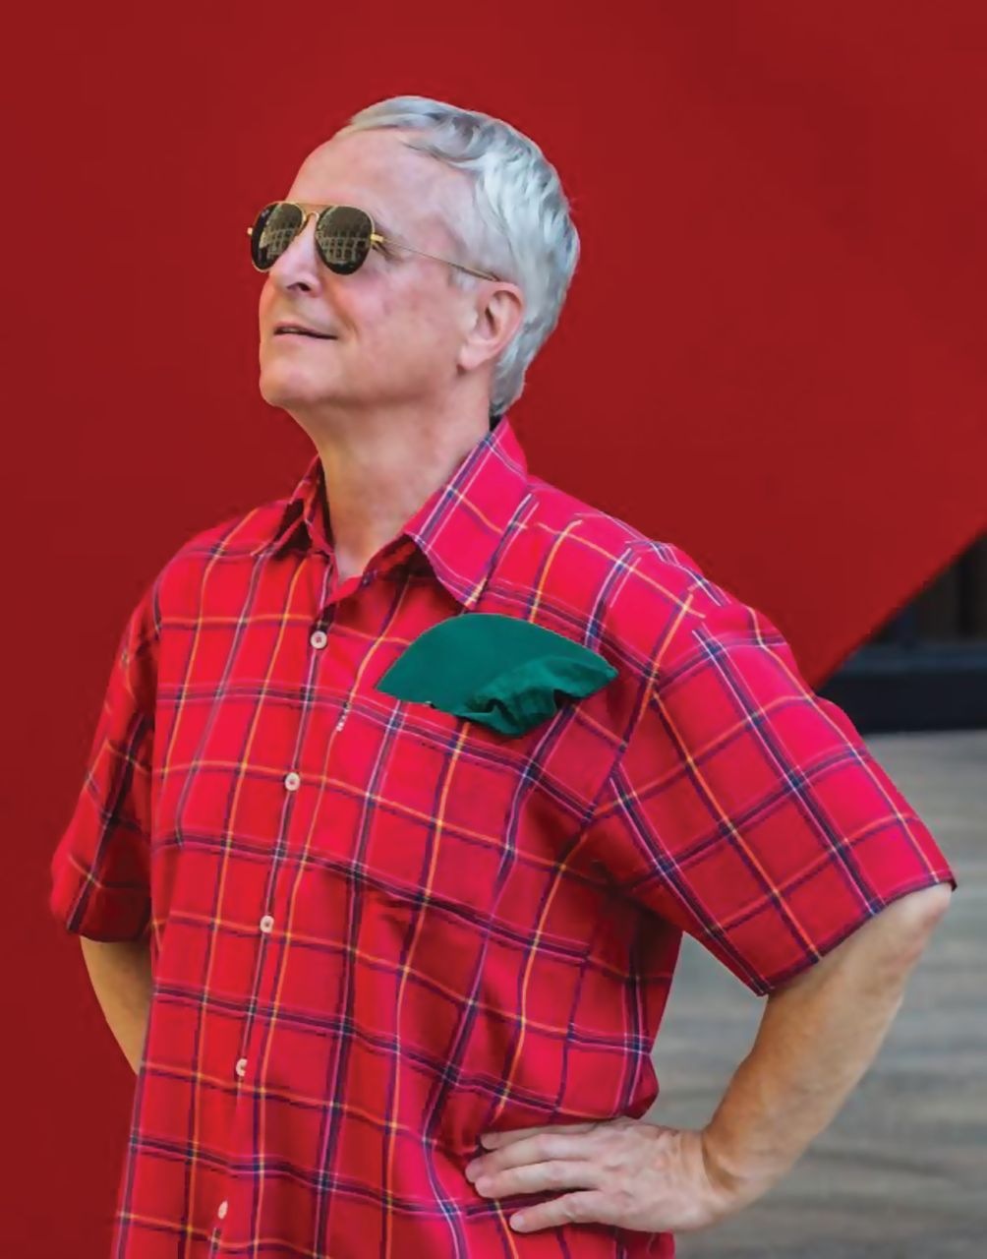
Notes:
Unless provided in the caption above, the following copyright applies to the content of this slide: © The Author 2016. Published by Oxford University Press on behalf of the Society for Experimental Biology. This is an Open Access article distributed under the terms of the Creative Commons Attribution License ( http://creativecommons.org/licenses/by/3.0/ ), which permits unrestricted reuse, distribution, and reproduction in any medium, provided the original work is properly cited.

