Slide 1
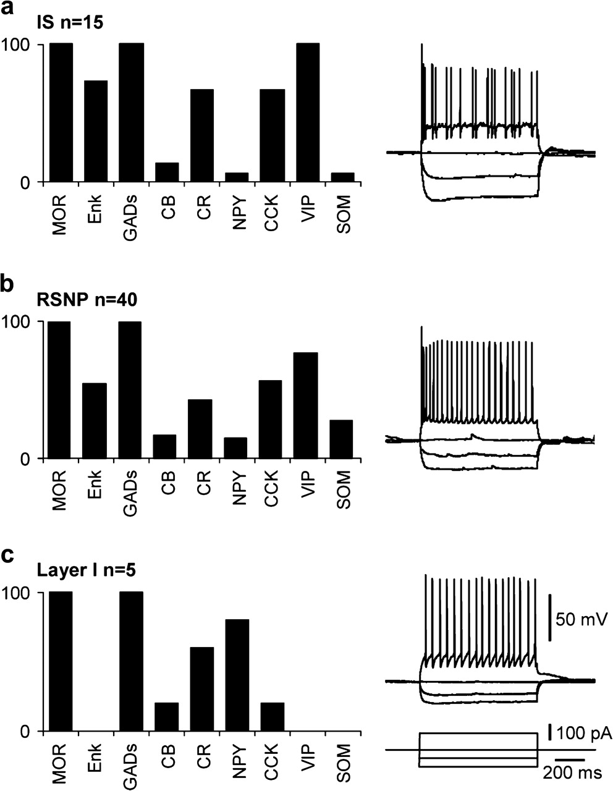
Figure 1. MOR-expressing neurons. The scPCR analyses of 360 neocortical neurons, including 98 pyramidal cells and 262 ...
Notes:
Figure 1. MOR-expressing neurons. The scPCR analyses of 360 neocortical neurons, including 98 pyramidal cells and 262 GABAergic interneurons, revealed MOR expression in 60 neurons including 15 IS (a), 40 RSNP (b), and 5 layer I interneurons (c). All MOR-positive neurons expressed GAD67 and/or GAD65 (GADs). MOR-expressing IS and RSNP interneurons exhibited similar molecular profiles characterized by a high expression level of VIP, CCK, Enk, and CR and a low expression level of CB, NPY, and SOM (a–b). MOR-expressing layer I interneurons presented a high expression level of NPY and CR, a low expression level of CB and CCK, and did not express Enk, VIP, and SOM (c). The current-clamp recordings shown on the right of each panel illustrate the voltage responses exhibited by an IS (a), a RSNP (b), and a layer I (c) MOR-expressing interneurons induced by hyperpolarizing and depolarizing current injections.
Unless provided in the caption above, the following copyright applies to the content of this slide: © 2006 The AuthorsThis is an Open Access article distributed under the terms of the Creative Commons Attribution Non-Commercial License (http://creativecommons.org/licenses/by-nc/2.0/uk/) which permits unrestricted non-commercial use, distribution, and reproduction in any medium, provided the original work is properly cited.

Slide 2
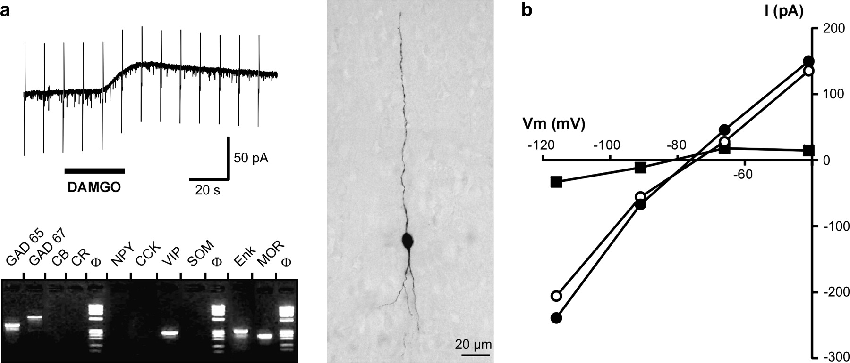
Figure 2. MOR activation opens a potassium conductance. (a) DAMGO (2.5 μM) induced a slow outward current with a peak ...
Notes:
Figure 2. MOR activation opens a potassium conductance. (a) DAMGO (2.5 μM) induced a slow outward current with a peak amplitude of 32 pA (upper left panel, steps of −5 mV were applied every 10 s) in a neuron recorded in voltage-clamp mode. Molecular analysis of this DAMGO-responsive neuron showed the expression of MOR together with GAD65, GAD67, VIP, and Enk (lower left panel, ϕ: molecular weight marker). Intracellular labeling of the same neuron by biocytin (right panel) revealed a bipolar/bitufted morphology typical of VIP-expressing interneurons (pial surface is upward). (b) Current–voltage plots obtained, in the presence of TTX (1 μM), from another cell in control conditions (open circles, input resistance: 133.16 MΩ) and at the peak of the DAMGO response (filled circles). The third plot (filled squares) shows the DAMGO-induced current obtained by subtracting control values from those measured during DAMGO application. The reversal potential for the DAMGO-induced current (−81.9 mV) was close to equilibrium potential of potassium (−85 mV in our experimental conditions).
Unless provided in the caption above, the following copyright applies to the content of this slide: © 2006 The AuthorsThis is an Open Access article distributed under the terms of the Creative Commons Attribution Non-Commercial License (http://creativecommons.org/licenses/by-nc/2.0/uk/) which permits unrestricted non-commercial use, distribution, and reproduction in any medium, provided the original work is properly cited.

Slide 3
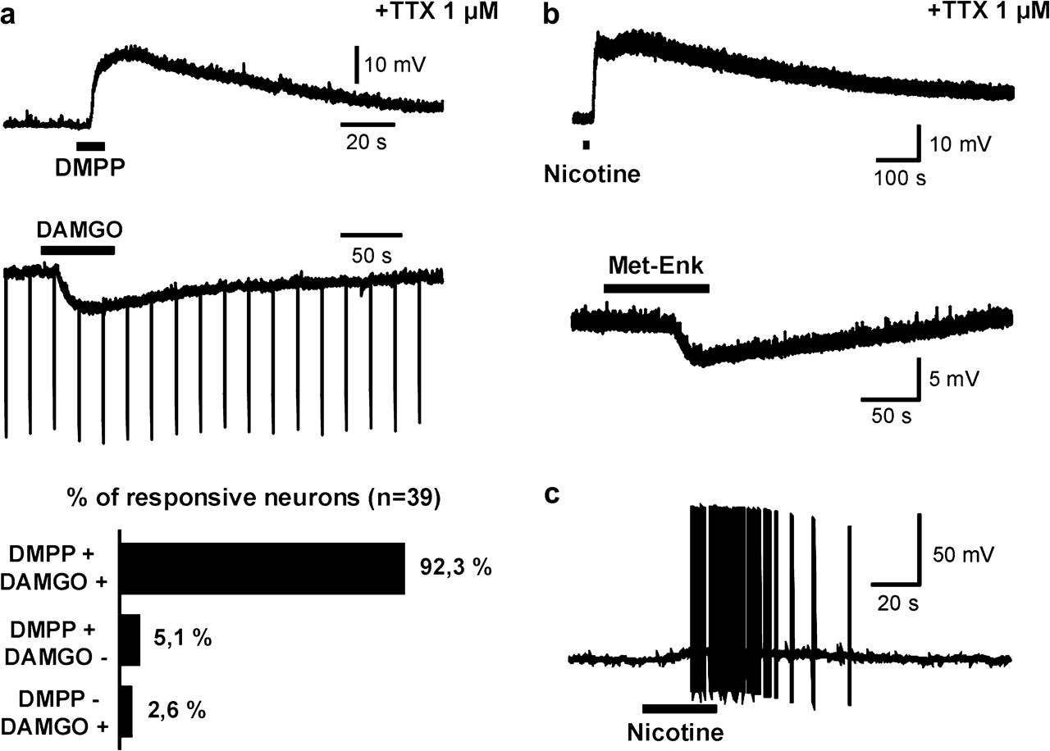
Figure 3. Nicotinic and μ-opioid agonists act on the same neocortical interneurons. Current-clamp recordings in (a, ...
Notes:
Figure 3. Nicotinic and μ-opioid agonists act on the same neocortical interneurons. Current-clamp recordings in (a, upper panels) show the responses of a neuron to sequential applications of the nicotinic agonist DMPP and the MOR-selective agonist DAMGO in the presence of TTX. In this neuron, DMPP (100 μM) induced a fast depolarization (19.2 mV), whereas DAMGO (2.5 μM) induced a hyperpolarization (−9.71 mV, steps of –50 pA were applied every 20 s). The lower panel shows the extensive overlap of nicotinic- and μ-opioid–responsive populations. The example of responses to nicotine (100 μM) and Met-Enk (30 μM) shown in (b) illustrates their similarity with those induced by DMPP and DAMGO, respectively. In this neuron, sequential nicotine and Met-Enk application induced a 21.6 mV depolarization and a 4.9 mV hyperpolarization, respectively. As illustrated by the current-clamp recording in (c), application of nicotine at low concentration (1 μM) resulted in a depolarization leading to a sustained action potential discharge in responsive interneurons.
Unless provided in the caption above, the following copyright applies to the content of this slide: © 2006 The AuthorsThis is an Open Access article distributed under the terms of the Creative Commons Attribution Non-Commercial License (http://creativecommons.org/licenses/by-nc/2.0/uk/) which permits unrestricted non-commercial use, distribution, and reproduction in any medium, provided the original work is properly cited.

Slide 4
Figure 4. Interneurons integrate nicotinic and μ-opioid responses. (a) In the presence of TTX, DMPP (100 μM) elicited a ...
Notes:
Figure 4. Interneurons integrate nicotinic and μ-opioid responses. (a) In the presence of TTX, DMPP (100 μM) elicited a membrane depolarization that was decreased in the presence of DAMGO (2.5 μM) and recovered after DAMGO washout. In this interneuron, the summation of DAMGO-induced hyperpolarization and of DMPP-induced depolarization resulted in a minimal deviation from the preset membrane potential. (b) In the presence of TTX, the amplitude of DMPP-induced depolarization was reversibly decreased by the application of DAMGO (n = 5). (c) In the absence of TTX, DMPP elicited an action potential discharge that was prevented in the presence of DAMGO and recovered after DAMGO washout. In this interneuron, the depolarizing effect of DMPP was virtually abolished in the presence of DAMGO.
Unless provided in the caption above, the following copyright applies to the content of this slide: © 2006 The AuthorsThis is an Open Access article distributed under the terms of the Creative Commons Attribution Non-Commercial License (http://creativecommons.org/licenses/by-nc/2.0/uk/) which permits unrestricted non-commercial use, distribution, and reproduction in any medium, provided the original work is properly cited.

Slide 5
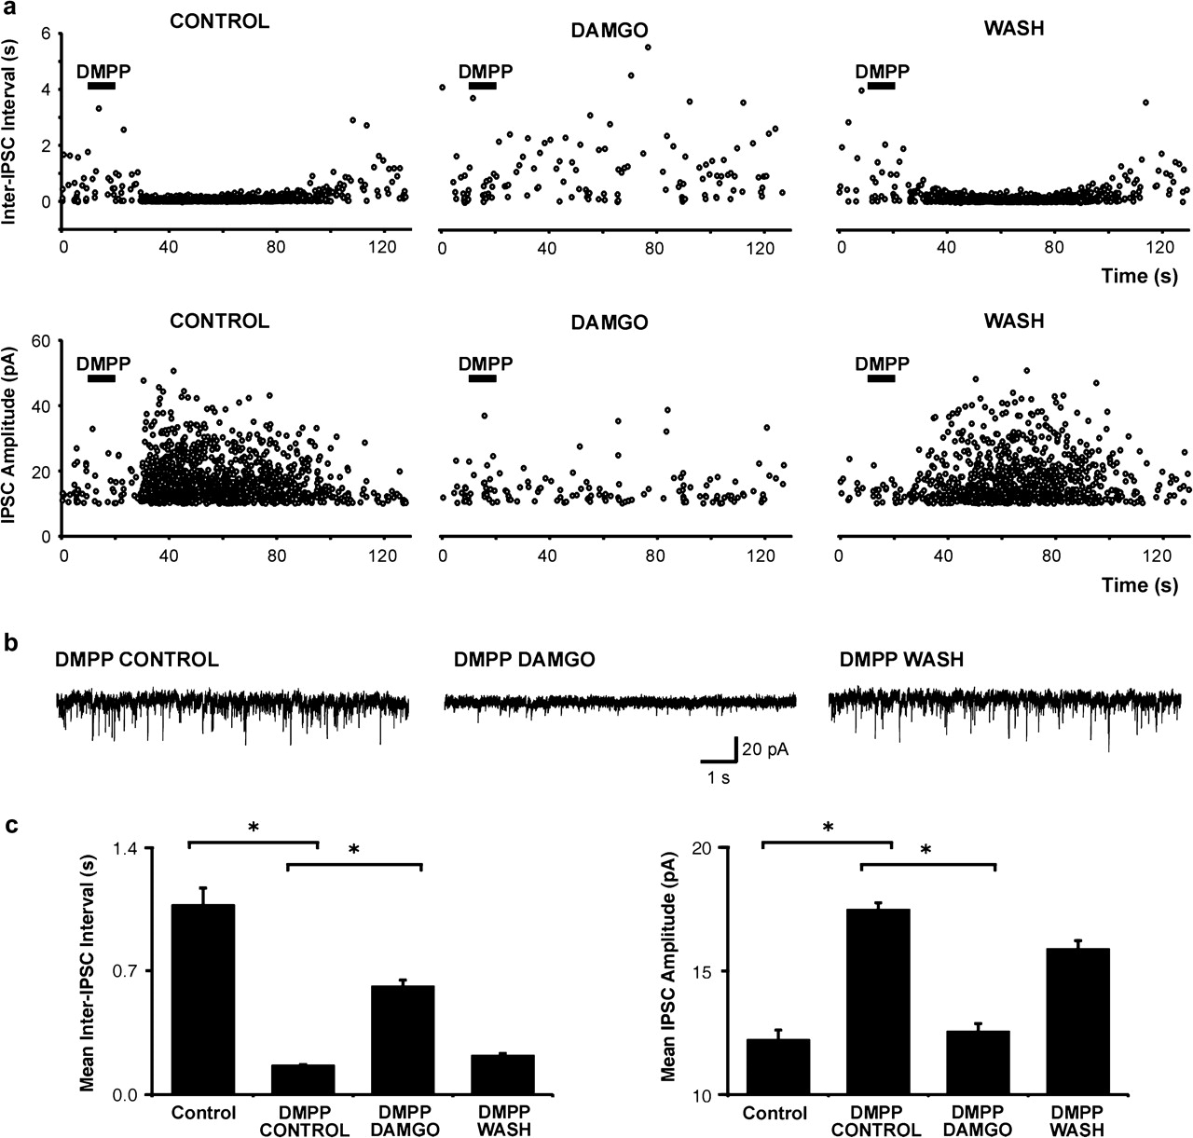
Figure 5. MOR controls the GABAergic output of nicotinic-responsive interneurons. DMPP-induced enhancement of ...
Notes:
Figure 5. MOR controls the GABAergic output of nicotinic-responsive interneurons. DMPP-induced enhancement of spontaneous IPSCs in a pyramidal neuron was reduced in the presence of DAMGO and recovered after DAMGO washout. (a) Scatter plots showing the change in inter-IPSC interval (upper panel) and IPSC amplitude (lower panel) in response to DMPP application (100 μM), in control condition (left panel), upon DAMGO application (2.5 μM, middle panel) and after DAMGO washout (right panel). (b) Spontaneous IPSCs recorded in this neuron 30 s after the DMPP application in each condition. (c) Mean inter-IPSC interval and IPSC amplitude for data pooled from 7 cells in each condition. Asterisk, P ≤ 0.05, Kruskal–Wallis one way analysis of variance on ranks followed by a Dunn's test.
Unless provided in the caption above, the following copyright applies to the content of this slide: © 2006 The AuthorsThis is an Open Access article distributed under the terms of the Creative Commons Attribution Non-Commercial License (http://creativecommons.org/licenses/by-nc/2.0/uk/) which permits unrestricted non-commercial use, distribution, and reproduction in any medium, provided the original work is properly cited.

Slide 6
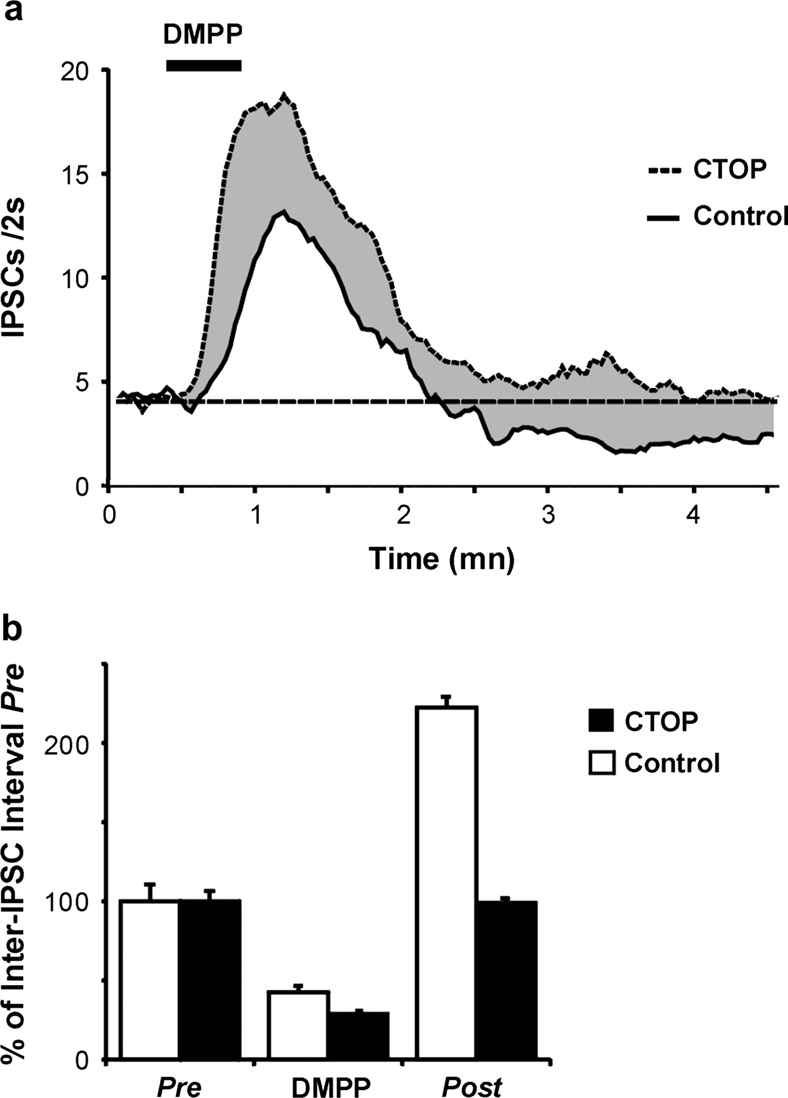
Figure 6. Nicotinic stimulation activates the endogenous μ-opioid system. Effect of DMPP (100 μM, 30 s application) on ...
Notes:
Figure 6. Nicotinic stimulation activates the endogenous μ-opioid system. Effect of DMPP (100 μM, 30 s application) on IPSC frequency in pyramidal cells in the absence (control, n = 11) or in the continuous presence of the MOR-selective antagonist CTOP (1 μM, n = 11). (a) Mean IPSC frequencies are expressed as the number of IPSCs per 2 s. DMPP increased IPSC frequency in both control and CTOP conditions. In control conditions, IPSC frequency subsequently fell below the baseline. This effect was prevented in the presence of CTOP. The gray area between the control and CTOP curves indicates the effect of MOR activation by endogenous Enk. (b) Same results presented as mean inter-IPSC interval measured before (pre, 0–30 s), during (DMPP, 50–100 s), and after (post, 180–280 s) the peak response to DMPP. Interevent intervals are expressed as percentages of the pre values. Note that post inter-IPSC interval differed significantly from pre values in control (P < 0.001) but not in CTOP conditions (P = 0.88, 2-way analysis of variance completed by the Holm–Sidak method of comparison).
Unless provided in the caption above, the following copyright applies to the content of this slide: © 2006 The AuthorsThis is an Open Access article distributed under the terms of the Creative Commons Attribution Non-Commercial License (http://creativecommons.org/licenses/by-nc/2.0/uk/) which permits unrestricted non-commercial use, distribution, and reproduction in any medium, provided the original work is properly cited.

