Slide 1
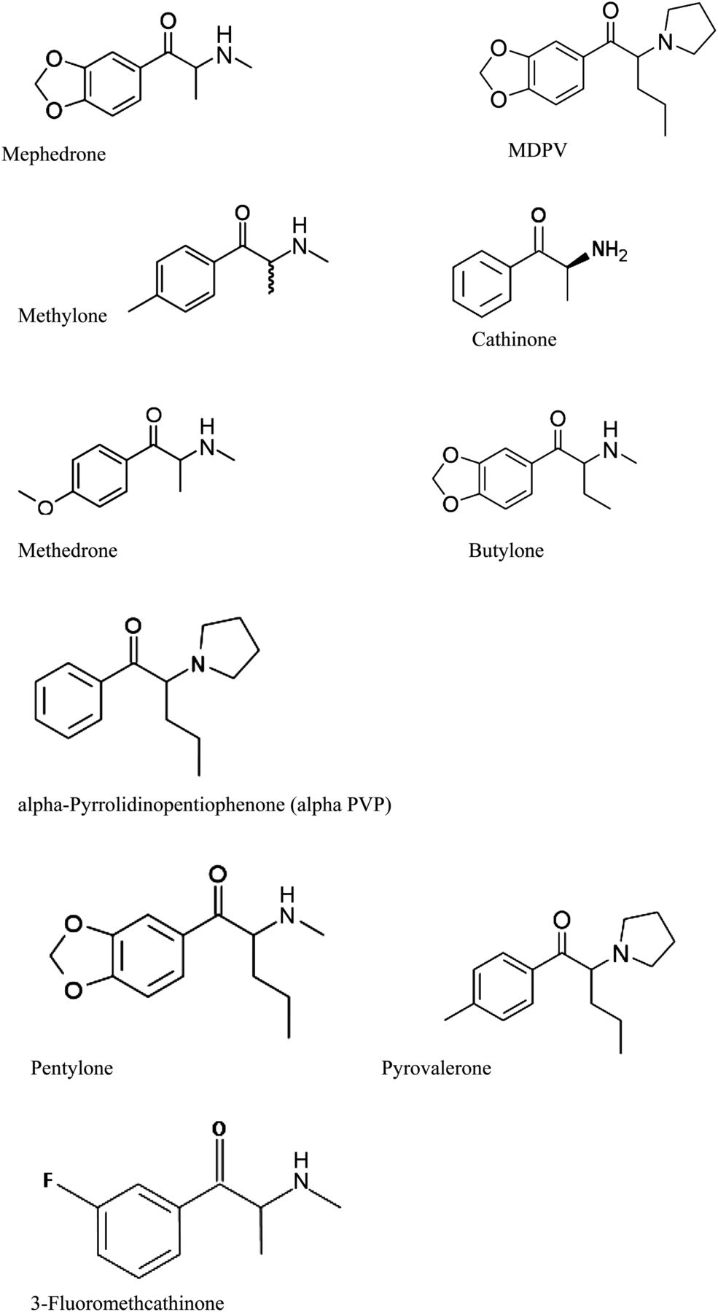
Figure 1. Cathinone and synthetic cathinone structures.
Notes:
Figure 1. Cathinone and synthetic cathinone structures.
Unless provided in the caption above, the following copyright applies to the content of this slide: © The Author [2013]. Published by Oxford University Press. All rights reserved. For Permissions, please email: journals.permissions@oup.com

Slide 2
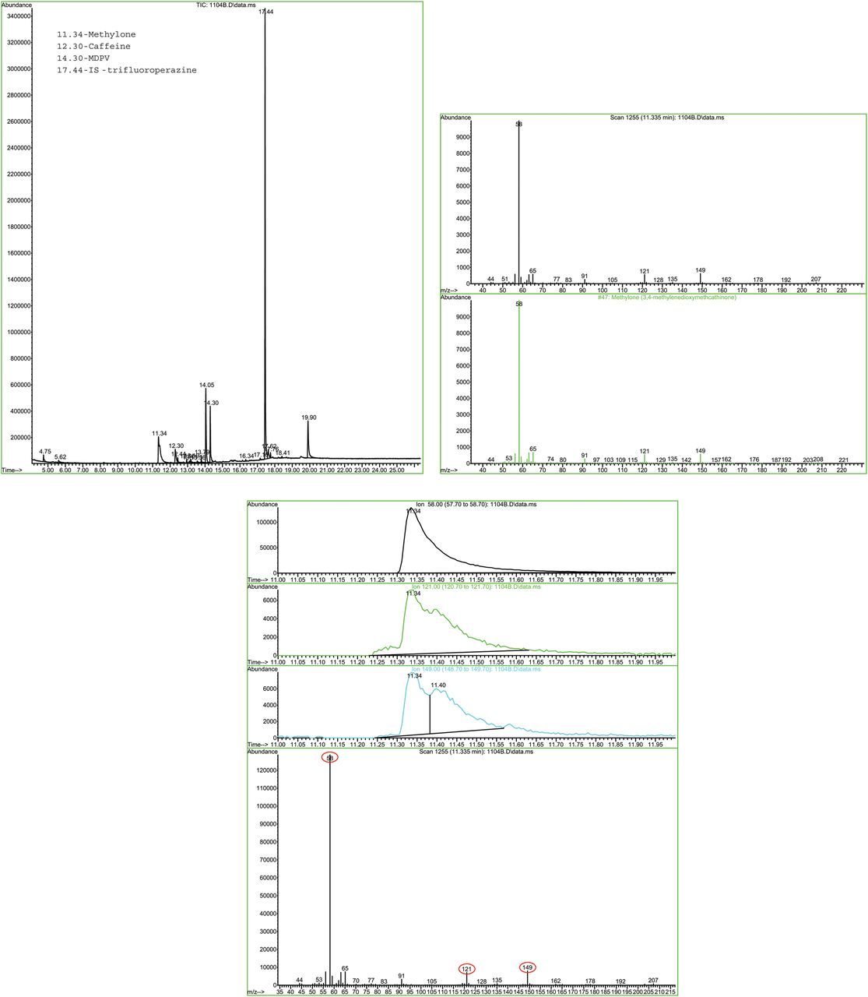
Figure 2. GC–MS data from basic drug screens: 3 mL of blood from PM Case 1 (A); 2 mL of urine from PM Case 1 (B).
Notes:
Figure 2. GC–MS data from basic drug screens: 3 mL of blood from PM Case 1 (A); 2 mL of urine from PM Case 1 (B).
Unless provided in the caption above, the following copyright applies to the content of this slide: © The Author [2013]. Published by Oxford University Press. All rights reserved. For Permissions, please email: journals.permissions@oup.com

Slide 3
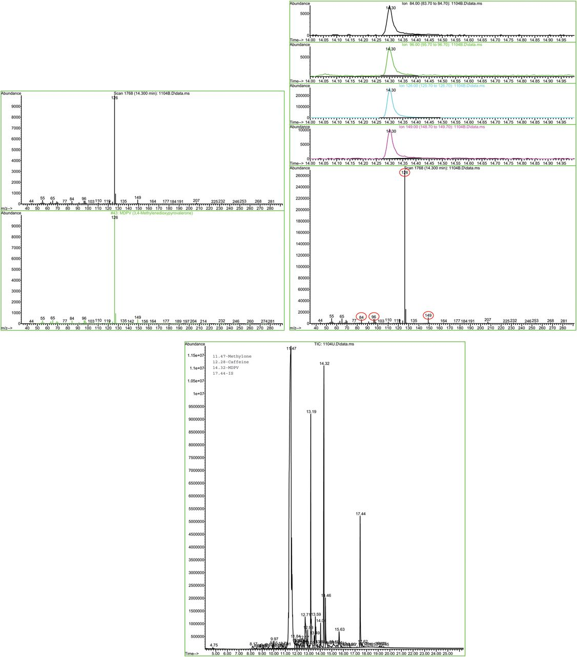
Figure 2. Continued.
Notes:
Figure 2. Continued.
Unless provided in the caption above, the following copyright applies to the content of this slide: © The Author [2013]. Published by Oxford University Press. All rights reserved. For Permissions, please email: journals.permissions@oup.com

Slide 4
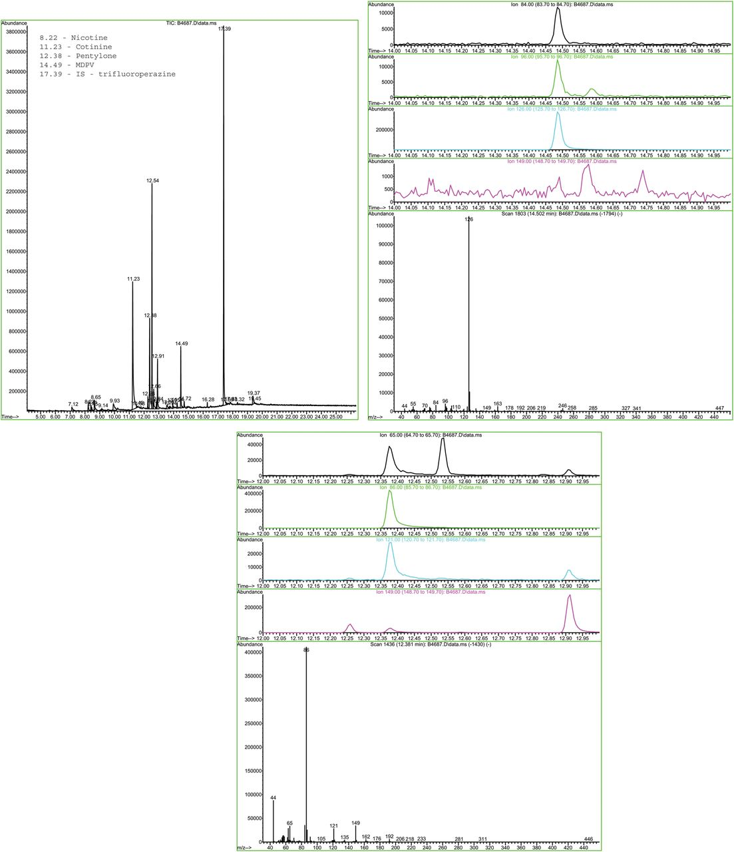
Figure 3. GC–MS data from a basic drug screen of 2 mL of urine from PM Case 16.
Notes:
Figure 3. GC–MS data from a basic drug screen of 2 mL of urine from PM Case 16.
Unless provided in the caption above, the following copyright applies to the content of this slide: © The Author [2013]. Published by Oxford University Press. All rights reserved. For Permissions, please email: journals.permissions@oup.com

Slide 5
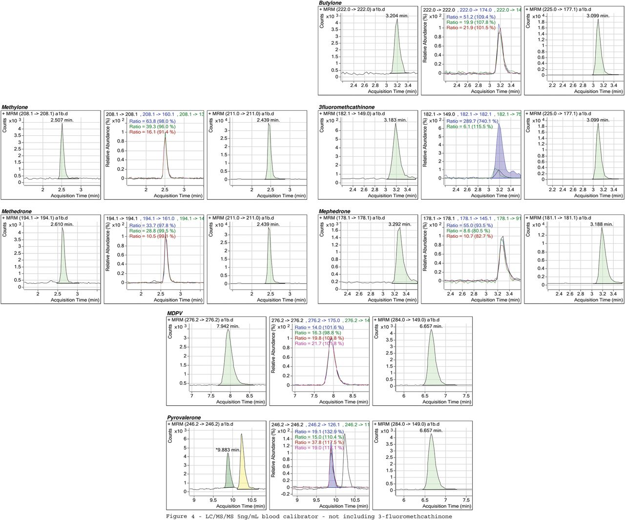
Figure 4. LC–MS-MS spectra from the 5 ng/mL calibrator in 1 mL of blood (3 fluoromethcathinone was not included in this ...
Notes:
Figure 4. LC–MS-MS spectra from the 5 ng/mL calibrator in 1 mL of blood (3 fluoromethcathinone was not included in this calibrator).
Unless provided in the caption above, the following copyright applies to the content of this slide: © The Author [2013]. Published by Oxford University Press. All rights reserved. For Permissions, please email: journals.permissions@oup.com

Slide 6
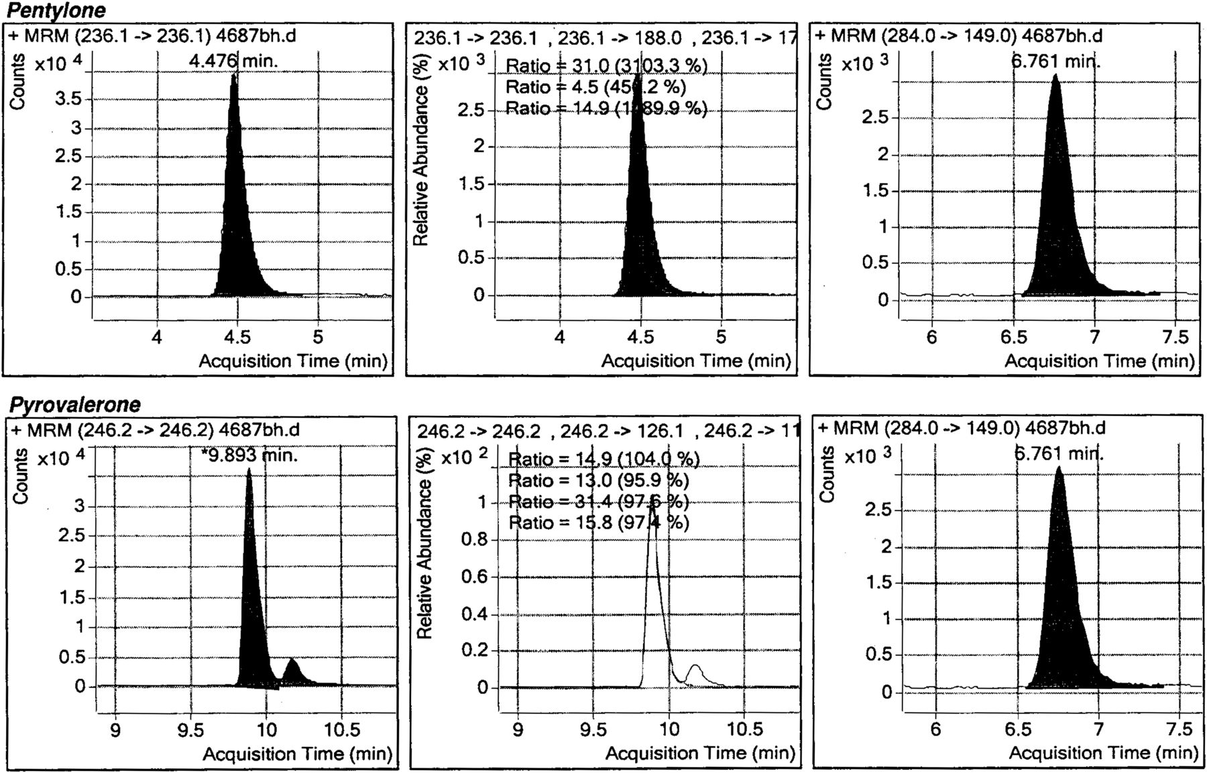
Figure 5. LC–MS-MS spectra from 1 mL of blood from PM Case 16.
Notes:
Figure 5. LC–MS-MS spectra from 1 mL of blood from PM Case 16.
Unless provided in the caption above, the following copyright applies to the content of this slide: © The Author [2013]. Published by Oxford University Press. All rights reserved. For Permissions, please email: journals.permissions@oup.com

Slide 7
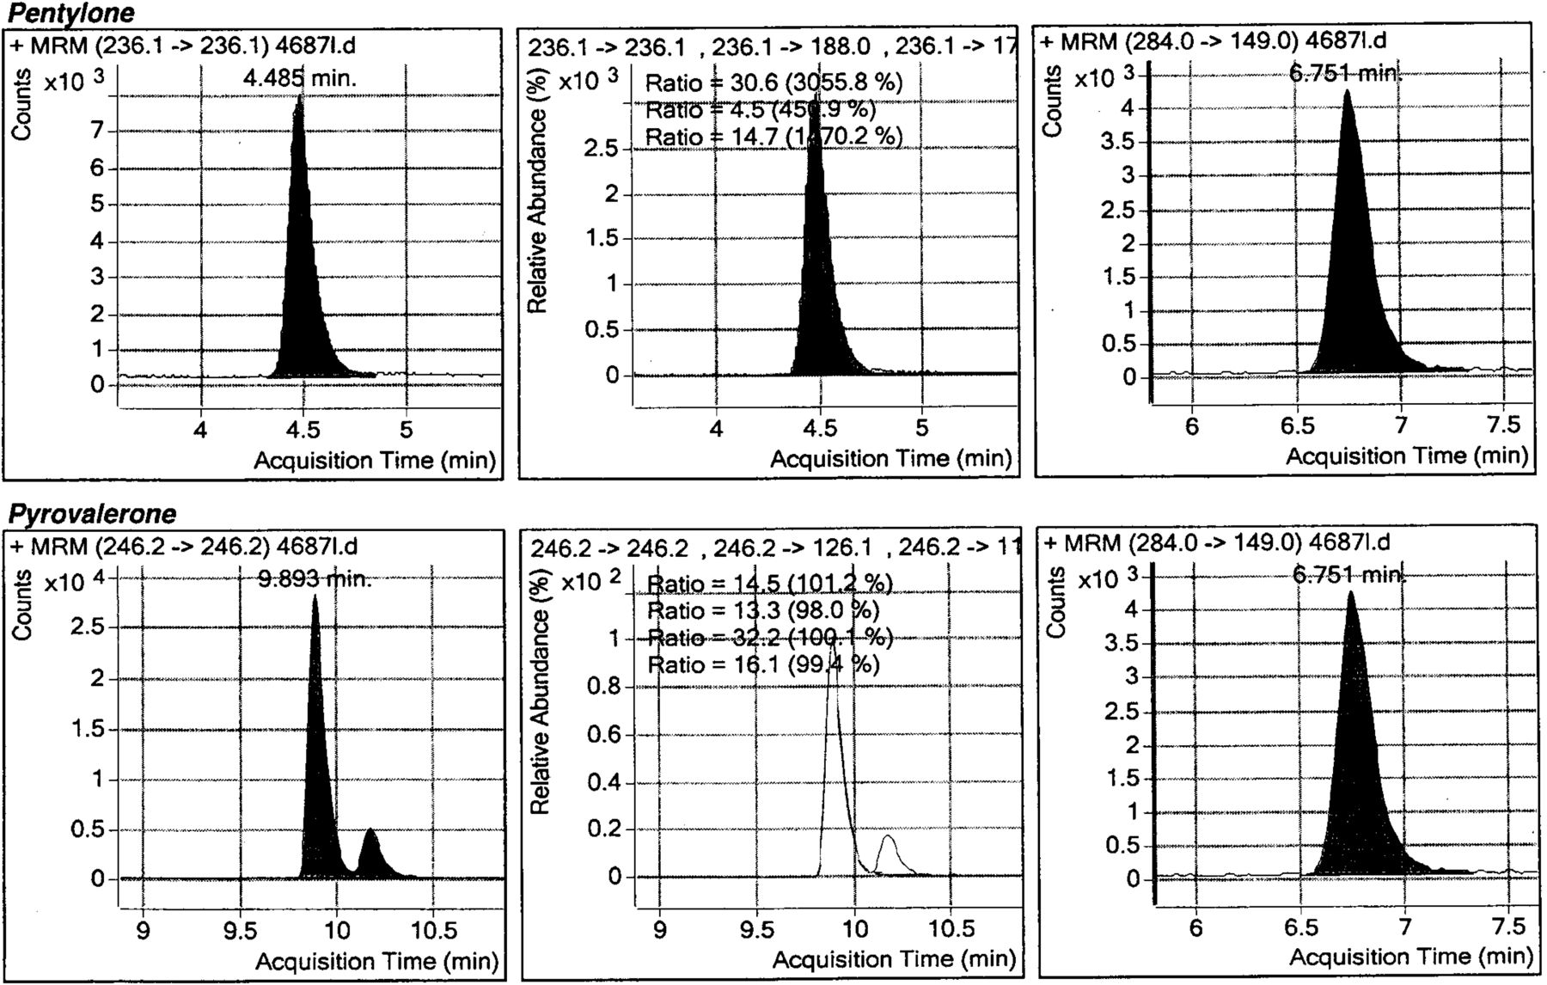
Figure 6. LC–MS-MS spectra from 1 mL of liver homogenate (1:3 dilution) from PM case 16
Notes:
Figure 6. LC–MS-MS spectra from 1 mL of liver homogenate (1:3 dilution) from PM case 16
Unless provided in the caption above, the following copyright applies to the content of this slide: © The Author [2013]. Published by Oxford University Press. All rights reserved. For Permissions, please email: journals.permissions@oup.com

