Slide 1
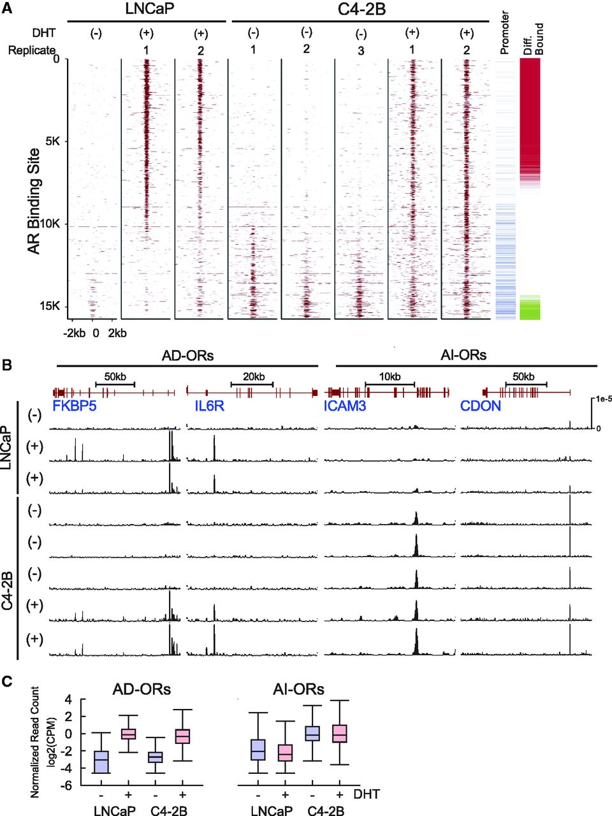
Figure 1. Androgen-independent AR binding in CRPC cells. ( A ) DHT dependence of AR ChIP-seq signal intensity in a ±2 ...
Notes:
Figure 1. Androgen-independent AR binding in CRPC cells. ( A ) DHT dependence of AR ChIP-seq signal intensity in a ±2 kb region around 15 709 AR binding sites observed in at least 1 ChIP-seq sample in LNCaP DHT−, LNCaP DHT+ (two replicates), C4-2B DHT− (three replicates) and C4-2B DHT+ (two replicates). AR binding sites located within ±1 kb of a TSS are marked in blue (promoter). AR binding sites showing increased binding in LNCaP DHT+ versus C4-2B DHT− are marked with red (androgen-dependent occupied regions or AD-ORs), whereas AR binding sites showing increased binding in C4-2B DHT− versus LNCaP DHT+ are marked green (androgen-independent occupied regions or AI-ORs) ( B ) Normalized ChIP-seq read counts at representative AD-ORs (left) and AI-ORs (right) ( C ) DHT dependence of average AR binding at AD-ORs and AI-ORs in LNCaP and C4-2B cells. Average binding is shown in log2 CPM, normalized by the number of uniquely mapped reads in the sample.
Unless provided in the caption above, the following copyright applies to the content of this slide: © The Author(s) 2012. Published by Oxford University Press.This is an Open Access article distributed under the terms of the Creative Commons Attribution License (http://creativecommons.org/licenses/by/3.0/), which permits unrestricted, distribution, and reproduction in any medium, provided the original work is properly cited.

Slide 2
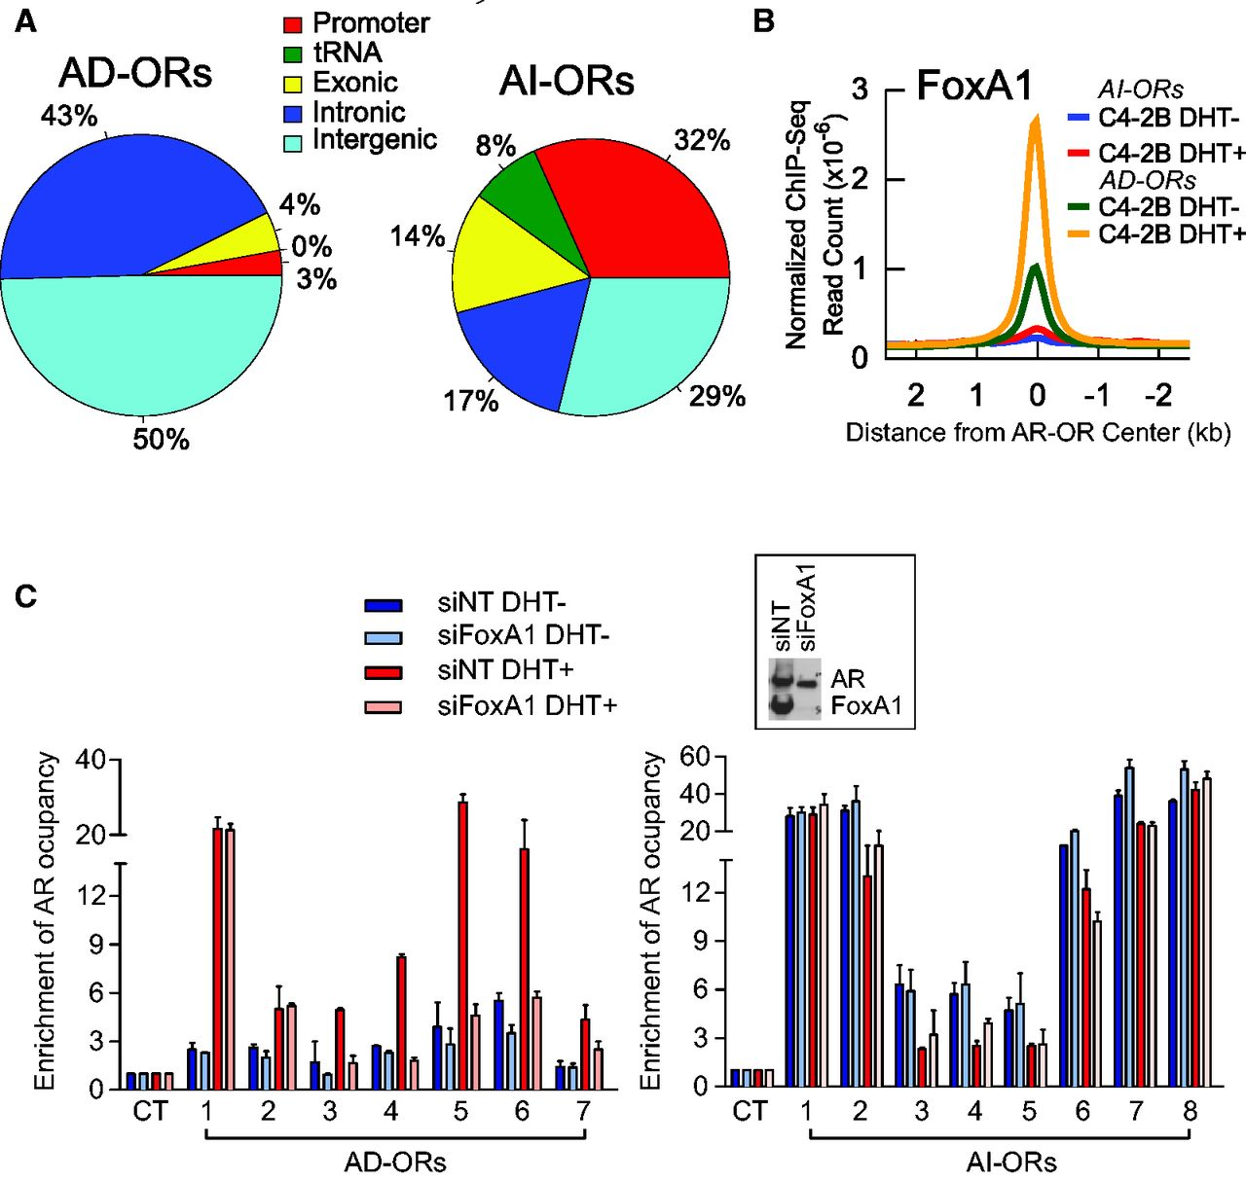
Figure 2. Genomic localization and FoxA1 independence of AR binding at AI-ORs. ( A ) Genomic localization of AD-ORs ...
Notes:
Figure 2. Genomic localization and FoxA1 independence of AR binding at AI-ORs. ( A ) Genomic localization of AD-ORs and AI-ORs. ( B ) DHT-treated and -untreated FoxA1 ChIP-seq signals at AD-ORs and AI-ORs. ( C ) AR occupancies measured by ChIP–qPCR at seven selected AD-ORs and eight AI-ORs after FoxA1 knockdown. AR occupancy at the negative control (CT) region was defined as 1. Knockdown of FoxA1 does not affect AR expression as demonstrated by the western blot (inset). Non-target siRNA (siNT) was used as a control.
Unless provided in the caption above, the following copyright applies to the content of this slide: © The Author(s) 2012. Published by Oxford University Press.This is an Open Access article distributed under the terms of the Creative Commons Attribution License (http://creativecommons.org/licenses/by/3.0/), which permits unrestricted, distribution, and reproduction in any medium, provided the original work is properly cited.

Slide 3
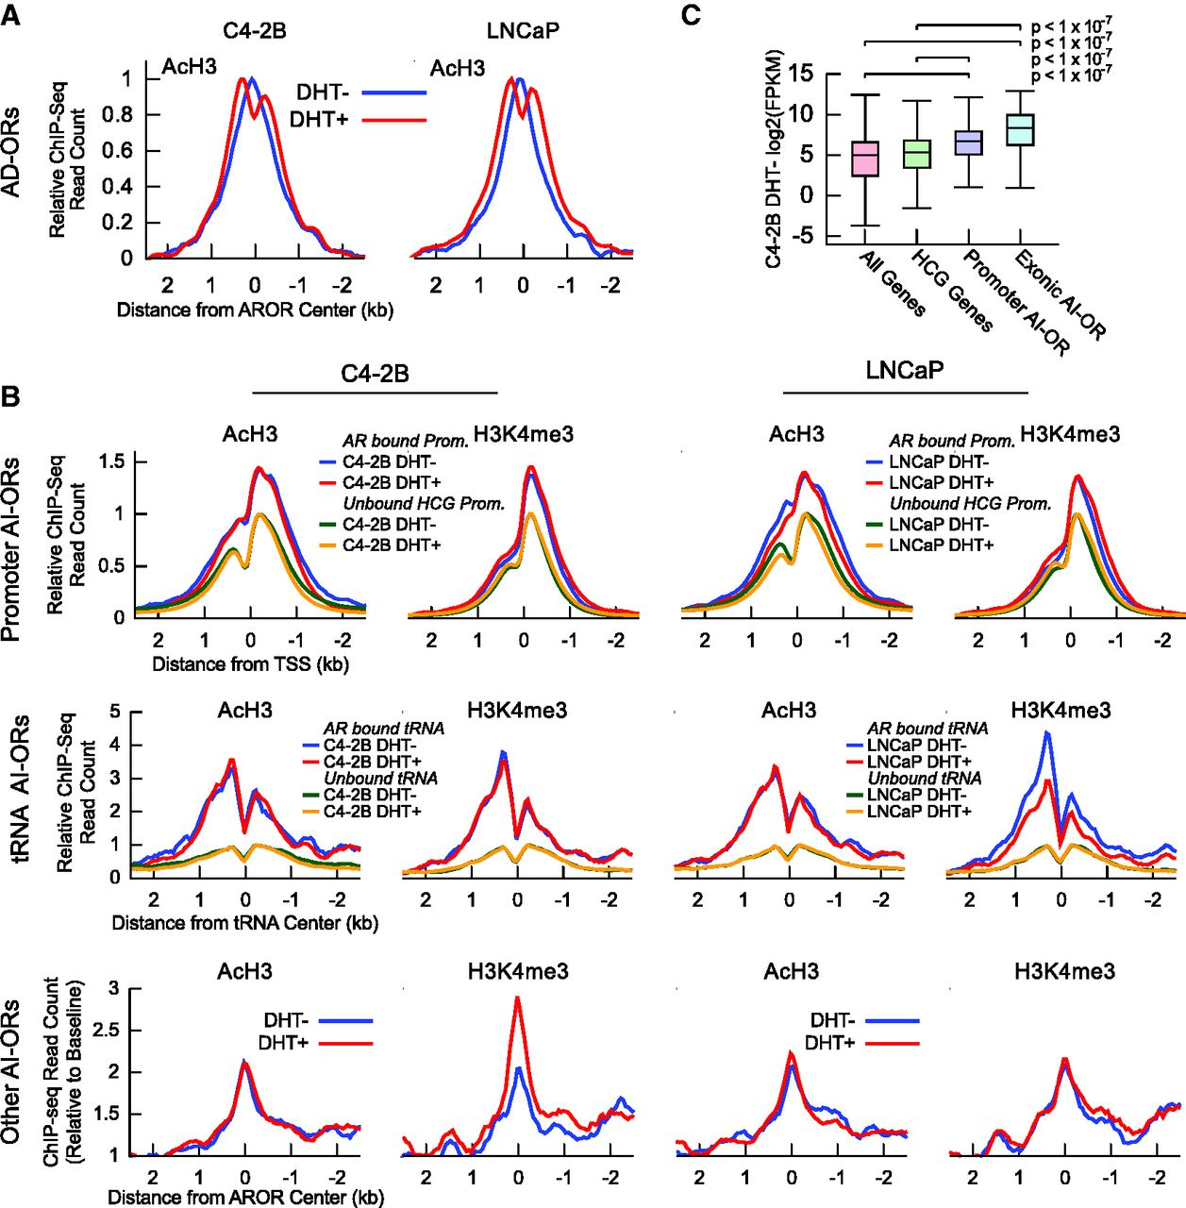
Figure 3. AI-ORs are preferentially located at open chromatin. ( A ) DHT dependence of AcH3 at AD-ORs. Data are ...
Notes:
Figure 3. AI-ORs are preferentially located at open chromatin. ( A ) DHT dependence of AcH3 at AD-ORs. Data are plotted as reads per base pair per peak, normalized to the maximum average signal for each experiment. ( B ) (top) DHT dependence of AcH3 and H3K4me3 at 276 AI-OR bound promoters. Data are plotted as reads per base pair per peak, normalized to the maximum average signal at unbound HCG promoters for each experiment. Note that 284 AI-ORs mapped to 276 promoters because some promoters were bound by multiple AI-ORs; (middle) AcH3 and H3K4me3 signal at 54 AI-OR bound and 578 unbound tRNA. AI-OR bound tRNA show a DHT-independent increase in AcH3 and H3K4me3 signal relative to unbound tRNA. Data are plotted as reads per base pair per peak, normalized to the maximum average signal at unbound tRNA for each experiment. Genomic locations of tRNA genes and pseudo-genes were obtained from the Genomic tRNA Database ( 46 ). Note that 20 tRNA genes annotated in repeat masker 3.2.7 but not included in the tRNA database were excluded when calculating the average signal; (bottom) AcH3 and H3K4me3 signal at 538 non-promoter and non-tRNA AI-ORs. Bound sites show a DHT-independent increase in signal relative to baseline, defined as the average signal in a region 2.5–5 kb away from the AI-OR center. ( C ) Comparison of expression levels between genes with promoter-bound AI-ORs, exonic AI-ORs, HCG promoters and all genes. Empirical P -values were determined by calculating median FPKMs for 1 x 10 7 simulated trials.
Unless provided in the caption above, the following copyright applies to the content of this slide: © The Author(s) 2012. Published by Oxford University Press.This is an Open Access article distributed under the terms of the Creative Commons Attribution License (http://creativecommons.org/licenses/by/3.0/), which permits unrestricted, distribution, and reproduction in any medium, provided the original work is properly cited.

Slide 4
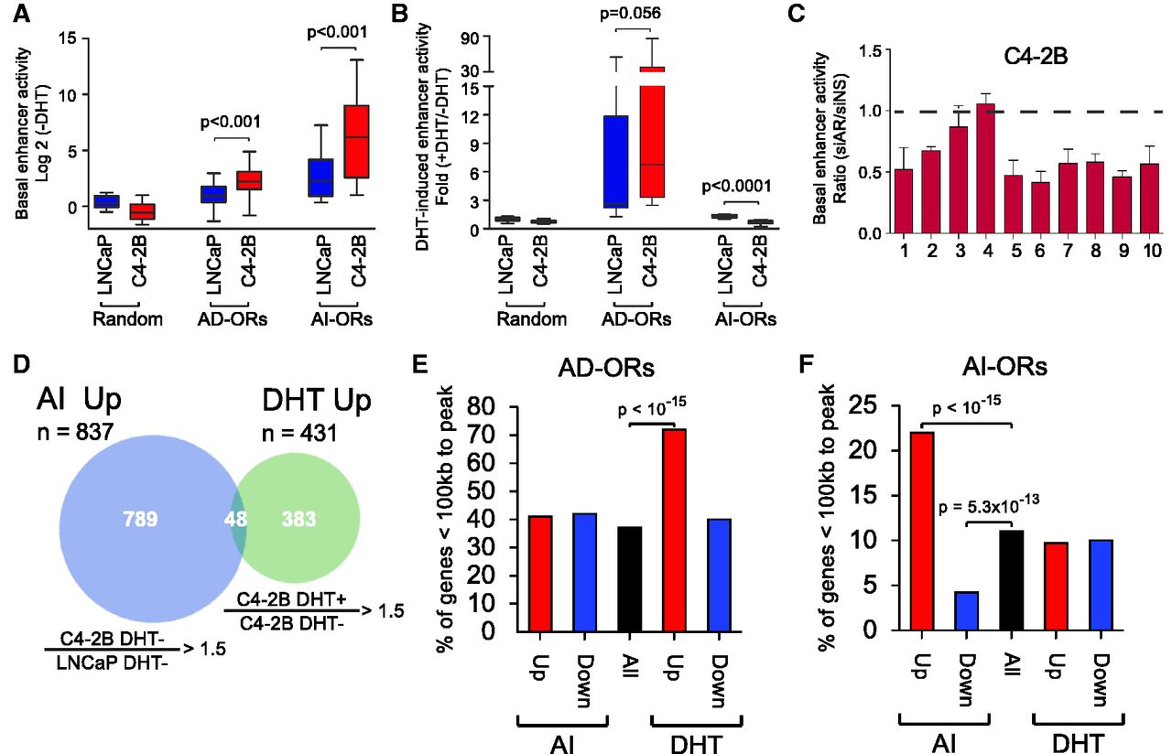
Figure 4. AI-ORs possess AR-dependent enhancer activity and correlate with AI-upregulated genes. ( A ) Luciferase ...
Notes:
Figure 4. AI-ORs possess AR-dependent enhancer activity and correlate with AI-upregulated genes. ( A ) Luciferase reporter assays showing basal enhancer activity of random regions ( n = 10), AD-ORs ( n = 10) and AI-ORs ( n = 10) in the absence of DHT. P -values were calculated based on matched two-tailed Student’s t -test. ( B ) DHT-induced enhancer activity of the same regions. ( C ) Basal enhancer activity of AI-ORs after AR knockdown. The data were normalized to non-specific siRNA. ( D ) RNA-seq Venn diagram showing overlap between genes upregulated in C4-2B DHT− versus LNCaP DHT− (termed AI-upregulated) and C4-2B DHT+ versus C4-2B DHT− (termed DHT-upregulated). ( E, F ) Percentage of AI-up and -downregulated, DHT up- and downregulated and all genes within 100 kb of (E) AD-ORs and (F) AI-ORs. P -values were calculated based on a hypergeometric test.
Unless provided in the caption above, the following copyright applies to the content of this slide: © The Author(s) 2012. Published by Oxford University Press.This is an Open Access article distributed under the terms of the Creative Commons Attribution License (http://creativecommons.org/licenses/by/3.0/), which permits unrestricted, distribution, and reproduction in any medium, provided the original work is properly cited.

Slide 5
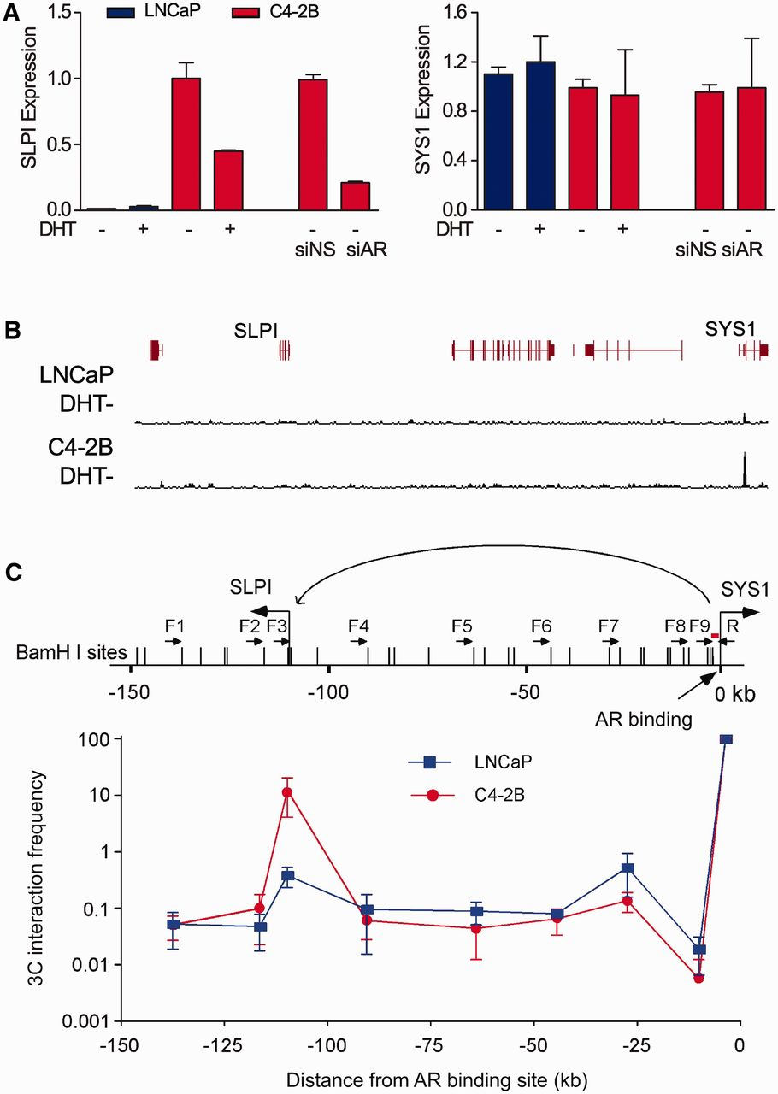
Figure 5. AI-upregulated genes are regulated by distal AI-ORs. ( A ) Real-time RT–PCR results showing expression of ...
Notes:
Figure 5. AI-upregulated genes are regulated by distal AI-ORs. ( A ) Real-time RT–PCR results showing expression of SLPI and SYS1 genes in LNCaP and C4-2B cells. SLPI but not SYS1 was downregulated after AR knockdown. ( B ) Normalized ChIP-seq read counts in the region near the AI-OR and the SYS1 promoter in LNCaP and C4-2B cells. ( C ) 3C assays showing the interaction between the AI-OR at the SYS1 promoter and the SLPI gene promoter. The results are presented as the mean ± standard deviation of two independent 3C preparations. Small black arrows represent the primers and a short red line indicates the probe for 3C-qPCR.
Unless provided in the caption above, the following copyright applies to the content of this slide: © The Author(s) 2012. Published by Oxford University Press.This is an Open Access article distributed under the terms of the Creative Commons Attribution License (http://creativecommons.org/licenses/by/3.0/), which permits unrestricted, distribution, and reproduction in any medium, provided the original work is properly cited.

Slide 6
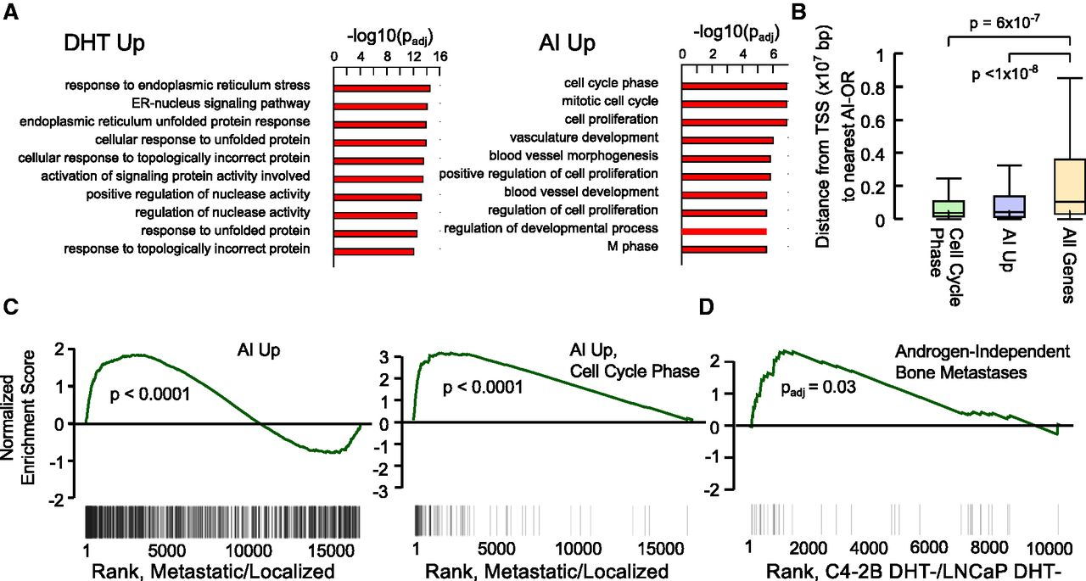
Figure 7. AI-upregulated genes are associated with mitotic cell cycle, proliferation and metastasis. ( A ) Top 10 ...
Notes:
Figure 7. AI-upregulated genes are associated with mitotic cell cycle, proliferation and metastasis. ( A ) Top 10 ontologies enriched in AI-upregulated and DHT-upregulated genes as determined by GOstats ( 56 ). P -values were calculated based on a hypergeometric test with Benjamini–Hochberg correction. ( B ) Distance from the TSS to the nearest AI-OR for AI-upregulated ‘cell cycle phase’ genes, AI-upregulated genes and all genes. Empirical P -values are based on computing the median distance to the nearest AI-OR for randomly selected gene sets using 10 8 trials. ( C ) AI-upregulated (left) and AI-upregulated ‘cell cycle phase’ genes (right) are enriched in metastatic versus localized CRPC. Genes were ranked by fold change in publicly available metastatic versus localized prostate cancer samples (GSE3325). Black lines denote the position of the AI-upregulated genes within the ranked list. (D ) A signature of androgen-independent bone metastases ( 73 ) is associated with increased expression in C4-2B DHT− versus LNCaP DHT− cells based on gene set enrichment analysis (GSEA). Genes were ranked by fold change in C4-2B DHT− versus LNCaP DHT− cells. Black lines denote position of genes in the androgen-independent bone metastases signature within the ranked list.
Unless provided in the caption above, the following copyright applies to the content of this slide: © The Author(s) 2012. Published by Oxford University Press.This is an Open Access article distributed under the terms of the Creative Commons Attribution License (http://creativecommons.org/licenses/by/3.0/), which permits unrestricted, distribution, and reproduction in any medium, provided the original work is properly cited.

Slide 7
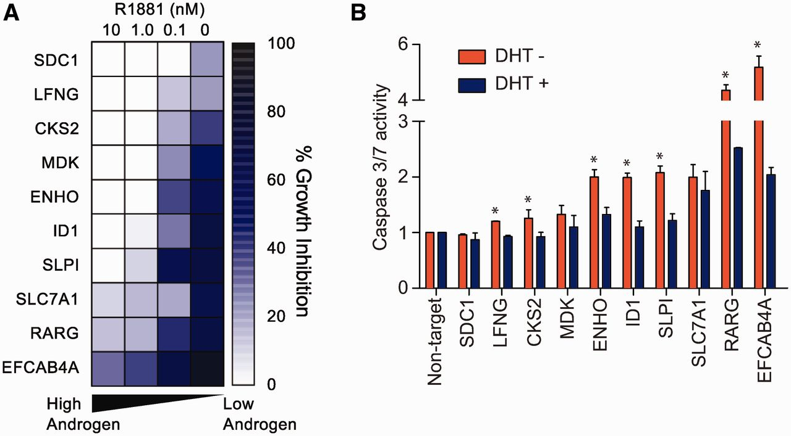
Figure 6. AI-upregulated genes are necessary for CRPC growth. ( A ) Heatmap showing inhibitory effects on C4-2B ...
Notes:
Figure 6. AI-upregulated genes are necessary for CRPC growth. ( A ) Heatmap showing inhibitory effects on C4-2B proliferation 5 days after gene-specific siRNA transfection in different concentrations of R1881. Percentage inhibition is normalized to non-target siRNA. ( B ) Apoptosis assay with C4-2B cells showing Caspase 3 and 7 activity 3 days after gene-specific siRNA transfection in the presence or absence of DHT (10 nM). The results are presented as the mean ± standard deviation of two independent experiments. * P < 0.05, two-tailed Student’s t -test.
Unless provided in the caption above, the following copyright applies to the content of this slide: © The Author(s) 2012. Published by Oxford University Press.This is an Open Access article distributed under the terms of the Creative Commons Attribution License (http://creativecommons.org/licenses/by/3.0/), which permits unrestricted, distribution, and reproduction in any medium, provided the original work is properly cited.

