Slide 1
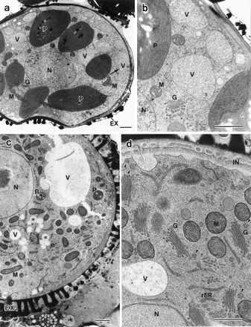
Fig. 1 Microspores during exine formation (a, b) and intine formation (c, d). (a) Vacuoles are distributed ...
Notes:
Fig. 1 Microspores during exine formation (a, b) and intine formation (c, d). (a) Vacuoles are distributed throughout the cytoplasm. (b) The electron density of vacuole is similar to that of the cytoplasm. Plastids contain starch grains and thylakoids that do not stack to grana. (c) A large vacuole locates in the cell periphery. Plastids markedly decreased in number and size. (d) The electron density of vacuoles is less than that of the cytoplasm. Golgi bodies have increased in number and their cisternae. Golgi vesicles are not seen around the vacuole but near the plasma membrane. EX, exine; G, Golgi body; IN, intine; M, mitochondrion; N, nucleus; P, plastid; V, vacuole; arrow, dumbbell shaped vacuole; arrowhead, Golgi vesicle; asterisk, lipid body. Bar = 1 µm (a–c), 0.5 µm (d).
Unless provided in the caption above, the following copyright applies to the content of this slide:

Slide 2
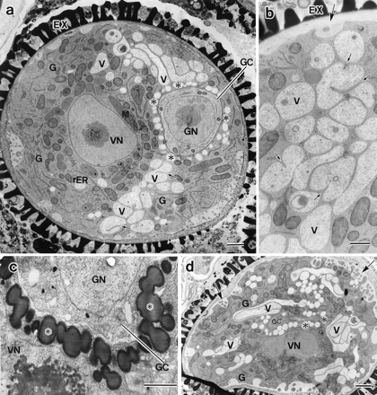
Fig. 2 Young pollen grains after generative cell formation. (a) Intine is still developing and vacuoles in ...
Notes:
Fig. 2 Young pollen grains after generative cell formation. (a) Intine is still developing and vacuoles in various sizes are in clusters. Lipid bodies surround the generative cell. (b) The invaginations of tonoplast occur at several points and developed from one side of a vacuole. The exocytosis of small vacuole is clear (large arrow). (c) Lipid bodies surrounding the generative cell are stained with p-phenylene diamine. Chemical fixation. (d) Dividing vacuoles, small vacuoles and lipids become more scattered than those in Fig. 2a. The plasma membrane is heavily convoluted (large arrow). EX, exine; G, Golgi body; GC, generative cell; GN, generative nucleus; M, mitochondrion; V, vacuole; VN, vegetative nucleus; small arrow, invagination of tonoplast; asterisk, lipid body. Bar = 1 µm (a, c, d), 0.5 µm (b).
Unless provided in the caption above, the following copyright applies to the content of this slide:

Slide 3
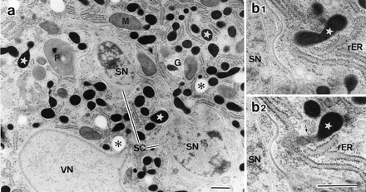
Fig. 3 Pollen grains after sperm cell formation. (a) Sperm cells are connected with each other. Numerous ...
Notes:
Fig. 3 Pollen grains after sperm cell formation. (a) Sperm cells are connected with each other. Numerous electron-dense structures are scattered in the cytoplasm. The rER cisterna is dilated. (b1, b2) Two serial sections. The electron-dense structure connects with rER (arrow). G, Golgi body; M, mitochondrion; P, plastid; SC, sperm cell; SN, sperm nucleus; VN, vegetative nucleus; asterisk, lipid body; star, electron-dense structure. Bar = 0.5 µm.
Unless provided in the caption above, the following copyright applies to the content of this slide:

Slide 4
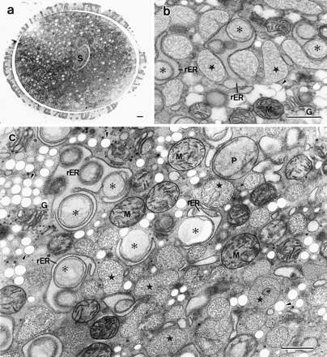
Fig. 4 Mature pollen grains collected just before anthesis and rapidly frozen in liquid propane (a, c) and by ...
Notes:
Fig. 4 Mature pollen grains collected just before anthesis and rapidly frozen in liquid propane (a, c) and by a high pressure-freezing apparatus (b). (a) Central section. (b, c) Many membrane-bound structures with fibrillar substances (MBFs) are observed. Highly dilated rER cisternae surround lipid bodies with thinner outlines than a unit-membrane. Golgi vesicles with 120–150 nm diameter are accumulated cell periphery (up-left in c). G, Golgi body; M, mitochondrion; P, plastid; S, sperm cell; arrowhead, Golgi vesicle; asterisk, lipid body; star, MBF. Bar = 1 µm (a), 0.5 µm (b, c).
Unless provided in the caption above, the following copyright applies to the content of this slide:

Slide 5
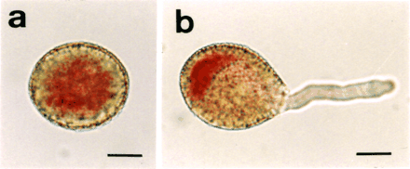
Fig. 5 Neutral red treatment. (a) A mature pollen grain from a flower just before anthesis. It corresponds to ...
Notes:
Fig. 5 Neutral red treatment. (a) A mature pollen grain from a flower just before anthesis. It corresponds to the pollen in Fig. 4a. (b) A geminated pollen. In the pollen grain, the base cytoplasm is more stained than the proximal one. Bar = 10 µm.
Unless provided in the caption above, the following copyright applies to the content of this slide:

Slide 6
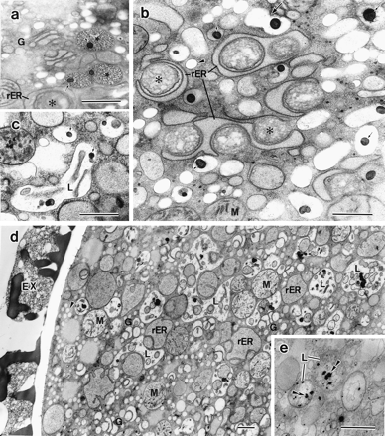
Fig. 6 Mature pollen grains from flowers after anthesis. (a) MBFs contain osmiophilic globoids. (b) ...
Notes:
Fig. 6 Mature pollen grains from flowers after anthesis. (a) MBFs contain osmiophilic globoids. (b) Electron-transparent membrane-bound structures with osmiophilic globoids but without fibrillar substances as like MBFs have appeared. Highly dilated rER surrounding lipid bodies is still observed. (c) A lysosomal structure containing osmiophilic globoids and tubular structures is observed in addition to the electron-transparent ones with the globoids. (d) The cytoplasm is occupied by lysosomal structures. Highly dilated rER surrounding lipid bodies have disappeared. The rER, Golgi body cisternae and mitochondria are intensely swollen. (e) Reaction products of acid phosphatases are observed in the lysosomal structure. EX, exine; G, Golgi body; M, mitochondrion; L, lysosomal structure; arrowhead, Golgi vesicle; large arrow, dumbbell-shaped membrane-bound structure; small arrow, osmiophilic globoid; asterisk, lipid body; double arrowheads, reaction products of acid phosphatases; star, MBF. Bar = 0.5 µm.
Unless provided in the caption above, the following copyright applies to the content of this slide:

Slide 7
Fig. 7 Schematic representation of the transformation of vacuoles during various stages of pollen ...
Notes:
Fig. 7 Schematic representation of the transformation of vacuoles during various stages of pollen development. N, nucleus; G, generative cell; S, sperm cell.
Unless provided in the caption above, the following copyright applies to the content of this slide:

