Slide 1
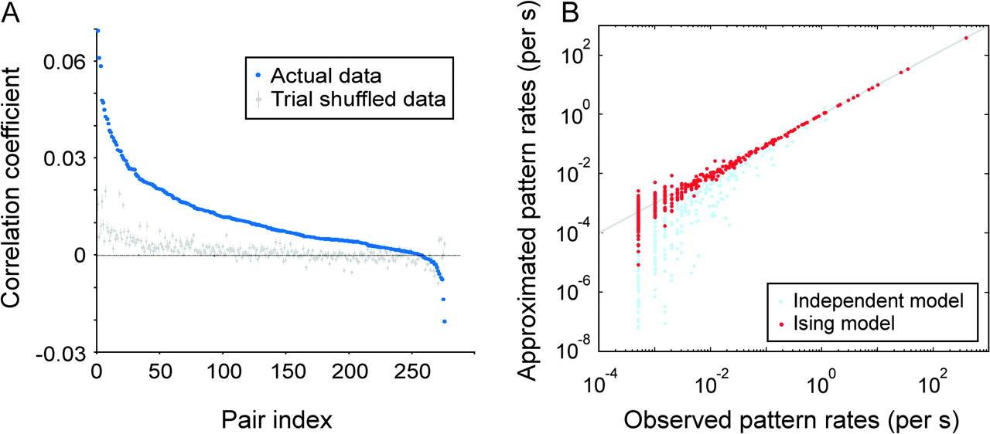
Figure 1. Correlations in neuronal activity and model approximation of the firing patterns. (A) Distribution of ...
Notes:
Figure 1. Correlations in neuronal activity and model approximation of the firing patterns. (A) Distribution of correlation coefficients between neuronal pairs computed from their original spiking activity (blue) and from trial-shuffled activity (50 repetitions of shuffling; gray). Error bars represent the SD. Neuronal pairs (pair index) are sorted by the magnitude of the correlation coefficient obtained for the actual (nonshuffled) data. (B) For an example of a 10-neuron group, the observed frequency of individual firing patterns is plotted against the frequency predicted by the Ising model (2nd-order correlation; red dots) and the predictions from the independent model (no correlation; light-blue dots). The solid line indicates equality.
Unless provided in the caption above, the following copyright applies to the content of this slide: © 2008 The AuthorsThis is an Open Access article distributed under the terms of the Creative Commons Attribution Non-Commercial License (http://creativecommons.org/licenses/by-nc/2.0/uk/) which permits unrestricted non-commercial use, distribution, and reproduction in any medium, provided the original work is properly cited.

Slide 2
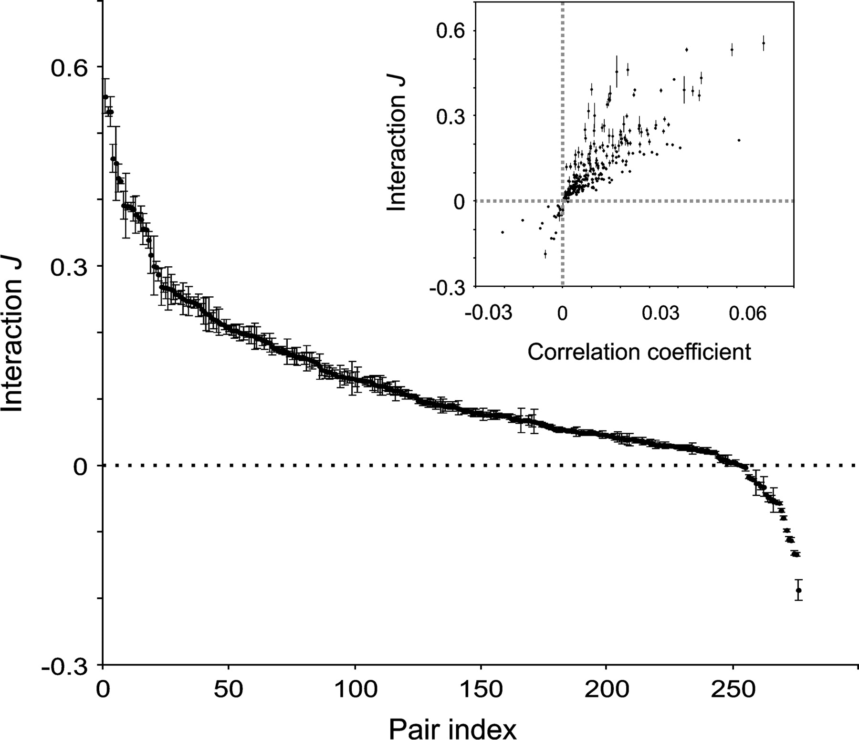
Figure 2. The stability of interactions estimated across different 10-neuron groups and their nontrivial relation to ...
Notes:
Figure 2. The stability of interactions estimated across different 10-neuron groups and their nontrivial relation to correlation coefficients. Distribution of interaction, J, for all 276 investigated neuronal pairs. Neuronal pairs (pair index) are sorted according to the mean interaction value. Inset: interactions, J, for pairs of units plotted against the corresponding correlation coefficients. Error bars represent SD of J across all estimates made for the same pair embedded into different 10-neuron groups.
Unless provided in the caption above, the following copyright applies to the content of this slide: © 2008 The AuthorsThis is an Open Access article distributed under the terms of the Creative Commons Attribution Non-Commercial License (http://creativecommons.org/licenses/by-nc/2.0/uk/) which permits unrestricted non-commercial use, distribution, and reproduction in any medium, provided the original work is properly cited.

Slide 3
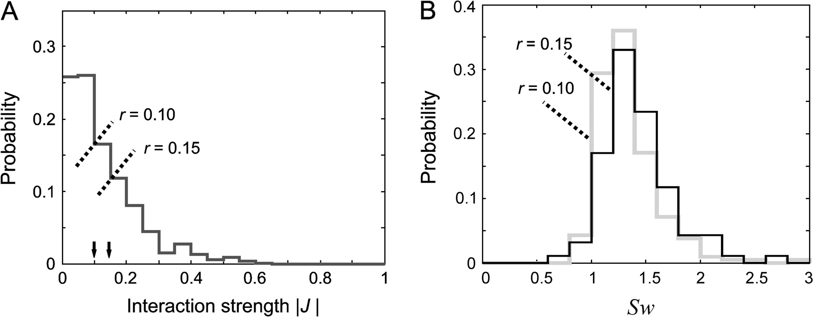
Figure 3. Distributions of interaction strength, |J|, and the measures of small-world property, Sw. (A) Distribution of ...
Notes:
Figure 3. Distributions of interaction strength, |J|, and the measures of small-world property, Sw. (A) Distribution of interaction strength |J| and the positions of the 2 different thresholds, r. (B) Distributions of Sw obtained for the 2 different thresholds in (A).
Unless provided in the caption above, the following copyright applies to the content of this slide: © 2008 The AuthorsThis is an Open Access article distributed under the terms of the Creative Commons Attribution Non-Commercial License (http://creativecommons.org/licenses/by-nc/2.0/uk/) which permits unrestricted non-commercial use, distribution, and reproduction in any medium, provided the original work is properly cited.

Slide 4
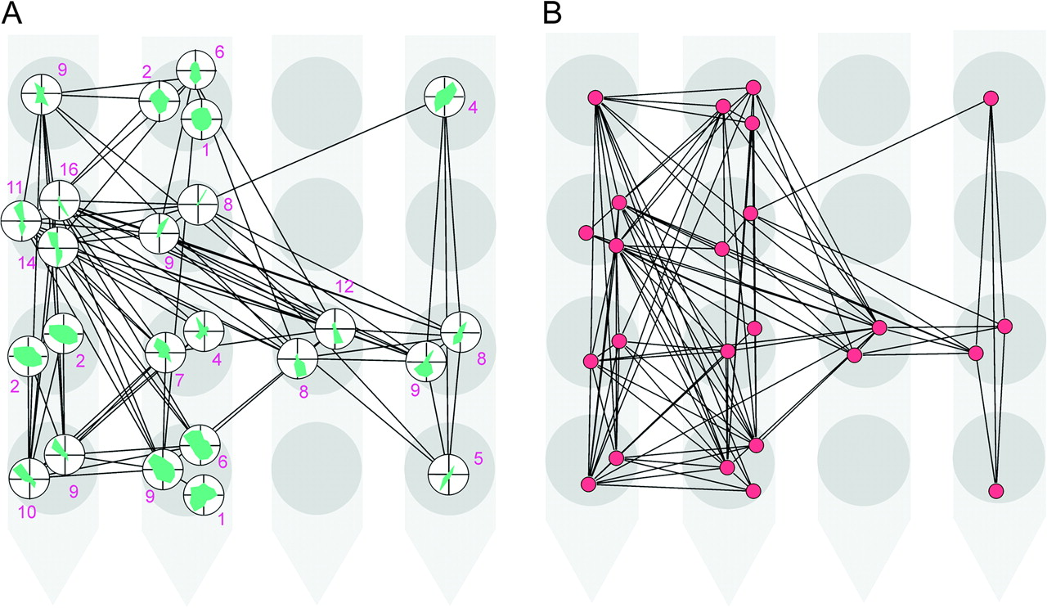
Figure 4. The connection matrices for 24 units are shown in a spatial constellation that depicts the relative positions ...
Notes:
Figure 4. The connection matrices for 24 units are shown in a spatial constellation that depicts the relative positions of the units as defined by the positions of the corresponding electrode contacts on a 16-channel (4-shank) Michigan probe. Contacts at the lower parts of the figure were recorded from deeper layers of the cortex. (A) The interaction matrix is thresholded at |J| = 0.15 (see Table 1). The orientation tuning curves are indicated for each unit by the small polar plots. The number associated to each unit indicates its degree. (B) A network obtained from the correlation matrix from which the interactions in (A) are extracted. This network is thresholded at r = 0.012 (see Supplementary Table 3).
Unless provided in the caption above, the following copyright applies to the content of this slide: © 2008 The AuthorsThis is an Open Access article distributed under the terms of the Creative Commons Attribution Non-Commercial License (http://creativecommons.org/licenses/by-nc/2.0/uk/) which permits unrestricted non-commercial use, distribution, and reproduction in any medium, provided the original work is properly cited.

Slide 5
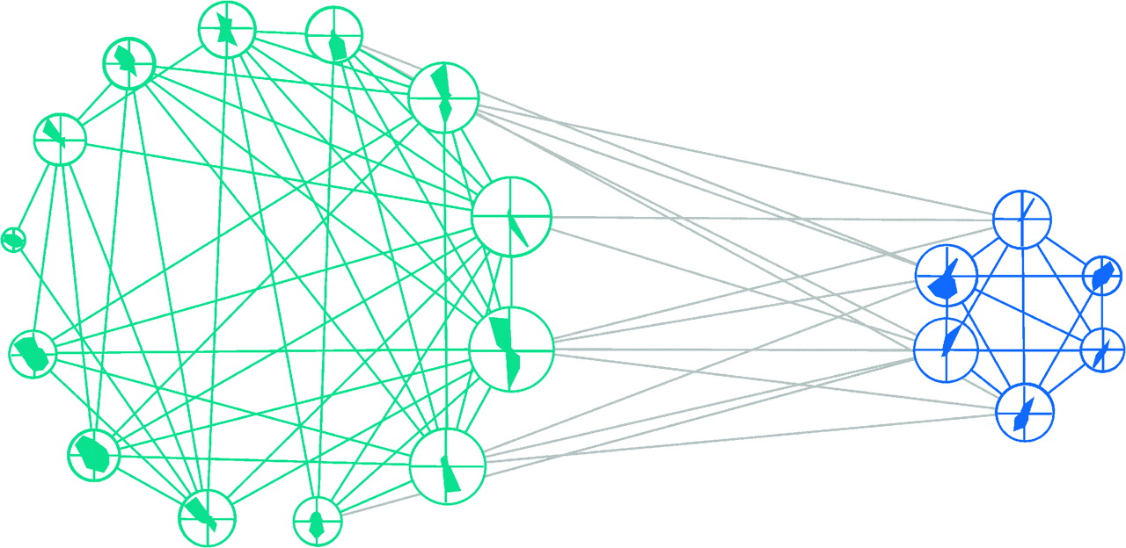
Figure 5. The connection matrix from Figure 4A rearranged such that the units with similar orientation preferences form ...
Notes:
Figure 5. The connection matrix from Figure 4A rearranged such that the units with similar orientation preferences form a group: One group comprises units with preferred orientations between 0° and 90° (blue) and the other between 90° and 180° (green). Five units with weakest orientation preferences could not be classified accurately and were, thus, removed from the plot. The size of each node is proportional to the number of its connections (i.e., its degree). Gray: intercluster connections. Note the higher interconnectivity within than between the groups (quantitative analysis is reported in the main text).
Unless provided in the caption above, the following copyright applies to the content of this slide: © 2008 The AuthorsThis is an Open Access article distributed under the terms of the Creative Commons Attribution Non-Commercial License (http://creativecommons.org/licenses/by-nc/2.0/uk/) which permits unrestricted non-commercial use, distribution, and reproduction in any medium, provided the original work is properly cited.

Slide 6
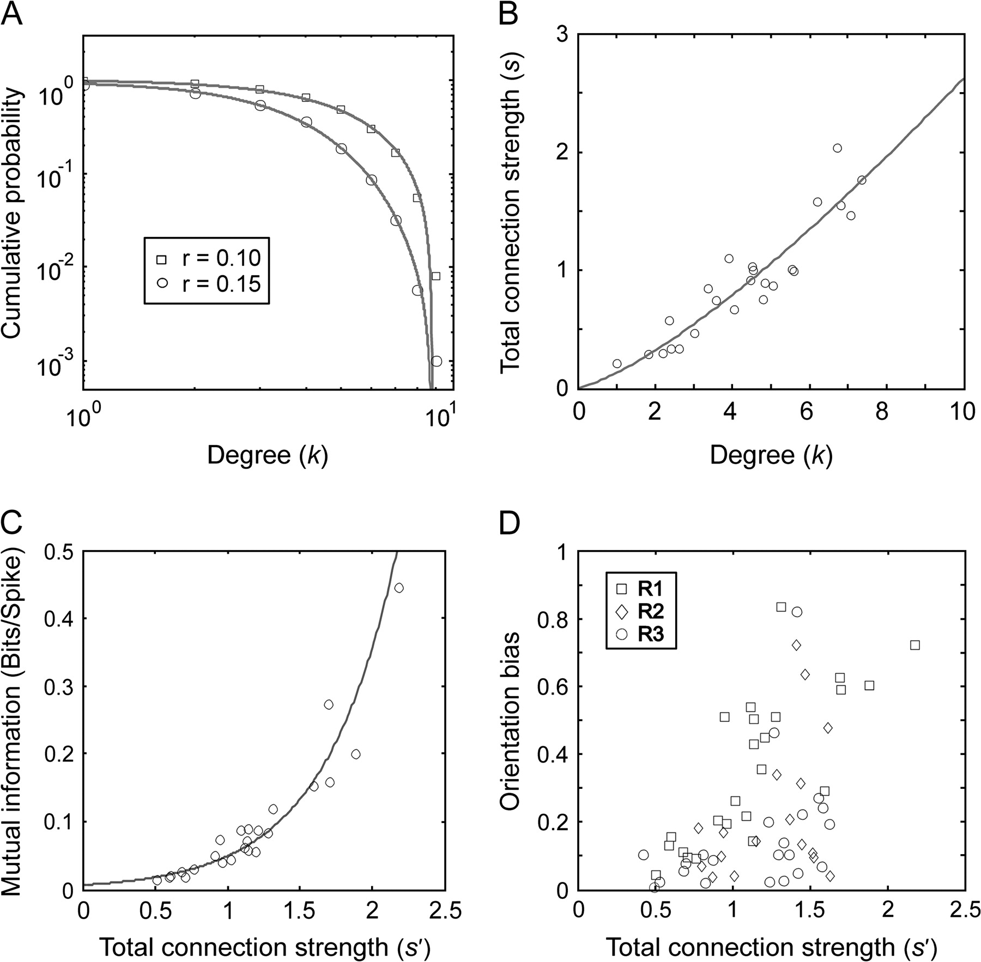
Figure 6. Various properties of interaction networks. (A) Average cumulative degree distribution (P|Degree ≥ k) for ...
Notes:
Figure 6. Various properties of interaction networks. (A) Average cumulative degree distribution (P|Degree ≥ k) for networks computed for the 2 values of thresholds, r (log–log plot). (B) The average degree values of individual neurons plotted against the neuron's average total connection strengths. (C) The average total connection strength of individual neurons plotted against the average mutual information between the activity of the corresponding neuron (spike present or not) and the activity of the remaining part of the investigated network (the pattern of spikes in other neurons). (D) The average total connection strength of individual neurons plotted against their OB. In A, B, and C, the results are shown only for the 24-neuron dataset and in D for all 63 neurons investigated in the present study and acquired across the 3 recording probes (R1–R3). Solid lines: best-fitting Gaussian function (A), best-fitting power law function (B), and best-fitting exponential function (C).
Unless provided in the caption above, the following copyright applies to the content of this slide: © 2008 The AuthorsThis is an Open Access article distributed under the terms of the Creative Commons Attribution Non-Commercial License (http://creativecommons.org/licenses/by-nc/2.0/uk/) which permits unrestricted non-commercial use, distribution, and reproduction in any medium, provided the original work is properly cited.

Slide 7
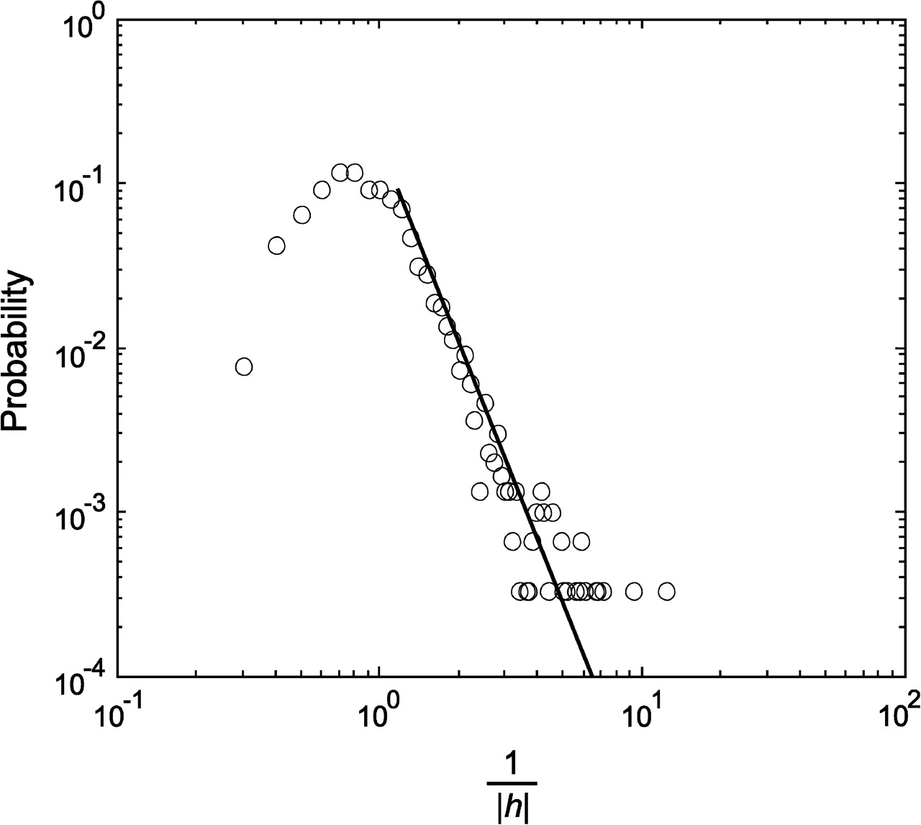
Figure 7. Distribution of the reciprocal of the absolute value of neuronal intrinsic property, |h|, estimated by the ...
Notes:
Figure 7. Distribution of the reciprocal of the absolute value of neuronal intrinsic property, |h|, estimated by the Ising model and shown in a log–log plot. Solid line: best-fitting power law function for the right tail of the distribution.
Unless provided in the caption above, the following copyright applies to the content of this slide: © 2008 The AuthorsThis is an Open Access article distributed under the terms of the Creative Commons Attribution Non-Commercial License (http://creativecommons.org/licenses/by-nc/2.0/uk/) which permits unrestricted non-commercial use, distribution, and reproduction in any medium, provided the original work is properly cited.

