Slide 1
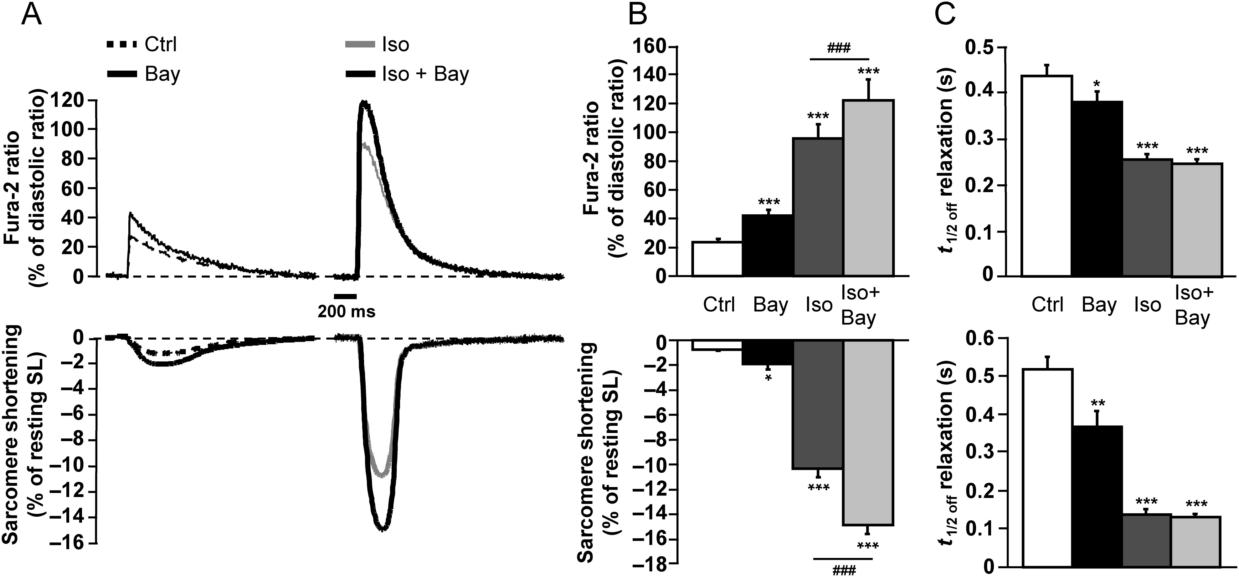
Figure 1 Effect of PDE2 inhibition on ECC in ARVMs. (A) Representative traces of Ca²⁺ transients (top) and ...
Notes:
Figure 1 Effect of PDE2 inhibition on ECC in ARVMs. (A) Representative traces of Ca2+ transients (top) and sarcomere shortening (bottom) recorded in ARVMs paced at 0.5 Hz and loaded with Fura-2 AM (5 µM) showing the effect of PDE2 inhibition by Bay (0.1 µM) (in black) on basal conditions (dashed lines) or upon β-adrenergic stimulation by 1 nM Iso (in grey). (B) Mean amplitude (±SEM) of Ca2+ transients (upper graph, in % of diastolic ratio) and sarcomere shortening (lower graph, in % of resting SL) in control (white bar, n = 24 cells, 13 rats), Bay (black bar, n = 24 cells, 13 rats), Iso (dark grey bar, n = 11 cells, 4 rats), and Iso + Bay (light grey bar, n = 11 cells, 4 rats). (C) Average time-to-50% relaxation of Ca2+ transients (upper graph) and sarcomere shortening (lower graph) in similar experimental conditions as in (B). Statistical significance is indicated as: *P < 0.05; **P < 0.01; ***P < 0.001; and ###P < 0.001 (one-way ANOVA, Newman–Keuls).
Unless provided in the caption above, the following copyright applies to the content of this slide: Published on behalf of the European Society of Cardiology. All rights reserved. © The Author 2013. For permissions please email: journals.permissions@oup.com.

Slide 2
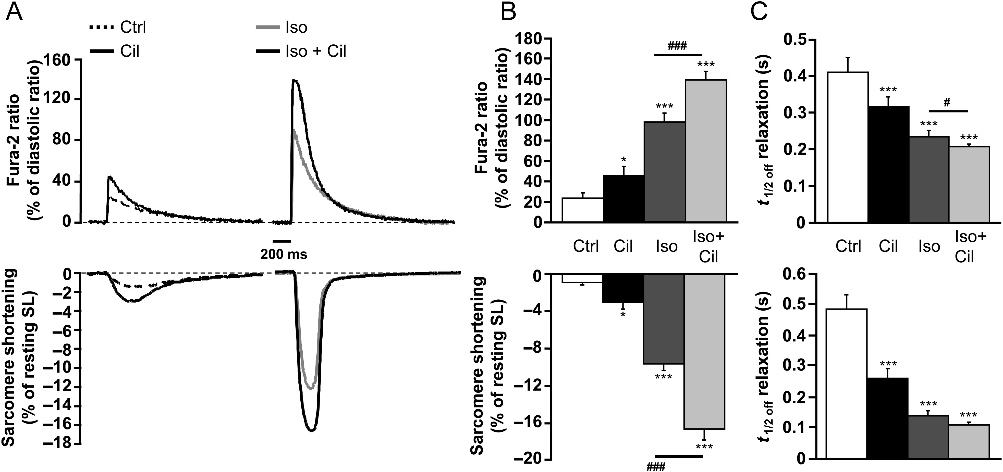
Figure 2 Effect of PDE3 inhibition on ECC in ARVMs. (A) Typical traces of Ca²⁺ transients (top) and ...
Notes:
Figure 2 Effect of PDE3 inhibition on ECC in ARVMs. (A) Typical traces of Ca2+ transients (top) and sarcomere shortening (bottom) in Fura-2 loaded ARVMs electrically stimulated (0.5 Hz) representing the effect of PDE3 inhibition by Cil (1 µM) (in black) under basal conditions (dashed lines) or during Iso stimulation (1 nM) (in grey). (B) Mean amplitude (±SEM) of Ca2+ transients (upper graph) and sarcomere shortening (lower graph) in control conditions (white bar, n = 16 cells, 7 rats), Cil (black bar, n = 16 cells, 7 rats), Iso (dark grey bar, n = 9 cells, 3 rats), and Iso + Cil (light grey bar, n = 9 cells, 3 rats). (C) Average time-to-50% relaxation for Ca2+ transients (upper graph) and sarcomere shortening (lower graph) are presented for each conditions tested. Statistical significance is indicated as: *P < 0.05; ***P < 0.001; and #P < 0.05; ###P < 0.001 (one-way ANOVA, Newman–Keuls).
Unless provided in the caption above, the following copyright applies to the content of this slide: Published on behalf of the European Society of Cardiology. All rights reserved. © The Author 2013. For permissions please email: journals.permissions@oup.com.

Slide 3
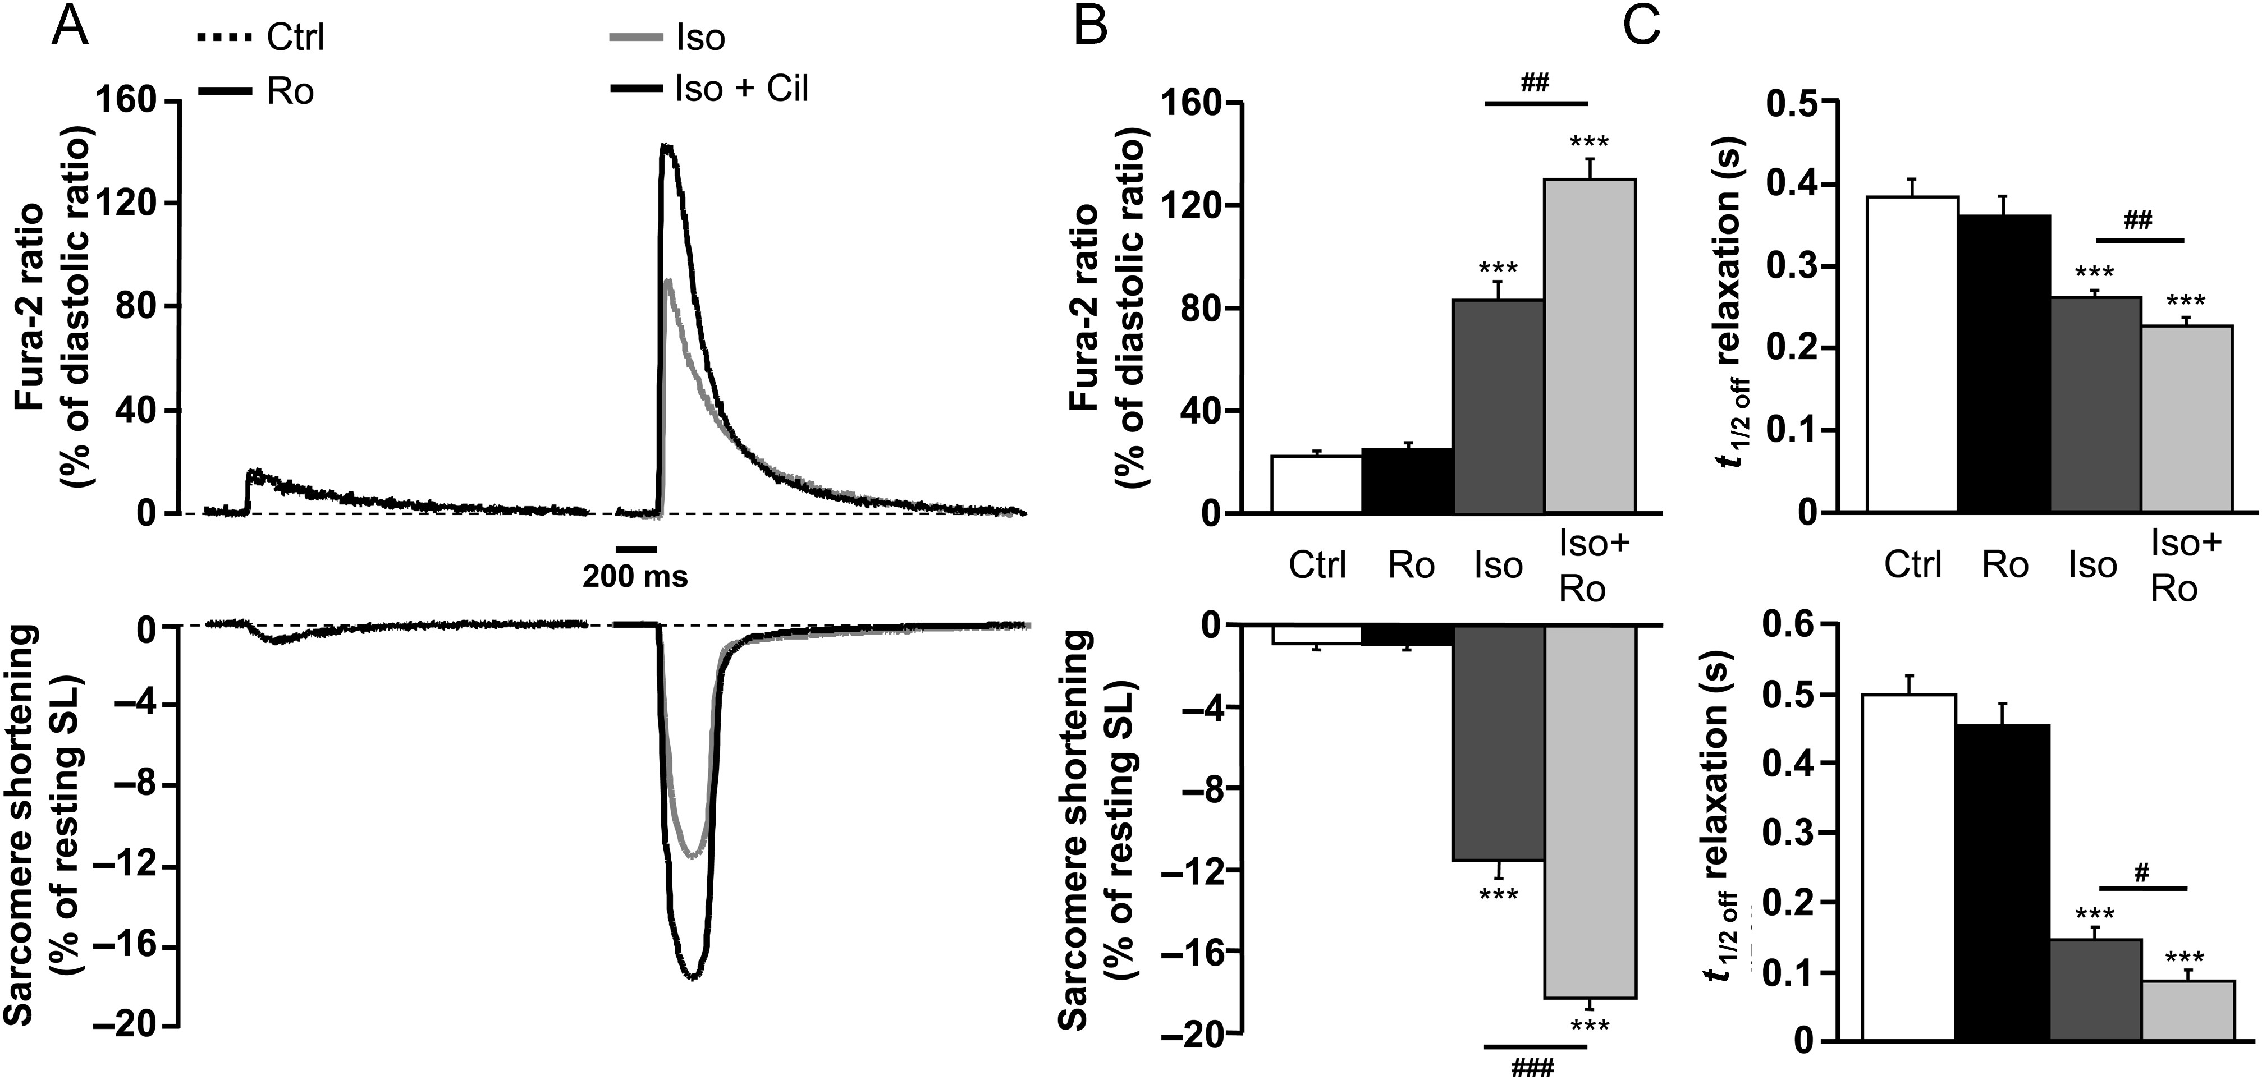
Figure 3 Effect of PDE4 inhibition on ECC in ARVMs. (A) Individual traces of Ca²⁺ transients (top) and ...
Notes:
Figure 3 Effect of PDE4 inhibition on ECC in ARVMs. (A) Individual traces of Ca2+ transients (top) and sarcomere shortening (bottom) in Fura-2 loaded ARVMs paced at 0.5 Hz representing the effect of PDE4 inhibition by Ro (10 µM) (in black) under basal conditions (dashed lines) or after Iso stimulation (1 nM) (in grey). (B) Mean amplitude (±SEM) of Ca2+ transients (upper graph) and sarcomere shortening (lower graph) in control conditions (white bar, n = 11 cells, 6 rats), Ro (black bar, n = 11, 6 rats), Iso (dark grey bar, n = 12 cells, 6 rats), and Iso + Ro (light grey bar, n = 12 cells, 6 rats). (C) Average time-to-50% relaxation for Ca2+ transients (upper graph) and sarcomere shortening (lower graph) are presented for control, Ro, Iso, and Iso + Ro. Statistical significance is indicated as: ***P < 0.001; and #P < 0.05; ##P < 0.01; ###P < 0.001 (one-way ANOVA, Newman–Keuls).
Unless provided in the caption above, the following copyright applies to the content of this slide: Published on behalf of the European Society of Cardiology. All rights reserved. © The Author 2013. For permissions please email: journals.permissions@oup.com.

Slide 4
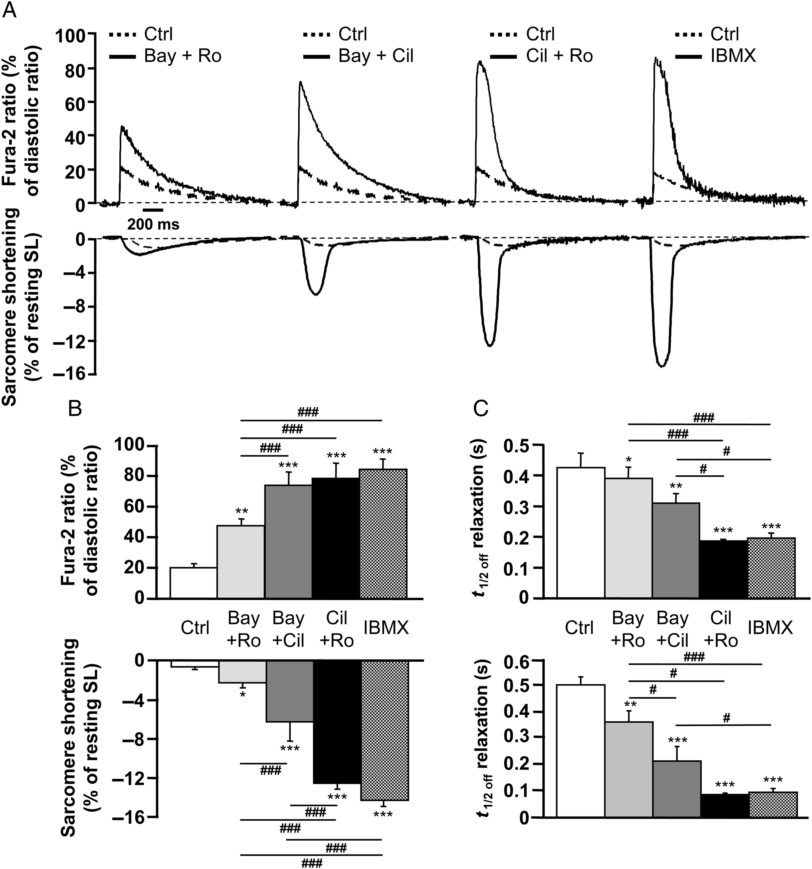
Figure 4 Effect of concomitant PDE inhibition on Ca²⁺ transients and cell contraction in ARVMs under basal ...
Notes:
Figure 4 Effect of concomitant PDE inhibition on Ca2+ transients and cell contraction in ARVMs under basal conditions. (A) Representative traces of Ca2+ transients (top) and sarcomere shortening (bottom) obtained in Fura-2 loaded ARVMs paced at 0.5 Hz showing the effect of simultaneous PDE2 and PDE4 inhibition by Bay (0.1 µM) and Ro (10 µM) (Bay + Ro); PDE2 and PDE3 inhibition by Bay and cilostamide (1 µM) (Bay + Cil); PDE3 and PDE4 inhibition by Cil and Ro (Cil + Ro); and global PDE inhibition by IBMX (100 µM). (B) Mean amplitude (±SEM) of Ca2+ transients (upper graph) and sarcomere shortening (lower graph) in control conditions (white bar), or after concomitant PDE inhibition by Bay + Ro (light grey bar, n = 14 cells, 5 rats), Bay + Cil (dark grey bar, n = 11 cells, 4 rats), Cil + Ro (black bar, n = 9 cells, 4 rats) and IBMX (hatched bar, n = 10 cells, 3 rats). (C) Mean (±SEM) time-to-50% relaxation for Ca2+ decay (upper graph) and sarcomere shortening (lower graph) the same conditions as in (B). Statistical significance is indicated as: *P < 0.05; **P < 0.01; ***P < 0.001; and #P < 0.05; ###P < 0.001 (one-way ANOVA, Newman–Keuls).
Unless provided in the caption above, the following copyright applies to the content of this slide: Published on behalf of the European Society of Cardiology. All rights reserved. © The Author 2013. For permissions please email: journals.permissions@oup.com.

Slide 5
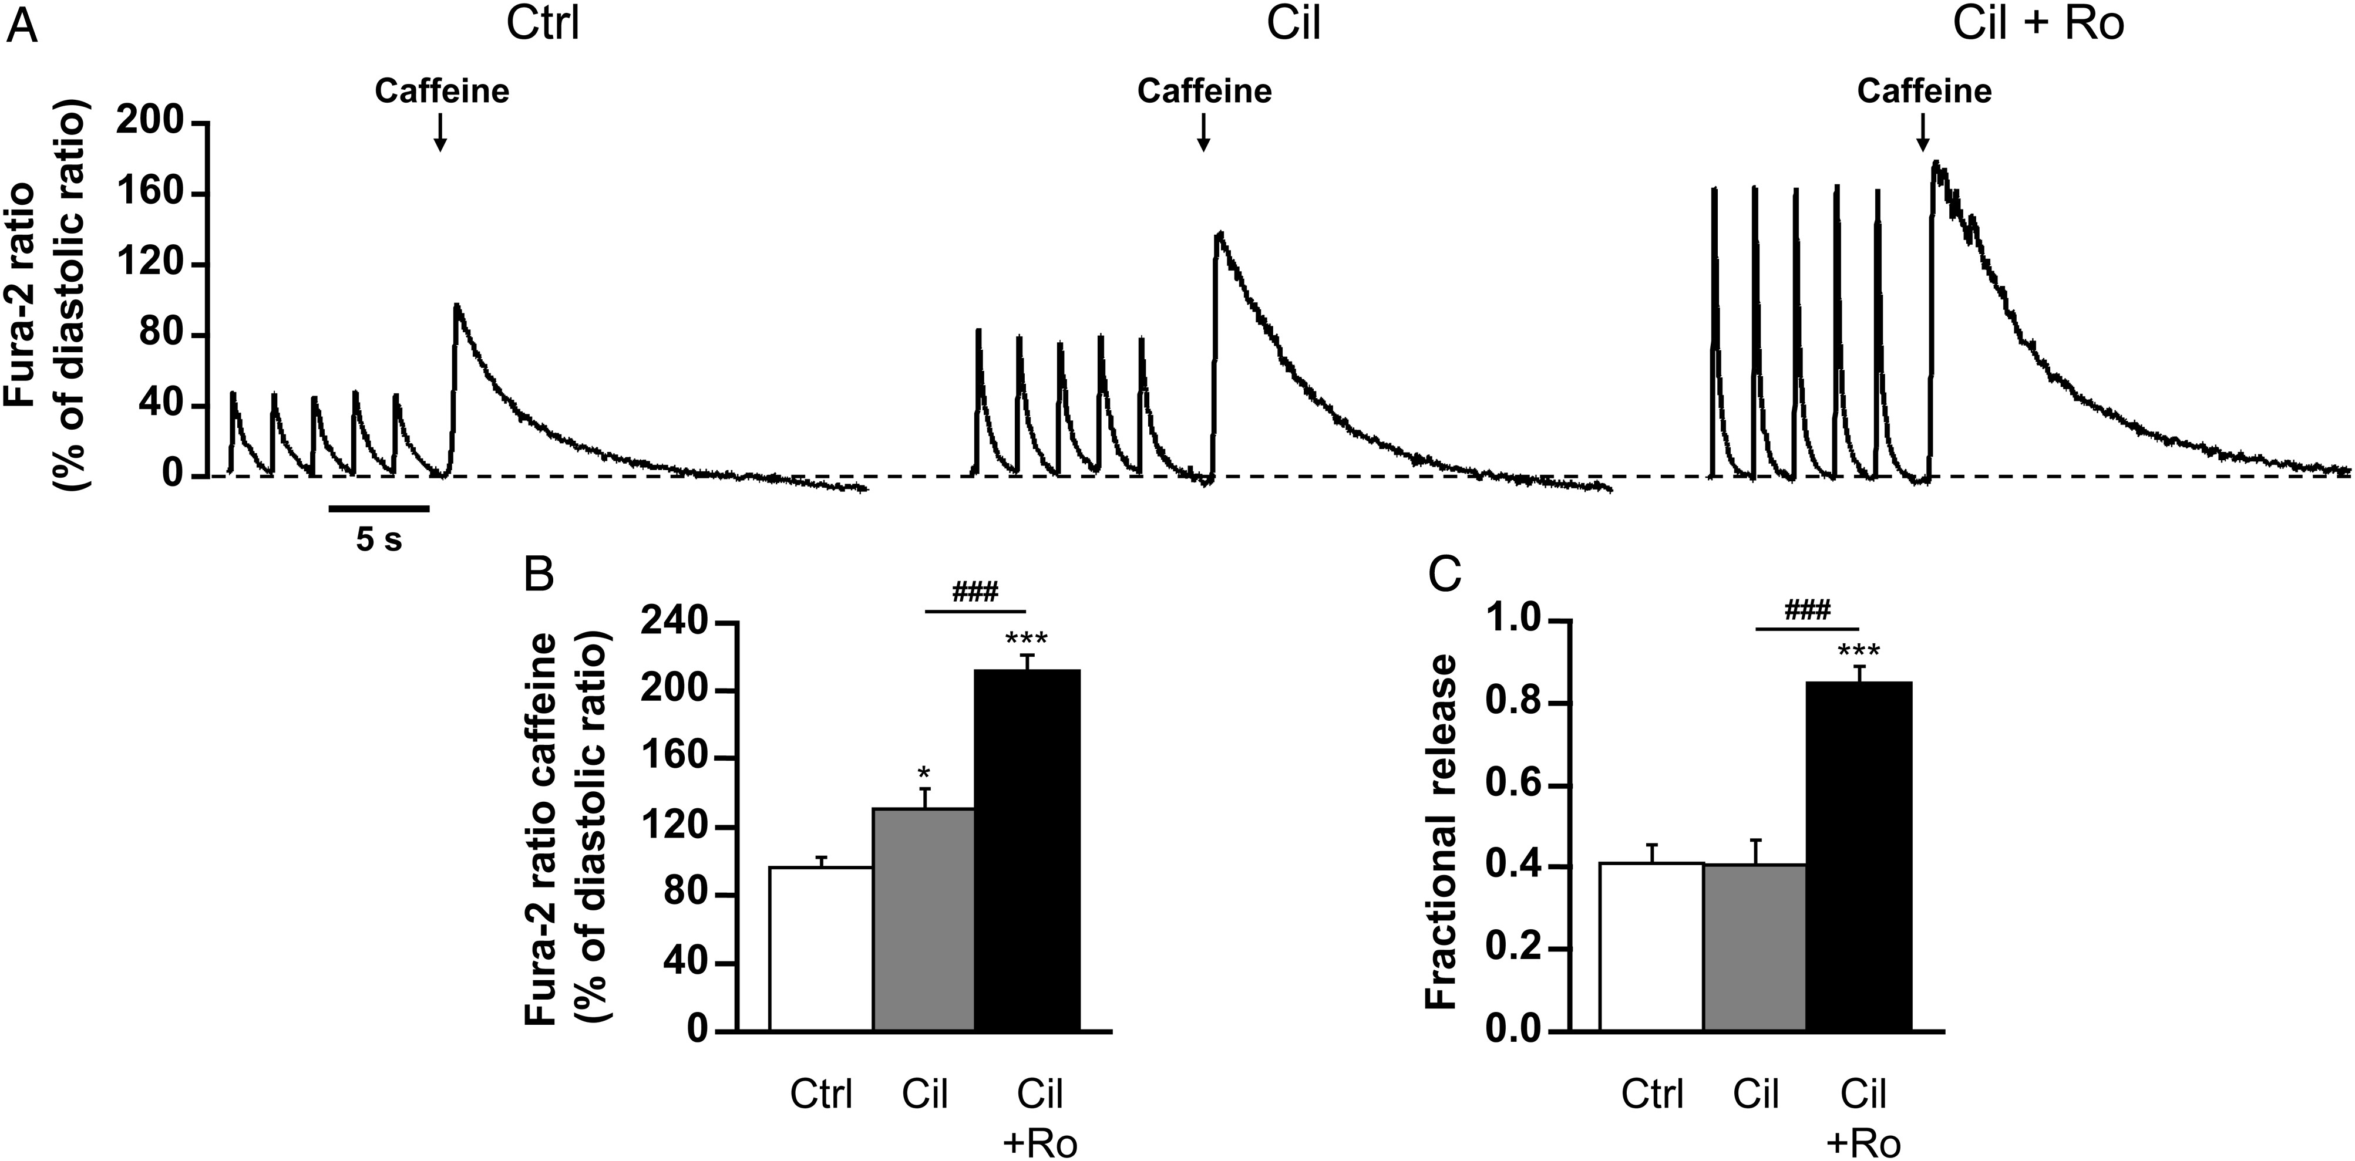
Figure 5 Effect of concomitant PDE3 and PDE4 inhibition on SR Ca²⁺ load and fractional release in ARVMs. ...
Notes:
Figure 5 Effect of concomitant PDE3 and PDE4 inhibition on SR Ca2+ load and fractional release in ARVMs. (A) Representative traces of Ca2+ transients obtained with caffeine (10 mM) recorded in Fura-2 loaded ARVMs after pacing at 0.5 Hz, under basal conditions (Ctrl), upon PDE3 inhibition by Cil (1 µM), or PDE3 and PDE4 inhibition by Cil and Ro (10 µM) (Ro + Cil). (B) Mean amplitude (±SEM) of calcium transients induced by caffeine (10 mM) estimating SR Ca2+ content in Ctrl (white bar, n = 8 cells, 3 rats), Cil (grey bar, n = 8 cells, 3 rats), and Cil + Ro (black bar, n = 9 cells, 3 rats). (C) Average fractional release (±SEM) in Ctrl (white bar, n = 8 cells, 3 rats), Cil (grey bar, n = 8 cells, 3 rats), and Cil + Ro (black bar, n = 9 cells, 3 rats). Statistical significance is indicated as: *P < 0.05; ***P < 0.001 (vs. control cells), and ###P < 0.001 (vs. Cil treated cells) (one-way ANOVA, Newman–Keuls).
Unless provided in the caption above, the following copyright applies to the content of this slide: Published on behalf of the European Society of Cardiology. All rights reserved. © The Author 2013. For permissions please email: journals.permissions@oup.com.

Slide 6
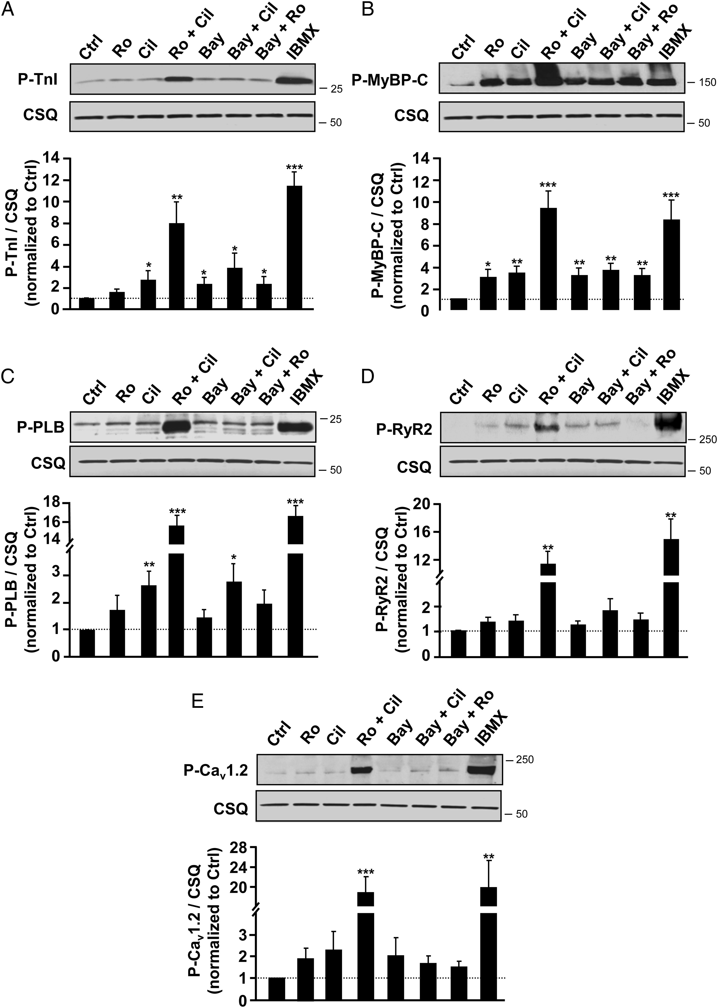
Figure 6 Effect of PDE inhibitors on phosphorylation of key ECC proteins in basal conditions. Unstimulated ARVMs were ...
Notes:
Figure 6 Effect of PDE inhibitors on phosphorylation of key ECC proteins in basal conditions. Unstimulated ARVMs were treated or not with Ro (10 µM), Cil (1 µM), Ro + Cil, Bay (0.1 µM), Bay + Cil, Bay + Ro, and IBMX (100 µM) as indicated for 15 min. Whole proteins were extracted and 50 µg of proteins were analysed by western blot using antibodies for phospho-TnI (P-TnI) (A), phospho-myosine-binding protein C (P-MyBP-C) (B), phospho-PLB (P-PLB) (C), phospho-ryanodine receptor (P-RyR2) (D), and phospho-CaV1.2 (E). The membranes were stripped and reprobed with CSQ antibodies used as a loading control. A representative blot is shown, and at least five separate experiments were performed (n = 6 for P-TnI, n = 5 for P-MyBP-C, n = 6 for P-PLB, n = 5 for P-RyR, and n = 5 for P-CaV1.2), giving similar results. Phosphorylated proteins/CSQ ratios were quantified, expressed as means ± SEM and normalized to untreated ARVMs (Ctrl). Statistical significance is indicated as: *P < 0.05; **P < 0.01; ***P < 0.001 (one-way ANOVA, Newman–Keuls).
Unless provided in the caption above, the following copyright applies to the content of this slide: Published on behalf of the European Society of Cardiology. All rights reserved. © The Author 2013. For permissions please email: journals.permissions@oup.com.

Slide 7
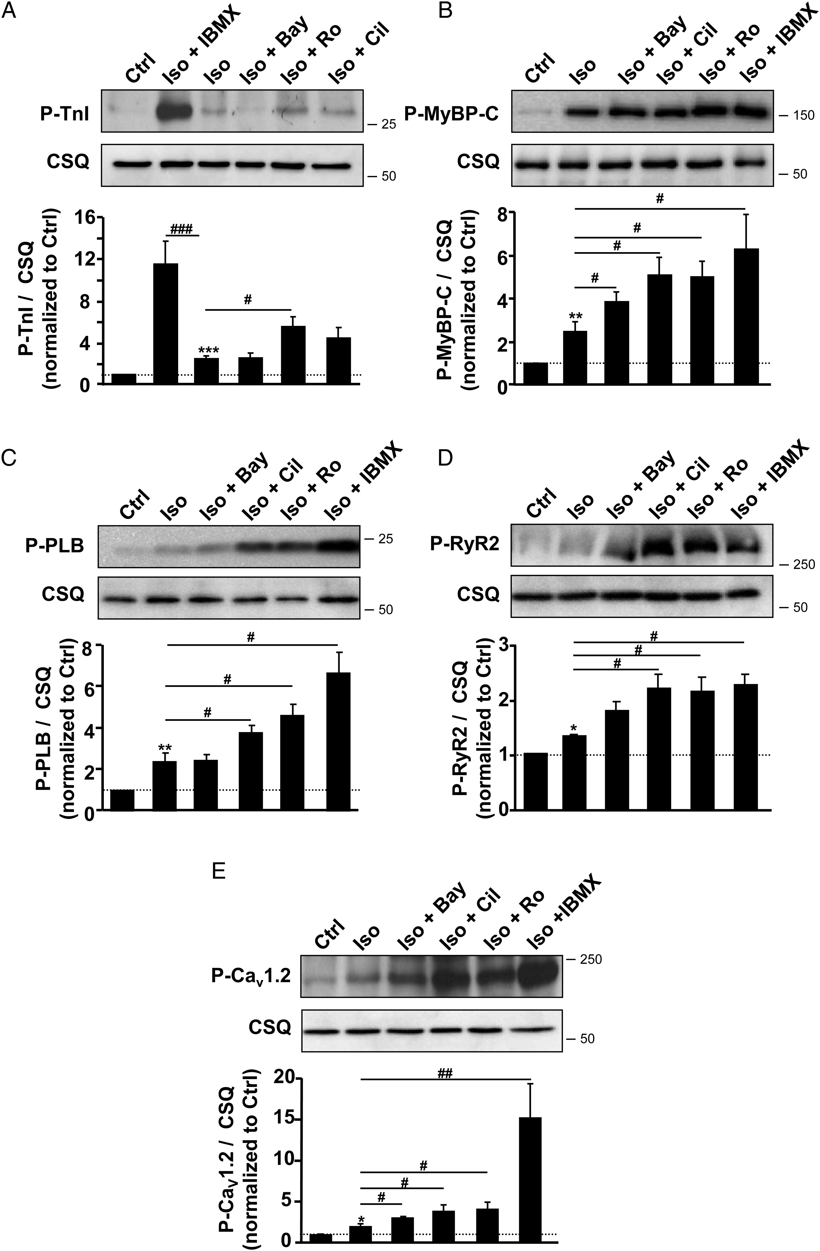
Figure 7 Effect of PDE inhibition on the phosphorylation of key ECC proteins under β-AR stimulation. ARVMs were ...
Notes:
Figure 7 Effect of PDE inhibition on the phosphorylation of key ECC proteins under β-AR stimulation. ARVMs were treated for 10 min with Iso (1 nM, Iso) followed by 10 min treatment with PDE inhibitors Bay (0.1 µM), Cil (1 µM), Ro (10 µM), or IBMX (100 µM). Representative western blots of cardiac myocyte lysates probed for phospho-TnI (P-TnI) (A), phospho-myosine-binding protein C (P-MyBP-C) (B), P-PLB (C), phospho-ryanodine receptor (P-RyR2) (D), and phospho-Cav1.2 (E). The membranes were stripped and reprobed with CSQ antibodies used as a loading control. A representative blot is shown, and at least five separate experiments were performed (n = 5 for P-TnI, n = 7 for P-MyBP-C, n = 6 for P-PLB, n = 6 for P-RyR, and n = 5 for P-CaV1.2), giving similar results. Phosphorylated proteins/CSQ ratios were quantified, expressed as means ± SEM, and normalized to untreated ARVMs (Ctrl). Statistical significance is indicated as: *P < 0.05; **P < 0.01; ***P < 0.001; and #P < 0.05; ##P < 0.01; ###P < 0.001 (one-way ANOVA, Newman–Keuls).
Unless provided in the caption above, the following copyright applies to the content of this slide: Published on behalf of the European Society of Cardiology. All rights reserved. © The Author 2013. For permissions please email: journals.permissions@oup.com.

