Slide 1
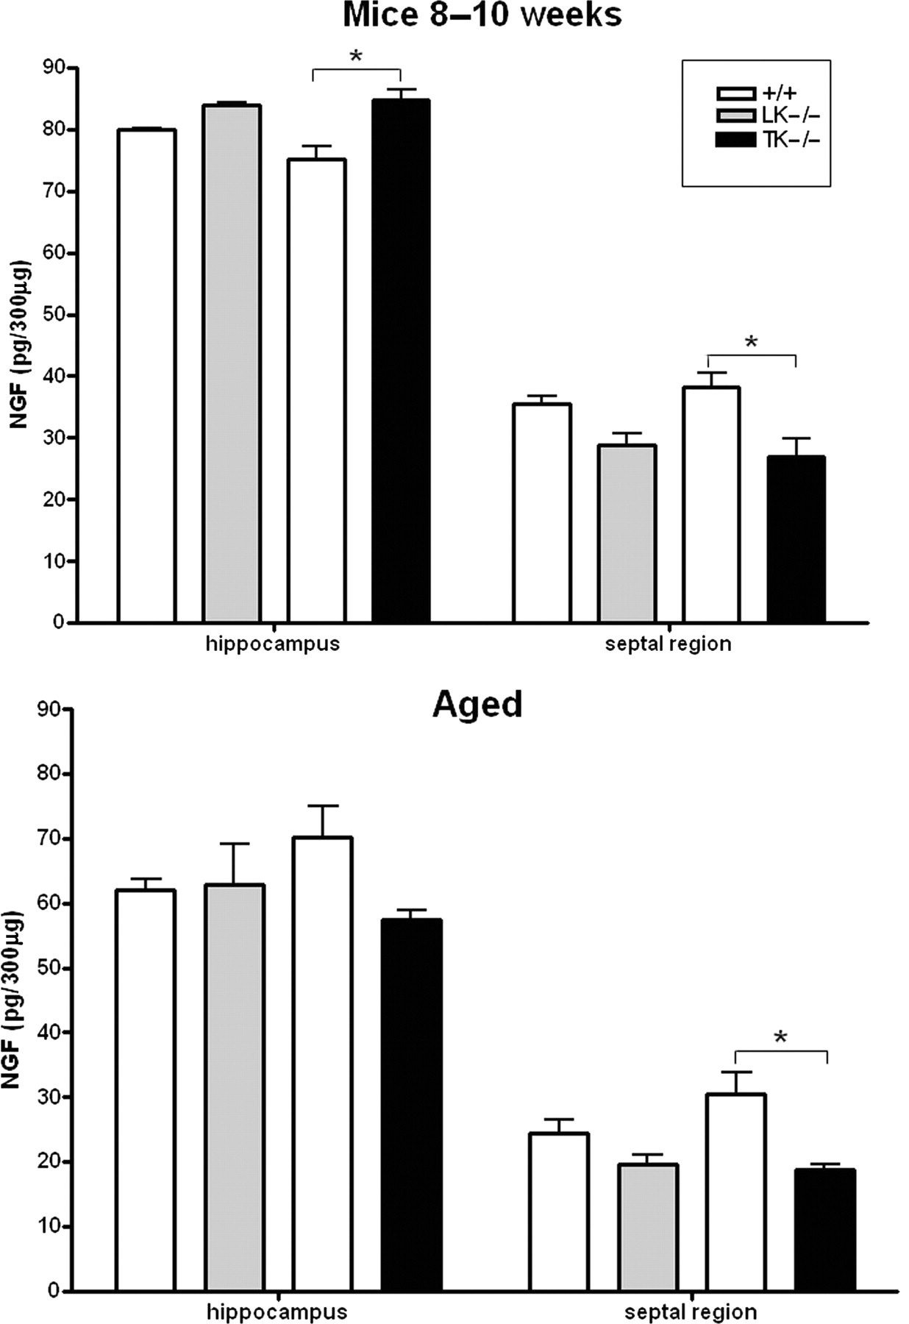
Figure 6. NGF levels are altered in Itsn1 null brains. NGF levels were quantified in either the hippocampus or septal ...
Notes:
Figure 6. NGF levels are altered in Itsn1 null brains. NGF levels were quantified in either the hippocampus or septal regions of the brain in young adult and in aged mice. Genotypes are as indicated. n = 3. NGF was significantly elevated in the hippocampus of younger Itsn1-TK mice (* P = 0.02) and significantly reduced in the septal regions of young and old Itsn1-TK mice (young, * P = 0.04; aged, * P = 0.03). Error bars are ±SEM.
Unless provided in the caption above, the following copyright applies to the content of this slide: © The Author 2008. Published by Oxford University Press. All rights reserved. For Permissions, please email: journals.permissions@oxfordjournals.org

