Slide 1
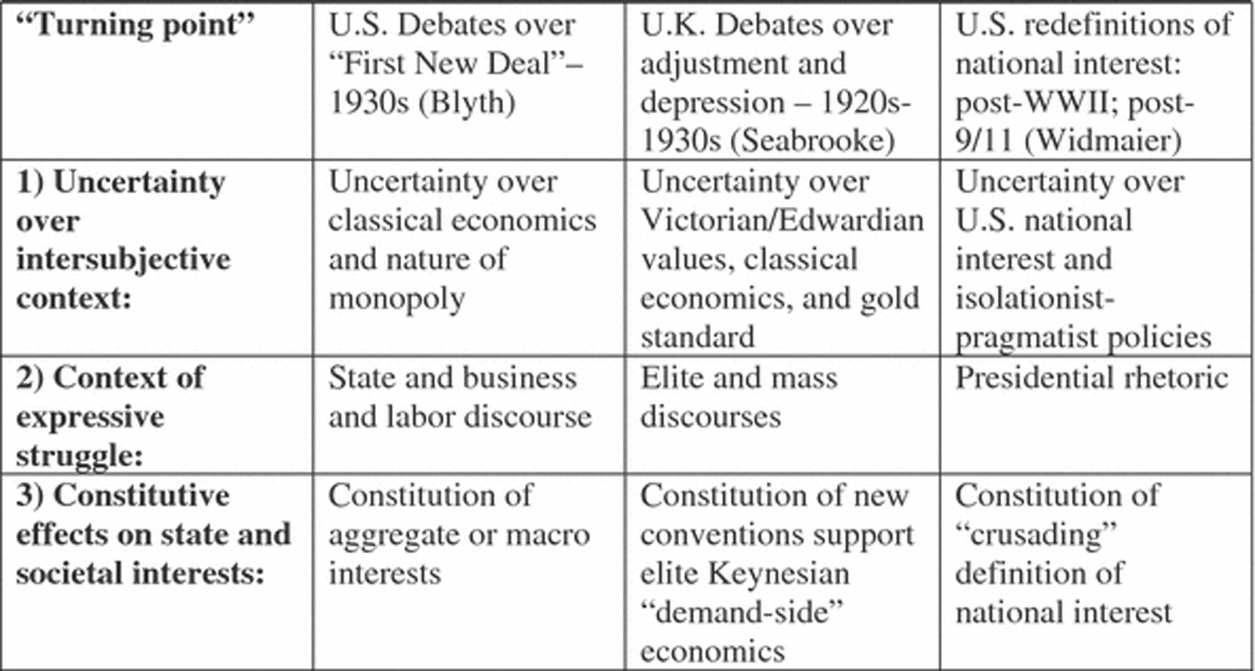
Fig. 1 International Turning Points: The Effects of Wars and Crises on State and Societal Interests.
Notes:
Fig. 1 International Turning Points: The Effects of Wars and Crises on State and Societal Interests.
Unless provided in the caption above, the following copyright applies to the content of this slide: © 2007 International Studies Association

