Slide 1
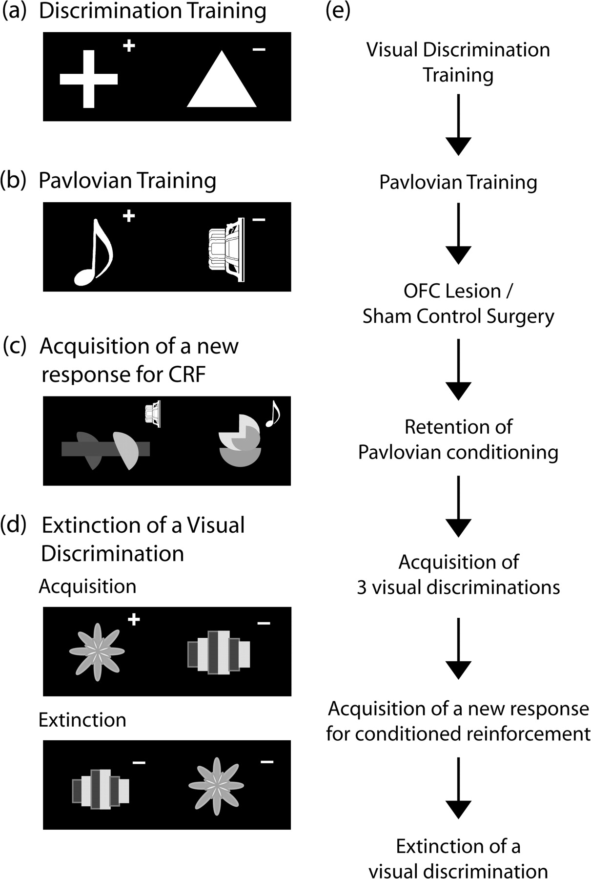
Figure 1. Task design. (a–d) Examples of the stimulus exemplars and the reward contingencies used for the various ...
Notes:
Figure 1. Task design. (a–d) Examples of the stimulus exemplars and the reward contingencies used for the various stages of the experiment. The real stimuli for the conditioned reinforcement (CRF) task and extinction were multicolored. The rewarded and unrewarded stimuli on each discrimination is indicated by the “+” and “−,” respectively. In (c) the “speaker” and “musical quaver” symbols represent, respectively, the white noise and tone (Pavlovian conditioned stimuli: CS+/CS−) that are presented upon response to the visual stimuli. The animals receive no primary reinforcement for responding to either visual stimulus in the CRF task. (e) A flow diagram depicting the stages of training both pre- and postsurgery.
Unless provided in the caption above, the following copyright applies to the content of this slide: © 2008 The AuthorsThis is an Open Access article distributed under the terms of the Creative Commons Attribution Non-Commercial License (http://creativecommons.org/licenses/by-nc/2.0/uk/) which permits unrestricted non-commercial use, distribution, and reproduction in any medium, provided the original work is properly cited.

Slide 2
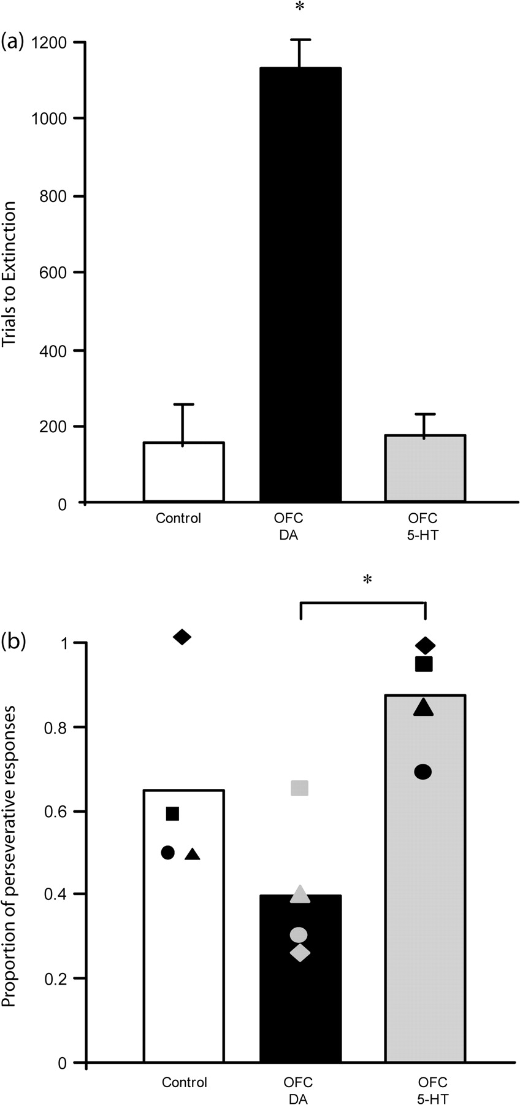
Figure 4. (a) Mean trials to extinction (±SEM) for control (n = 4), DA-depleted (n = 4), and 5-HT (n = 4) depleted ...
Notes:
Figure 4. (a) Mean trials to extinction (±SEM) for control (n = 4), DA-depleted (n = 4), and 5-HT (n = 4) depleted monkeys. *DA-depleted monkeys took significantly more trials to extinguish responding than control or 5-HT depleted monkeys, P < 0.01. (b) Proportion of responses in extinction which were classified as perseverative (individual data represented by the filled shapes). *5-HT depleted monkeys made a significantly higher proportion of perseverative responses to the previously rewarded stimulus than DA-depleted monkeys, P < 0.01.
Unless provided in the caption above, the following copyright applies to the content of this slide: © 2008 The AuthorsThis is an Open Access article distributed under the terms of the Creative Commons Attribution Non-Commercial License (http://creativecommons.org/licenses/by-nc/2.0/uk/) which permits unrestricted non-commercial use, distribution, and reproduction in any medium, provided the original work is properly cited.

Slide 3
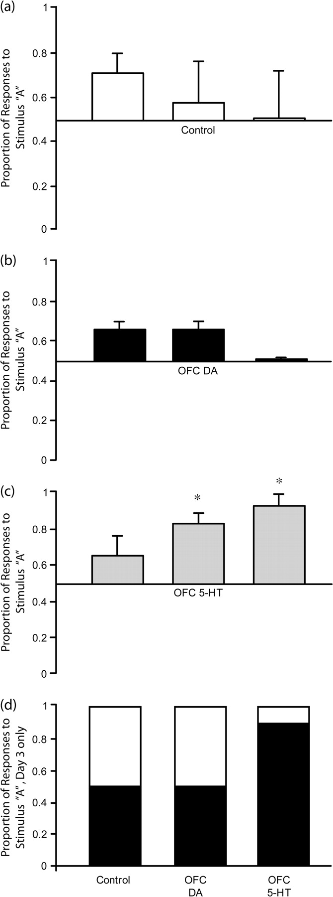
Figure 3. Mean proportion of responses made to stimulus “A” versus stimulus “B” on each of the 3 test days (±SEM) for ...
Notes:
Figure 3. Mean proportion of responses made to stimulus “A” versus stimulus “B” on each of the 3 test days (±SEM) for (a) control (n = 4), (b) DA-depleted (n = 4), and (c) 5-HT-depleted (n = 4) groups. Mean distribution of responses to stimulus “A” (black portion) and stimulus “B” (white portion) on the final test day is shown in (d). 5-HT depleted monkeys responded more to stimulus “A” than stimulus “B,” DA-depleted and control groups did not. *5-HT depleted monkeys responded more to stimulus “A” on days 2 and 3 than day 1, P = 0.01.
Unless provided in the caption above, the following copyright applies to the content of this slide: © 2008 The AuthorsThis is an Open Access article distributed under the terms of the Creative Commons Attribution Non-Commercial License (http://creativecommons.org/licenses/by-nc/2.0/uk/) which permits unrestricted non-commercial use, distribution, and reproduction in any medium, provided the original work is properly cited.

Slide 4
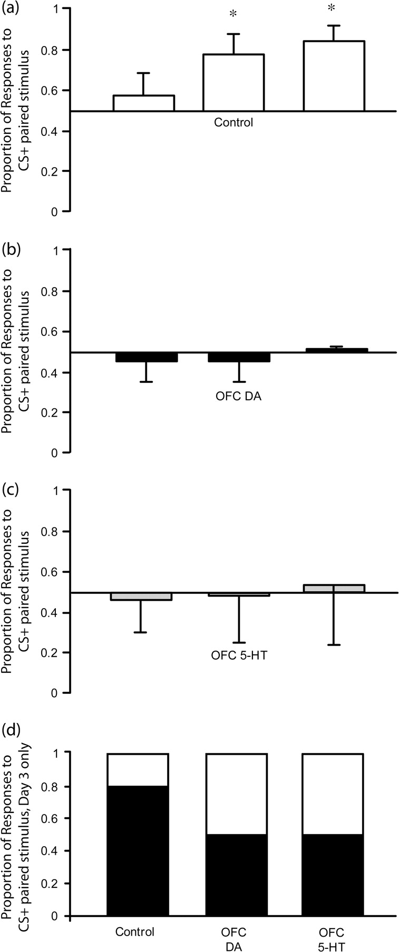
Figure 2. Mean proportion of responses made to the stimulus paired with the CS+ on each of the 3 test days (±SEM) for ...
Notes:
Figure 2. Mean proportion of responses made to the stimulus paired with the CS+ on each of the 3 test days (±SEM) for (a) control (n = 4), (b) DA-depleted (n = 4), and (c) 5-HT-depleted (n = 4) groups. Mean distribution of responses to stimulus paired with CS+ (black portion) and CS− (white portion) on the final test day is shown in (d). *Control monkeys responded significantly more to the stimulus paired with the CS+ on days 2 and 3 compared with day 1, P < 0.05 whilst 5-HT and DA-depleted monkeys did not.
Unless provided in the caption above, the following copyright applies to the content of this slide: © 2008 The AuthorsThis is an Open Access article distributed under the terms of the Creative Commons Attribution Non-Commercial License (http://creativecommons.org/licenses/by-nc/2.0/uk/) which permits unrestricted non-commercial use, distribution, and reproduction in any medium, provided the original work is properly cited.

