Slide 1
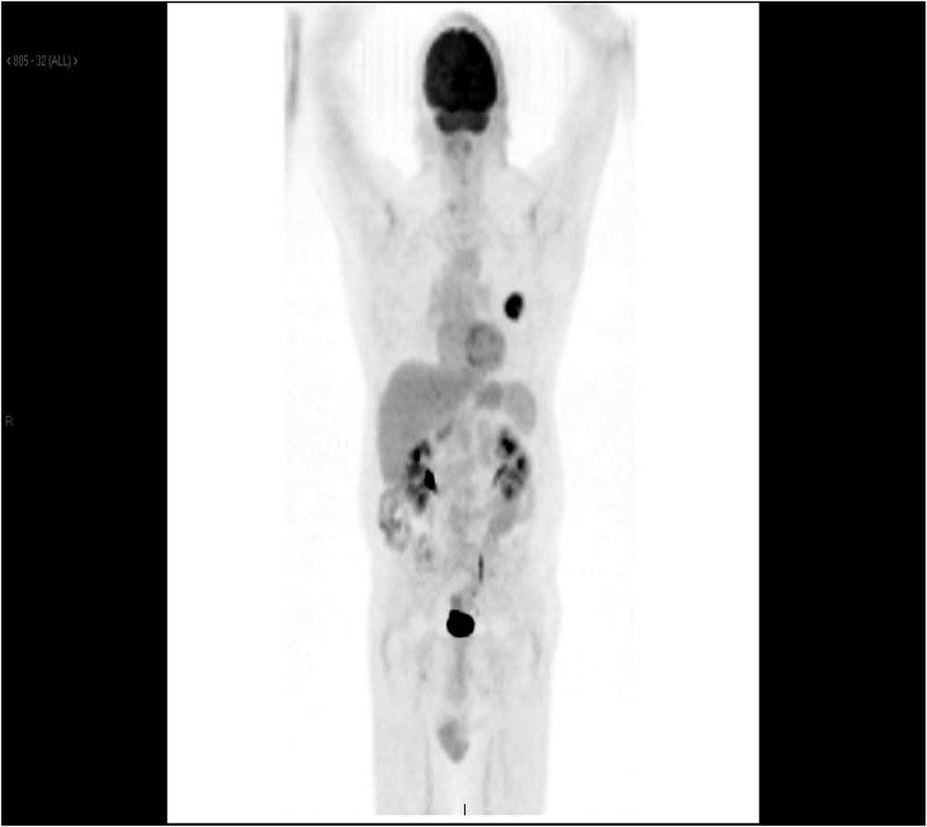
Figure 1: PET CT showing left lingular malignancy and no evidence of metastasis.
Notes:
Figure 1: PET CT showing left lingular malignancy and no evidence of metastasis.
Unless provided in the caption above, the following copyright applies to the content of this slide: Published by Oxford University Press and JSCR Publishing Ltd. All rights reserved. © The Author 2013.This is an Open Access article distributed under the terms of the Creative Commons Attribution License (http://creativecommons.org/licenses/by-nc/3.0/), which permits non-commercial use, distribution, and reproduction in any medium, provided the original work is properly cited. For commercial re-use, please contact journals.permissions@oup.com.

Slide 2
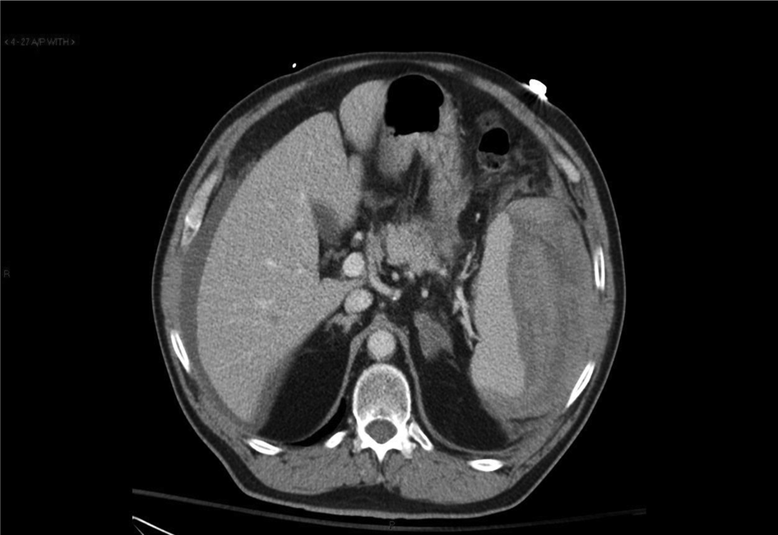
Figure 2: Atraumatic splenic rupture with hemoperitoneum.
Notes:
Figure 2: Atraumatic splenic rupture with hemoperitoneum.
Unless provided in the caption above, the following copyright applies to the content of this slide: Published by Oxford University Press and JSCR Publishing Ltd. All rights reserved. © The Author 2013.This is an Open Access article distributed under the terms of the Creative Commons Attribution License (http://creativecommons.org/licenses/by-nc/3.0/), which permits non-commercial use, distribution, and reproduction in any medium, provided the original work is properly cited. For commercial re-use, please contact journals.permissions@oup.com.

