Slide 1
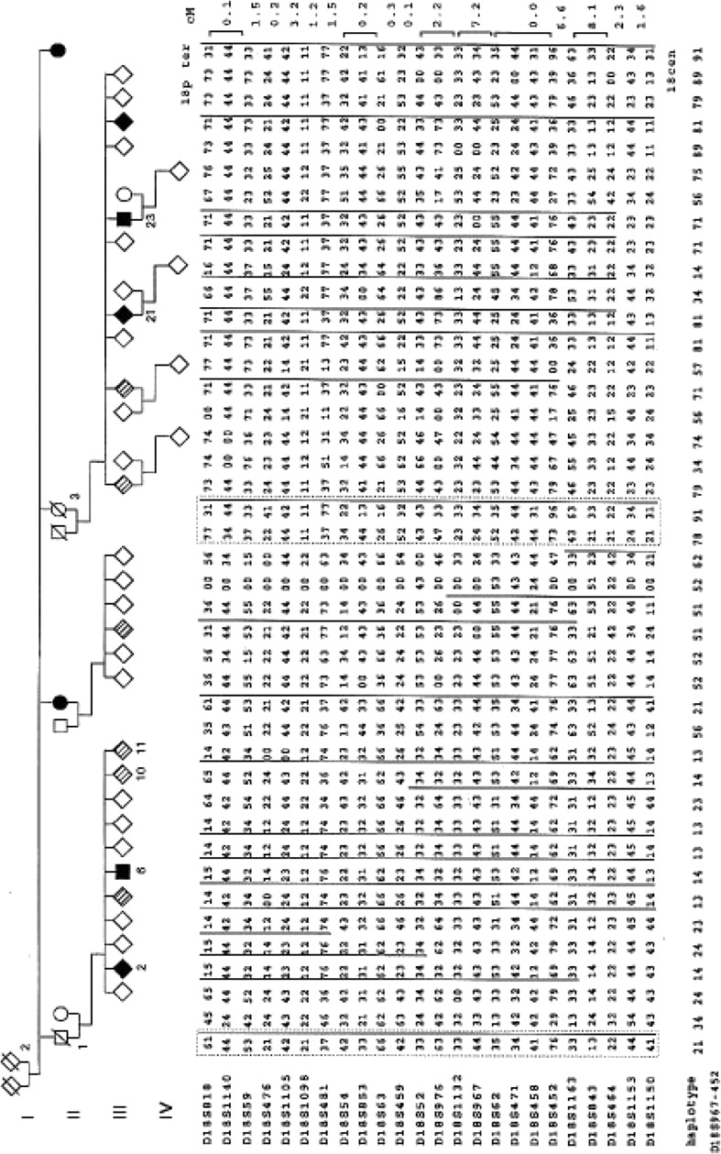
Figure 1 German pedigree with purely focal, adult onset ITD in seven definitely affected individuals, three obligate ...
Notes:
Figure 1 German pedigree with purely focal, adult onset ITD in seven definitely affected individuals, three obligate gene carriers and six possibly affected individuals. For the sake of anonymity, the sex was not always given. Definite dystonia is indicated by black symbols, possible dystonia in generation III by symbols with stripes. Four individuals in generation IV were typed for the sake of haplotype construction and have unknown affection status at ages <20 years. Individuals I.2, II1 and II.3 are obligate transmitters under the assumption of autosomal dominant inheritance. Individual haplotypes are shown, with paternal alleles written on the left. The designation 00 indicates that the marker was not run or did not work well in that individual. The distance in cM between the markers is shown on the right. The ancestral disease haplotype and its different parts in descendants are indicated by bars. Eight unaffected individuals at risk and one individual with unknown affection status contained parts of the disease haplotype. Reconstructed haplotypes are indicated by dotted frames.
Unless provided in the caption above, the following copyright applies to the content of this slide: © 1996 Oxford University Press

