Slide 1
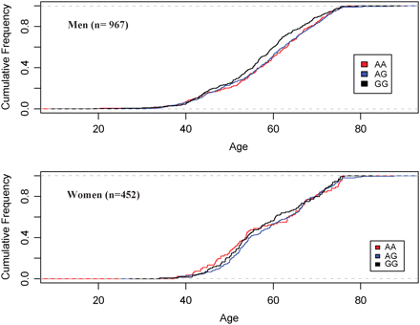
Figure 1. Distribution of age of onset of clinical coronary artery disease by genotype for rs10757278 combining young ...
Notes:
Figure 1. Distribution of age of onset of clinical coronary artery disease by genotype for rs10757278 combining young and old white, Hispanic, and East Asian cases, stratified by sex.
Unless provided in the caption above, the following copyright applies to the content of this slide: © The Author 2008. Published by Oxford University Press. All rights reserved. For Permissions, please email: journals.permissions@oxfordjournals.org

