Slide 1
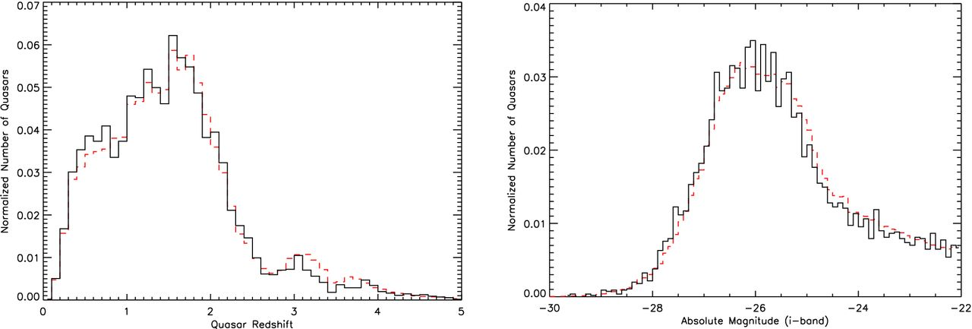
Figure 1. Number distributions of the 5550 SDSS DR7 quasars with repeat observations as a function of quasar redshift ...
Notes:
Figure 1. Number distributions of the 5550 SDSS DR7 quasars with repeat observations as a function of quasar redshift (left-hand panel: zqso) and i-band absolute magnitude (right-hand: Mi). The bin size is 0.1, and the y-axis is normalized to enable comparison with the entire DR7 quasar catalogue (dashed red line; Schneider et al. 2010). The shape of both histograms closely matches, suggesting that the sample of quasars with repeat observations is unbiased with respect to the full SDSS DR7 quasar sample.
Unless provided in the caption above, the following copyright applies to the content of this slide: Published by Oxford University Press on behalf of the Royal Astronomical Society. This work is written by US Government employees and is in the public domain in the US.

Slide 2
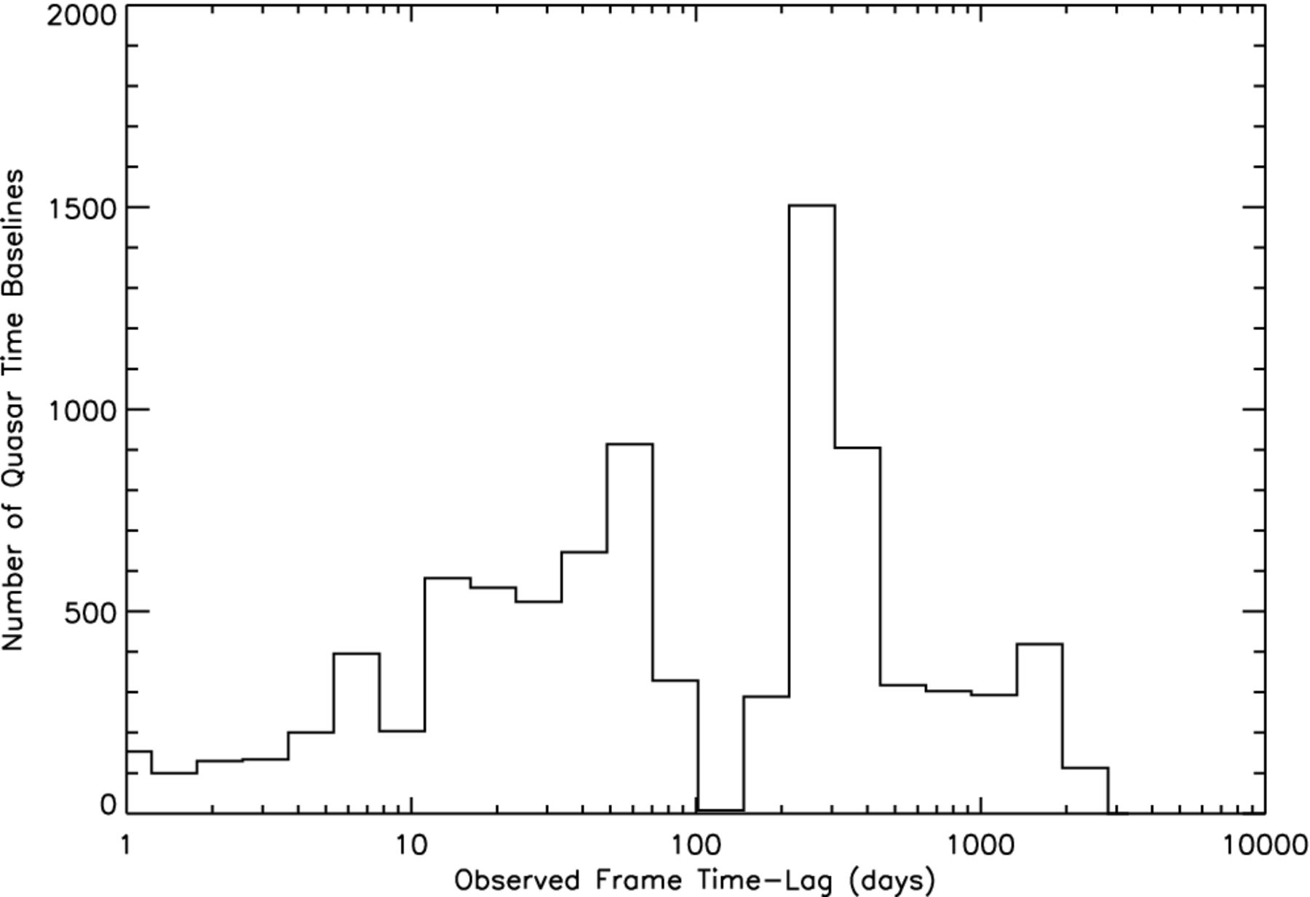
Figure 2. Number distribution of the 9021 time baselines for the 5550 SDSS DR7 quasars with repeat observations as a ...
Notes:
Figure 2. Number distribution of the 9021 time baselines for the 5550 SDSS DR7 quasars with repeat observations as a function of observed frame time between observations (Δtobs). A logarithmic scale is used for the x-axis due to the large range of time separations spanning days to years. Although 30 per cent of the repeat observations are separated by less than one month, the FITS file headers indicate that none of the spectra have been co-added.
Unless provided in the caption above, the following copyright applies to the content of this slide: Published by Oxford University Press on behalf of the Royal Astronomical Society. This work is written by US Government employees and is in the public domain in the US.

Slide 3
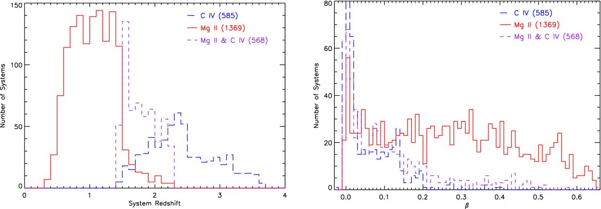
Figure 3. The absorption system redshift (left-hand panel: z_{abs}) and β (right-hand) distributions of the ...
Notes:
Figure 3. The absorption system redshift (left-hand panel: zabs) and β (right-hand) distributions of the 2522 SDSS DR7 QAL systems with repeat observations. The bin sizes are 0.1 and 0.01, respectively, and the y-axis range on the right-hand panel is truncated to more clearly show the trends for all system classifications (the peak of the C iv line is 191 systems at 0 ≤ β < 0.01). The Mg ii and C iv system redshift distributions are determined by the quasar redshift distribution and the redshift ranges where these doublets are longward of the Lyα forest and shifted to optical wavelengths. The β distributions reflect the typical environments where different ionization species are found.
Unless provided in the caption above, the following copyright applies to the content of this slide: Published by Oxford University Press on behalf of the Royal Astronomical Society. This work is written by US Government employees and is in the public domain in the US.

Slide 4
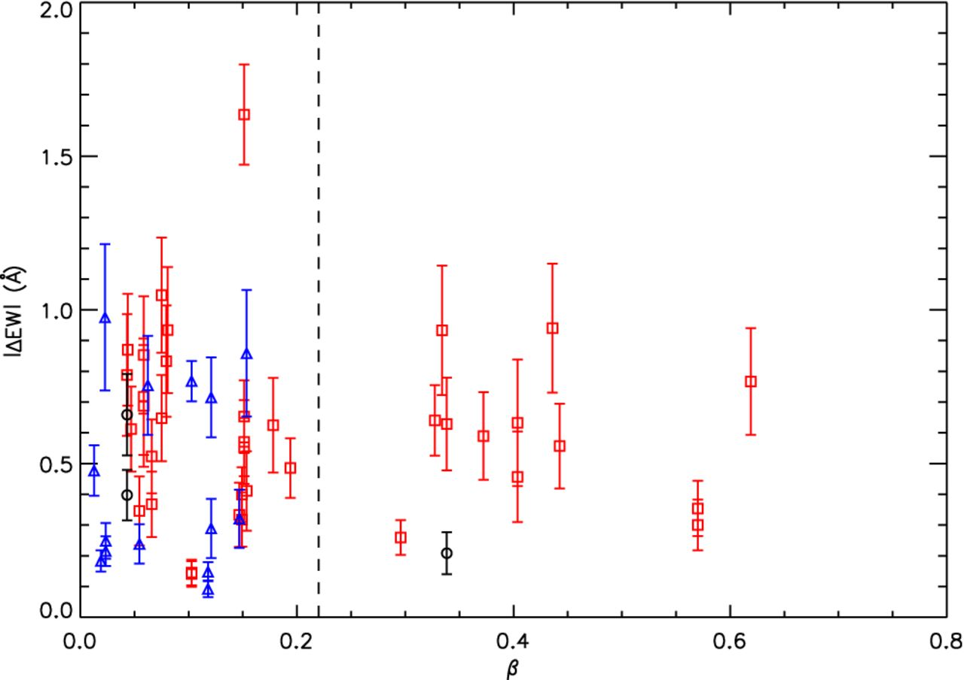
Figure 4. The absolute change in EW (|ΔEW|) versus β for our sample of significantly variable absorption lines. ...
Notes:
Figure 4. The absolute change in EW (|ΔEW|) versus β for our sample of significantly variable absorption lines. Different lines with the same β are from the same NAL system. The 13 lines from 10 intervening systems with β > 0.22 are all low-ionization lines since any high-ionization lines are shifted into the Lyα forest at these β values. The 41 lines from the remaining 23 NAL systems have a mix of ionization states due to the extreme environment close to the background quasar and the higher redshifts of these systems (see Fig. 9).
Unless provided in the caption above, the following copyright applies to the content of this slide: Published by Oxford University Press on behalf of the Royal Astronomical Society. This work is written by US Government employees and is in the public domain in the US.

Slide 5
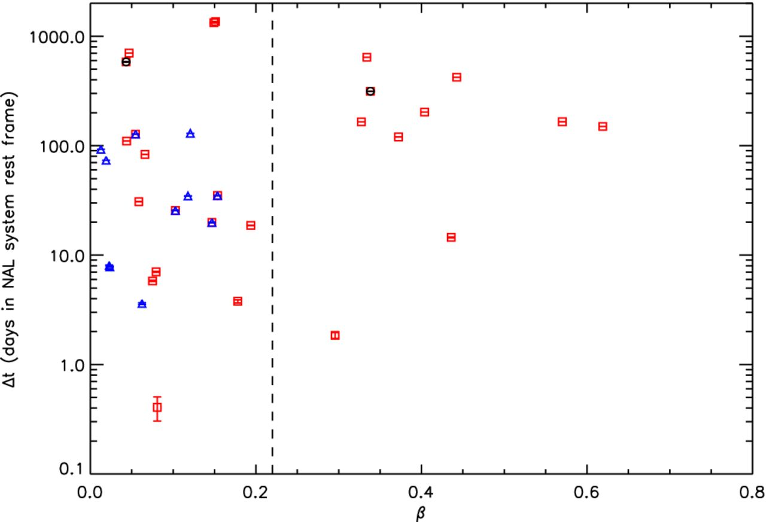
Figure 5. The rest-frame time between observations (Δt_{r}) versus β for the significantly variable absorption ...
Notes:
Figure 5. The rest-frame time between observations (Δtr) versus β for the significantly variable absorption lines in our sample. A logarithmic scale is used for the y-axis due to the large range of time separations spanning days to years, and we divide our sample into intervening and low-β systems at β = 0.22. The points are scattered in both the high and low-β regimes meaning that there is no obvious dependence between Δtr and β.
Unless provided in the caption above, the following copyright applies to the content of this slide: Published by Oxford University Press on behalf of the Royal Astronomical Society. This work is written by US Government employees and is in the public domain in the US.

Slide 6
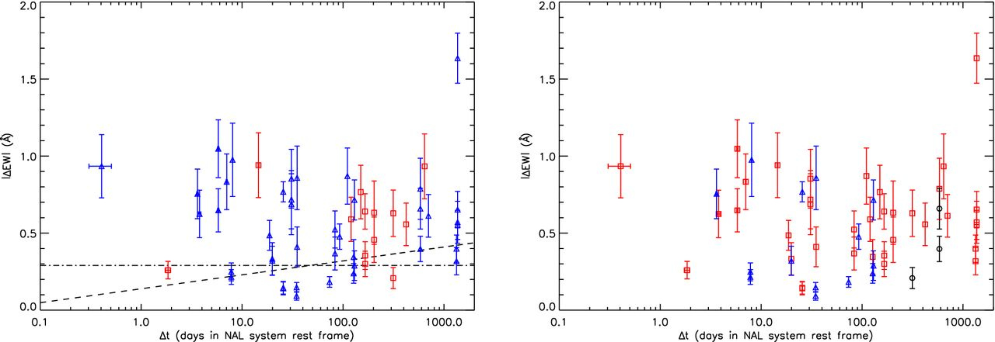
Figure 6. The absolute change in EW (|ΔEW|) versus the rest-frame time between observations (Δt_{r}) for the ...
Notes:
Figure 6. The absolute change in EW (|ΔEW|) versus the rest-frame time between observations (Δtr) for the significantly variable absorption lines in our sample. A logarithmic scale is used for the x-axis due to the large range of time separations spanning days to years. In the left-hand panel, the points are colour-coded by β (high-β: red squares; low-β: blue triangles) with log-linear (dashed) and zero-slope (dot–dashed) best-fitting lines to all points. These fits indicate no dependence between ΔEW and Δtr, which suggests that some of the absorbing gas clouds may be comprised of small-scale structures. In the right-hand panel, the lines from a wide range of ions are scattered at all values of ΔEW and Δtr, which again suggests that the sample is unbiased.
Unless provided in the caption above, the following copyright applies to the content of this slide: Published by Oxford University Press on behalf of the Royal Astronomical Society. This work is written by US Government employees and is in the public domain in the US.

Slide 7
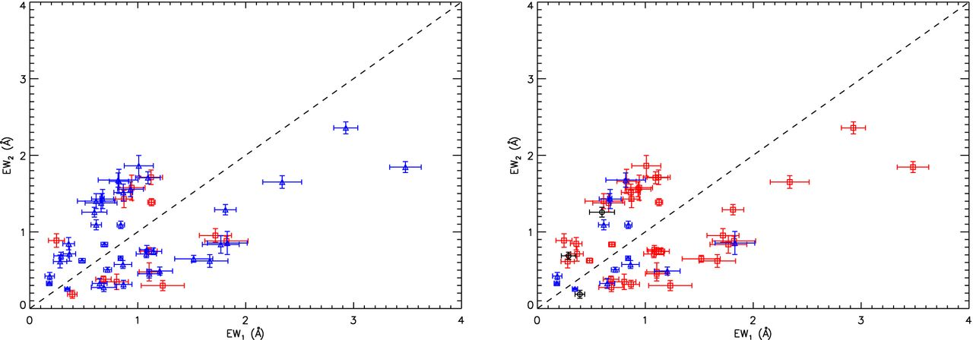
Figure 7. The first (EW₁) and second (EW₂) epoch EW measurements for the significantly variable ...
Notes:
Figure 7. The first (EW1) and second (EW2) epoch EW measurements for the significantly variable absorption lines in our sample. In the left-hand panel, both the intervening (β > 0.22; red squares) and low-β systems (blue triangles) have similar numbers of lines above (26) and below (28) the EW1 = EW2 line, which suggests that an absorption line is just as likely to get weaker as it is to get stronger between observations. In the right-hand panel, all absorption lines are scattered around the EW1 = EW2 line. The exception is Mg ii with three outlying points with EW1 > EW2 that are biased due to saturation.
Unless provided in the caption above, the following copyright applies to the content of this slide: Published by Oxford University Press on behalf of the Royal Astronomical Society. This work is written by US Government employees and is in the public domain in the US.

Slide 8
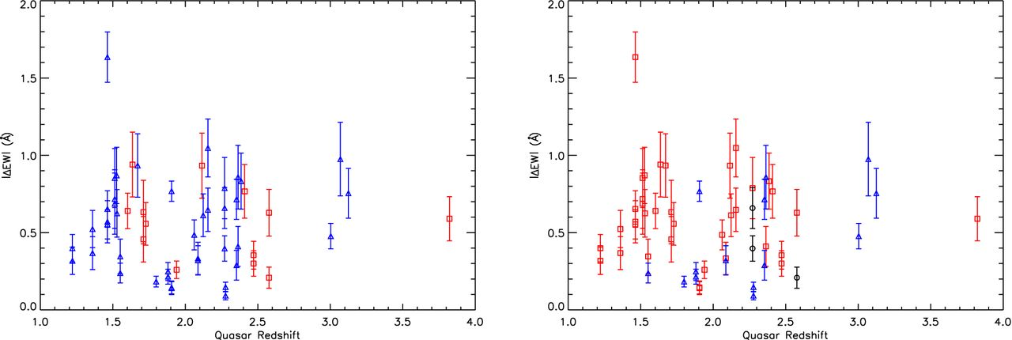
Figure 8. The absolute change in EW (|ΔEW|) versus quasar redshift (z_{qso}) for the significantly variable ...
Notes:
Figure 8. The absolute change in EW (|ΔEW|) versus quasar redshift (zqso) for the significantly variable absorption lines in our sample. Although the points in the left-hand panel (high-β systems: red squares; low-β systems: blue triangles) are scattered indicating that absorption line variability does not depend on zqso, the overall distribution is slightly biased towards higher redshift compared to all SDSS DR7 quasars with repeat observations (see Fig. 1) because the UV absorption lines in quasars at lower zqso are not shifted into the optical range of the SDSS spectrographs. In the right-hand panel, the high-ionization and minor lines have a higher average zqso compared to the low-ionization lines because their rest wavelengths require higher zqso for detection by the SDSS spectrographs.
Unless provided in the caption above, the following copyright applies to the content of this slide: Published by Oxford University Press on behalf of the Royal Astronomical Society. This work is written by US Government employees and is in the public domain in the US.

Slide 9
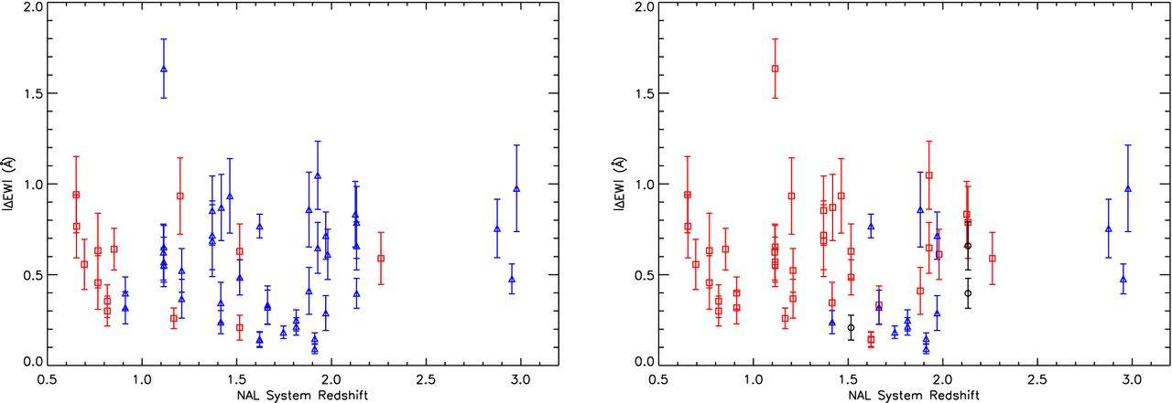
Figure 9. The absolute change in EW (|ΔEW|) versus NAL system redshift (z_{abs}) for the significantly variable ...
Notes:
Figure 9. The absolute change in EW (|ΔEW|) versus NAL system redshift (zabs) for the significantly variable absorption lines in our sample. The points in the left-hand panel (high-β systems: red squares; low-β systems: blue triangles) are scattered, which confirms that there is no clear dependence between |ΔEW| and zabs. In the right-hand panel, there is a higher occurrence of low-ionization lines at lower zabs and high-ionization and minor lines at higher zabs due to the observable redshift window in SDSS quasar spectra.
Unless provided in the caption above, the following copyright applies to the content of this slide: Published by Oxford University Press on behalf of the Royal Astronomical Society. This work is written by US Government employees and is in the public domain in the US.

Slide 10
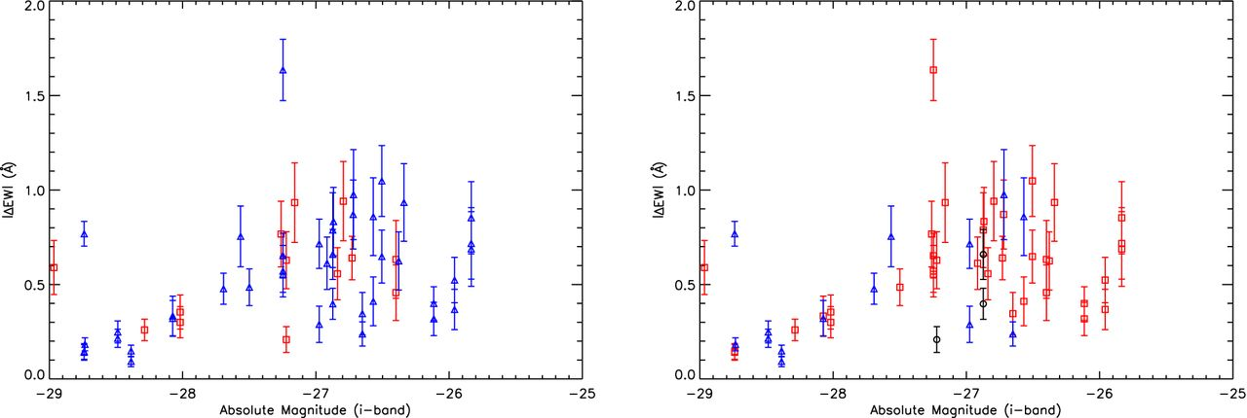
Figure 10. The absolute change in EW (|ΔEW|) versus i-band absolute magnitude (M_{i}) for the significantly ...
Notes:
Figure 10. The absolute change in EW (|ΔEW|) versus i-band absolute magnitude (Mi) for the significantly variable absorption lines in our sample. For systems with Mi > −28, the points in the left-hand panel are scattered with no dependence between variability, quasar luminosity or β (high-β systems: red squares; low-β systems: blue triangles). The apparent bias of points towards lower quasar luminosity is a selection effect caused by the peak in the distribution of SDSS DR7 quasars with repeat observations at −27 < Mi < −25 (see Fig. 1). In the right-hand panel, the high-ionization and minor lines are found in the brighter quasar spectra compared to low-ionization lines for two reasons: these lines must be at higher redshift to be shifted to the optical range of the SDSS spectrographs, and higher redshift quasars are preferentially brighter due to the flux limit of the survey.
Unless provided in the caption above, the following copyright applies to the content of this slide: Published by Oxford University Press on behalf of the Royal Astronomical Society. This work is written by US Government employees and is in the public domain in the US.

Slide 11
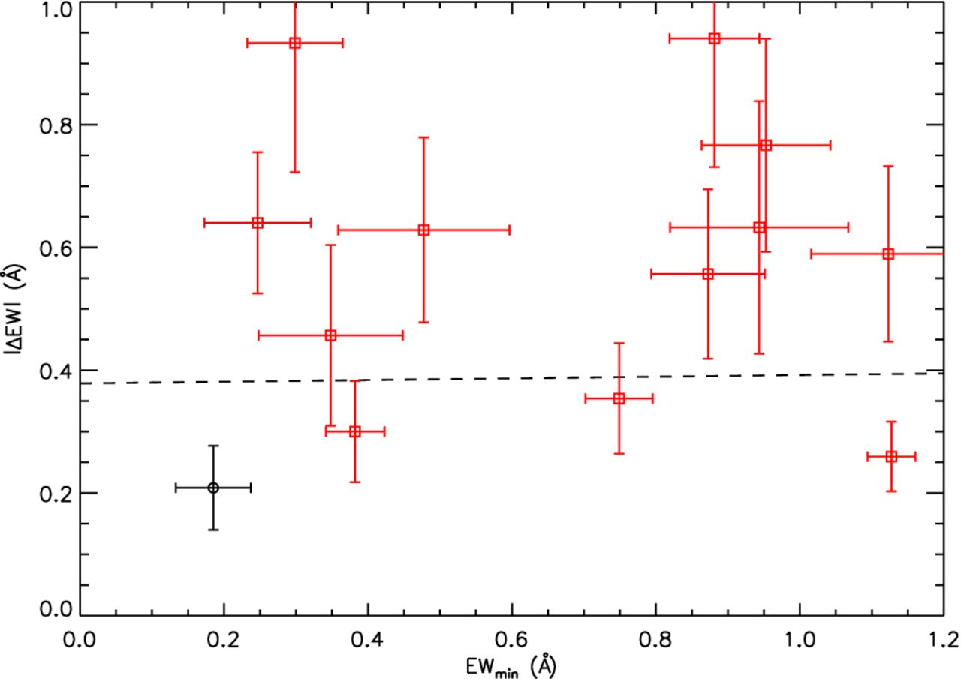
Figure 11. The absolute change in EW (|ΔEW|) versus the minimum EW (EW_{min}) for our sample of significantly ...
Notes:
Figure 11. The absolute change in EW (|ΔEW|) versus the minimum EW (EWmin) for our sample of significantly variable IALs. The best-fitting line (dashed black) implies that there is no strong dependence between variability and line strength.
Unless provided in the caption above, the following copyright applies to the content of this slide: Published by Oxford University Press on behalf of the Royal Astronomical Society. This work is written by US Government employees and is in the public domain in the US.

Slide 12
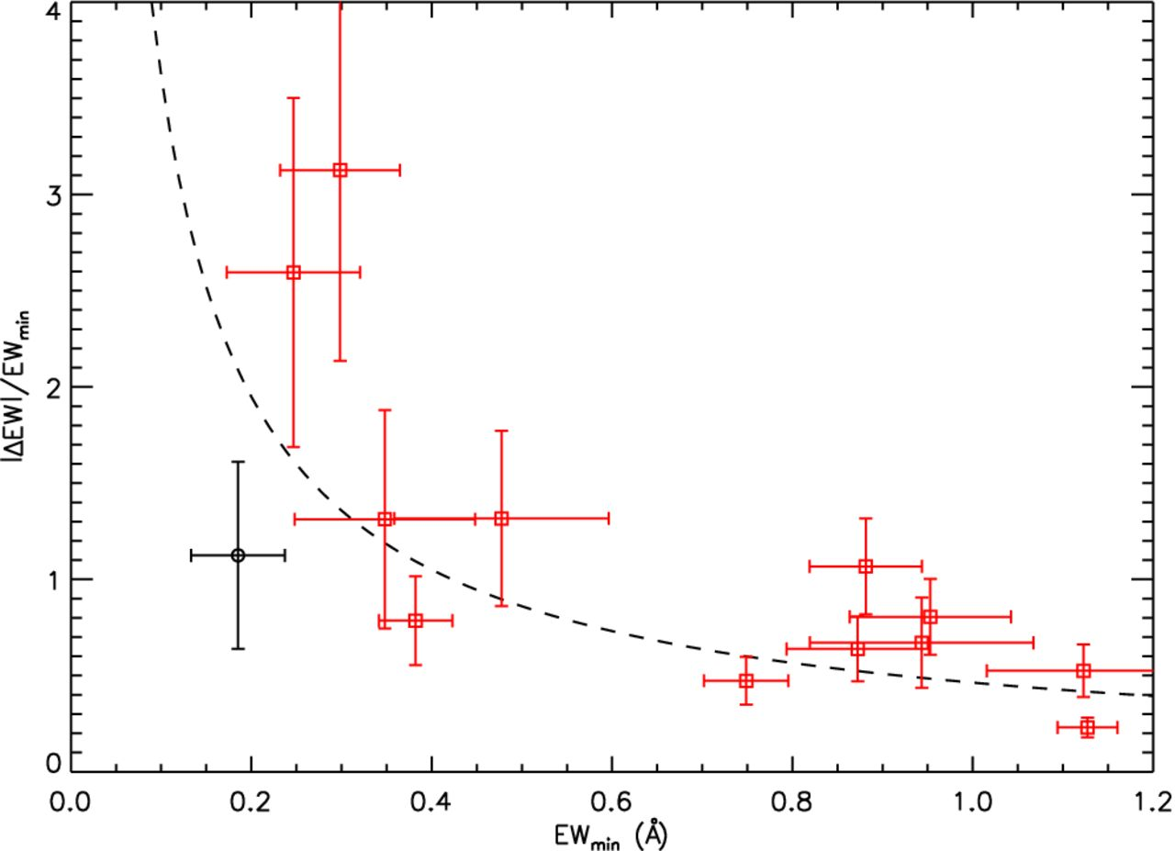
Figure 12. The absolute fractional change in EW (|ΔEW|/EW_{min}) versus the minimum EW (EW_{min}) for ...
Notes:
Figure 12. The absolute fractional change in EW (|ΔEW|/EWmin) versus the minimum EW (EWmin) for our sample of significantly variable IALs. The best-fitting line (dashed black) shows that weaker lines have higher fractional variability in agreement with previous BAL variability studies.
Unless provided in the caption above, the following copyright applies to the content of this slide: Published by Oxford University Press on behalf of the Royal Astronomical Society. This work is written by US Government employees and is in the public domain in the US.

Slide 13
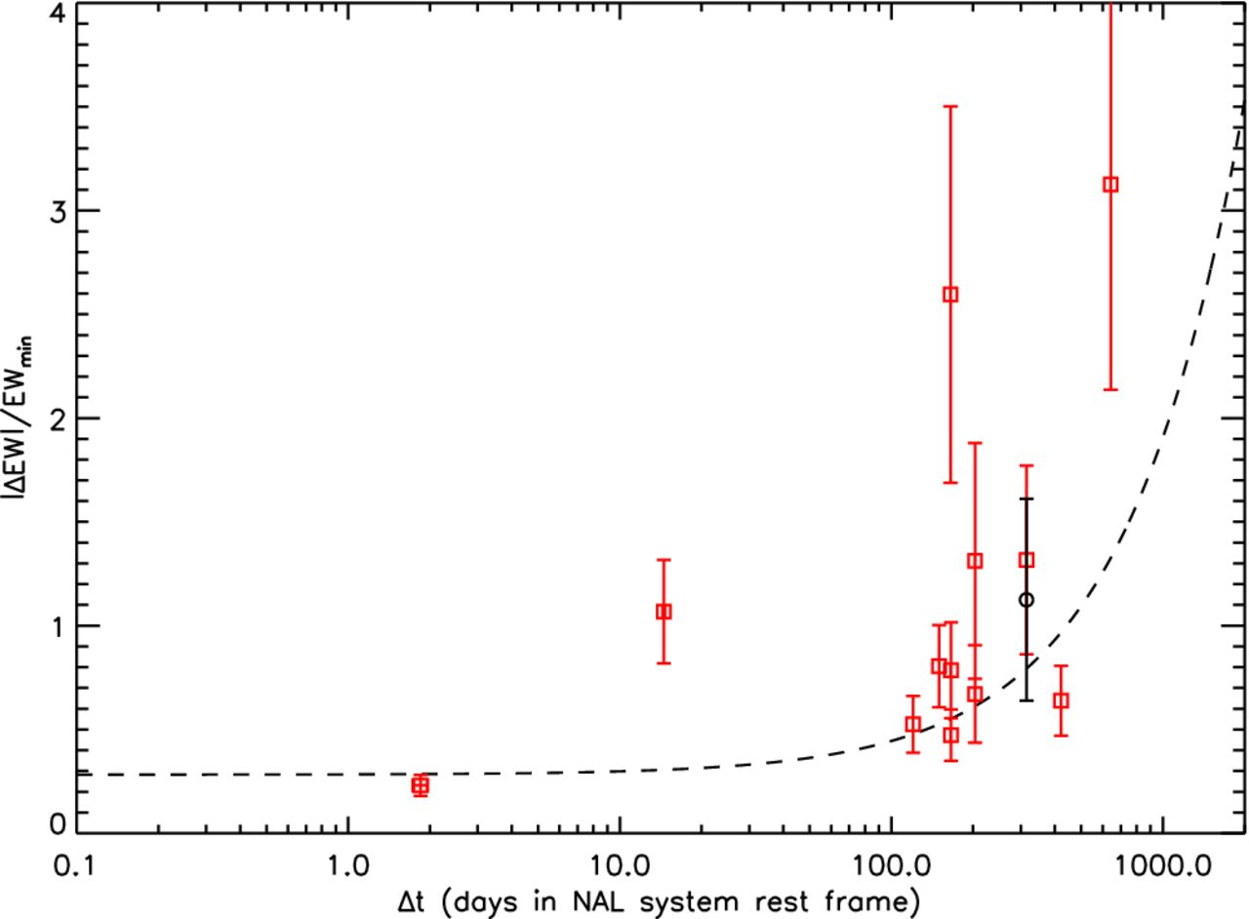
Figure 13. The absolute fractional change in EW (|ΔEW|/EW_{min}) versus the rest-frame time between observations ...
Notes:
Figure 13. The absolute fractional change in EW (|ΔEW|/EWmin) versus the rest-frame time between observations (Δtr) for our sample of significantly variable IALs. A logarithmic scale is used for the x-axis due to the large range of time separations spanning days to years. The slope of the best-fitting line (dashed black) indicates that IALs have bigger fractional changes over longer time periods.
Unless provided in the caption above, the following copyright applies to the content of this slide: Published by Oxford University Press on behalf of the Royal Astronomical Society. This work is written by US Government employees and is in the public domain in the US.

Slide 14
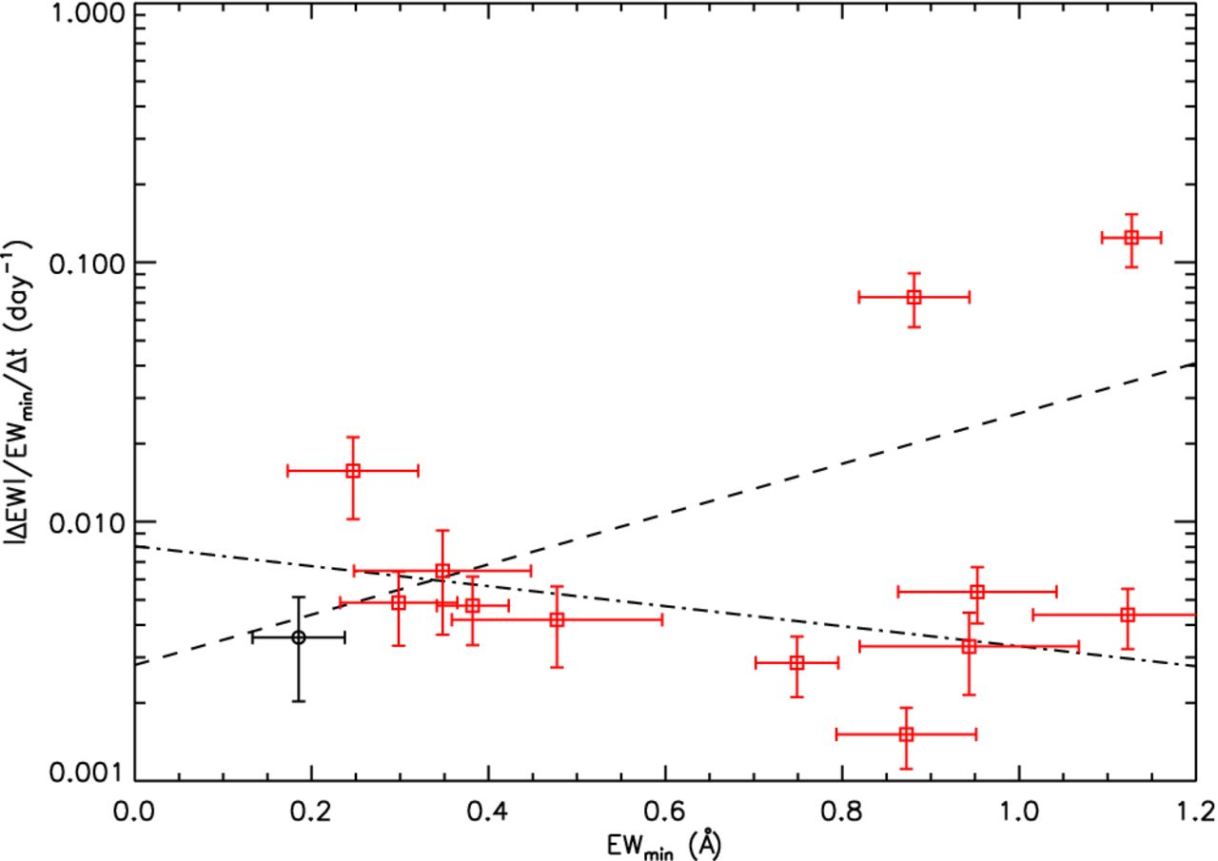
Figure 14. The absolute rate of fractional change in EW (|ΔEW|/EW_{min}/Δt_{r}) versus the minimum EW ...
Notes:
Figure 14. The absolute rate of fractional change in EW (|ΔEW|/EWmin/Δtr) versus the minimum EW (EWmin) for our sample of significantly variable IALs. A logarithmic scale is used for the y-axis due to the large range of time separations spanning days to years. Excluding the two lines with the highest rate of change gives an improved fit (dot-dashed black line) to the remaining 11 points and appears to show that weaker variable absorption lines have a faster rate of variability.
Unless provided in the caption above, the following copyright applies to the content of this slide: Published by Oxford University Press on behalf of the Royal Astronomical Society. This work is written by US Government employees and is in the public domain in the US.

Slide 15
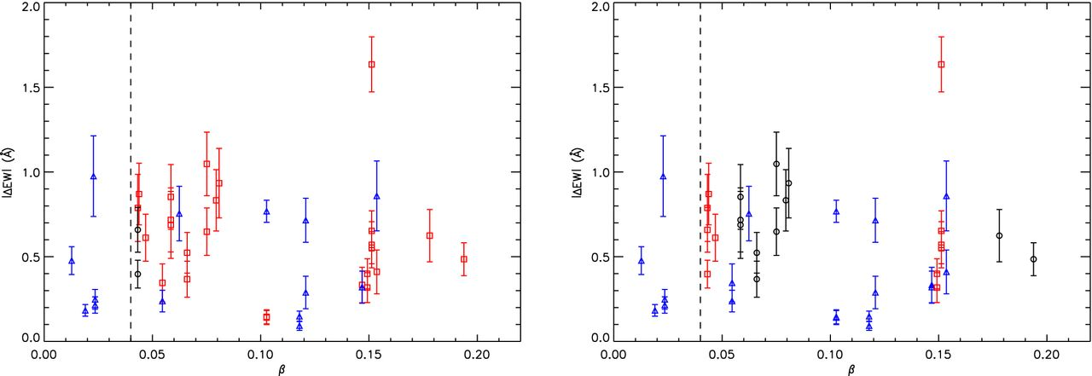
Figure 15. The absolute change in EW (|ΔEW|) versus β for our sample of significantly variable low-β absorption lines. ...
Notes:
Figure 15. The absolute change in EW (|ΔEW|) versus β for our sample of significantly variable low-β absorption lines. Different absorption lines with the same β are from the same NAL system. The dashed line at β < 0.04 is the nominal cut-off between associated and intrinsic/intervening NAL systems (Wild et al. 2008). However, the existence of variable high-ionization lines in the left-hand panel at a wide range of β values suggests that a simple β cut is insufficient to distinguish between intrinsic, associated and intervening NAL systems. In the right-hand panel and Figs 16–19, all of the systems with doubly and triply ionized lines are grouped in a sub-sample of intrinsic NAL systems (blue triangles). The other two groups are comprised of systems with variable low-ionization lines and are divided into sub-samples with Δtr > 100 d (red squares) and Δtr < 100 d (black circles).
Unless provided in the caption above, the following copyright applies to the content of this slide: Published by Oxford University Press on behalf of the Royal Astronomical Society. This work is written by US Government employees and is in the public domain in the US.

Slide 16
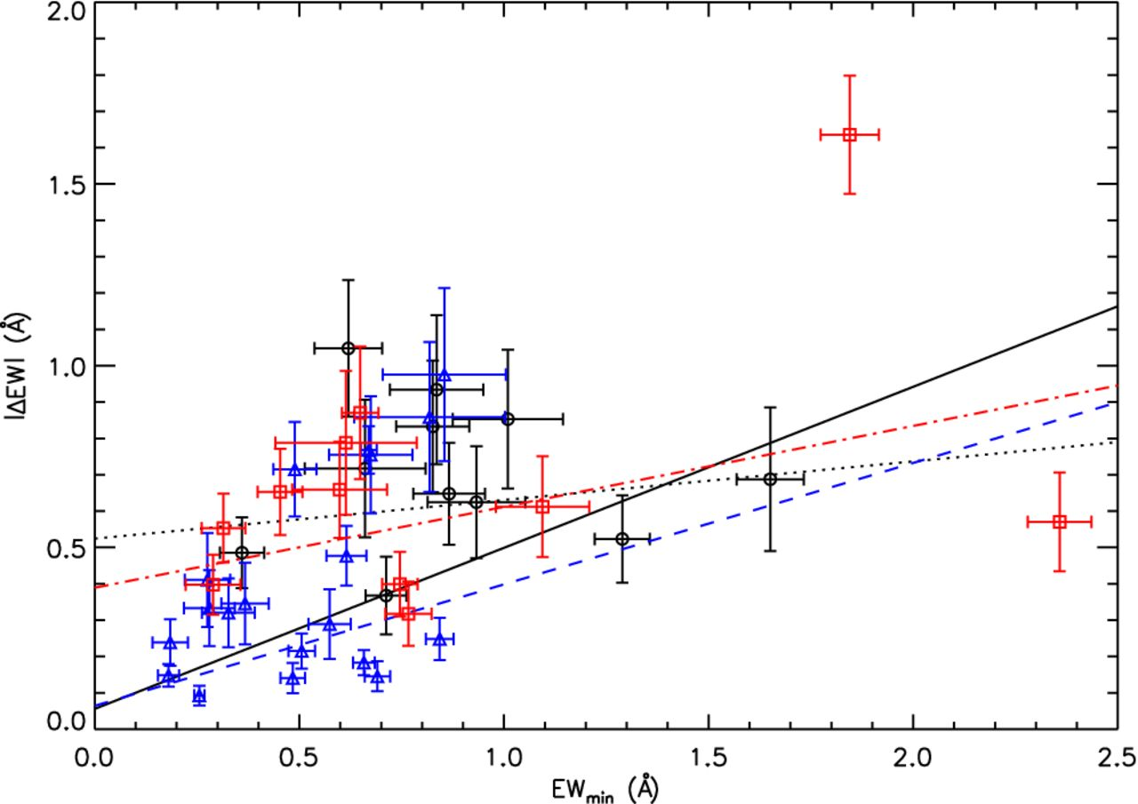
Figure 16. The absolute change in EW (|ΔEW|) versus the minimum EW (EW_{min}) for our sample of significantly ...
Notes:
Figure 16. The absolute change in EW (|ΔEW|) versus the minimum EW (EWmin) for our sample of significantly variable low-β absorption lines. The slope of the best-fitting line (solid black) to all points indicates that the amount of absorption line variability increases with line strength. Fits to the three sub-samples imply that they all are increasingly contaminated by intervening systems.
Unless provided in the caption above, the following copyright applies to the content of this slide: Published by Oxford University Press on behalf of the Royal Astronomical Society. This work is written by US Government employees and is in the public domain in the US.

Slide 17
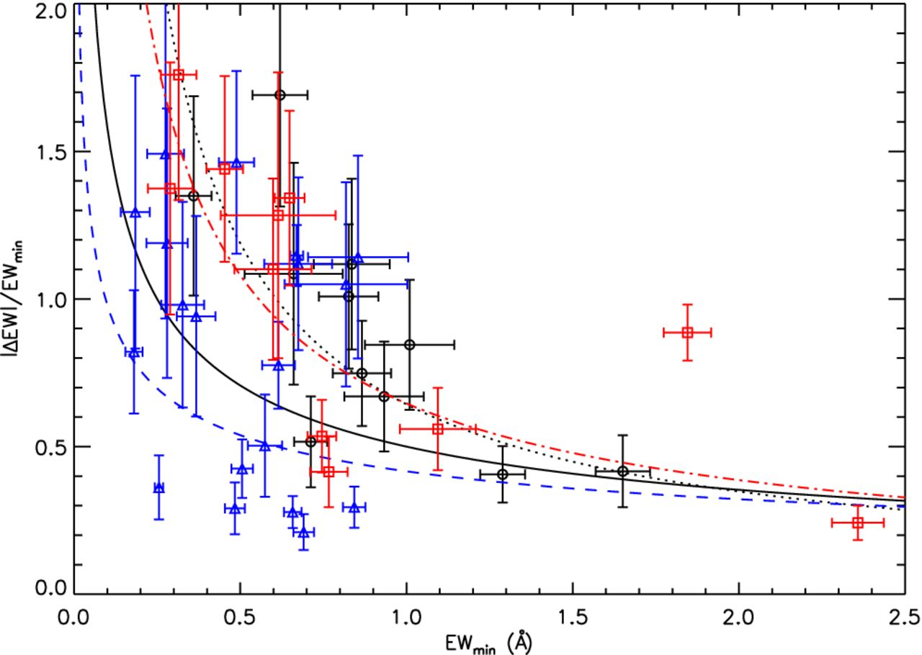
Figure 17. The absolute fractional change in EW (|ΔEW|/EW_{min}) versus the minimum EW (EW_{min}) for ...
Notes:
Figure 17. The absolute fractional change in EW (|ΔEW|/EWmin) versus the minimum EW (EWmin) for our sample of significantly variable low-β absorption lines. As showed by the over-plotted best-fitting lines for the entire sample (solid black line) and each sub-sample, these points appear to show increasing fractional changes in weaker lines although the pattern is less pronounced compared to the high-β systems (see Fig. 12).
Unless provided in the caption above, the following copyright applies to the content of this slide: Published by Oxford University Press on behalf of the Royal Astronomical Society. This work is written by US Government employees and is in the public domain in the US.

Slide 18
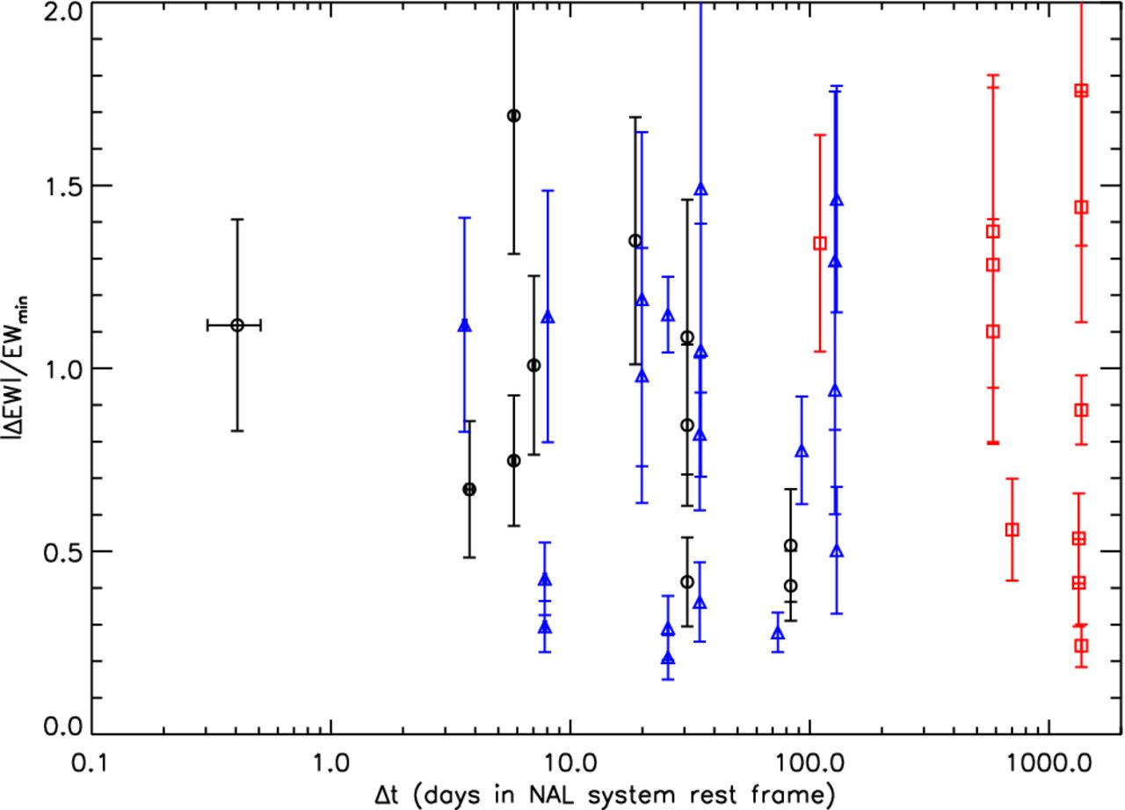
Figure 18. The absolute fractional change in EW (|ΔEW|/EW_{min}) versus the rest-frame time between observations ...
Notes:
Figure 18. The absolute fractional change in EW (|ΔEW|/EWmin) versus the rest-frame time between observations (Δtr) for our sample of significantly variable low-β absorption lines. A logarithmic scale is used for the x-axis due to the large range of time separations spanning days to years. Although there is one outlier, the general pattern of the low-β absorption lines shows almost no dependence between fractional change and time between observations.
Unless provided in the caption above, the following copyright applies to the content of this slide: Published by Oxford University Press on behalf of the Royal Astronomical Society. This work is written by US Government employees and is in the public domain in the US.

Slide 19
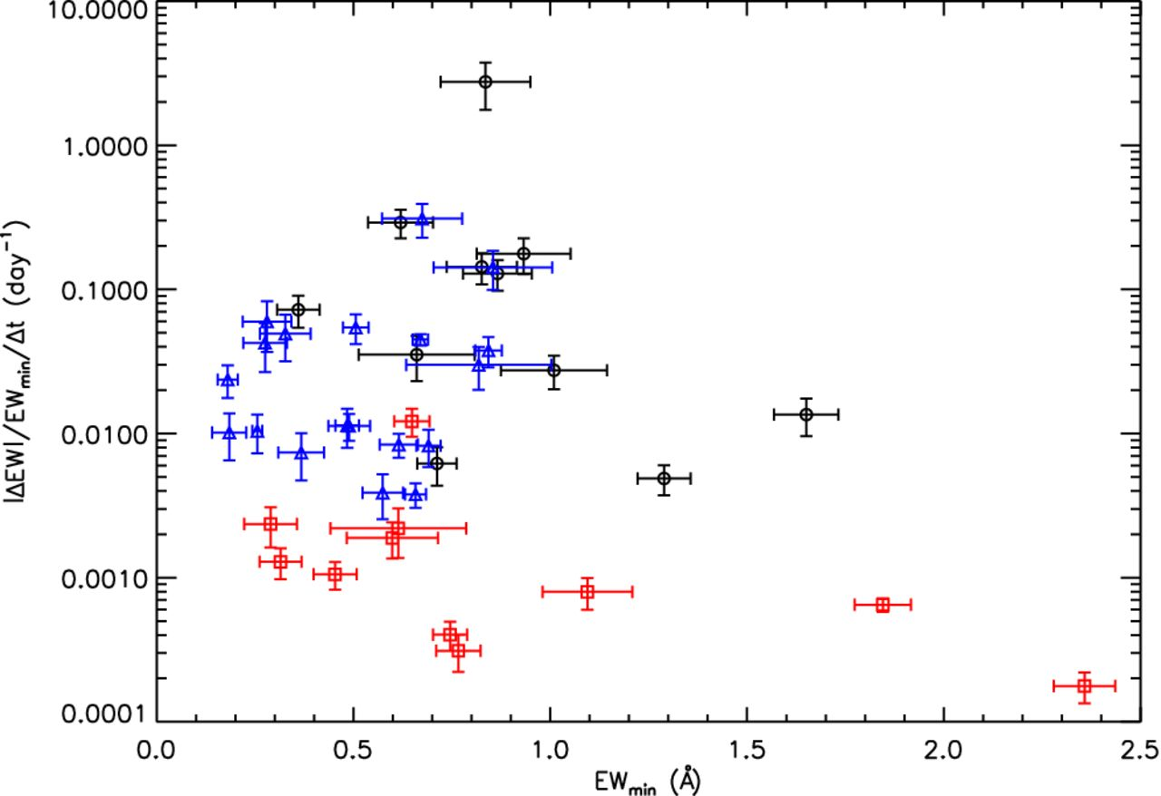
Figure 19. The absolute rate of fractional change in EW (|ΔEW|/EW_{min}/Δt_{r}) versus the minimum EW ...
Notes:
Figure 19. The absolute rate of fractional change in EW (|ΔEW|/EWmin/Δtr) versus the minimum EW (EWmin) for our sample of significantly variable low-β absorption lines. A logarithmic scale is used for the y-axis due to the large range of time separations spanning days to years. Most of the lines have a small rate of change with no obvious dependence on EWmin.
Unless provided in the caption above, the following copyright applies to the content of this slide: Published by Oxford University Press on behalf of the Royal Astronomical Society. This work is written by US Government employees and is in the public domain in the US.

