Slide 1
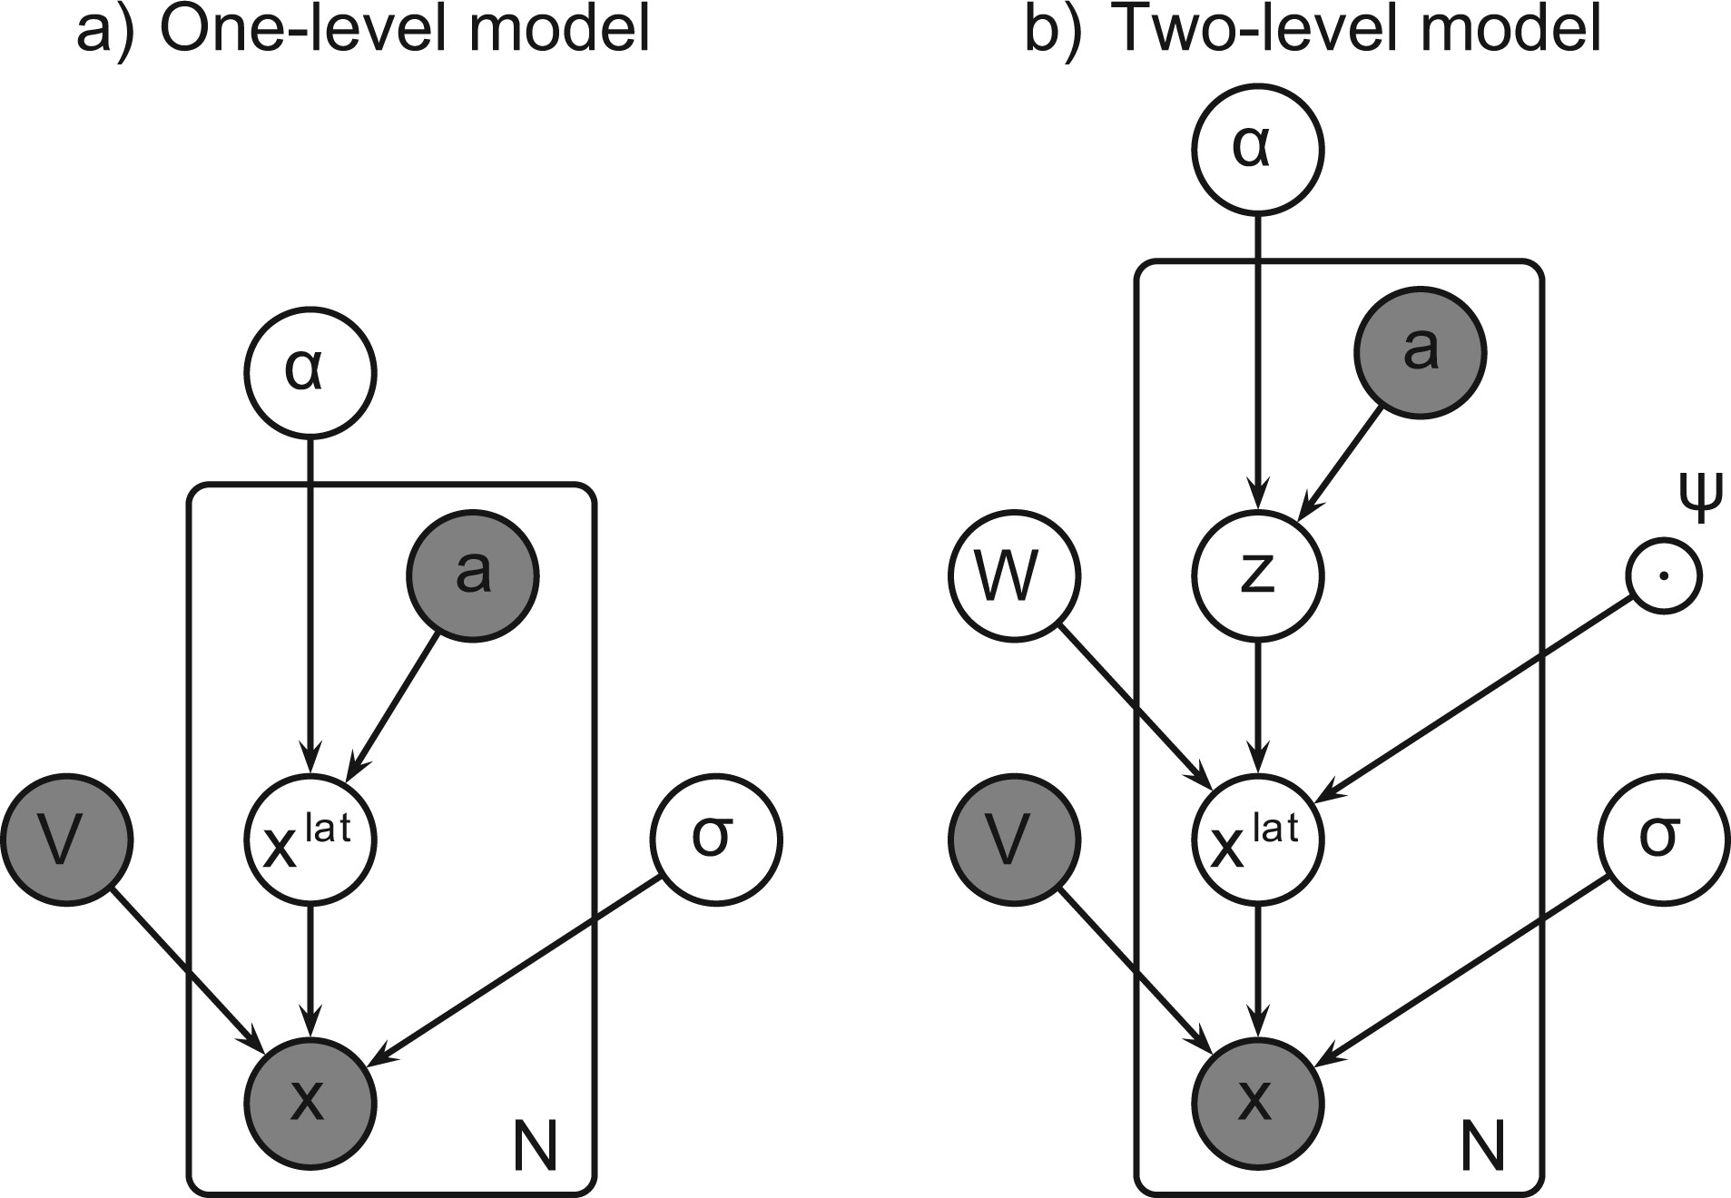
Fig. 1. Plate diagrams of the one-level peak-clustering model (a) (Suvitaival et al., 2014) and the two-level ...
Notes:
Fig. 1. Plate diagrams of the one-level peak-clustering model (a) (Suvitaival et al., 2014) and the two-level compound-clustering model (b) (proposed in this work). The two-level model has a second level of hierarchy for modeling coherently responding groups of compounds. The shaded variables are observed: the intensity data X, the covariate vector a and the peak-clustering matrix V, which is acquired from the peak-clustering stage. White variables are inferred: the compound-specific latent variable Xlat, the peak-specific variance σ2, the compound-clustering W, the compound group-specific latent variable z and the covariate effects α. The compound-level variance parameter ψ2 is selected via cross-validation
Unless provided in the caption above, the following copyright applies to the content of this slide: © The Author 2014. Published by Oxford University Press.This is an Open Access article distributed under the terms of the Creative Commons Attribution Non-Commercial License (http://creativecommons.org/licenses/by-nc/4.0/), which permits non-commercial re-use, distribution, and reproduction in any medium, provided the original work is properly cited. For commercial re-use, please contact journals.permissions@oup.com

Slide 2
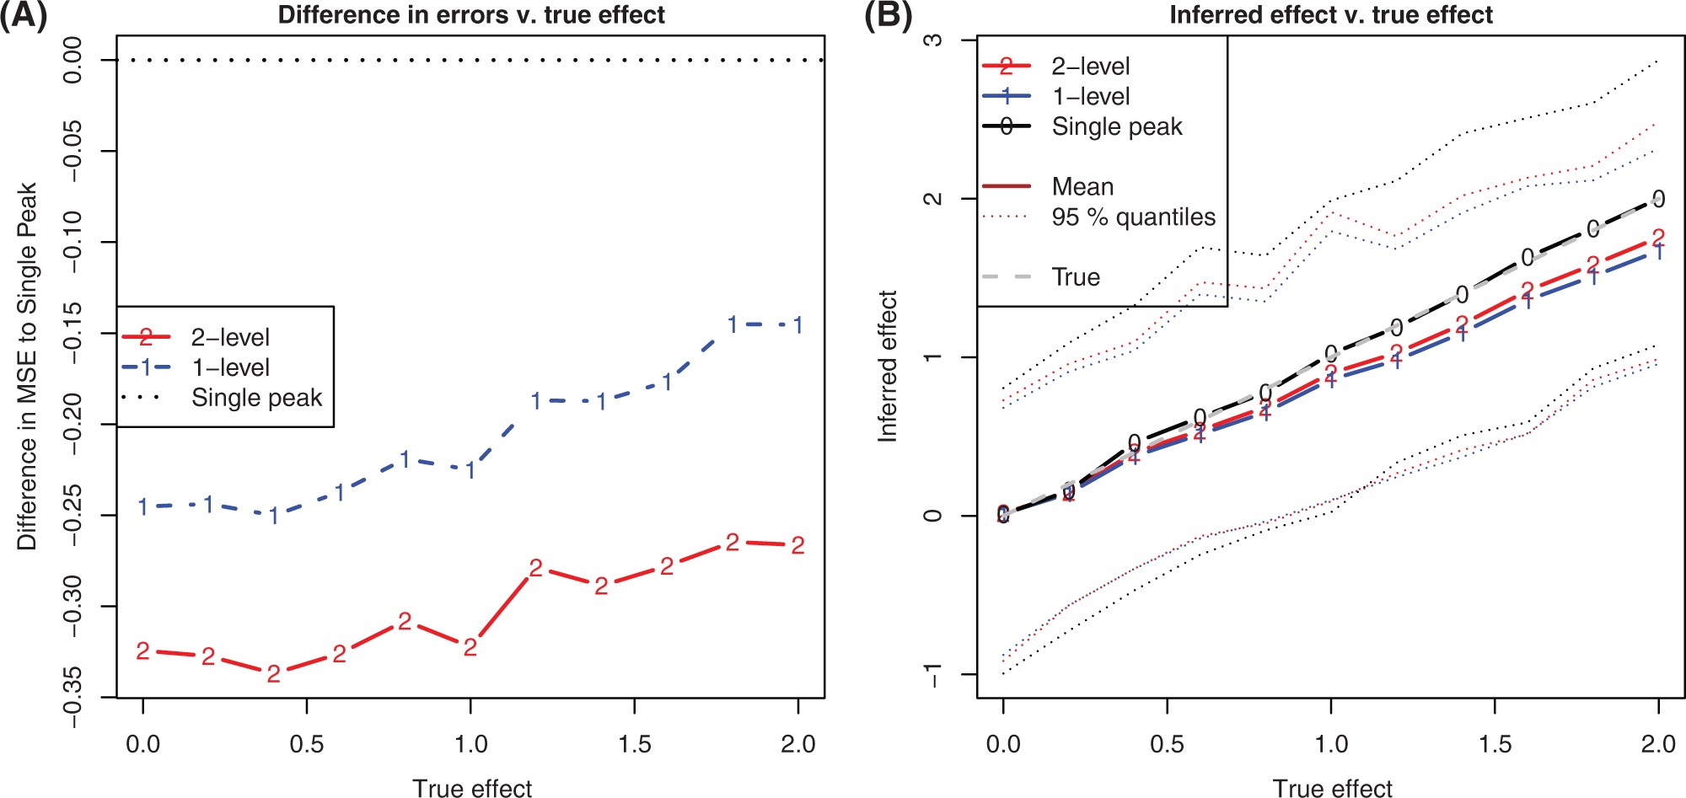
Fig. 2. The peak-clustering and the compound-clustering models (‘1-level’ and ‘2-level’) reduced uncertainty around ...
Notes:
Fig. 2. The peak-clustering and the compound-clustering models (‘1-level’ and ‘2-level’) reduced uncertainty around the covariate effect compared with the single-peak approach. The hierarchical models have a bias toward zero, which follows from the model assumption incorporated to the prior of the covariate effect. The prior-induced bias lead to a slight increase in the error of the peak-clustering models as the true effect increased but acted to prevent the models from overfitting and thus from false findings at normal effect sizes. (a) Pairwise difference in the error between the single-peak approach and each of the two clustering models shown as a function of the magnitude of the true effect. (b) Inferred effect as a function of the magnitude of the true effect. Result from the second simulated experiment (Section 3.1.2), where the true covariate effect was varied from 0 to 2
Unless provided in the caption above, the following copyright applies to the content of this slide: © The Author 2014. Published by Oxford University Press.This is an Open Access article distributed under the terms of the Creative Commons Attribution Non-Commercial License (http://creativecommons.org/licenses/by-nc/4.0/), which permits non-commercial re-use, distribution, and reproduction in any medium, provided the original work is properly cited. For commercial re-use, please contact journals.permissions@oup.com

Slide 3
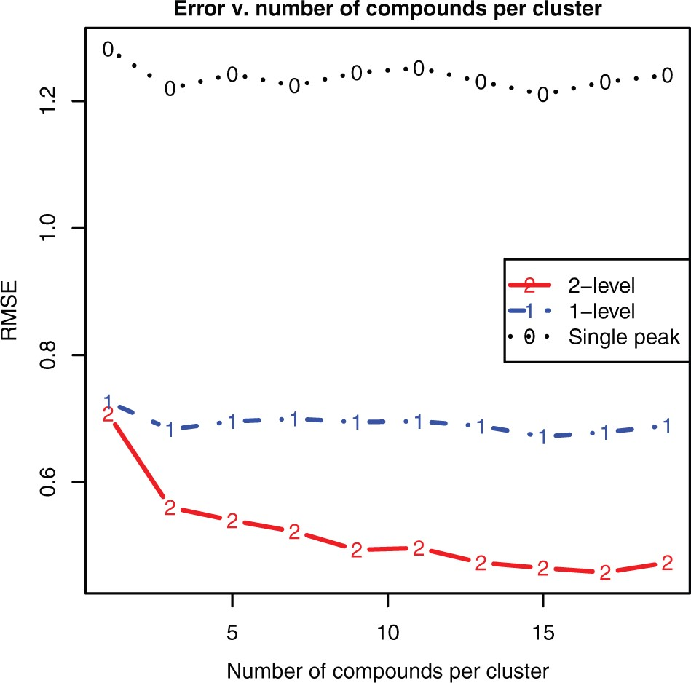
Fig. 3. The error in the covariate effect inferred by the compound-clustering model (‘2-level’) decreased when more ...
Notes:
Fig. 3. The error in the covariate effect inferred by the compound-clustering model (‘2-level’) decreased when more coherently responding compounds were observed. The accuracy of the peak-clustering model and the data-based single-peak approach (‘1-level’ and ‘Single peak’, respectively) remained constant. Root mean squared error (RMSE) is shown as a function of the number of compounds (i.e. lower-level clusters) per higher-level cluster. Result from the third simulated experiment (Section 3.1.3), where a weak covariate effect of 0.2 was generated and the number of compounds was gradually increased from 1 to 19
Unless provided in the caption above, the following copyright applies to the content of this slide: © The Author 2014. Published by Oxford University Press.This is an Open Access article distributed under the terms of the Creative Commons Attribution Non-Commercial License (http://creativecommons.org/licenses/by-nc/4.0/), which permits non-commercial re-use, distribution, and reproduction in any medium, provided the original work is properly cited. For commercial re-use, please contact journals.permissions@oup.com

