Slide 1
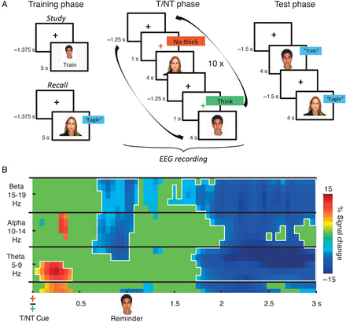
Figure 1. (A) Experimental procedure, trial sequence, and stimulus timing for T and NT items, baseline items not shown. ...
Notes:
Figure 1. (A) Experimental procedure, trial sequence, and stimulus timing for T and NT items, baseline items not shown. (B) Power difference between NT and T conditions (NT–T), averaged across all electrode sites. Power values are masked with the results of a continuous Wilcoxon signed-rank test over 10 ms and 1 Hz time–frequency bins. Only differences with P < 0.05 (one-tailed) are shown. Significant clusters surviving permutation-based correction are framed in white. Black lines indicate upper and lower borders of the frequency bands of interest.
Unless provided in the caption above, the following copyright applies to the content of this slide: © The Author 2014. Published by Oxford University Press. All rights reserved. For Permissions, please e-mail: journals.permissions@oup.com

Slide 2
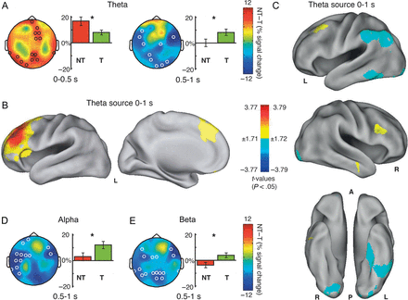
Figure 2. Significant (P_{corr} < 0.05) EEG power differences between NT and T conditions in the theta (A), ...
Notes:
Figure 2. Significant (Pcorr T (NT < T) power in the respective time–frequency windows. Significant overall effects are marked by asterisks. Significant (P < 0.5) NT–T theta (7 Hz) power differences at the source level (B) between conditions (NT–T) and (C) high and low forgetters (NT–T) for the 0–1 s time window.
Unless provided in the caption above, the following copyright applies to the content of this slide: © The Author 2014. Published by Oxford University Press. All rights reserved. For Permissions, please e-mail: journals.permissions@oup.com

Slide 3
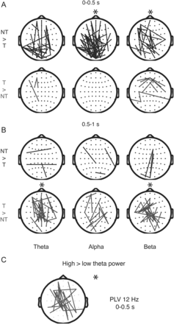
Figure 3. PLV differences between NT and T conditions in the 0–0.5 s (A) and 0.5–1 s (B) time windows. Lines display ...
Notes:
Figure 3. PLV differences between NT and T conditions in the 0–0.5 s (A) and 0.5–1 s (B) time windows. Lines display electrode pairs for which significant (P T = upper rows, T > NT = lower rows). (C) T/NT-Cue-related (0–0.5 s) alpha (12 Hz) PLV difference (NT–T) between subjects showing high and low theta power differences in the same time window. Significant overall effects (Pcorr < 0.05) are marked by asterisks.
Unless provided in the caption above, the following copyright applies to the content of this slide: © The Author 2014. Published by Oxford University Press. All rights reserved. For Permissions, please e-mail: journals.permissions@oup.com

Slide 4
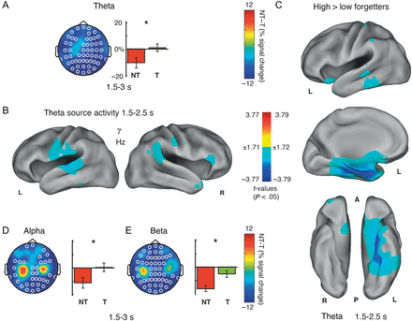
Figure 4. Significant (P_{corr} < 0.05) EEG power differences between NT and T conditions in the theta (A), ...
Notes:
Figure 4. Significant (Pcorr < 0.05) EEG power differences between NT and T conditions in the theta (A), alpha (D), and beta (E) frequency bands following the reminder stimulus from 1.5 to 3 s. Headplots depict topographical distribution of NT–T power differences and bar graphs depict power values within conditions at the significant electrode sites. White circles indicate electrodes for which power in the NT condition is lower than for the T condition. Significant overall effects are marked by asterisks. Significant (P < 0.5) NT–T theta (7 Hz) power differences at the source level (B) between conditions (NT–T) and (C) high and low forgetters (NT–T) for the 1.5–2.5 s time window.
Unless provided in the caption above, the following copyright applies to the content of this slide: © The Author 2014. Published by Oxford University Press. All rights reserved. For Permissions, please e-mail: journals.permissions@oup.com

Slide 5
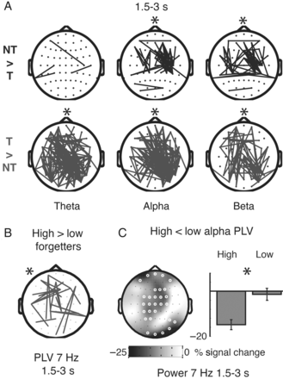
Figure 5. (A) PLV differences between NT and T conditions in the 1.5–3 s time window. Lines display electrode pairs for ...
Notes:
Figure 5. (A) PLV differences between NT and T conditions in the 1.5–3 s time window. Lines display electrode pairs for which significant (P T = upper row, T > NT = lower row). (B) Reminder-related (1.5–3 s) theta (7 Hz) PLV differences between high and low forgetters. Significant overall effects (Pcorr < 0.05) are marked by asterisks. (C) Reminder-related (1.5–3 s) theta (7 Hz) power differences between subjects showing high and low alpha PLV differences in the same time window.
Unless provided in the caption above, the following copyright applies to the content of this slide: © The Author 2014. Published by Oxford University Press. All rights reserved. For Permissions, please e-mail: journals.permissions@oup.com

