Slide 1
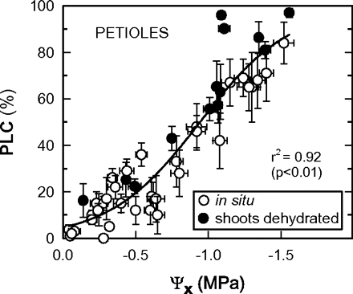
Fig. 1. Vulnerability to cavitation (PLC, percentage loss of conductivity) versus stem xylem water potential ...
Notes:
Fig. 1. Vulnerability to cavitation (PLC, percentage loss of conductivity) versus stem xylem water potential (Ψx) for grapevine leaf petioles measured in situ and of dehydrated shoots. Means ±SE of four petioles. Chasselas, Leytron (CH), 2009.
Unless provided in the caption above, the following copyright applies to the content of this slide: © 2011 The Author(s).This is an Open Access article distributed under the terms of the Creative Commons Attribution Non-Commercial License (http://creativecommons.org/licenses/by-nc/2.5), which permits unrestricted non-commercial use, distribution, and reproduction in any medium, provided the original work is properly cited.This paper is available online free of all access charges (see http://jxb.oxfordjournals.org/open_access.html for further details)

Slide 2
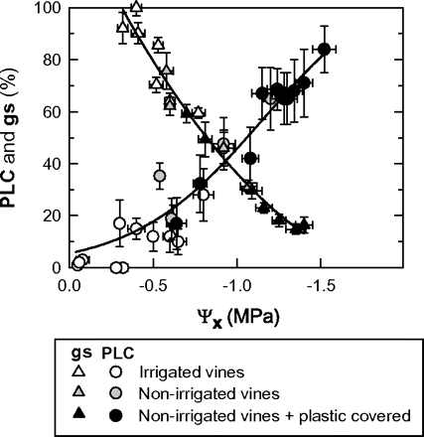
Fig. 2. Vulnerability to cavitation (PLC, percentage loss of conductivity) and stomatal conductance (g_{s}) ...
Notes:
Fig. 2. Vulnerability to cavitation (PLC, percentage loss of conductivity) and stomatal conductance (gs) versus stem xylem water potential (Ψx) for grapevine leaf petioles. Means ±SE of four petioles (for PLC), and eight leaves (for gs). Chasselas, Leytron (CH), 2009.
Unless provided in the caption above, the following copyright applies to the content of this slide: © 2011 The Author(s).This is an Open Access article distributed under the terms of the Creative Commons Attribution Non-Commercial License (http://creativecommons.org/licenses/by-nc/2.5), which permits unrestricted non-commercial use, distribution, and reproduction in any medium, provided the original work is properly cited.This paper is available online free of all access charges (see http://jxb.oxfordjournals.org/open_access.html for further details)

Slide 3
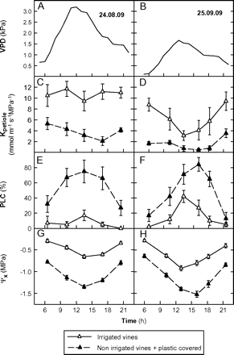
Fig. 3. Diurnal courses of leaf-atmospheric (VPD) (A, B), petiole hydraulic conductance (K_{petiole}) (C, D), ...
Notes:
Fig. 3. Diurnal courses of leaf-atmospheric (VPD) (A, B), petiole hydraulic conductance (Kpetiole) (C, D), vulnerability of petioles to cavitation (PLC, percentage loss of conductivity) (E, F), and stem xylem water potential (Ψx) (G, H) during two days (24 August and 25 September) for different irrigation treatments. Chasselas, Leytron (CH), 2009.
Unless provided in the caption above, the following copyright applies to the content of this slide: © 2011 The Author(s).This is an Open Access article distributed under the terms of the Creative Commons Attribution Non-Commercial License (http://creativecommons.org/licenses/by-nc/2.5), which permits unrestricted non-commercial use, distribution, and reproduction in any medium, provided the original work is properly cited.This paper is available online free of all access charges (see http://jxb.oxfordjournals.org/open_access.html for further details)

Slide 4
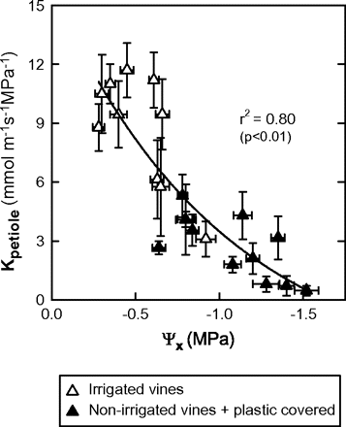
Fig. 4. Relationship between the stem xylem water potential (Ψ_{x}) and the petiole hydraulic conductance ...
Notes:
Fig. 4. Relationship between the stem xylem water potential (Ψx) and the petiole hydraulic conductance (Kpetiole) for adult leaves and different irrigation treatments. Means ±SE of four petioles/leaves. Chasselas, Leytron (CH), 2009.
Unless provided in the caption above, the following copyright applies to the content of this slide: © 2011 The Author(s).This is an Open Access article distributed under the terms of the Creative Commons Attribution Non-Commercial License (http://creativecommons.org/licenses/by-nc/2.5), which permits unrestricted non-commercial use, distribution, and reproduction in any medium, provided the original work is properly cited.This paper is available online free of all access charges (see http://jxb.oxfordjournals.org/open_access.html for further details)

Slide 5
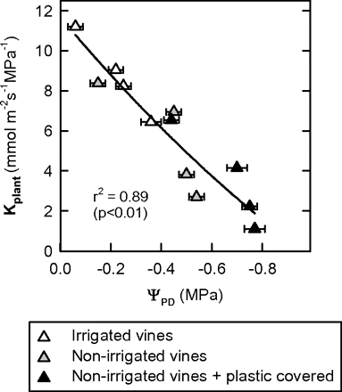
Fig. 5. Relationship between mid-morning leaf-specific hydraulic conductance ...
Notes:
Fig. 5. Relationship between mid-morning leaf-specific hydraulic conductance [Kplant=E/(ΨPD–Ψleaf), equation from Sperry and Pockman (1993)] and the pre-dawn water potential (ΨPD) for different irrigation treatments. Means ±SE of eight leaves. Chasselas, Leytron (CH), 2009.
Unless provided in the caption above, the following copyright applies to the content of this slide: © 2011 The Author(s).This is an Open Access article distributed under the terms of the Creative Commons Attribution Non-Commercial License (http://creativecommons.org/licenses/by-nc/2.5), which permits unrestricted non-commercial use, distribution, and reproduction in any medium, provided the original work is properly cited.This paper is available online free of all access charges (see http://jxb.oxfordjournals.org/open_access.html for further details)

Slide 6
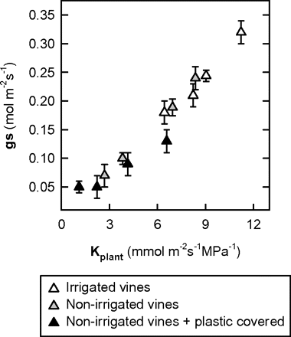
Fig. 6. Stomatal conductance (g_{s}) as a function of mid-morning leaf-specific hydraulic conductance ...
Notes:
Fig. 6. Stomatal conductance (gs) as a function of mid-morning leaf-specific hydraulic conductance (Kplant) for different irrigation treatments. Means ±SE of eight leaves. Chasselas, Leytron (CH), 2009.
Unless provided in the caption above, the following copyright applies to the content of this slide: © 2011 The Author(s).This is an Open Access article distributed under the terms of the Creative Commons Attribution Non-Commercial License (http://creativecommons.org/licenses/by-nc/2.5), which permits unrestricted non-commercial use, distribution, and reproduction in any medium, provided the original work is properly cited.This paper is available online free of all access charges (see http://jxb.oxfordjournals.org/open_access.html for further details)

Slide 7
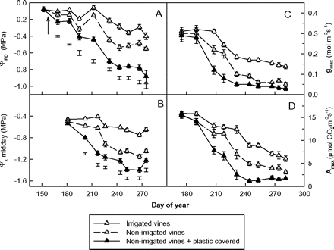
Fig. 7. Changes in (A) pre-dawn water potential (Ψ_{PD}), (B) stem xylem water potential (Ψ_{x}), (C) ...
Notes:
Fig. 7. Changes in (A) pre-dawn water potential (ΨPD), (B) stem xylem water potential (Ψx), (C) maximum stomatal conductance (gmax), and (D) maximum photosynthetic rate (Amax) during the 2009 season with different irrigation treatments. The arrow indicates irrigation onset. Means ±SE for eight leaves. Bars: statistically significant at the 5% level of probability. Chasselas, Leytron (CH).
Unless provided in the caption above, the following copyright applies to the content of this slide: © 2011 The Author(s).This is an Open Access article distributed under the terms of the Creative Commons Attribution Non-Commercial License (http://creativecommons.org/licenses/by-nc/2.5), which permits unrestricted non-commercial use, distribution, and reproduction in any medium, provided the original work is properly cited.This paper is available online free of all access charges (see http://jxb.oxfordjournals.org/open_access.html for further details)

