Slide 1
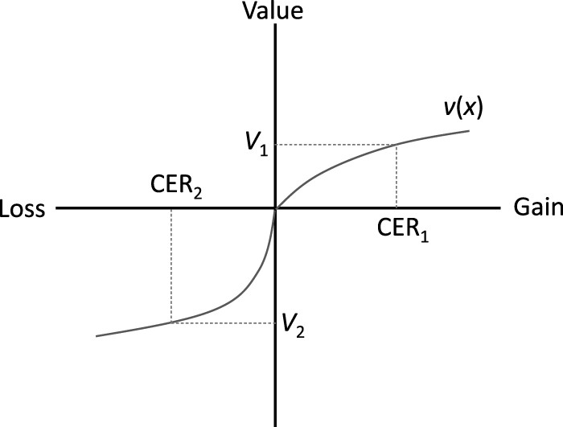
Figure 1. Calculation of certainty equivalent returns in prospect theory
Notes:
Figure 1. Calculation of certainty equivalent returns in prospect theory
Unless provided in the caption above, the following copyright applies to the content of this slide: © The Author 2015. Published by Oxford University Press on behalf of the Agricultural and Applied Economics Association. All rights reserved. For permissions, please e-mail: journals.permissions@oup.com

Slide 2
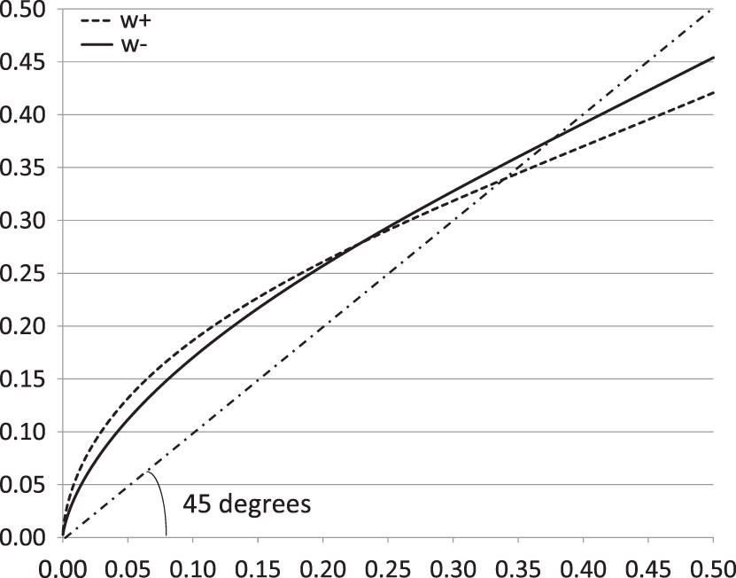
Figure 2. Probability weighting functions
Notes:
Figure 2. Probability weighting functions
Unless provided in the caption above, the following copyright applies to the content of this slide: © The Author 2015. Published by Oxford University Press on behalf of the Agricultural and Applied Economics Association. All rights reserved. For permissions, please e-mail: journals.permissions@oup.com

Slide 3
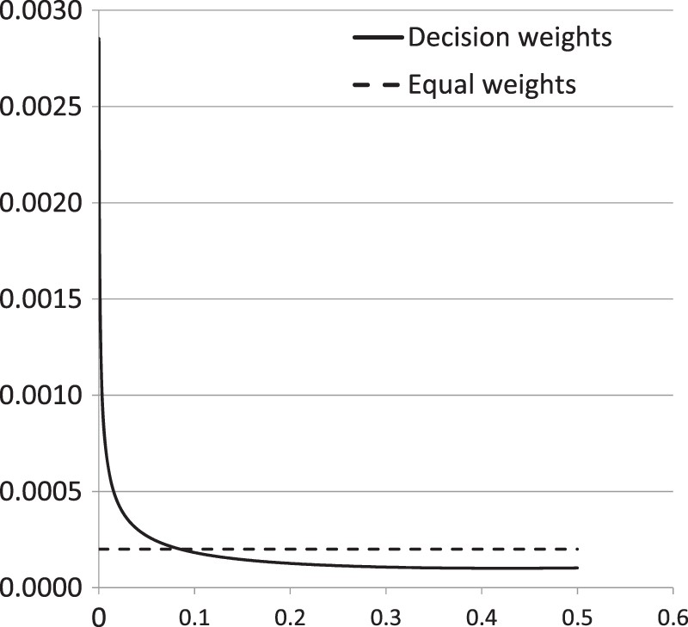
Figure 3. Decision weights vs equal weights
Notes:
Figure 3. Decision weights vs equal weights
Unless provided in the caption above, the following copyright applies to the content of this slide: © The Author 2015. Published by Oxford University Press on behalf of the Agricultural and Applied Economics Association. All rights reserved. For permissions, please e-mail: journals.permissions@oup.com

