Slide 1
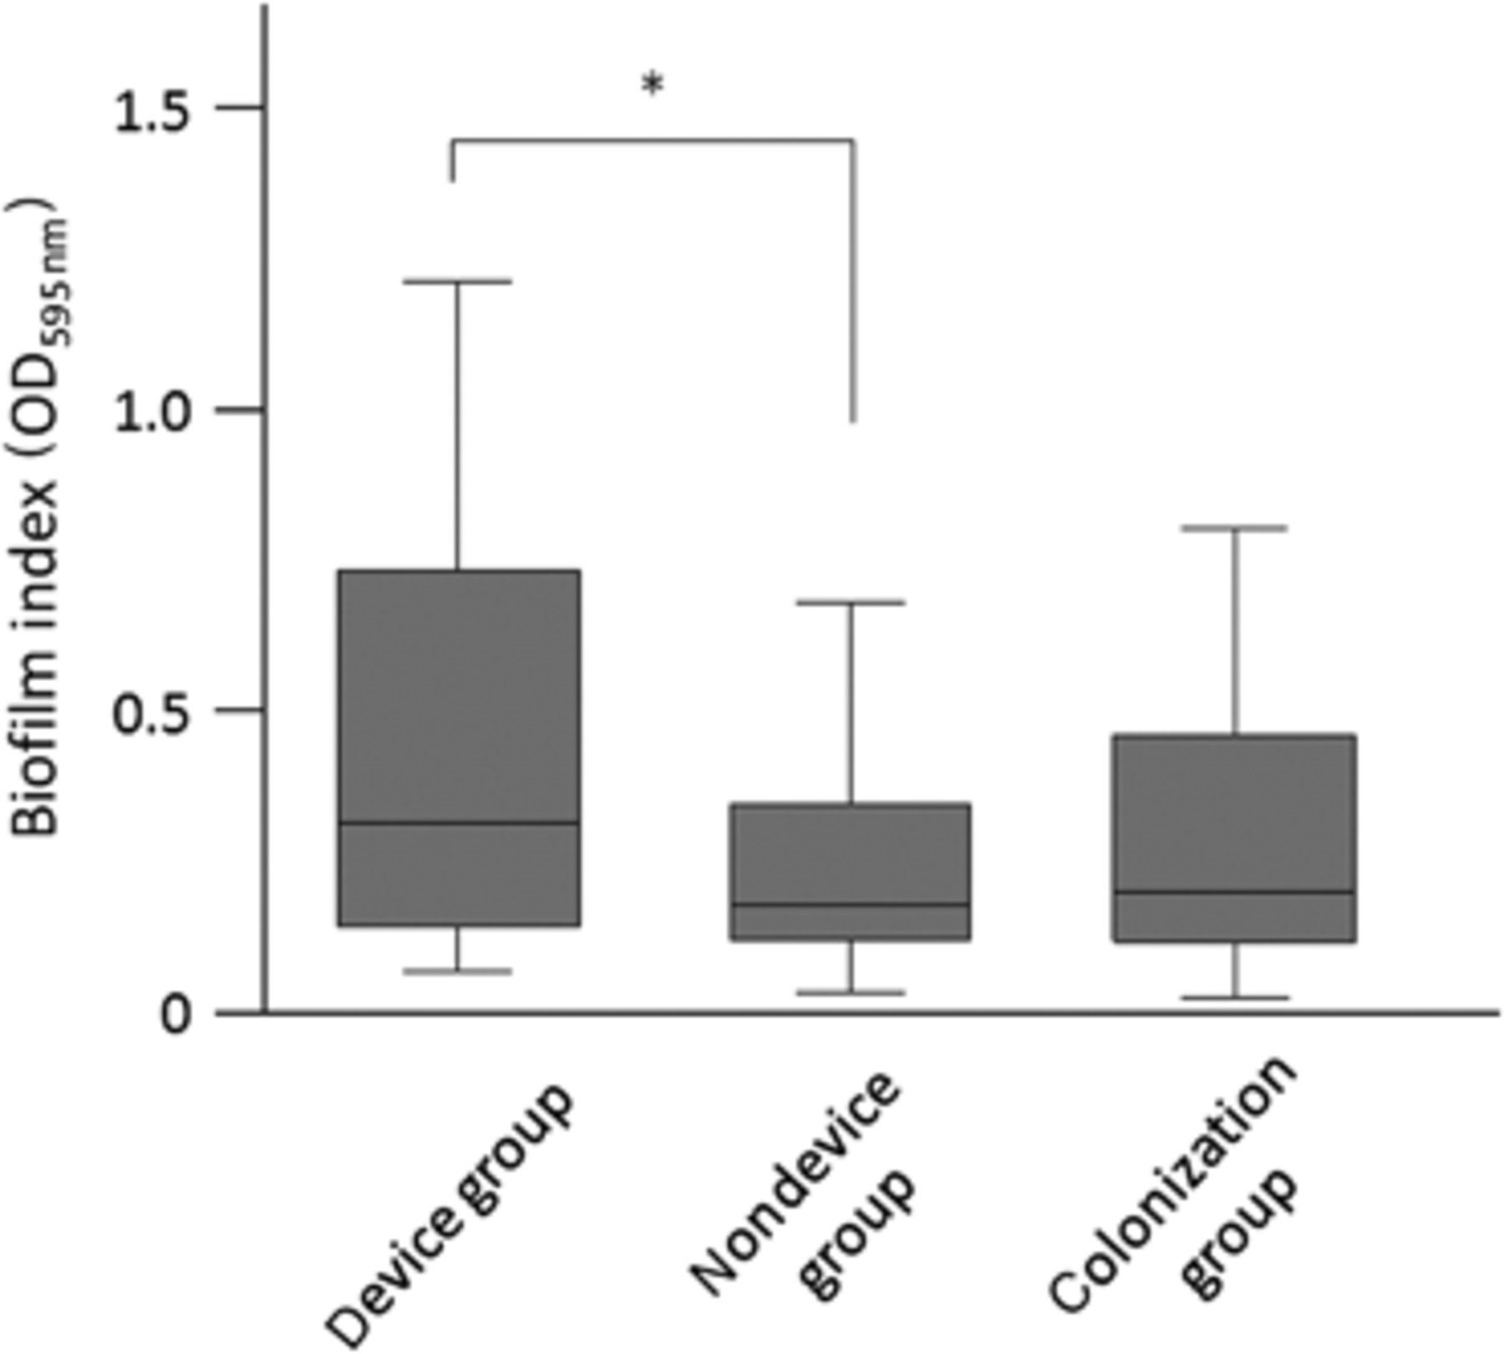
Figure 1 Comparison of the biofilm index among three groups (device group, n=23; nondevice group, n=55; colonization ...
Notes:
Figure 1 Comparison of the biofilm index among three groups (device group, n=23; nondevice group, n=55; colonization group, n=90). Box plots show the median and the 10th, 25th, 75th, and 90th percentiles. *P=0.039.
Unless provided in the caption above, the following copyright applies to the content of this slide: © 2011 Federation of European Microbiological Societies

Slide 2
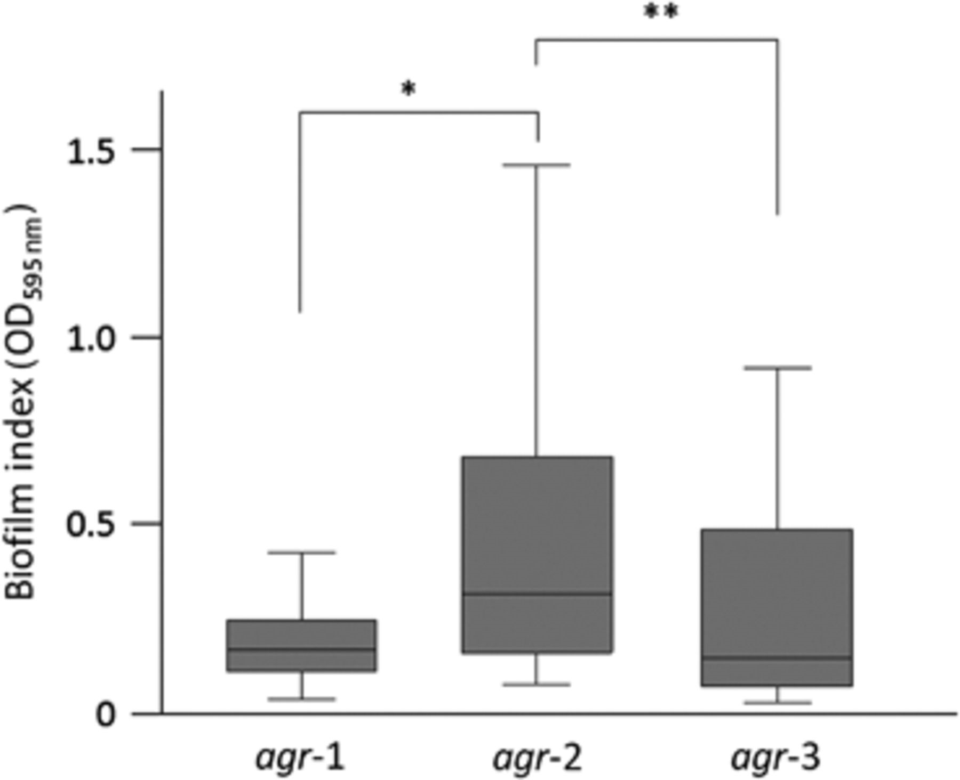
Figure 2 Comparison of biofilm formation among agr types: agr-1, n=72; agr-2, n=81; agr-3, n=14. Box plots show the ...
Notes:
Figure 2 Comparison of biofilm formation among agr types: agr-1, n=72; agr-2, n=81; agr-3, n=14. Box plots show the median and the 10th, 25th, 75th, and 90th percentiles. *P<0.0001; **P=0.045.
Unless provided in the caption above, the following copyright applies to the content of this slide: © 2011 Federation of European Microbiological Societies

