Slide 1
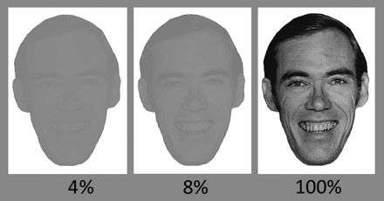
Fig. 1. Examples of faces used in experiment 2. Faces were presented at different contrasts, with several of the ...
Notes:
Fig. 1. Examples of faces used in experiment 2. Faces were presented at different contrasts, with several of the contrasts shown here.
Unless provided in the caption above, the following copyright applies to the content of this slide: © The Author 2009. Published by Oxford University Press on behalf of the Maryland Psychiatric Research Center. All rights reserved. For permissions, please email: journals.permissions@oxfordjournals.org.

Slide 2
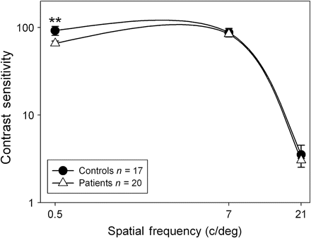
Fig. 2. Psychophysical contrast sensitivity functions for patients with schizophrenia and healthy controls. Values ...
Notes:
Fig. 2. Psychophysical contrast sensitivity functions for patients with schizophrenia and healthy controls. Values are plotted as contrast sensitivity, defined as the reciprocal of contrast threshold percentage. Results at the lower spatial frequencies are indicative of performance of the magnocellular system, and results at the higher spatial frequencies are indicative of performance of the parvocellular system. **P = .005.
Unless provided in the caption above, the following copyright applies to the content of this slide: © The Author 2009. Published by Oxford University Press on behalf of the Maryland Psychiatric Research Center. All rights reserved. For permissions, please email: journals.permissions@oxfordjournals.org.

Slide 3
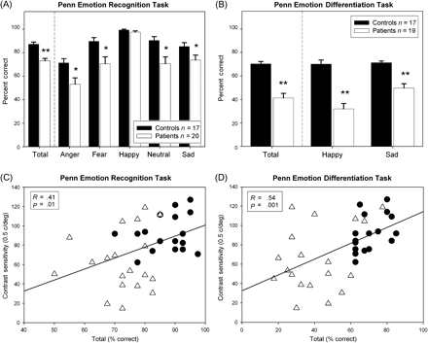
Fig. 3. Percent correct on the Penn Emotion Recognition (ER-40) (A) and Penn Emotion Differentiation (EMODIFF) (B) ...
Notes:
Fig. 3. Percent correct on the Penn Emotion Recognition (ER-40) (A) and Penn Emotion Differentiation (EMODIFF) (B) tasks. Relationships between contrast sensitivity for the magnocellular-biased low spatial frequency (0.5 cycles/degree) grating and performance on the ER-40 (C) or EMODIFF (D) tasks. Triangles correspond to patients and circles to controls. *P < .05; **P < .001.
Unless provided in the caption above, the following copyright applies to the content of this slide: © The Author 2009. Published by Oxford University Press on behalf of the Maryland Psychiatric Research Center. All rights reserved. For permissions, please email: journals.permissions@oxfordjournals.org.

Slide 4
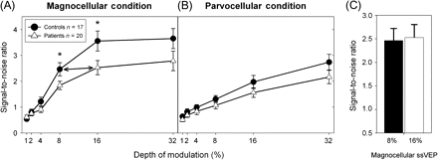
Fig. 4. Steady-state visual evoked potential (ssVEP) signal-to-noise ratios for patients with schizophrenia and ...
Notes:
Fig. 4. Steady-state visual evoked potential (ssVEP) signal-to-noise ratios for patients with schizophrenia and healthy controls in test conditions using depth of modulation (% luminance modulation) to emphasize the magnocellular (A) or parvocellular (B) visual pathways. Patients needed 16% contrast to obtain the same response as controls at 8% contrast (C). *P ≤ .05.
Unless provided in the caption above, the following copyright applies to the content of this slide: © The Author 2009. Published by Oxford University Press on behalf of the Maryland Psychiatric Research Center. All rights reserved. For permissions, please email: journals.permissions@oxfordjournals.org.

Slide 5
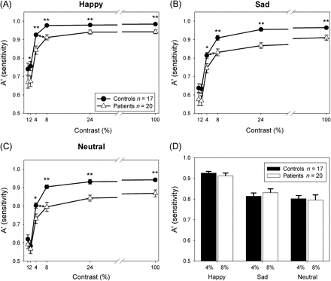
Fig. 5. Sensitivity (A′) for detection of happy (A), sad (B), or neutral (C) faces at different contrasts. Patients ...
Notes:
Fig. 5. Sensitivity (A′) for detection of happy (A), sad (B), or neutral (C) faces at different contrasts. Patients needed 8% contrast to obtain the same sensitivity as controls at 4% contrast (D). *P < .01; **P < .001.
Unless provided in the caption above, the following copyright applies to the content of this slide: © The Author 2009. Published by Oxford University Press on behalf of the Maryland Psychiatric Research Center. All rights reserved. For permissions, please email: journals.permissions@oxfordjournals.org.

Slide 6
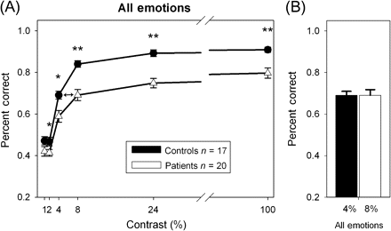
Fig. 6. Percent correct across emotions for faces at different contrasts (A). Patients needed 8% contrast to obtain ...
Notes:
Fig. 6. Percent correct across emotions for faces at different contrasts (A). Patients needed 8% contrast to obtain the same response as controls for 4% contrast (B). *P < .05; **P < .001.
Unless provided in the caption above, the following copyright applies to the content of this slide: © The Author 2009. Published by Oxford University Press on behalf of the Maryland Psychiatric Research Center. All rights reserved. For permissions, please email: journals.permissions@oxfordjournals.org.

