Slide 1
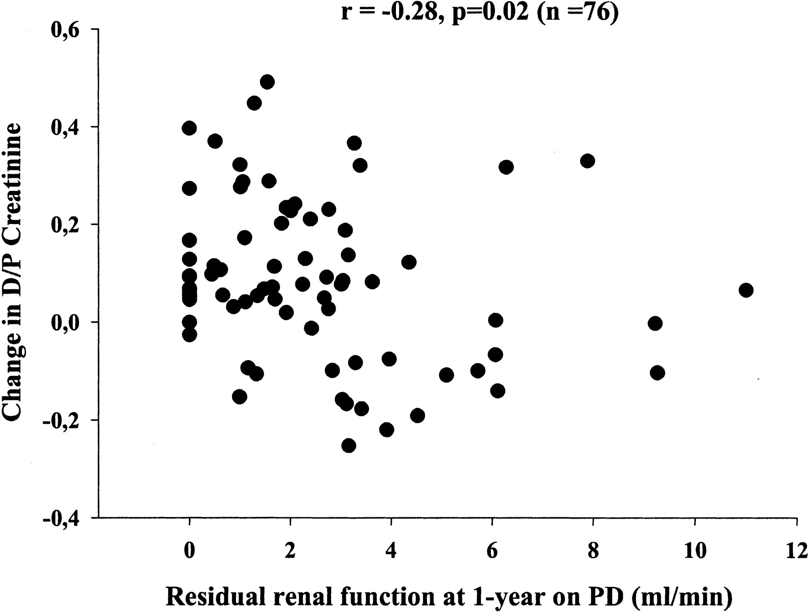
Fig. 1. Relationship between RRF at 1‐year on PD and changes in D/P Cr during first year on PD. RRF at 1‐year on PD ...
Notes:
Fig. 1. Relationship between RRF at 1‐year on PD and changes in D/P Cr during first year on PD. RRF at 1‐year on PD was inversely correlated with changes in D/P Cr (r=−0.28, P=0.02, n=76).
Unless provided in the caption above, the following copyright applies to the content of this slide: European Renal Association-European Dialysis and Transplant Association

