Slide 1
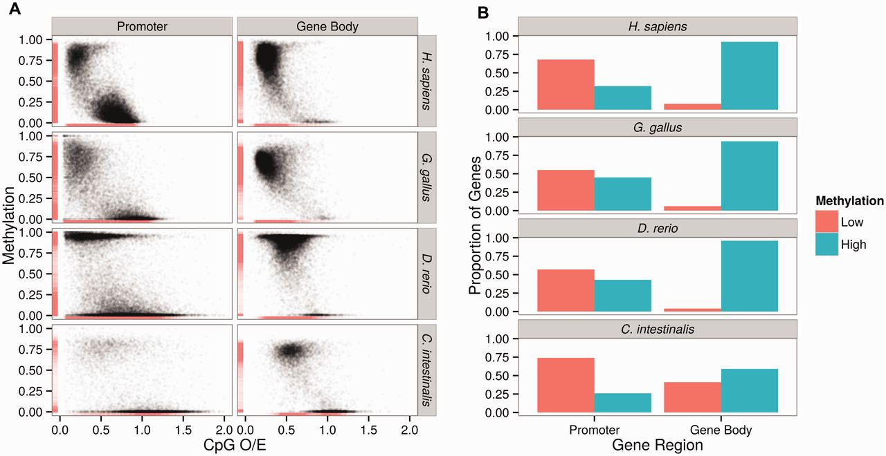
Fig. 1. (A) Distributions of promoter and gene body DNA methylation from whole-genome methylation maps in four ...
Notes:
Fig. 1. (A) Distributions of promoter and gene body DNA methylation from whole-genome methylation maps in four species across the chordate phylogeny. Both promoters and gene bodies are composed of lowly (mean fractional methylation level 0.5) subsets in these species, and show good correspondence with the CpG O/E values. (B) Using empirical cutoff values, the proportions of lowly and highly methylated promoters and gene bodies of the study species are depicted.
Unless provided in the caption above, the following copyright applies to the content of this slide: © The Author(s) 2015. Published by Oxford University Press on behalf of the Society for Molecular Biology and Evolution.This is an Open Access article distributed under the terms of the Creative Commons Attribution Non-Commercial License (http://creativecommons.org/licenses/by-nc/4.0/), which permits non-commercial re-use, distribution, and reproduction in any medium, provided the original work is properly cited. For commercial re-use, please contact journals.permissions@oup.com

Slide 2
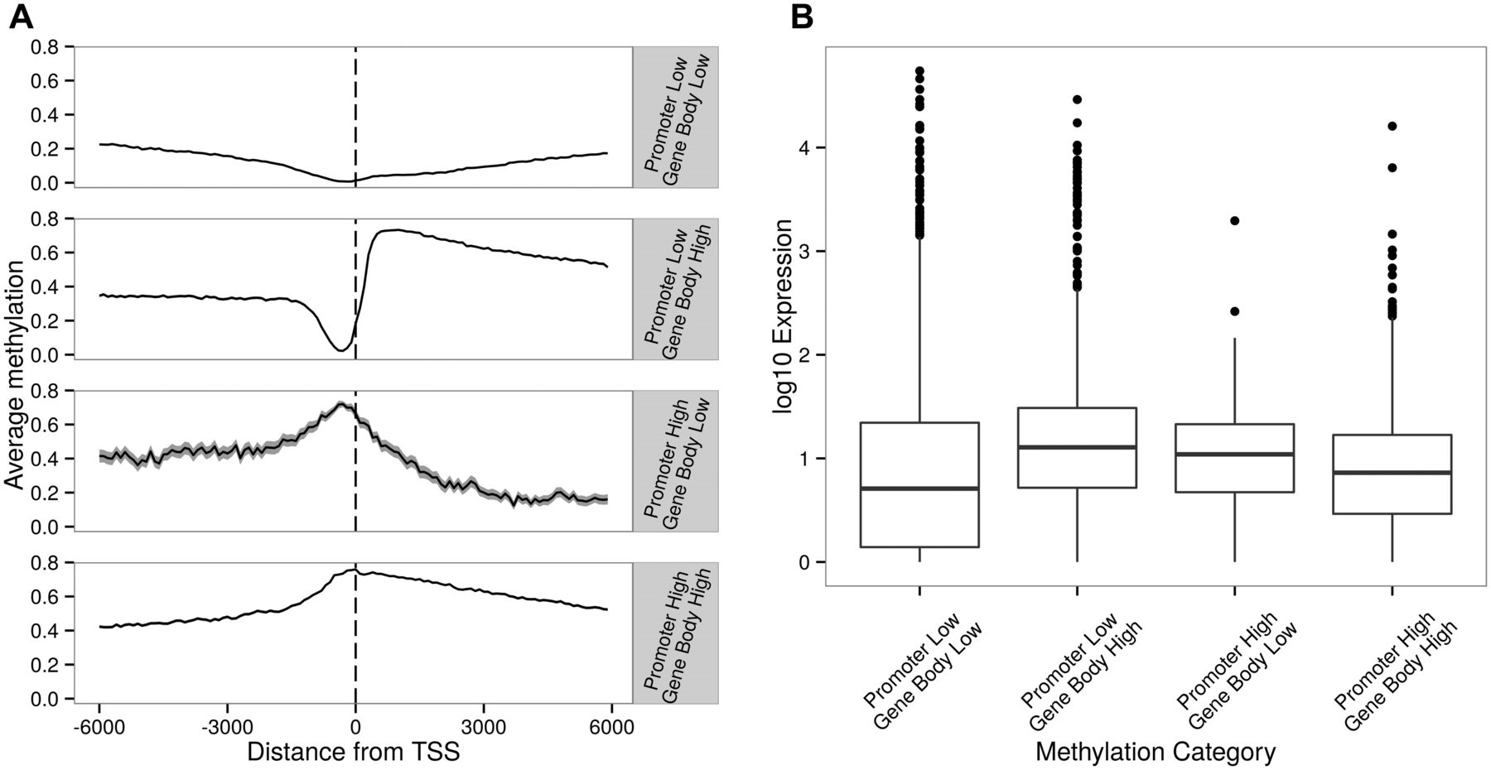
Fig. 2. (A) Sea squirt (Ciona intestinalis) genes with low and high levels of DNA methylation in promoters and gene ...
Notes:
Fig. 2. (A) Sea squirt (Ciona intestinalis) genes with low and high levels of DNA methylation in promoters and gene bodies. Figures drawn using values calculated from sliding windows that are 100 bases wide with a 10-base step size. Genes in this species can be classified into four groups, where promoter and gene bodies are lowly and highly methylated, respectively. The numbers of genes in each group are described in the main text. (B) Variation of gene expression levels of these four methylation categories.
Unless provided in the caption above, the following copyright applies to the content of this slide: © The Author(s) 2015. Published by Oxford University Press on behalf of the Society for Molecular Biology and Evolution.This is an Open Access article distributed under the terms of the Creative Commons Attribution Non-Commercial License (http://creativecommons.org/licenses/by-nc/4.0/), which permits non-commercial re-use, distribution, and reproduction in any medium, provided the original work is properly cited. For commercial re-use, please contact journals.permissions@oup.com

Slide 3
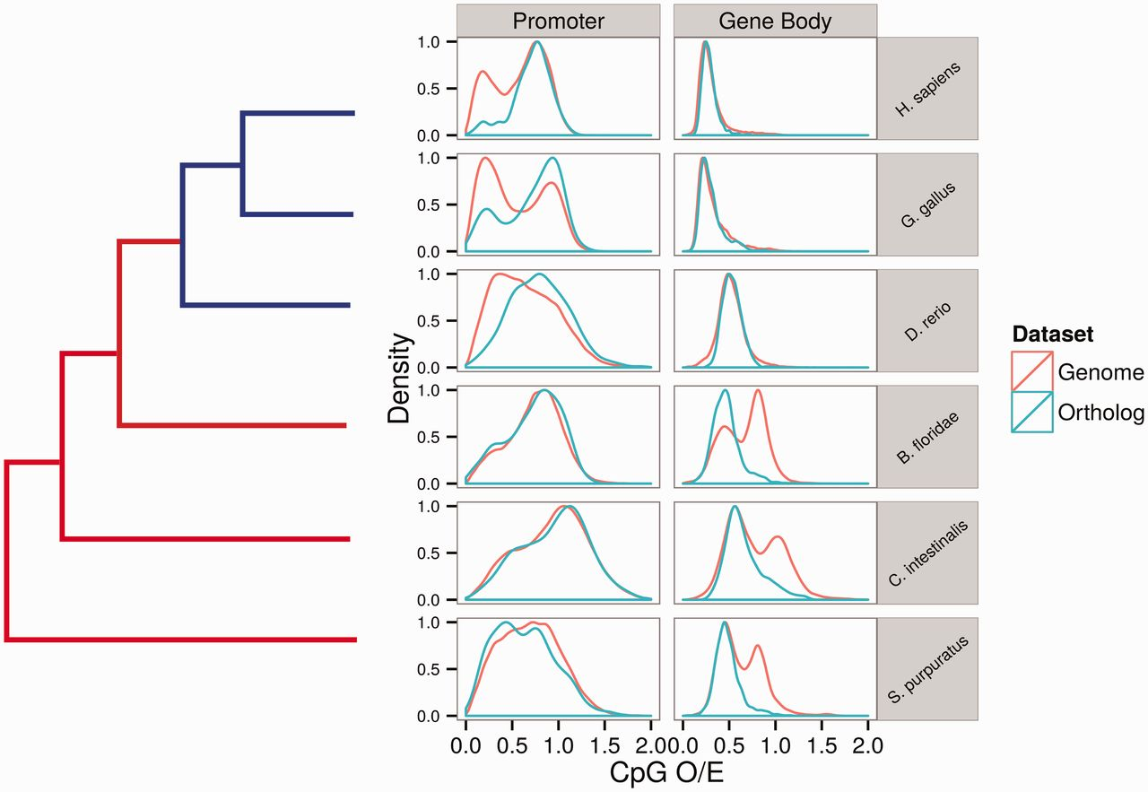
Fig. 5. Contrasting distributions of CpG O/E in all genes versus orthologs across the invertebrate–vertebrate ...
Notes:
Fig. 5. Contrasting distributions of CpG O/E in all genes versus orthologs across the invertebrate–vertebrate boundary.
Unless provided in the caption above, the following copyright applies to the content of this slide: © The Author(s) 2015. Published by Oxford University Press on behalf of the Society for Molecular Biology and Evolution.This is an Open Access article distributed under the terms of the Creative Commons Attribution Non-Commercial License (http://creativecommons.org/licenses/by-nc/4.0/), which permits non-commercial re-use, distribution, and reproduction in any medium, provided the original work is properly cited. For commercial re-use, please contact journals.permissions@oup.com

Slide 4
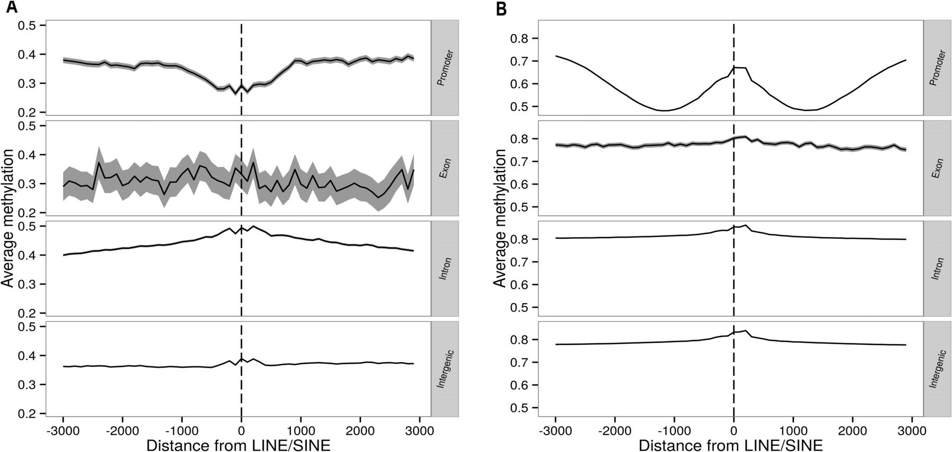
Fig. 4. Variation of DNA methylation in different genomic regions as a function of the distance from LINEs/SINEs in ...
Notes:
Fig. 4. Variation of DNA methylation in different genomic regions as a function of the distance from LINEs/SINEs in (A) Ciona intestinalis and (B) Danio rerio. Although a peak of DNA methylation in the promoters of D. rerio is apparent in (B), promoters of C. intestinalis do not show such a pattern. Other vertebrates have similar methylation patterns (supplementary fig. S2, Supplementary Material online). Figures drawn using values calculated from sliding windows that are 100 bases wide with a 10-base step size.
Unless provided in the caption above, the following copyright applies to the content of this slide: © The Author(s) 2015. Published by Oxford University Press on behalf of the Society for Molecular Biology and Evolution.This is an Open Access article distributed under the terms of the Creative Commons Attribution Non-Commercial License (http://creativecommons.org/licenses/by-nc/4.0/), which permits non-commercial re-use, distribution, and reproduction in any medium, provided the original work is properly cited. For commercial re-use, please contact journals.permissions@oup.com

Slide 5
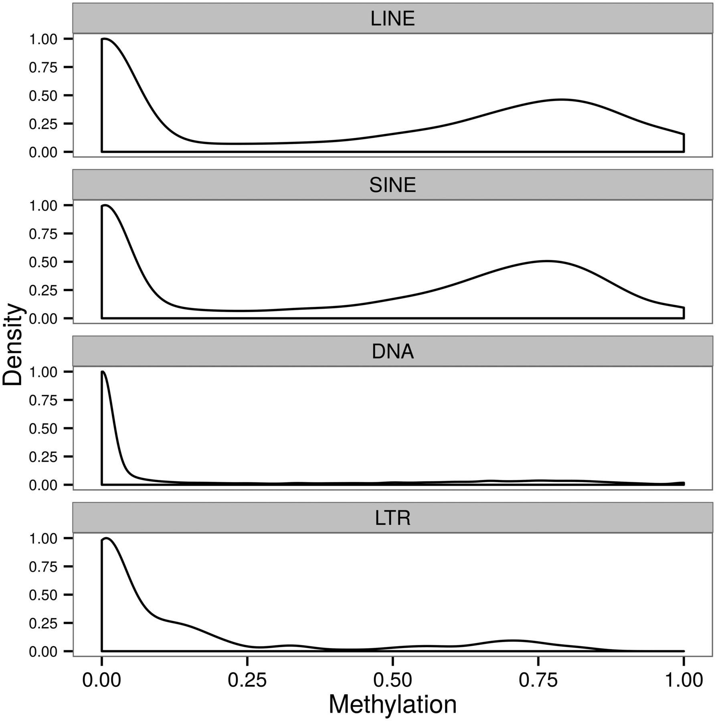
Fig. 3. Distribution of DNA methylation in different TE classes of Ciona intestinalis. Only LINEs and SINEs have ...
Notes:
Fig. 3. Distribution of DNA methylation in different TE classes of Ciona intestinalis. Only LINEs and SINEs have substantially methylated subsets.
Unless provided in the caption above, the following copyright applies to the content of this slide: © The Author(s) 2015. Published by Oxford University Press on behalf of the Society for Molecular Biology and Evolution.This is an Open Access article distributed under the terms of the Creative Commons Attribution Non-Commercial License (http://creativecommons.org/licenses/by-nc/4.0/), which permits non-commercial re-use, distribution, and reproduction in any medium, provided the original work is properly cited. For commercial re-use, please contact journals.permissions@oup.com

