Slide 1
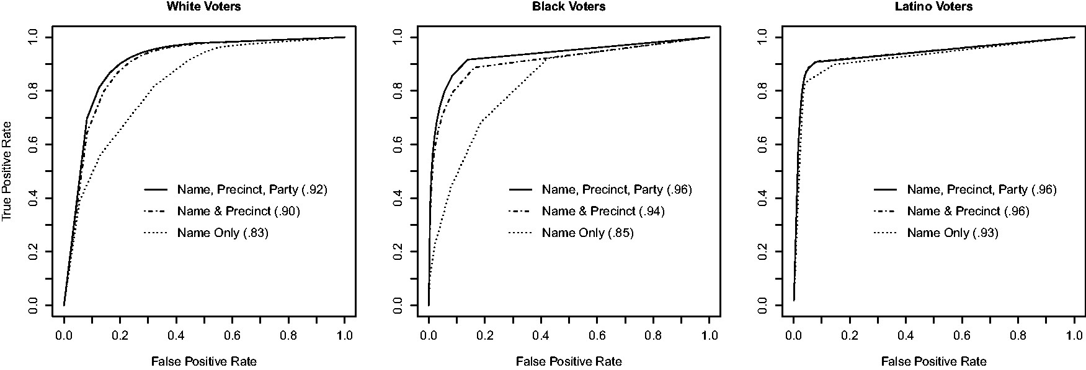
Fig. 1 ROC curves for the proposed race prediction methods. ROC curves plot true positive rate (vertical axis) ...
Notes:
Fig. 1 ROC curves for the proposed race prediction methods. ROC curves plot true positive rate (vertical axis) against false positive rate (horizontal axis) for all possible thresholds used for classification. The area under the ROC curves, given in the legend, summarizes the overall classification success. Among White and Black voters, using voter precinct (denoted as “Precinct”) in addition to surname (“Name”) substantially improves classification accuracy. Adding voter party registration (“Party”) results in further improvements. Among Latino voters, surname alone yields a high success rate and adding other information produces minor improvements.
Unless provided in the caption above, the following copyright applies to the content of this slide: © The Author 2016. Published by Oxford University Press on behalf of the Society for Political Methodology. All rights reserved. For Permissions, please email: journals.permissions@oup.com

