Slide 1
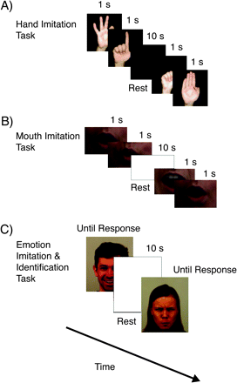
Fig. 1. The Procedure for the 3 Imitation Tasks. (a) Hand movement imitation task. (b) Mouth movement imitation task. ...
Notes:
Fig. 1. The Procedure for the 3 Imitation Tasks. (a) Hand movement imitation task. (b) Mouth movement imitation task. (c) Emotional face imitation and identification task.
Unless provided in the caption above, the following copyright applies to the content of this slide: © The Author 2008. Published by Oxford University Press on behalf of the Maryland Psychiatric Research Center. All rights reserved. For permissions, please email: journals.permissions@oxfordjournals.org.

Slide 2
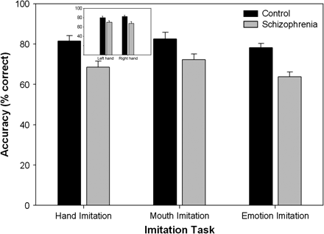
Fig. 2. Accuracy (% Correct) of Schizophrenia Patients and Healthy Control Participants on the 3 Imitation Tasks.
Notes:
Fig. 2. Accuracy (% Correct) of Schizophrenia Patients and Healthy Control Participants on the 3 Imitation Tasks.
Unless provided in the caption above, the following copyright applies to the content of this slide: © The Author 2008. Published by Oxford University Press on behalf of the Maryland Psychiatric Research Center. All rights reserved. For permissions, please email: journals.permissions@oxfordjournals.org.

Slide 3
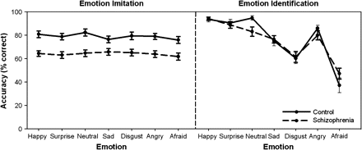
Fig. 3. Accuracy (% Correct) of Schizophrenia Patients and Healthy Control Participants on the Emotional Face ...
Notes:
Fig. 3. Accuracy (% Correct) of Schizophrenia Patients and Healthy Control Participants on the Emotional Face Imitation and Identification Tasks.
Unless provided in the caption above, the following copyright applies to the content of this slide: © The Author 2008. Published by Oxford University Press on behalf of the Maryland Psychiatric Research Center. All rights reserved. For permissions, please email: journals.permissions@oxfordjournals.org.

