Slide 1
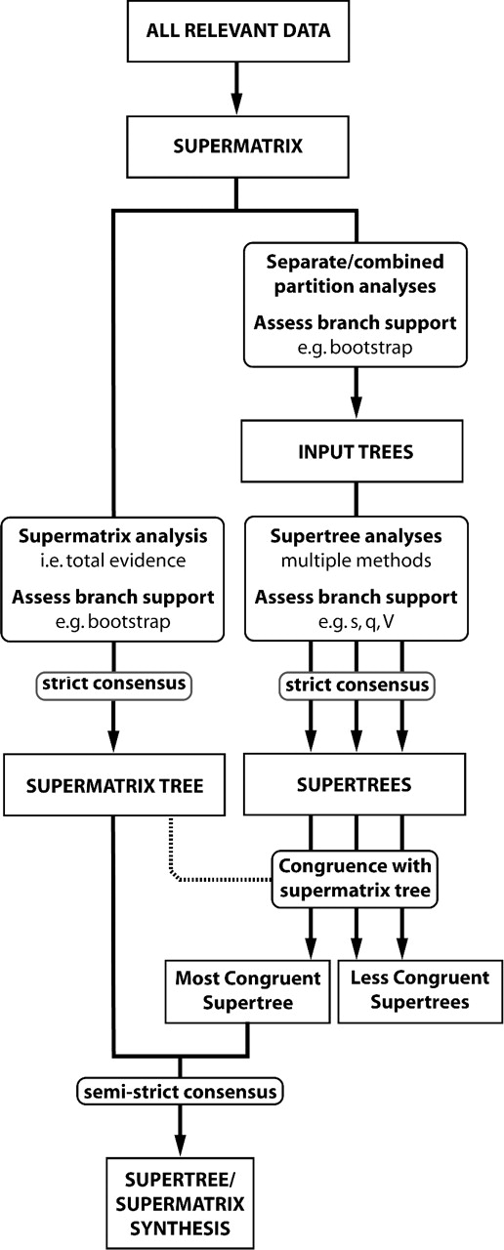
FIGURE 1. A schematic representation of the use of supermatrix and supertree methods in this study. See text for full ...
Notes:
FIGURE 1. A schematic representation of the use of supermatrix and supertree methods in this study. See text for full details.
Unless provided in the caption above, the following copyright applies to the content of this slide: © Society of Systematic Biologists

Slide 2
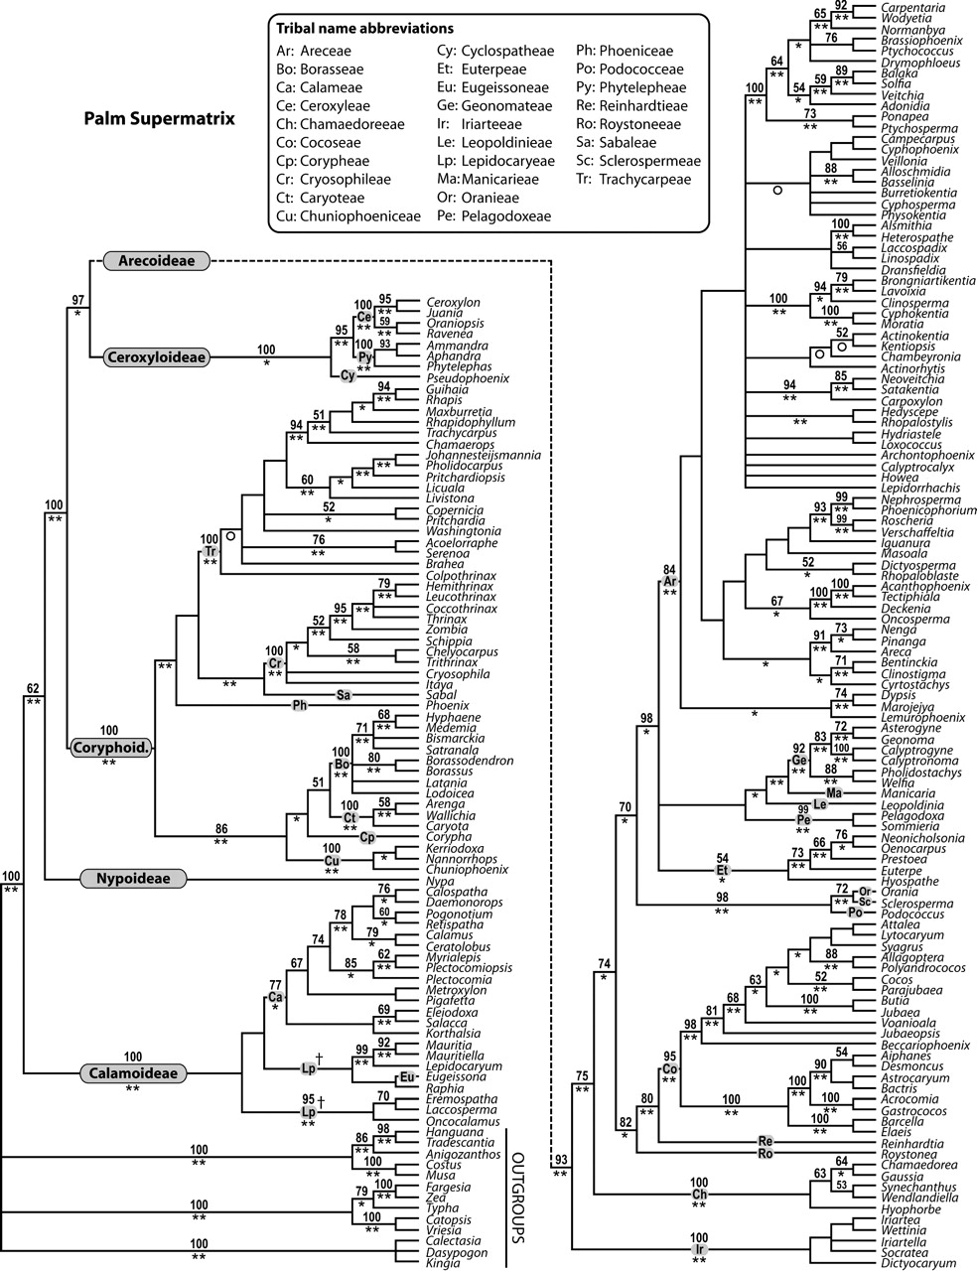
FIGURE 2. Strict consensus of the 46 080 trees from the supermatrix analysis of all palm genera (tree length = 15 173, ...
Notes:
FIGURE 2. Strict consensus of the 46 080 trees from the supermatrix analysis of all palm genera (tree length = 15 173, CI = 0.41, RI = 0.62). Values above branches are BPs (>50%). Asterisks below branches indicate clades also recovered in supertrees; 1 asterisk denotes a clade recovered in the “most congruent supertree”(Fig. 2), 2 asterisks denote a clade recovered in all supertrees summarized in Figure 3 (including the most congruent supertree, see Fig. 3 legend). An open circle indicates a clade absent from, but compatible with, the most congruent supertree. Palm subfamilies and tribes are indicated. Nonmonophyletic higher taxa are marked with a dagger symbol.
Unless provided in the caption above, the following copyright applies to the content of this slide: © Society of Systematic Biologists

Slide 3
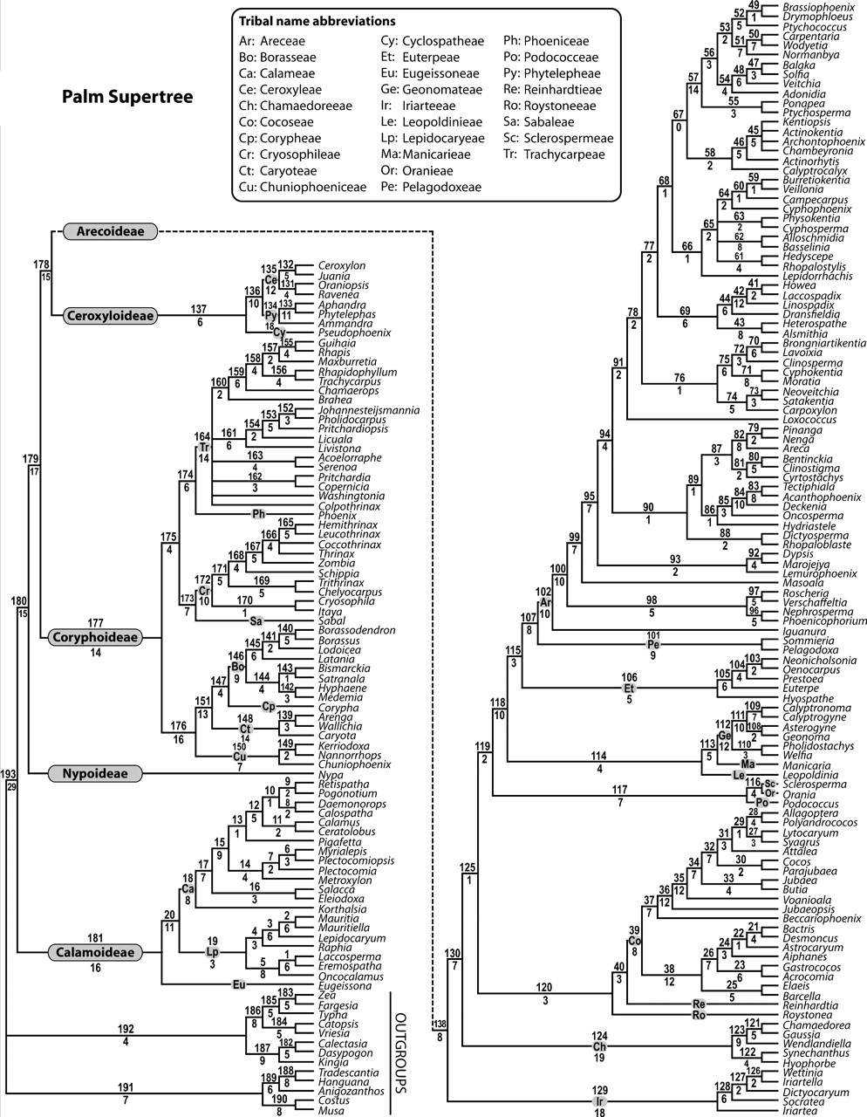
FIGURE 3. The “most congruent supertree.”Strict consensus of 5000 supertrees from standard MRP analysis based on the ...
Notes:
FIGURE 3. The “most congruent supertree.”Strict consensus of 5000 supertrees from standard MRP analysis based on the expanded input tree set with matrix elements weighted in proportion to bootstrap values of corresponding input tree clades (maximum weight = 10, tree length = 11 830.667, CI = 0.80, RI = 0.95). Numbers above branches are clade numbers (see online Supplementary Appendix 1 for support values). Those below branches indicate the number of input trees that support a given clade (s). Palm subfamilies and tribes are indicated. Only Node 67 is not supported by any input tree.
Unless provided in the caption above, the following copyright applies to the content of this slide: © Society of Systematic Biologists

Slide 4
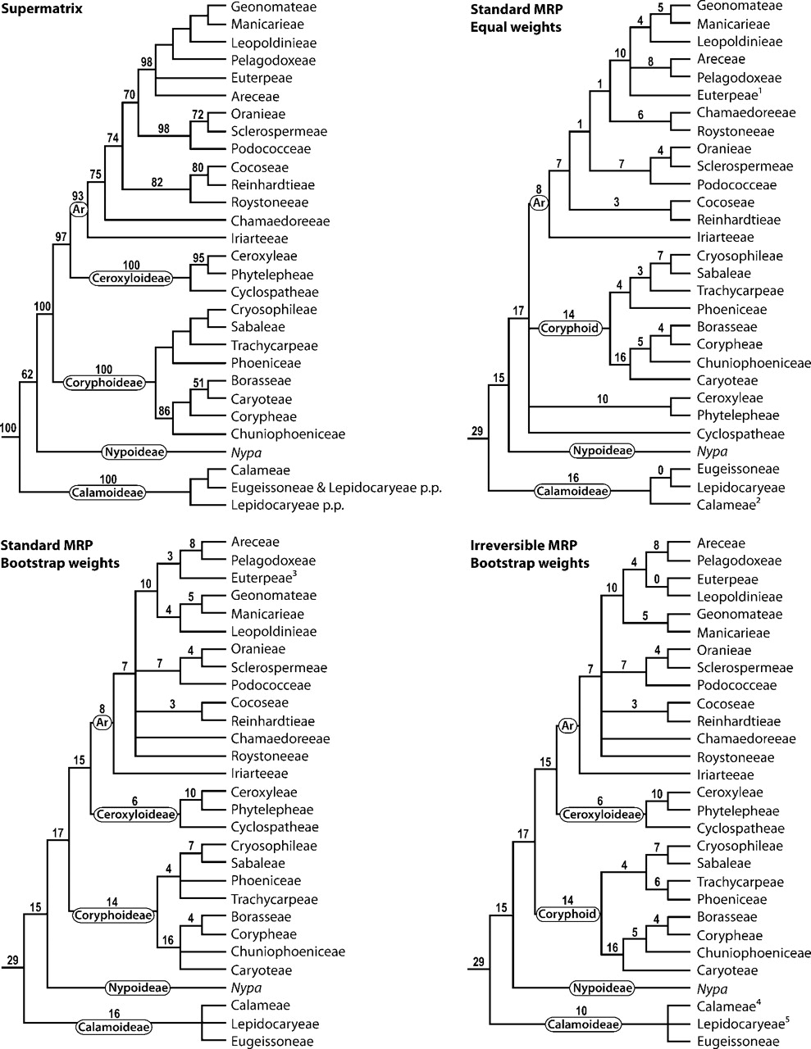
FIGURE 4. Summary trees depicting relationships between palm subfamilies and tribes that are resolved by the ...
Notes:
FIGURE 4. Summary trees depicting relationships between palm subfamilies and tribes that are resolved by the supermatrix and MRP analyses based on the expanded input tree set. The upper 2 trees show the relationships resolved by the supermatrix and equal weights standard MRP analyses. The lower 2 trees show relationships in common between all bootstrap-weighted standard MRP analyses and all bootstrap-weighted irreversible MRP analyses, respectively. The equal-weights irreversible MRP supertree is not shown here. Values above branches are BPs for the supermatrix tree and sfor the supertrees. Palm subfamilies are indicated (Ar = Arecoideae). Notes: 1Hyospatheresolves outside Euterpeae; 2Calameae paraphyletic; 3Hyospatheresolves outside Euterpeae in analyses with maximum weights = 1 and 2; 4nonmonophyletic in analyses with maximum weights = 1 and 2; 5nonmonophyletic in analyses with maximum weights = 1.
Unless provided in the caption above, the following copyright applies to the content of this slide: © Society of Systematic Biologists

Slide 5
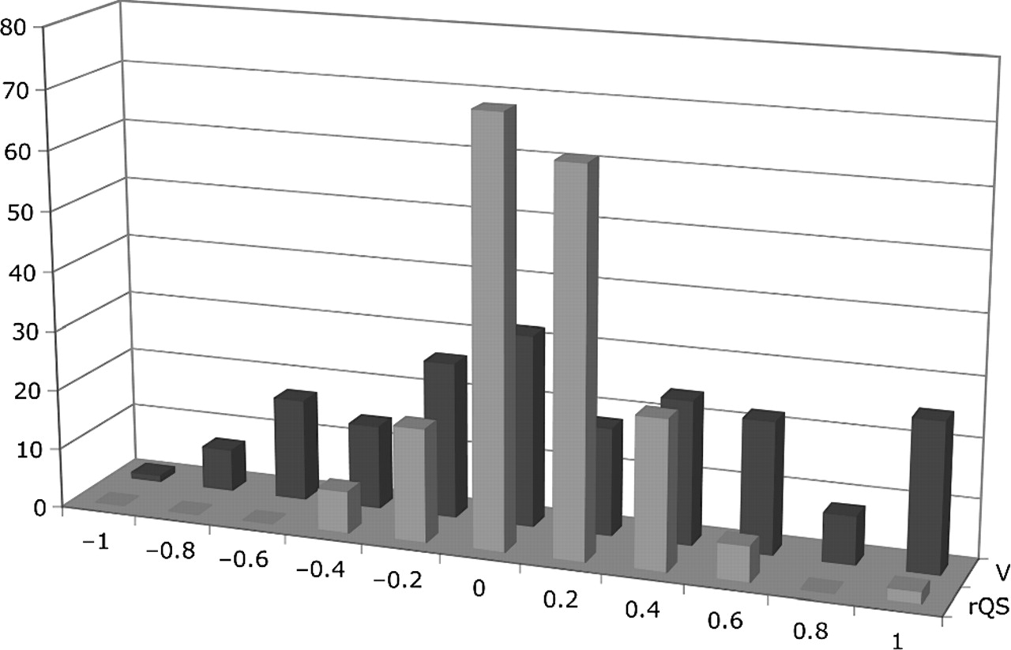
FIGURE 5. Histogram showing distribution of values of V and rQS derived from the “most congruent supertree”presented in ...
Notes:
FIGURE 5. Histogram showing distribution of values of V and rQS derived from the “most congruent supertree”presented in Figure 3.
Unless provided in the caption above, the following copyright applies to the content of this slide: © Society of Systematic Biologists

