Slide 1
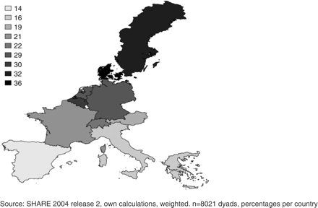
Figure 1 Help for parents during the last 12 months
Notes:
Figure 1 Help for parents during the last 12 months
Unless provided in the caption above, the following copyright applies to the content of this slide: © The Author 2009. Published by Oxford University Press. All rights reserved. For permissions, please e-mail: journals.permissions@oxfordjournals.org

Slide 2
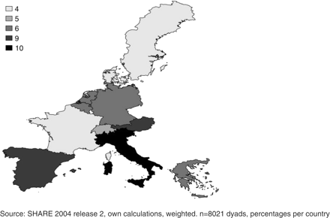
Figure 2 Care for parents during the last 12 months
Notes:
Figure 2 Care for parents during the last 12 months
Unless provided in the caption above, the following copyright applies to the content of this slide: © The Author 2009. Published by Oxford University Press. All rights reserved. For permissions, please e-mail: journals.permissions@oxfordjournals.org

Slide 3
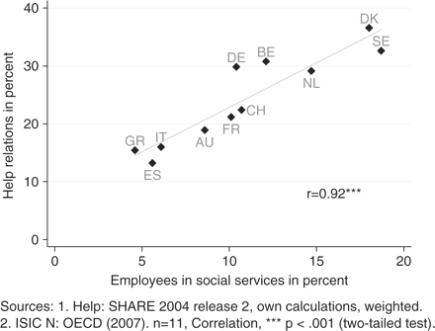
Figure 3 Help for parents during the last 12 months and social services
Notes:
Figure 3 Help for parents during the last 12 months and social services
Unless provided in the caption above, the following copyright applies to the content of this slide: © The Author 2009. Published by Oxford University Press. All rights reserved. For permissions, please e-mail: journals.permissions@oxfordjournals.org

Slide 4
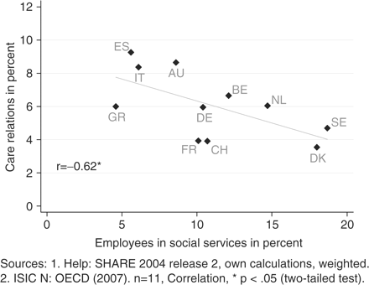
Figure 4 Care for parents during the last 12 months and social services
Notes:
Figure 4 Care for parents during the last 12 months and social services
Unless provided in the caption above, the following copyright applies to the content of this slide: © The Author 2009. Published by Oxford University Press. All rights reserved. For permissions, please e-mail: journals.permissions@oxfordjournals.org

