Slide 1
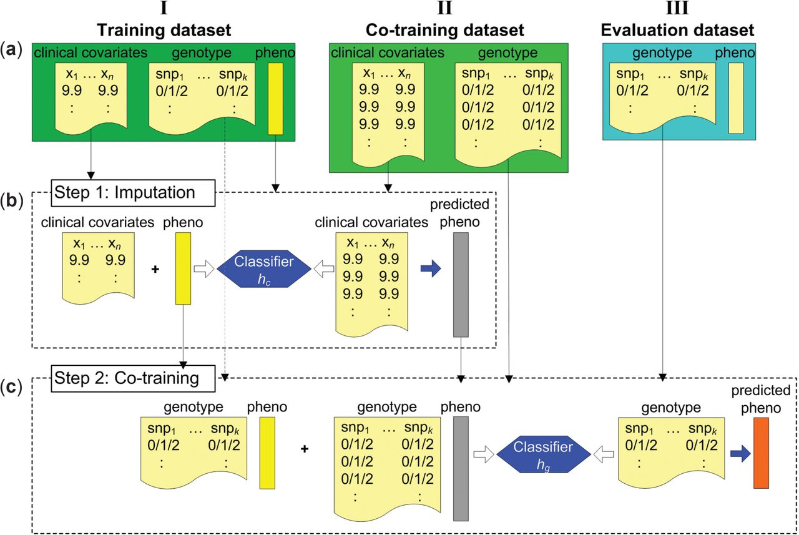
Fig. 1. Partitioning of the data and the proposed two-stage approach to co-training. Information about the disease ...
Notes:
Fig. 1. Partitioning of the data and the proposed two-stage approach to co-training. Information about the disease phenotype (diagnosis) indicated as “pheno” and colored in gold (true labels) and silver (imputed labels). Clinical covariates shown as a generic real value (9.9). Genotype information coded as a model of additive effects {0, 1, 2}
Unless provided in the caption above, the following copyright applies to the content of this slide: © The Author 2015. Published by Oxford University Press.This is an Open Access article distributed under the terms of the Creative Commons Attribution Non-Commercial License (http://creativecommons.org/licenses/by-nc/4.0/), which permits non-commercial re-use, distribution, and reproduction in any medium, provided the original work is properly cited. For commercial re-use, please contact journals.permissions@oup.com

Slide 2
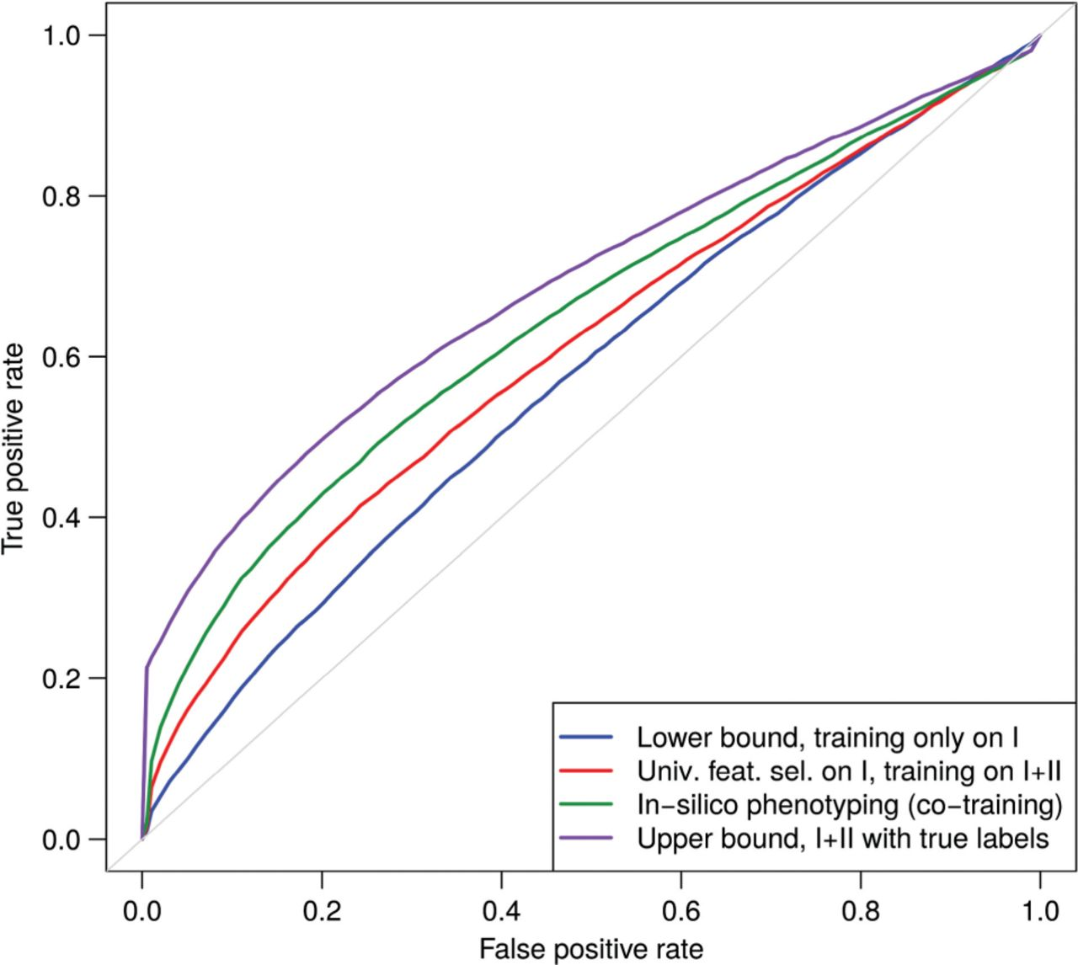
Fig. 2. ROC curves of bounds and prediction performance of in silico phenotyping. Partition of data into sets: I = ...
Notes:
Fig. 2. ROC curves of bounds and prediction performance of in silico phenotyping. Partition of data into sets: I = 10%, II = 70% and III = 20%; 100 random folds
Unless provided in the caption above, the following copyright applies to the content of this slide: © The Author 2015. Published by Oxford University Press.This is an Open Access article distributed under the terms of the Creative Commons Attribution Non-Commercial License (http://creativecommons.org/licenses/by-nc/4.0/), which permits non-commercial re-use, distribution, and reproduction in any medium, provided the original work is properly cited. For commercial re-use, please contact journals.permissions@oup.com

Slide 3
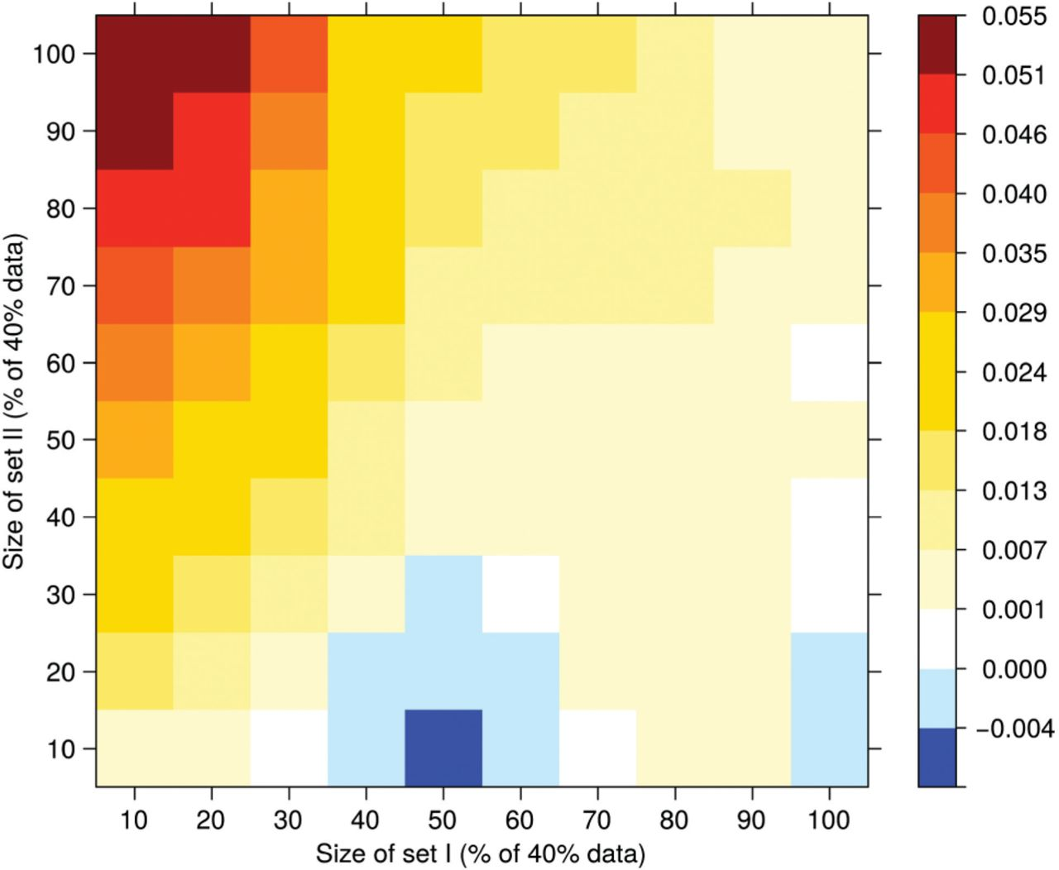
Fig. 3. Delta of mean AUC (in silico phenotyping vs. lower bound) for varying sizes of I and II
Notes:
Fig. 3. Delta of mean AUC (in silico phenotyping vs. lower bound) for varying sizes of I and II
Unless provided in the caption above, the following copyright applies to the content of this slide: © The Author 2015. Published by Oxford University Press.This is an Open Access article distributed under the terms of the Creative Commons Attribution Non-Commercial License (http://creativecommons.org/licenses/by-nc/4.0/), which permits non-commercial re-use, distribution, and reproduction in any medium, provided the original work is properly cited. For commercial re-use, please contact journals.permissions@oup.com

