Slide 1
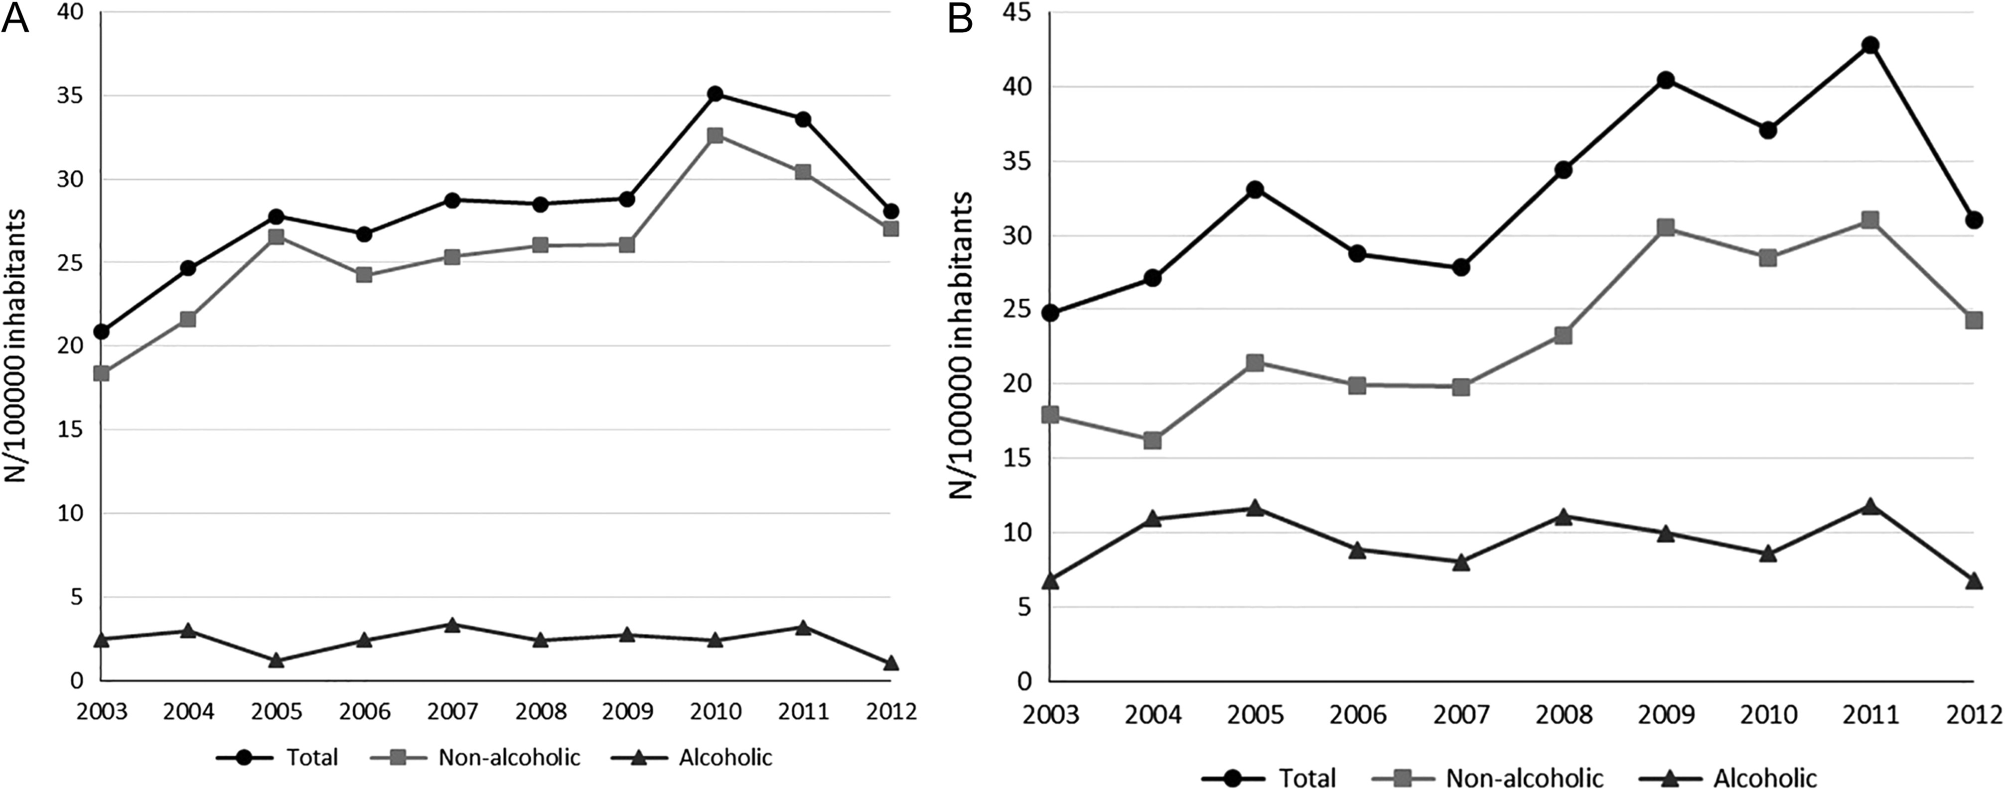
Fig. 1. Annual age-adjusted incidence in women (A) and men (B). Increasing time trends were found for total and ...
Notes:
Fig. 1. Annual age-adjusted incidence in women (A) and men (B). Increasing time trends were found for total and non-alcoholic AP in both men and women (Pearson coefficient r = 0.63 – 0.8, P 0.05).
Unless provided in the caption above, the following copyright applies to the content of this slide: © The Author 2017. Medical Council on Alcohol and Oxford University Press. All rights reserved.

Slide 2
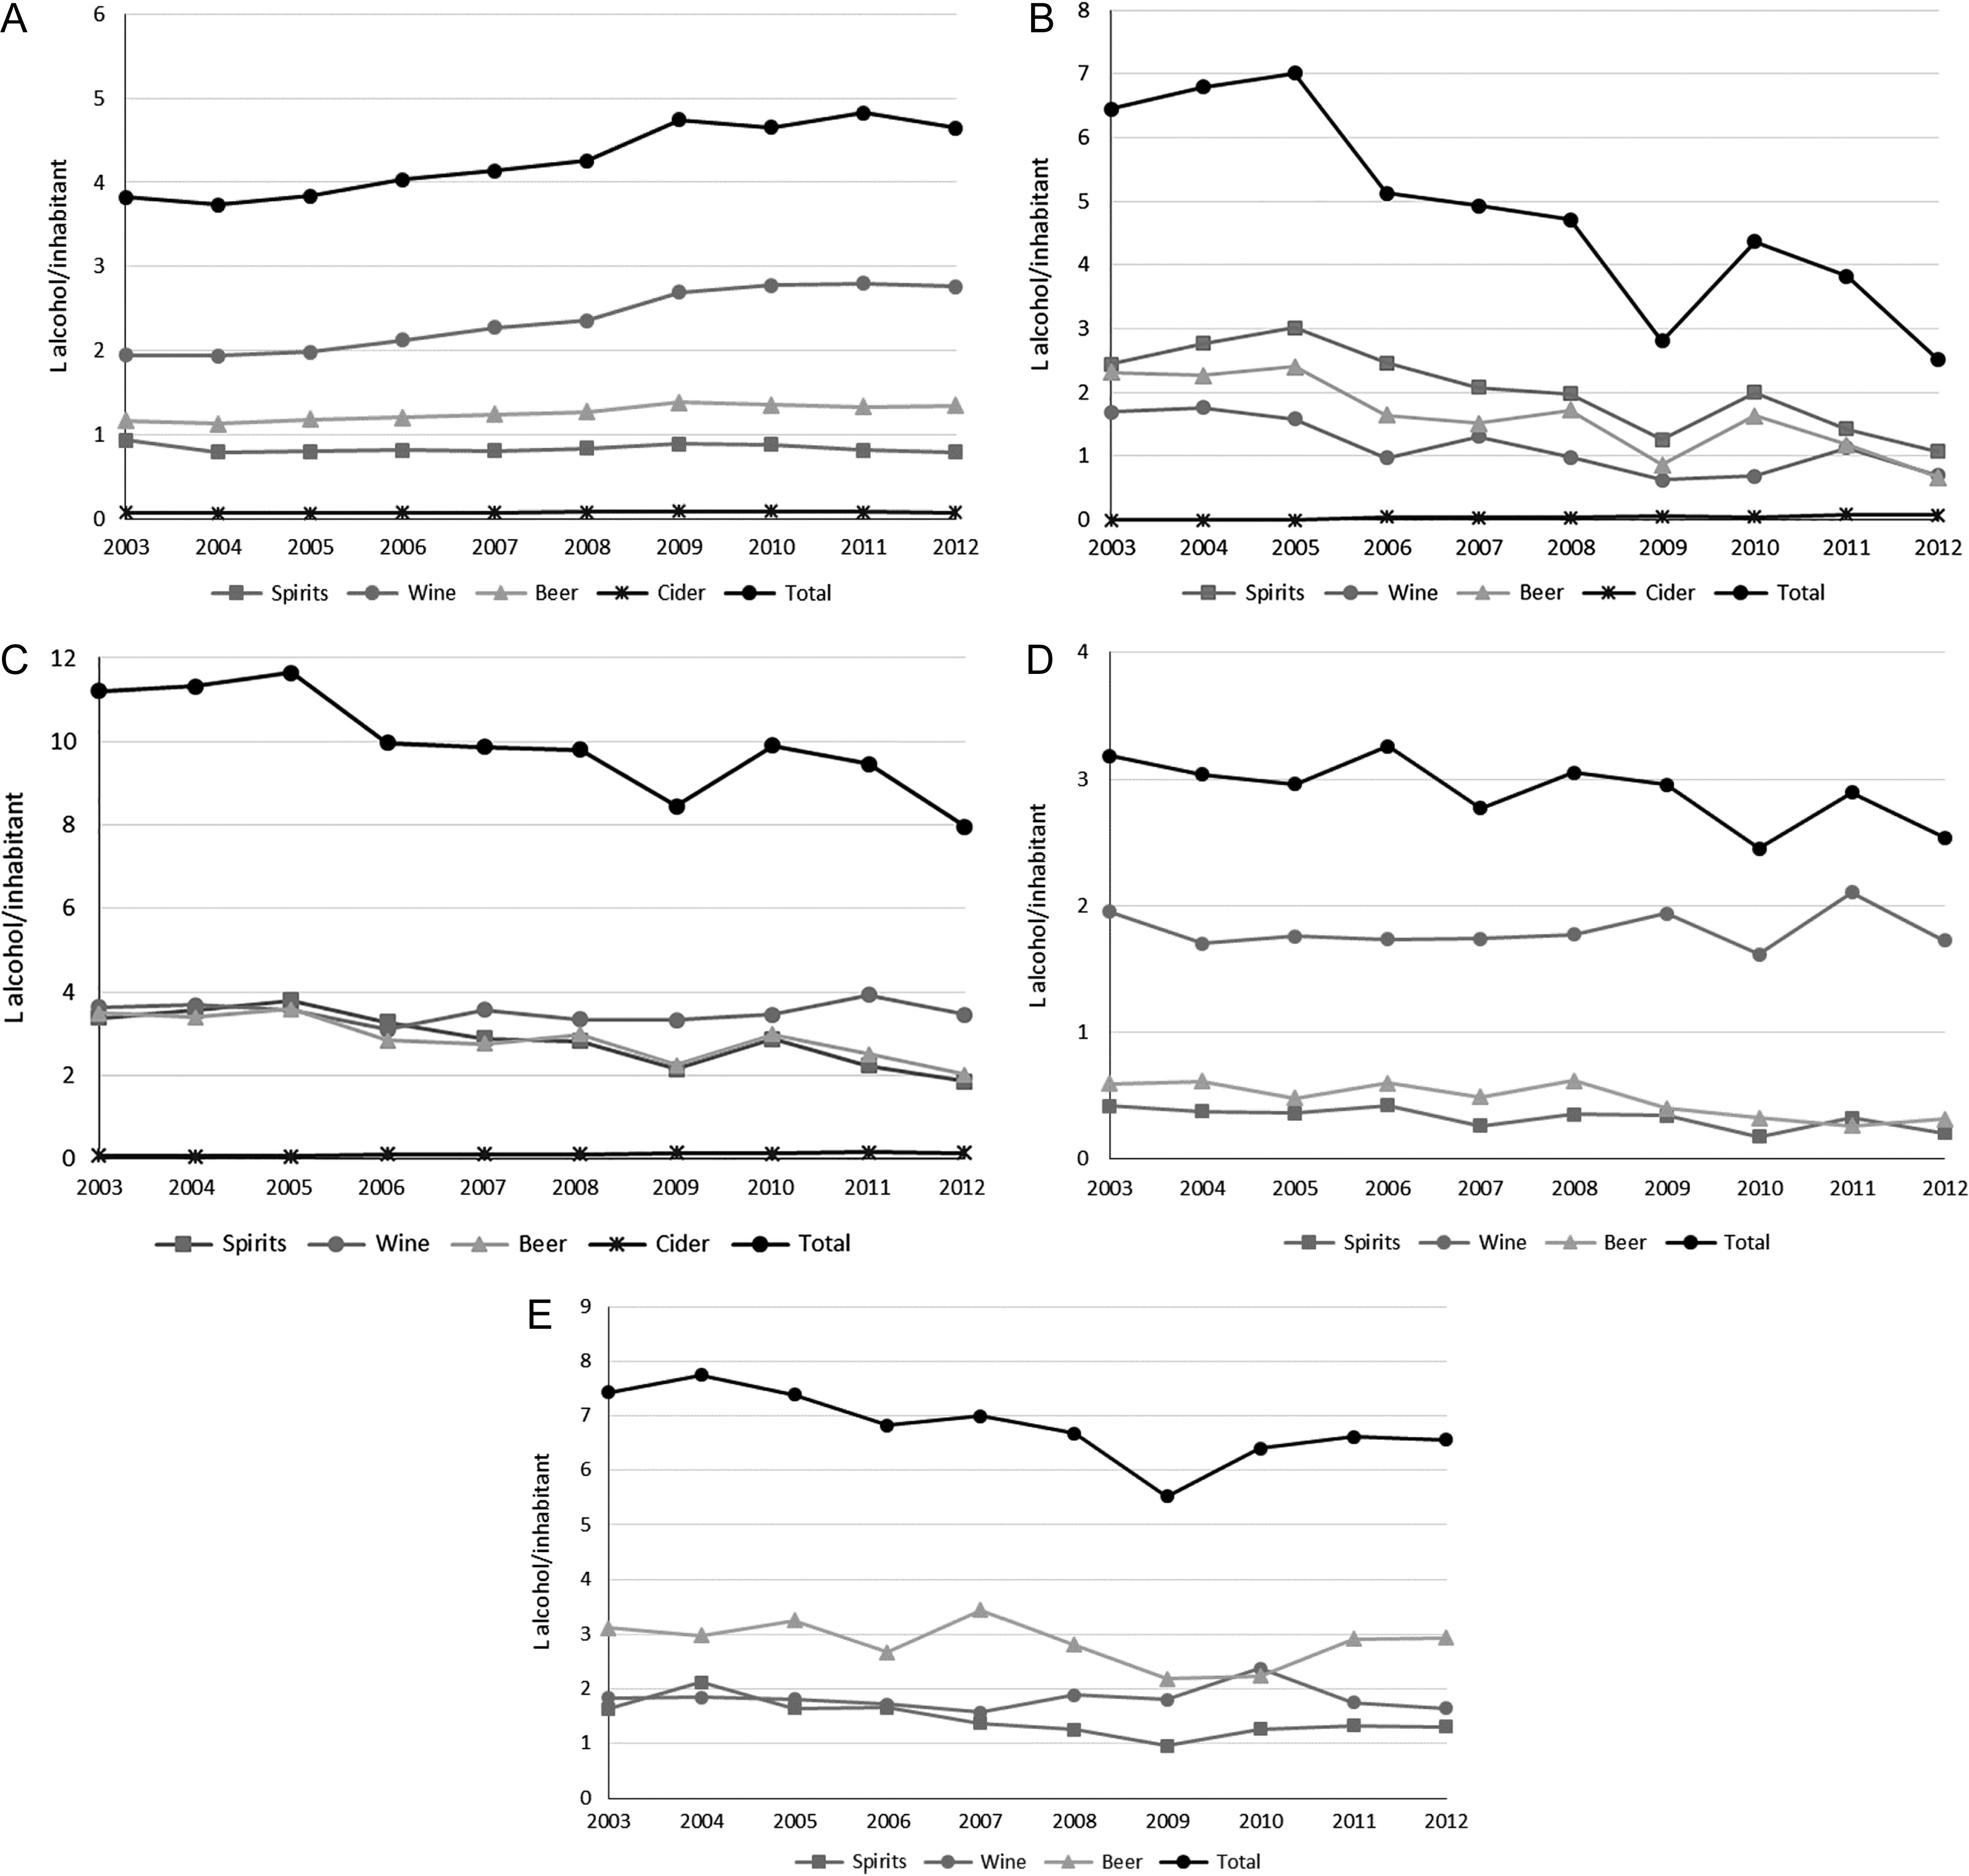
Fig. 2. Annual alcohol sales in the general population during the study period: registered (A), unregistered (B) and ...
Notes:
Fig. 2. Annual alcohol sales in the general population during the study period: registered (A), unregistered (B) and total (C) and annual self-reported alcohol consumption in the general population during the study period for women (D) and men (E). (A) Increasing time trends for total alcohol, wine, beer and cider (Pearson coefficient r = 0.67 – 0.97, P < 0.05 for all), but not for spirits (Pearson coefficient r = −0.18, P = 0.625). (B) Decreasing time trends for total alcohol, spirits, wine and beer (Pearson coefficient r = −0.83 to −0.90, P < 0.05 for all). Increasing time trend for cider (Pearson coefficient r = 0.92, P < 0.001). (C) Decreasing time trends for total alcohol, spirits and beer (Pearson coefficient r = −0.84 to −0.89, P < 0.001). Increasing time trend for cider (Pearson coefficient r = 0.92, P < 0.001). No significant change for wine (r = −0.00, P = 0.991). (D) Decreasing time trends for spirits and beer (Pearson coefficient r = −0.70 to −0.83, P 0.05). (E) Decreasing time trends for total alcohol consumption and spirits (Pearson coefficient r = −0.71 to −0.75, P 0.05).
Unless provided in the caption above, the following copyright applies to the content of this slide: © The Author 2017. Medical Council on Alcohol and Oxford University Press. All rights reserved.

