Slide 1
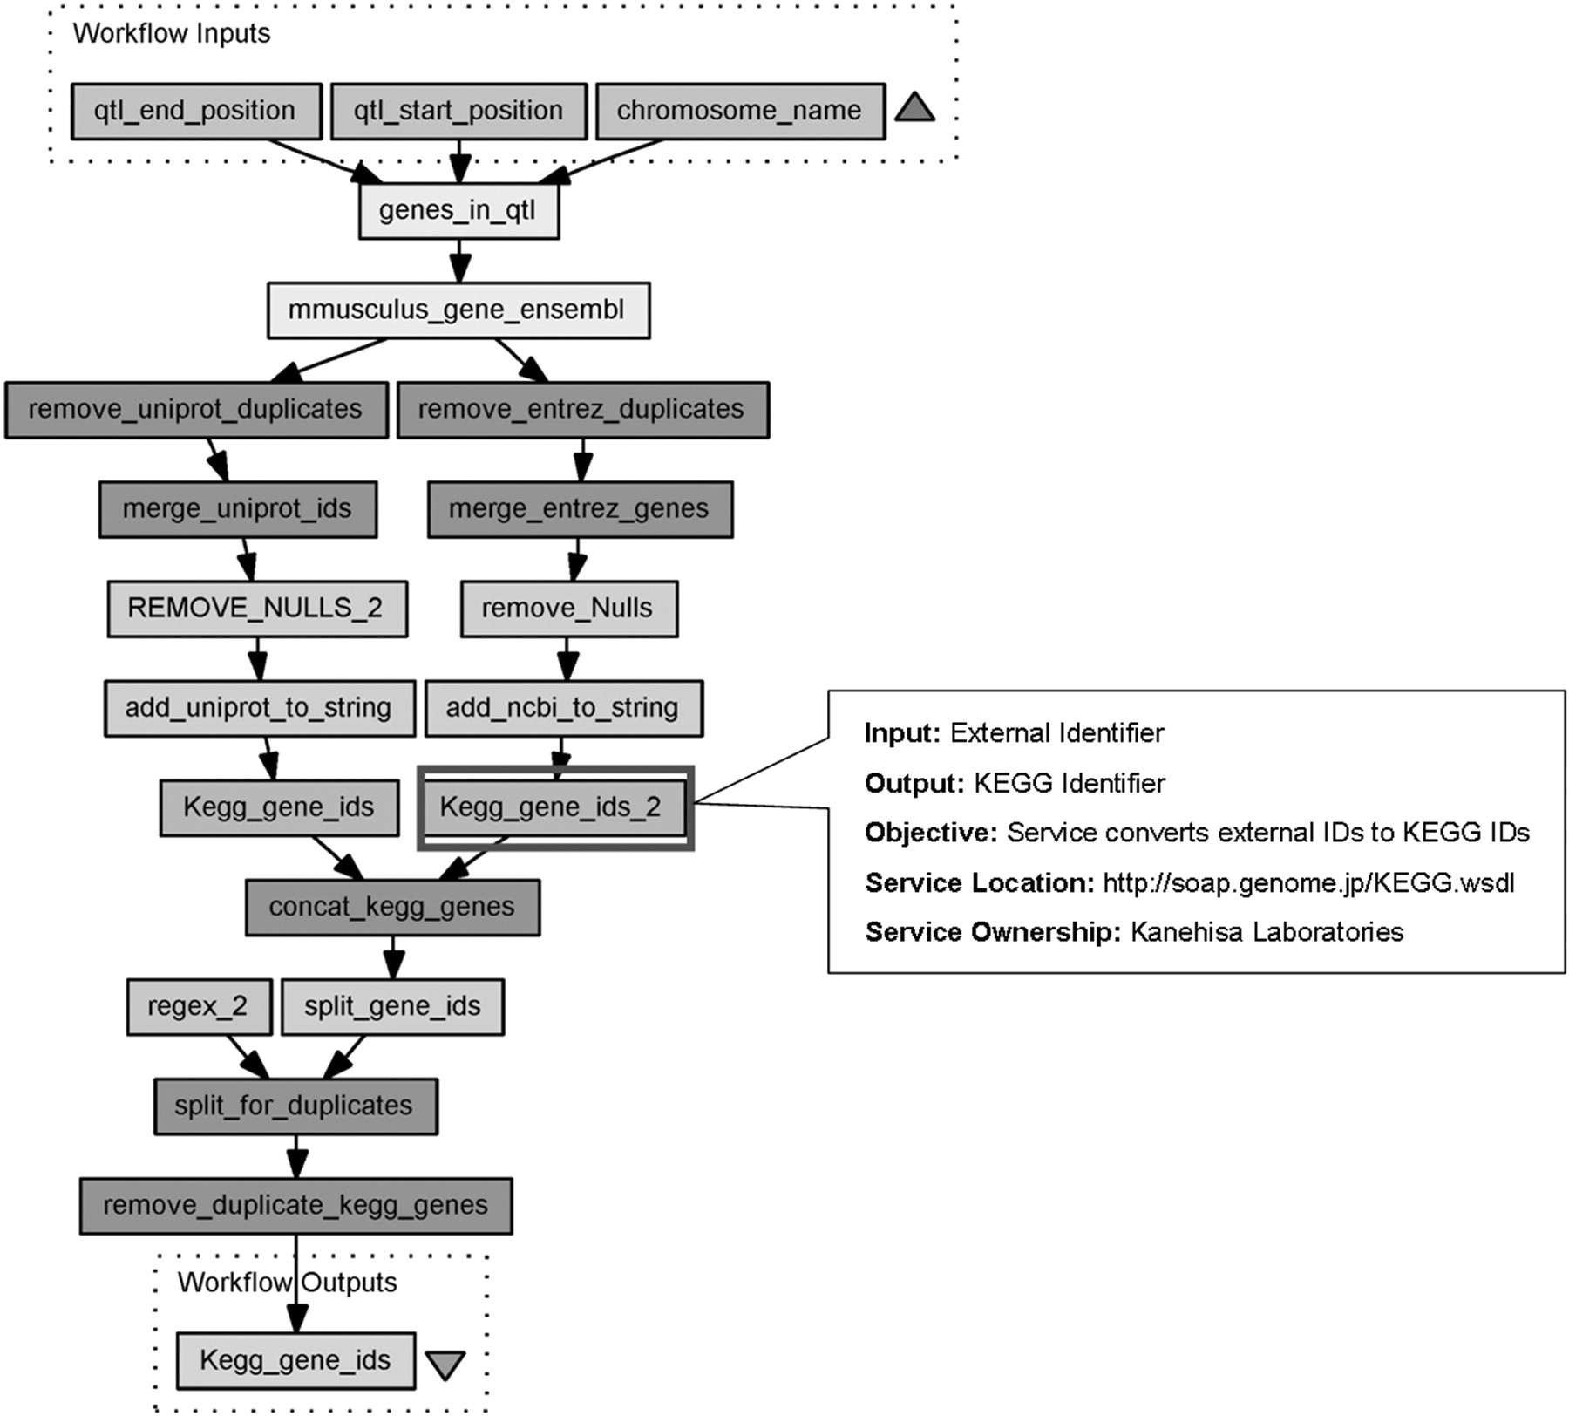
Figure 1: A workflow from the Taverna workflow management system [35], highlighting a KEGG [66] web service operation.
Notes:
Figure 1: A workflow from the Taverna workflow management system [35], highlighting a KEGG [66] web service operation.
Unless provided in the caption above, the following copyright applies to the content of this slide: © The Author 2008. Published by Oxford University Press. For Permissions, please email: journals.permissions@oxfordjournals.org

Slide 2
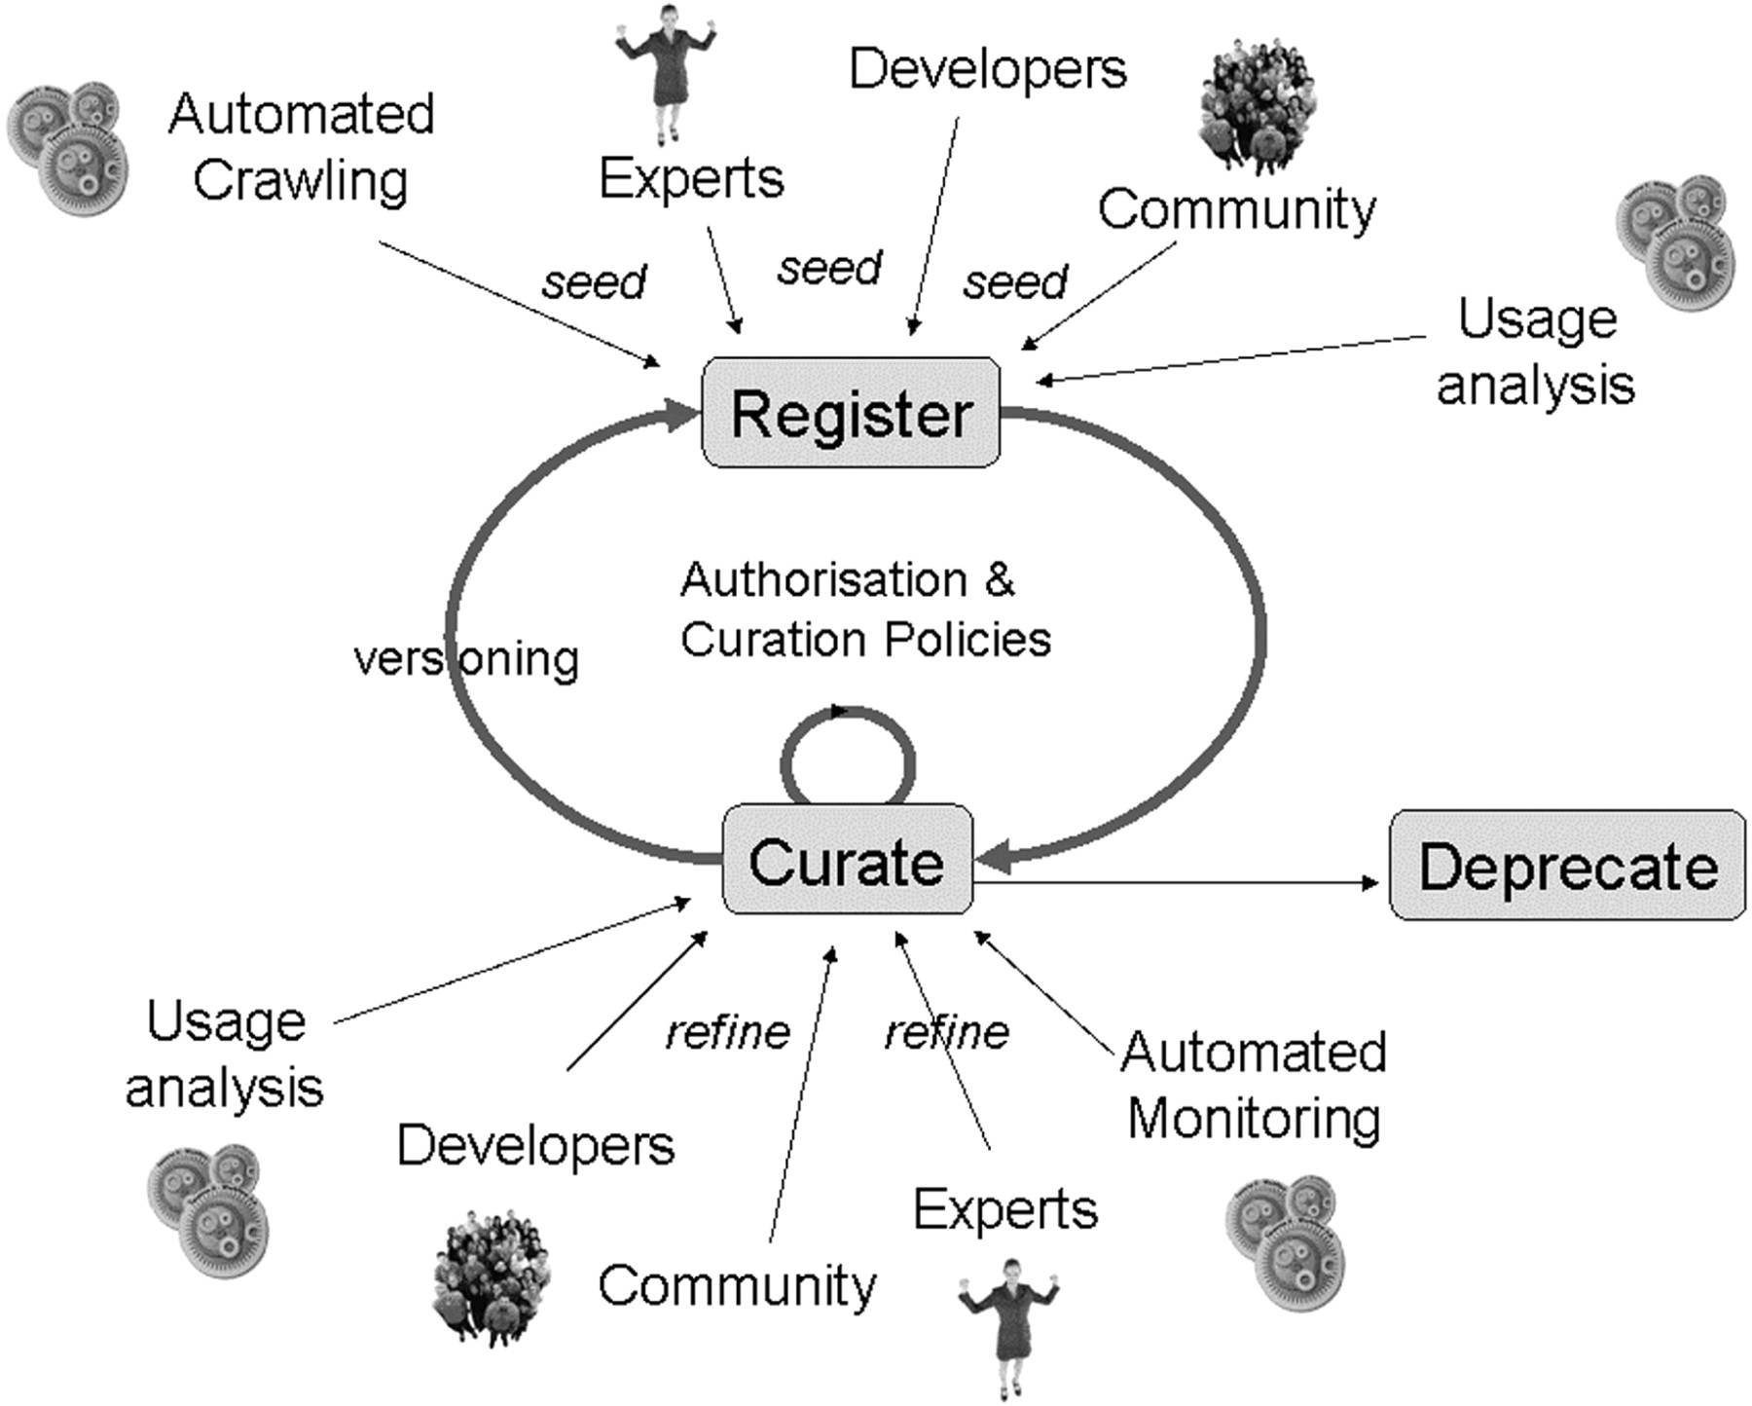
Figure 3: Curation life cycle and its participating curators.
Notes:
Figure 3: Curation life cycle and its participating curators.
Unless provided in the caption above, the following copyright applies to the content of this slide: © The Author 2008. Published by Oxford University Press. For Permissions, please email: journals.permissions@oxfordjournals.org

Slide 3
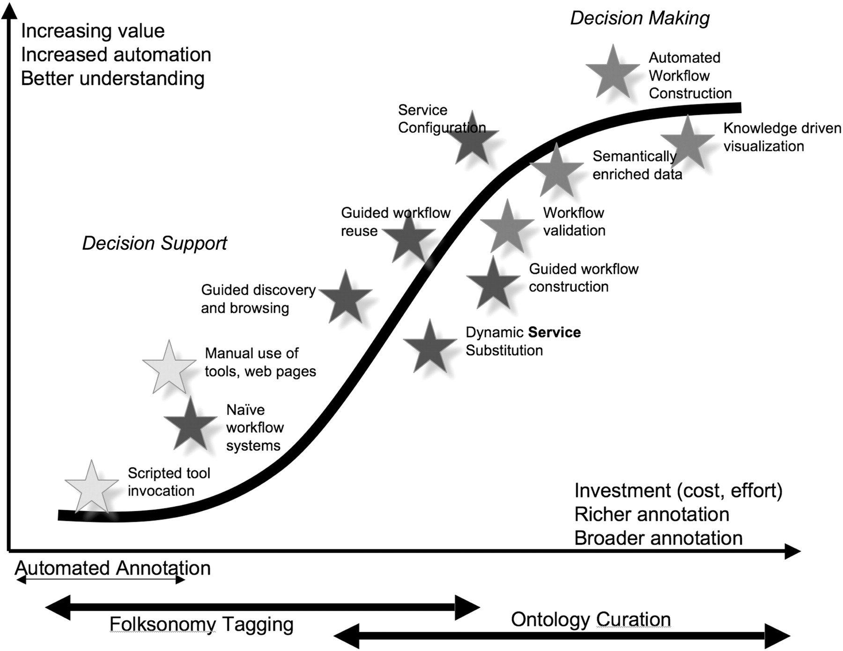
Figure 2: A curation continuum for functional metadata.
Notes:
Figure 2: A curation continuum for functional metadata.
Unless provided in the caption above, the following copyright applies to the content of this slide: © The Author 2008. Published by Oxford University Press. For Permissions, please email: journals.permissions@oxfordjournals.org

