Slide 1
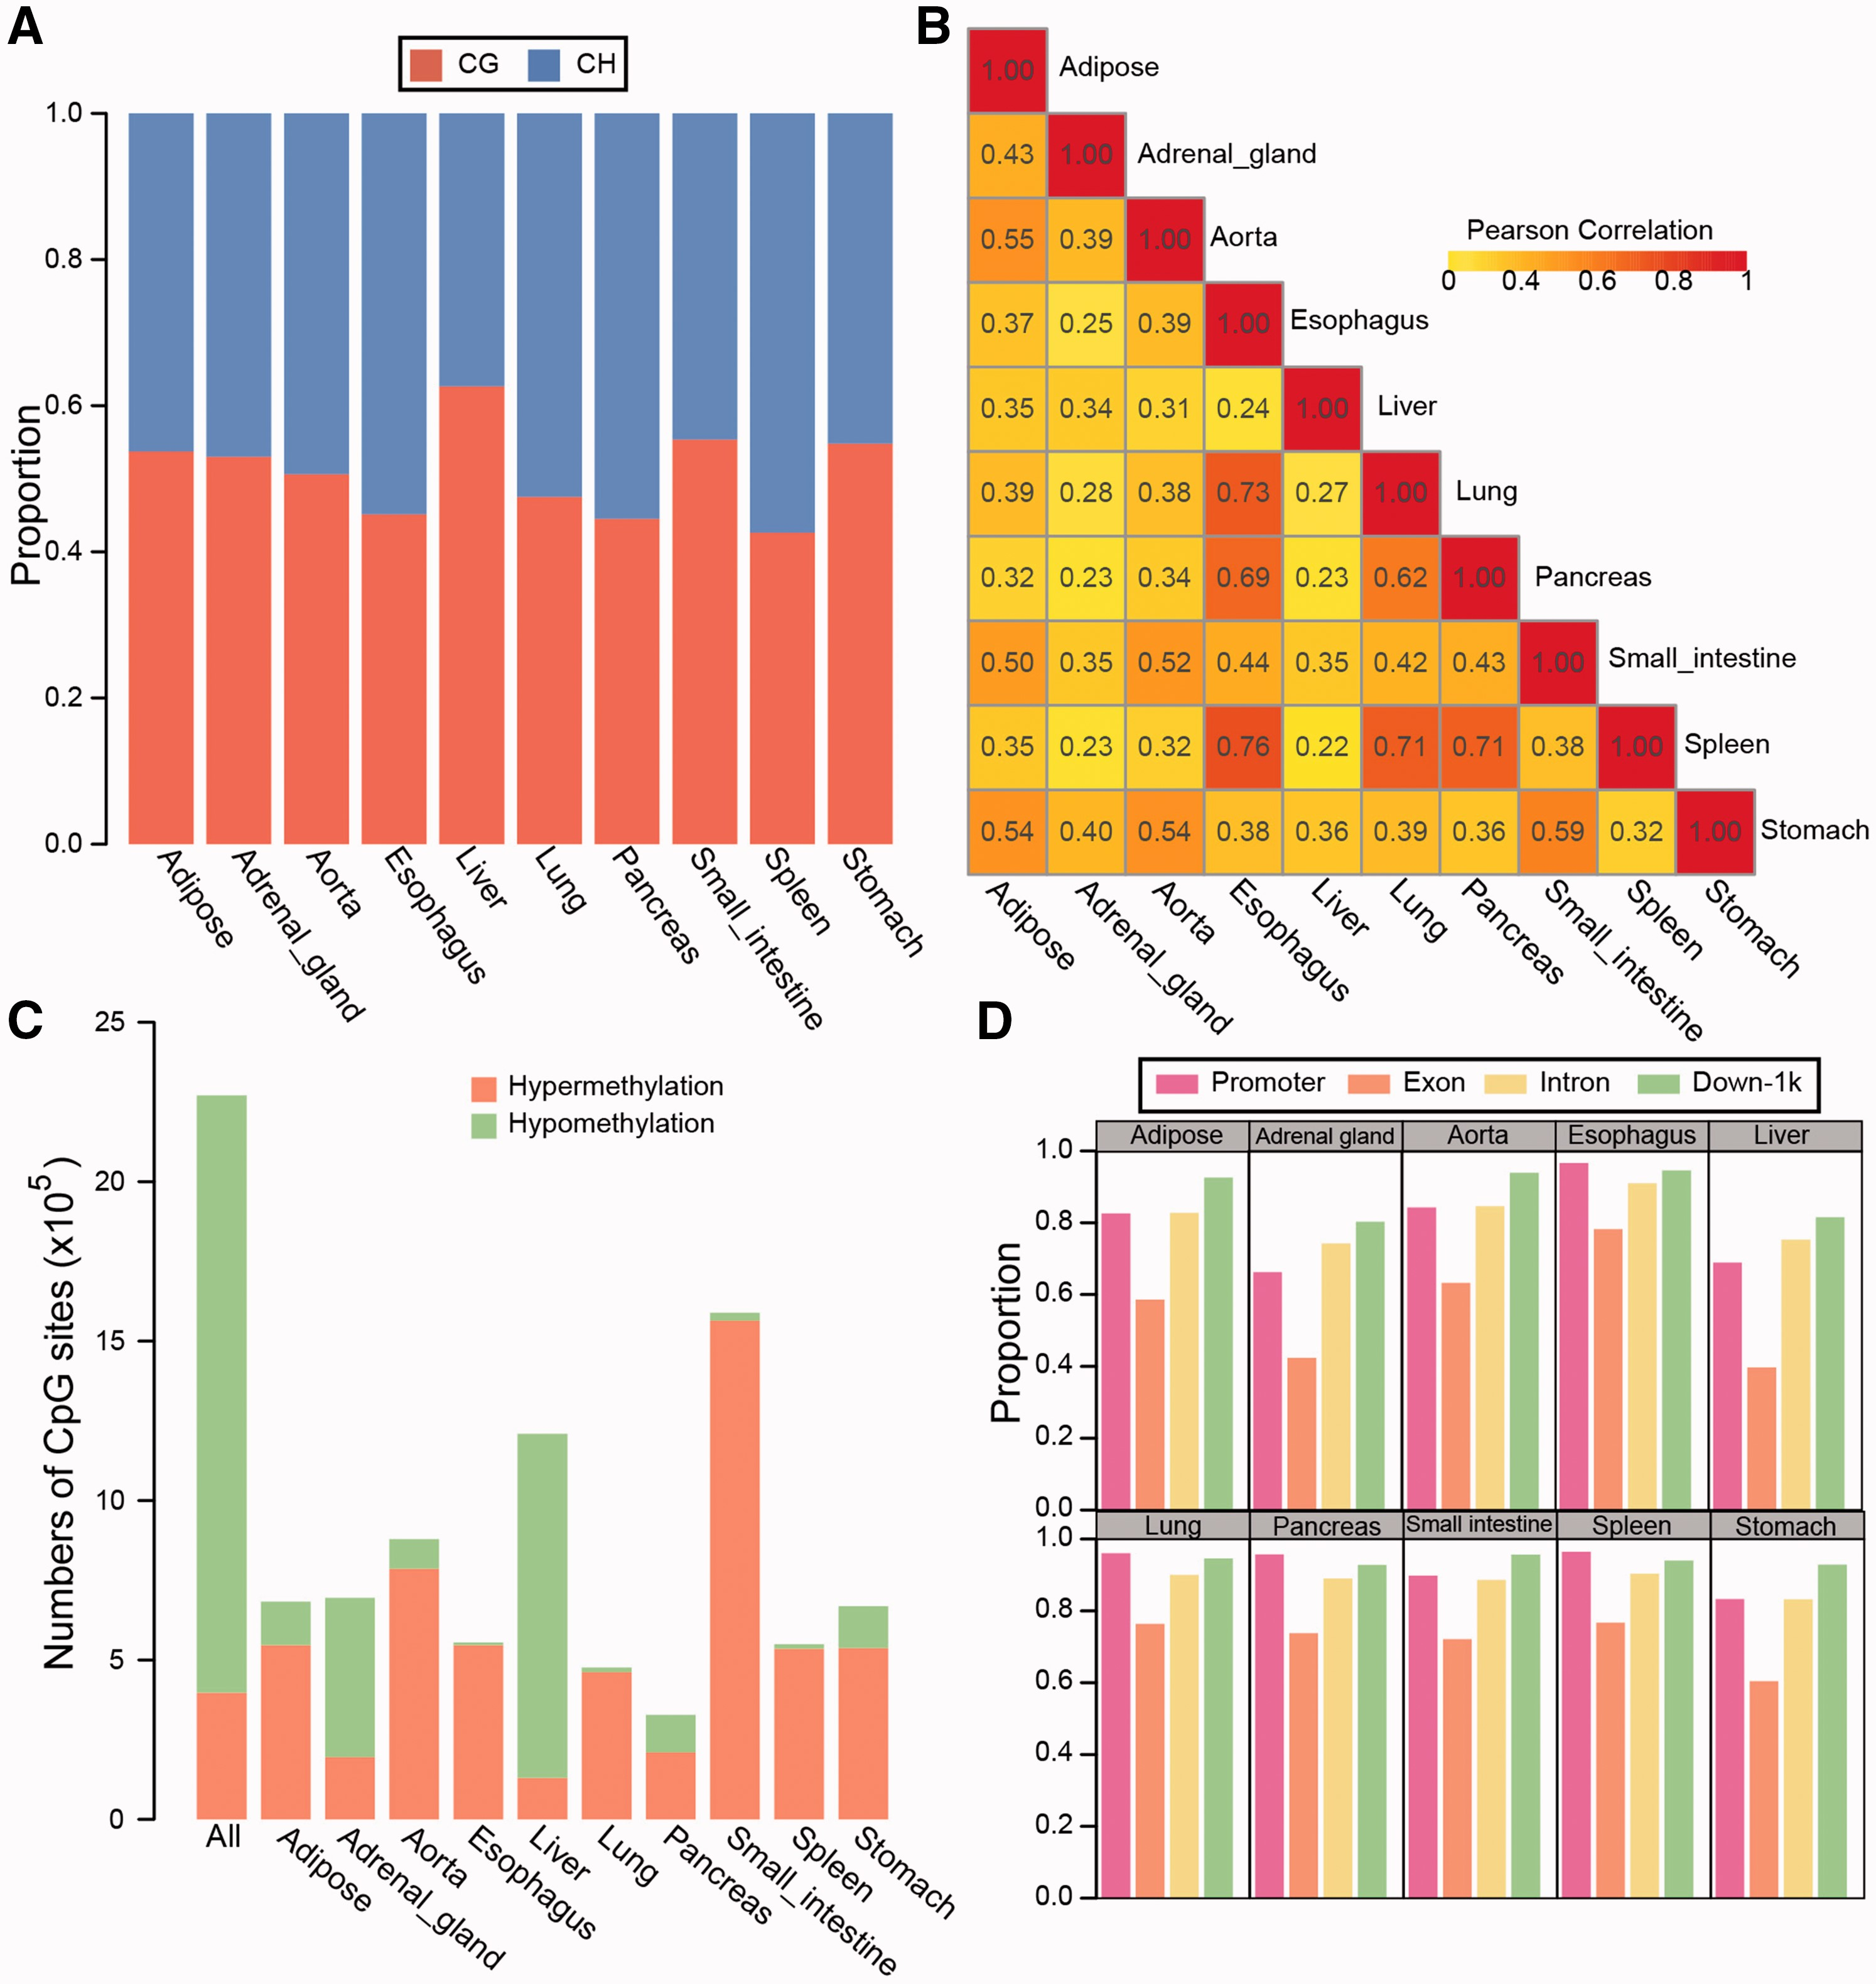
Figure 1 Pervasive DNA methylation across the human genome in multiple tissues. (A) Composition of all methylated ...
Notes:
Figure 1 Pervasive DNA methylation across the human genome in multiple tissues. (A) Composition of all methylated cytosine loci in the human genome across various tissues. The proportion of each type of cytosines was denoted by bars. (B) The correlation of methylation densities between tissues. The whole genome was split into 1 kb regions, then the mean methylation levels of CpGs within each 1 kb region were calculated. The genome-wide methylation intensities of different tissues were compared, and the Pearson Correlation Coefficient was computed. (C) Numbers of common and tissue-specific high-methylated and low-methylated cytosines. (D) The fraction of methylated features (features harboring mCpGs) in different human tissues. These gene-related features included promoters (the up 1 kb regions of genes), exons, introns and down 1 kb regions.
Unless provided in the caption above, the following copyright applies to the content of this slide: © The Author 2017. Published by Oxford University Press. All rights reserved. For Permissions, please email: journals.permissions@oup.comThis article is published and distributed under the terms of the Oxford University Press, Standard Journals Publication Model (https://academic.oup.com/journals/pages/open_access/funder_policies/chorus/standard_publication_model)

Slide 2
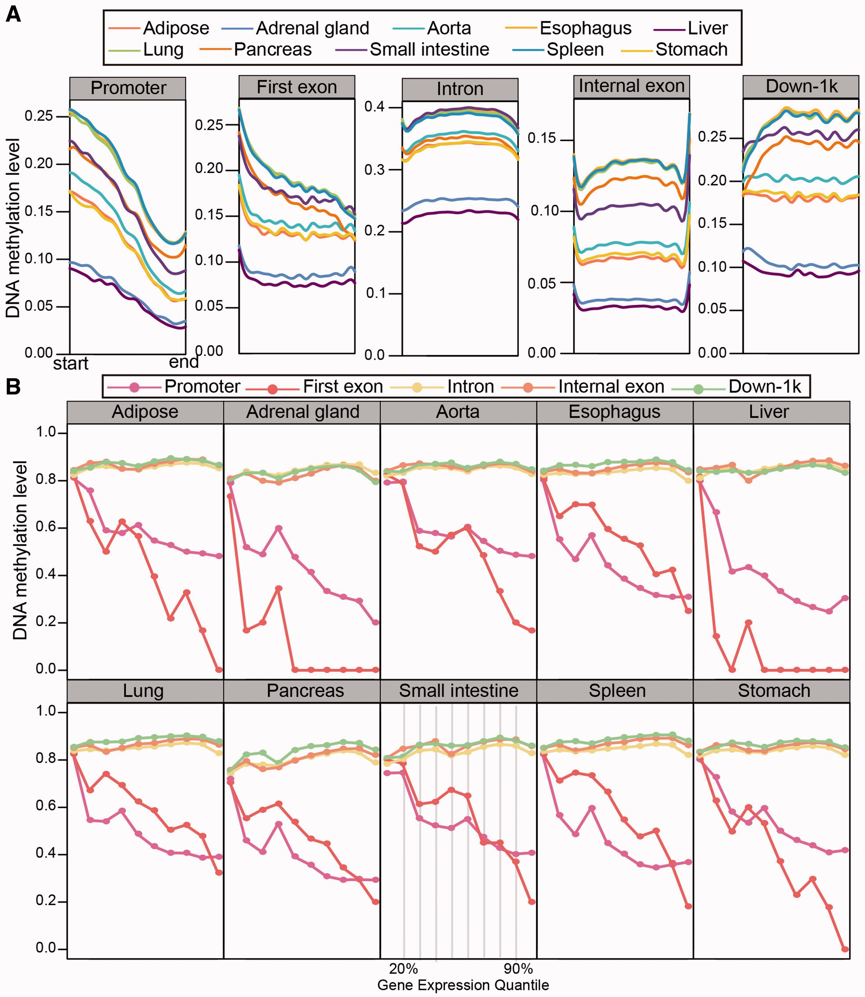
Figure 2 Distributions and effects of DNA methylation levels in genomic features. (A) The distribution of DNA ...
Notes:
Figure 2 Distributions and effects of DNA methylation levels in genomic features. (A) The distribution of DNA methylation levels across different regions (promoters, first exons, introns, internal exons and down 1 kb regions). Each region was partitioned into 20 equal bins; the average methylation levels within each bin were then calculated for each region. Lines were smoothened across these 20 bins. The Y-axis shows DNA methylation levels as beta values, and the X-axis indicates the regions. (B) The relationship between methylation levels in genomic features and expression levels of corresponding genes. Genes were divided into 10 groups, according to their expression levels. In each panel, which stands for one tissue type, gene groups are represented by points. The Y-axis shows the average methylation levels, as beta values, for each gene group; the X-axis shows the expression quantiles, from low to high levels.
Unless provided in the caption above, the following copyright applies to the content of this slide: © The Author 2017. Published by Oxford University Press. All rights reserved. For Permissions, please email: journals.permissions@oup.comThis article is published and distributed under the terms of the Oxford University Press, Standard Journals Publication Model (https://academic.oup.com/journals/pages/open_access/funder_policies/chorus/standard_publication_model)

Slide 3
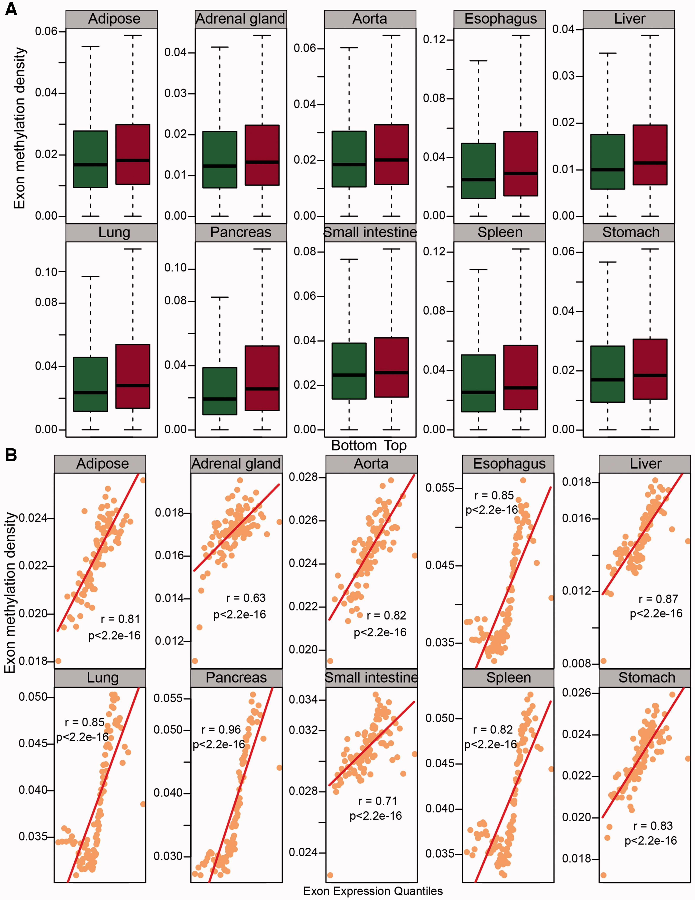
Figure 3 Positive correlation between exon methylation and expression levels. (A) Boxplots showing the difference of ...
Notes:
Figure 3 Positive correlation between exon methylation and expression levels. (A) Boxplots showing the difference of methylation levels between exons from the top 20th expression percentile and bottom 20th percentile. Red boxes represent the top 20th percentile, and green boxes are the bottom 20th percentile. (B) Scatterplots showing the positive relationship between exon methylation and expression levels. Exons were grouped into 100 bins, according to their expression levels; each point designates the median expression levels or methylation levels for individual bins. The points are in ascending order of expression level, from left to right, on the X-axis.
Unless provided in the caption above, the following copyright applies to the content of this slide: © The Author 2017. Published by Oxford University Press. All rights reserved. For Permissions, please email: journals.permissions@oup.comThis article is published and distributed under the terms of the Oxford University Press, Standard Journals Publication Model (https://academic.oup.com/journals/pages/open_access/funder_policies/chorus/standard_publication_model)

Slide 4
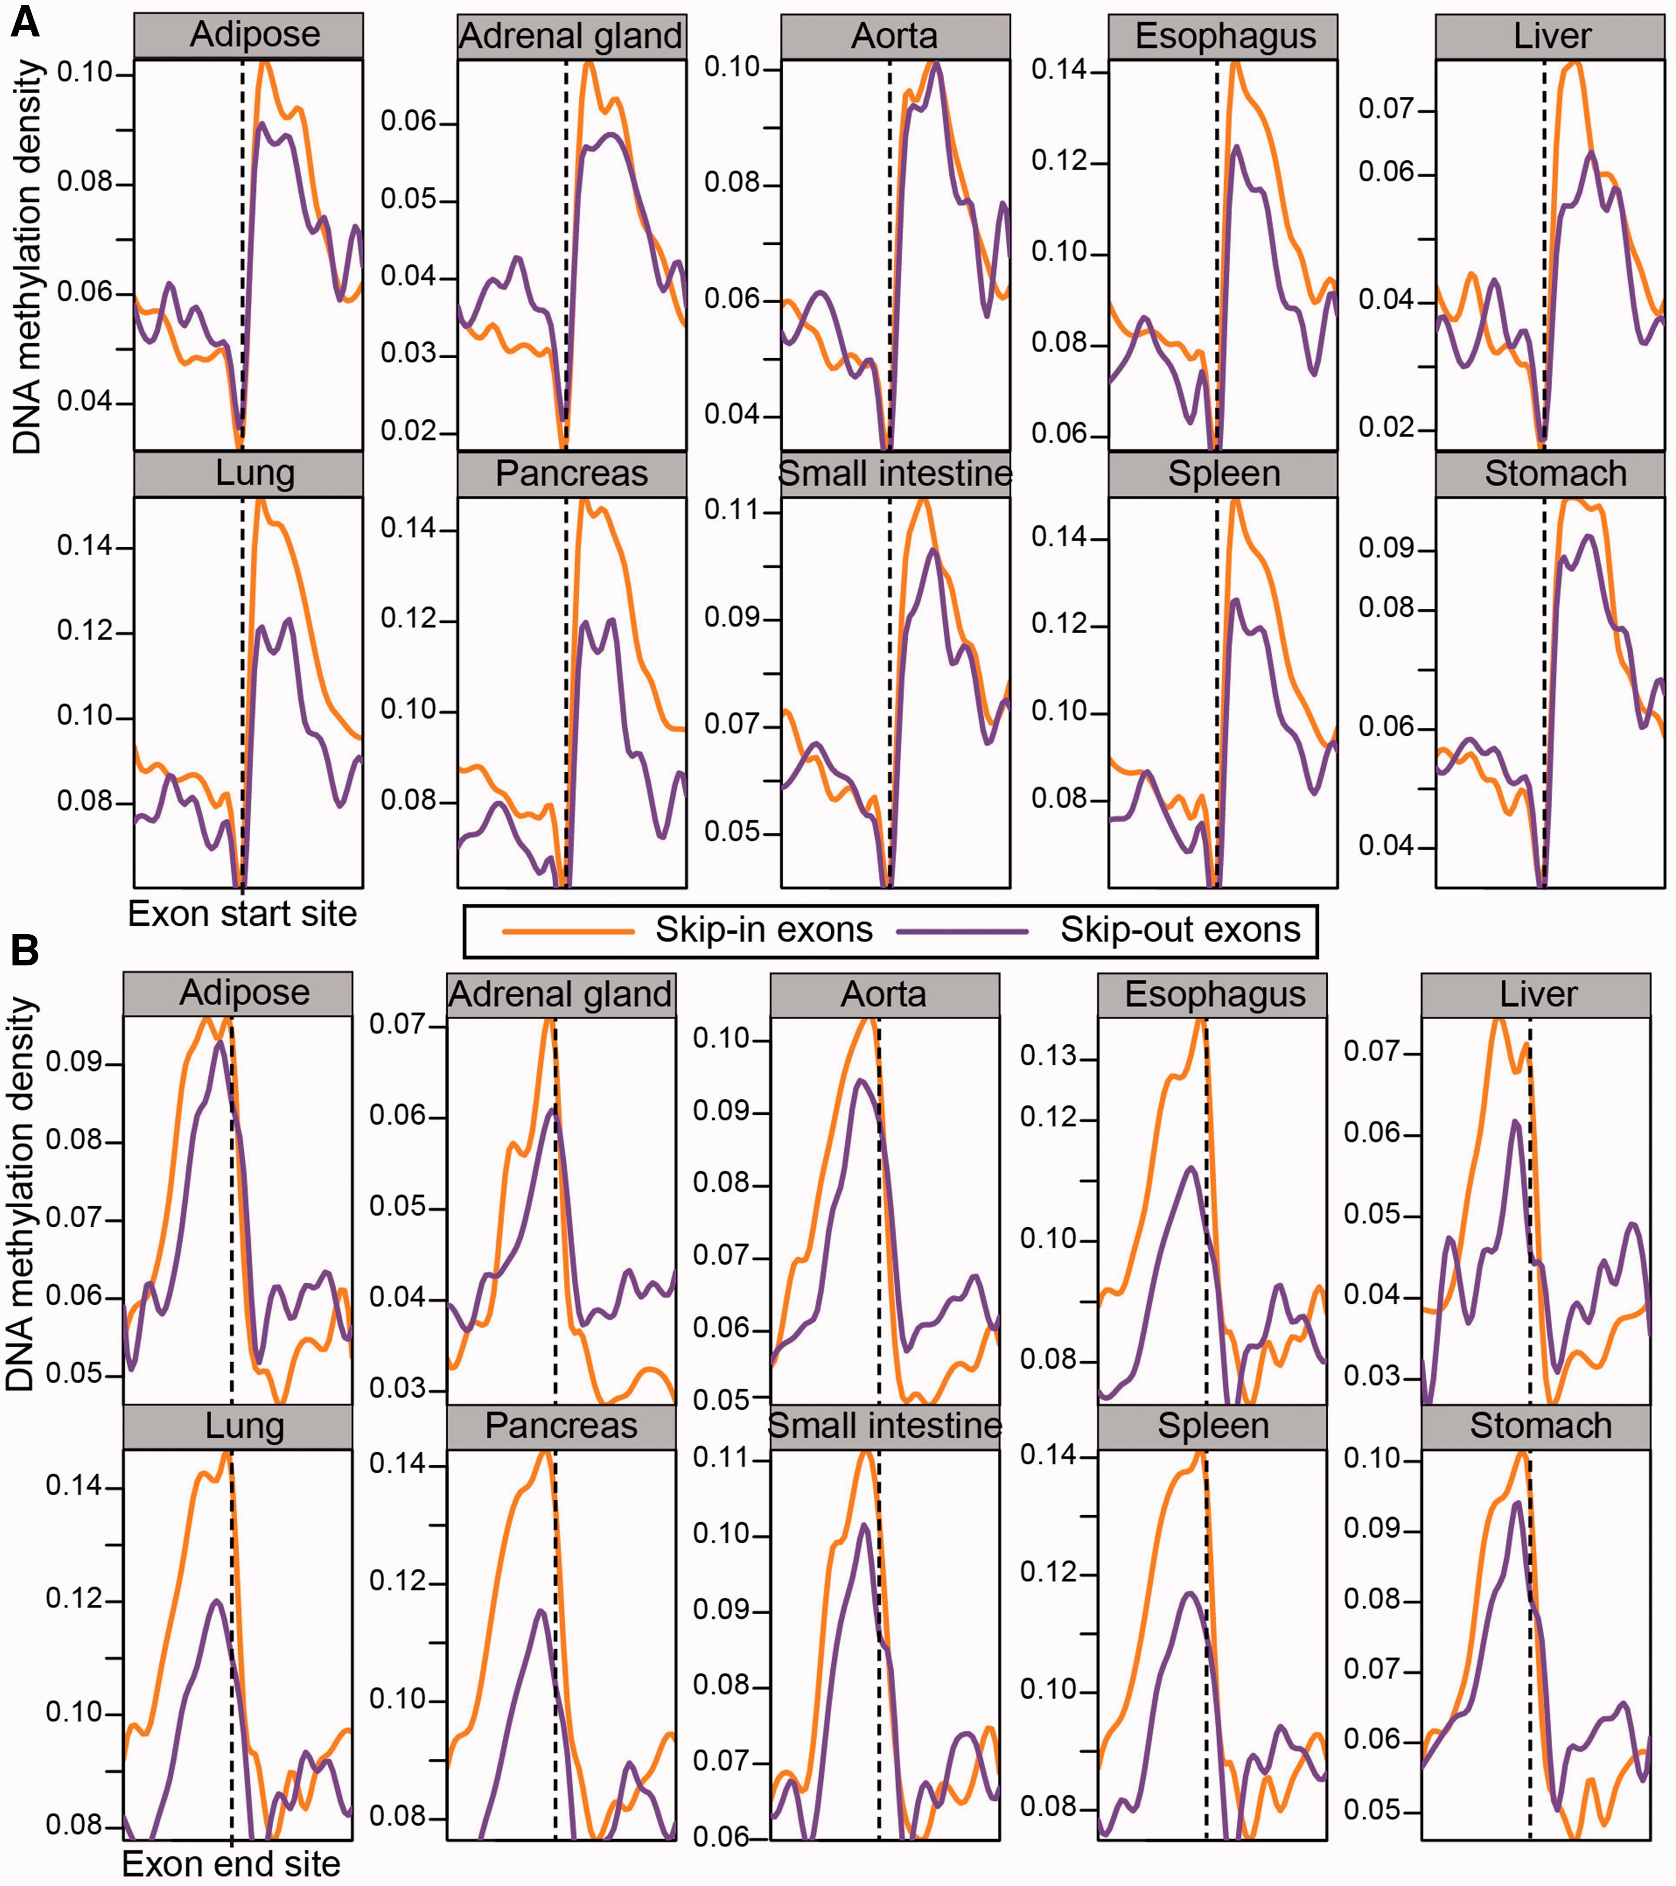
Figure 4 Difference in methylation levels between skip-in and skip-out exons around the exon start sites (A) and end ...
Notes:
Figure 4 Difference in methylation levels between skip-in and skip-out exons around the exon start sites (A) and end sites (B). Regions within 200 bp up-stream and down-stream of exon start sites and/or end sites were divided into 10 bins of 20 bp. The median methylation densities of bins with the same relative coordinates from all the exons were calculated. The lines were smoothened across the 20 bins corresponding to regions around start or end sites.
Unless provided in the caption above, the following copyright applies to the content of this slide: © The Author 2017. Published by Oxford University Press. All rights reserved. For Permissions, please email: journals.permissions@oup.comThis article is published and distributed under the terms of the Oxford University Press, Standard Journals Publication Model (https://academic.oup.com/journals/pages/open_access/funder_policies/chorus/standard_publication_model)

Slide 5
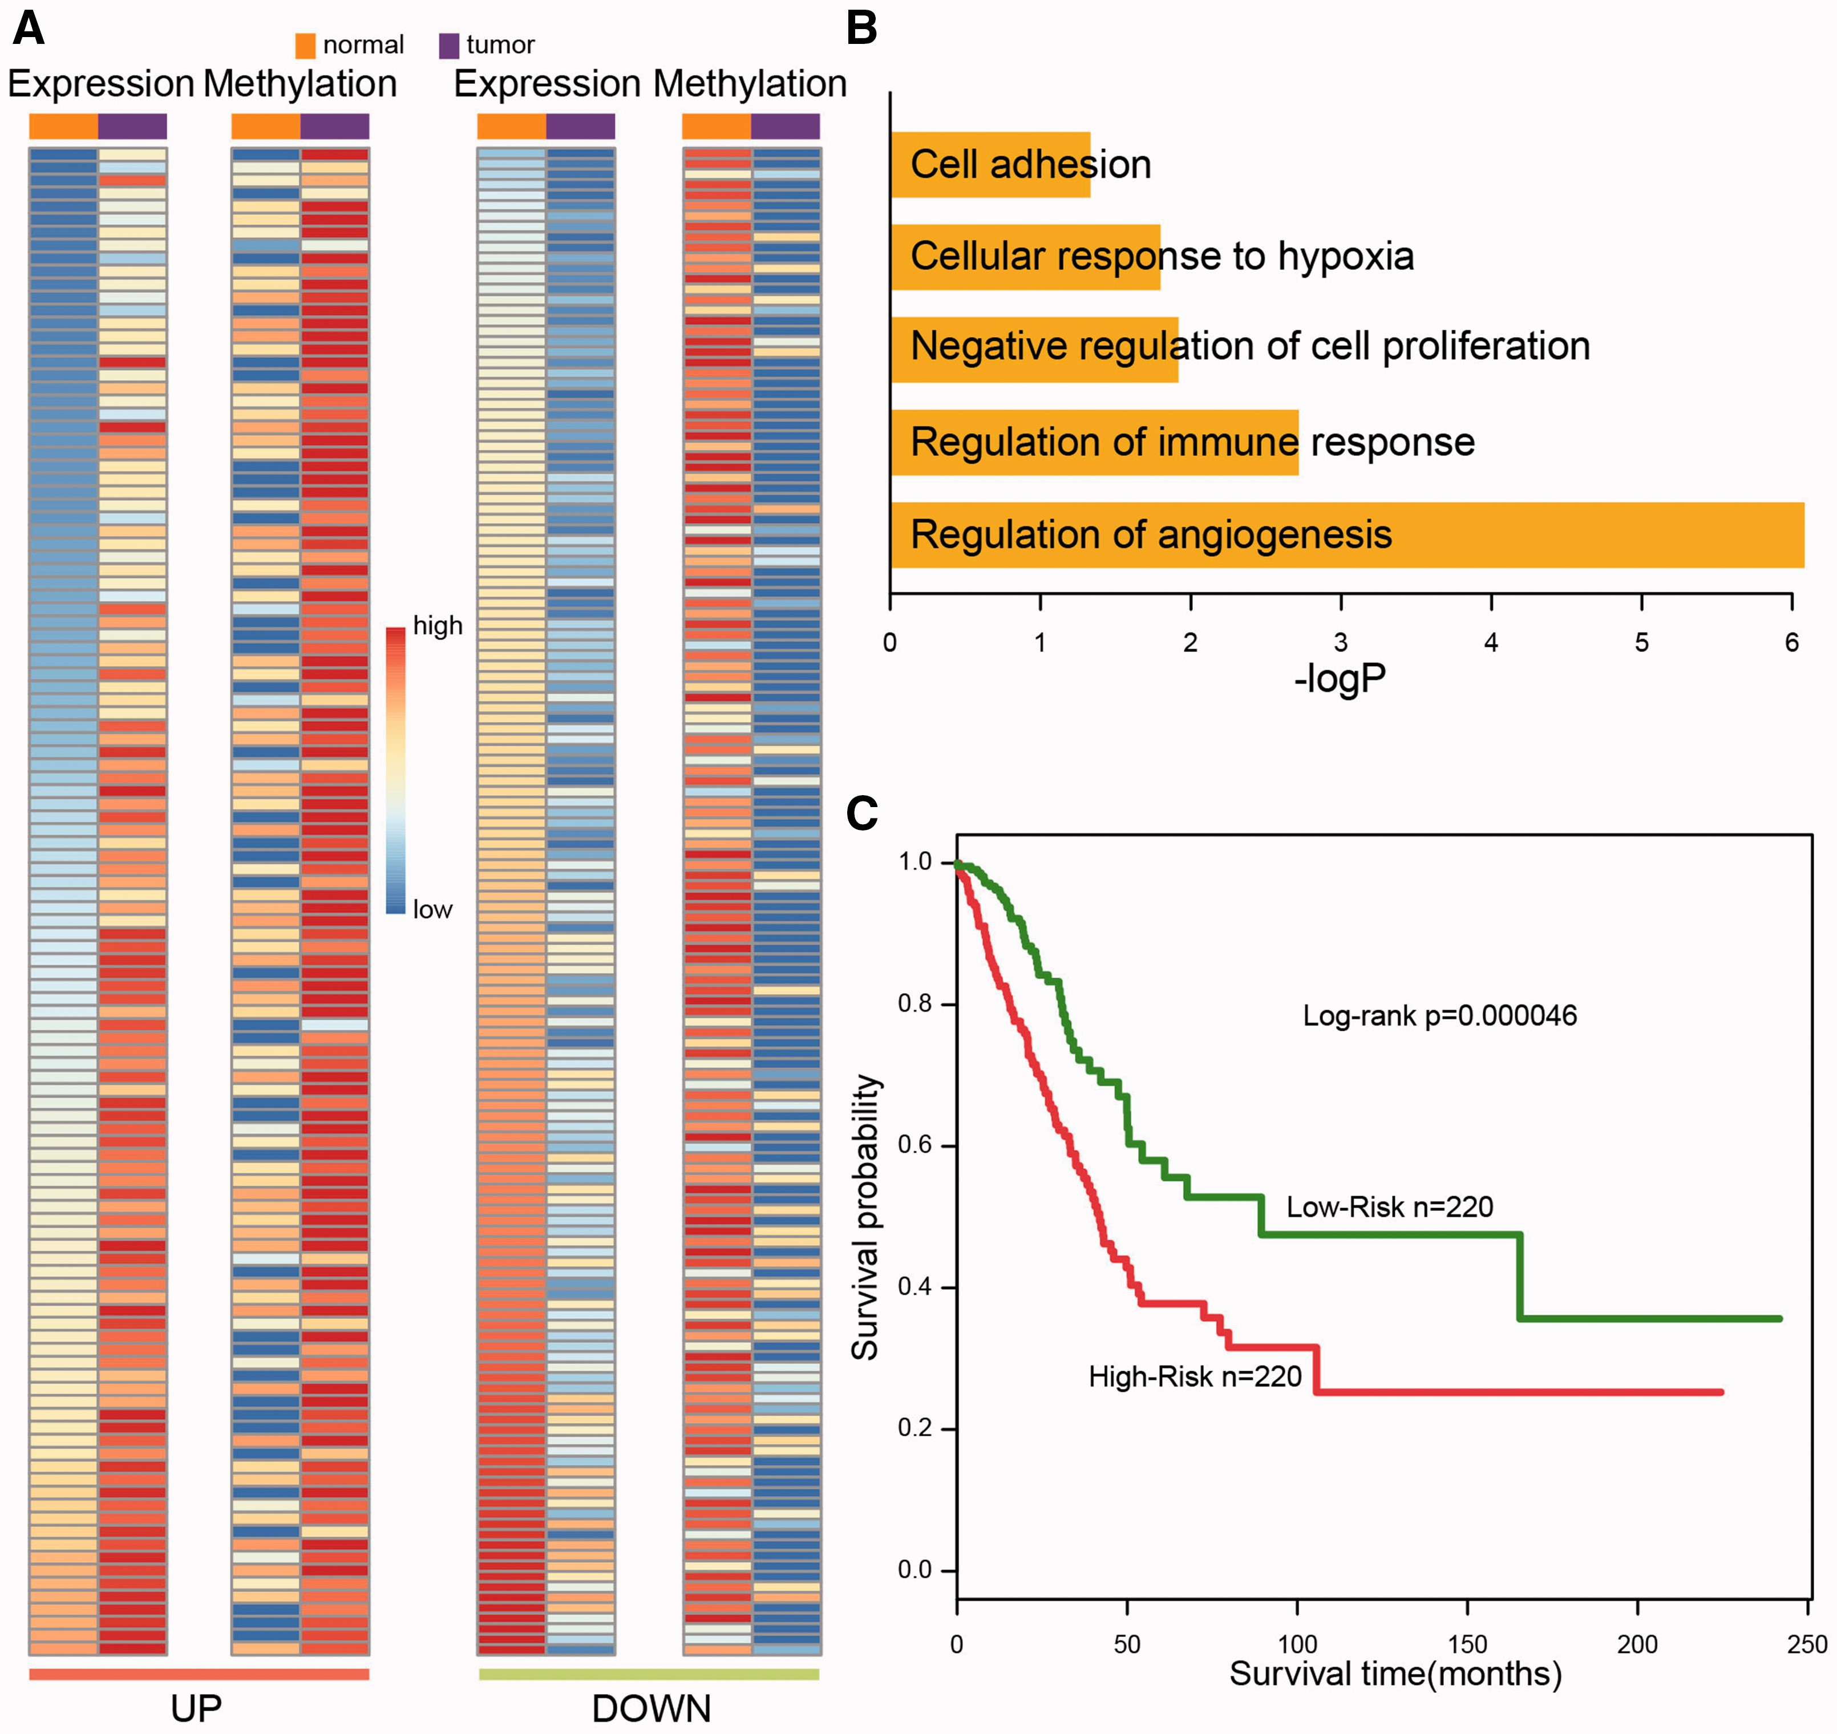
Figure 5 Differentially regulated exons in lung cancer. (A) Heatmaps of expression and methylation levels of 116 ...
Notes:
Figure 5 Differentially regulated exons in lung cancer. (A) Heatmaps of expression and methylation levels of 116 up-regulated (left panel) and 144 down-regulated (right panel) exons, in normal and cancer cells. In each panel (upper and lower), exons are in ascending order of expression level, from top to bottom. (B) Barplots showing the GO biological processes that were enriched by genes harboring differentially regulated exons. These processes are all considered human cancer hallmarks. (C) Kaplan–Meier curves of overall survival times between high- and low-risk patient groups, which were classified by risk scores.
Unless provided in the caption above, the following copyright applies to the content of this slide: © The Author 2017. Published by Oxford University Press. All rights reserved. For Permissions, please email: journals.permissions@oup.comThis article is published and distributed under the terms of the Oxford University Press, Standard Journals Publication Model (https://academic.oup.com/journals/pages/open_access/funder_policies/chorus/standard_publication_model)

