Slide 1
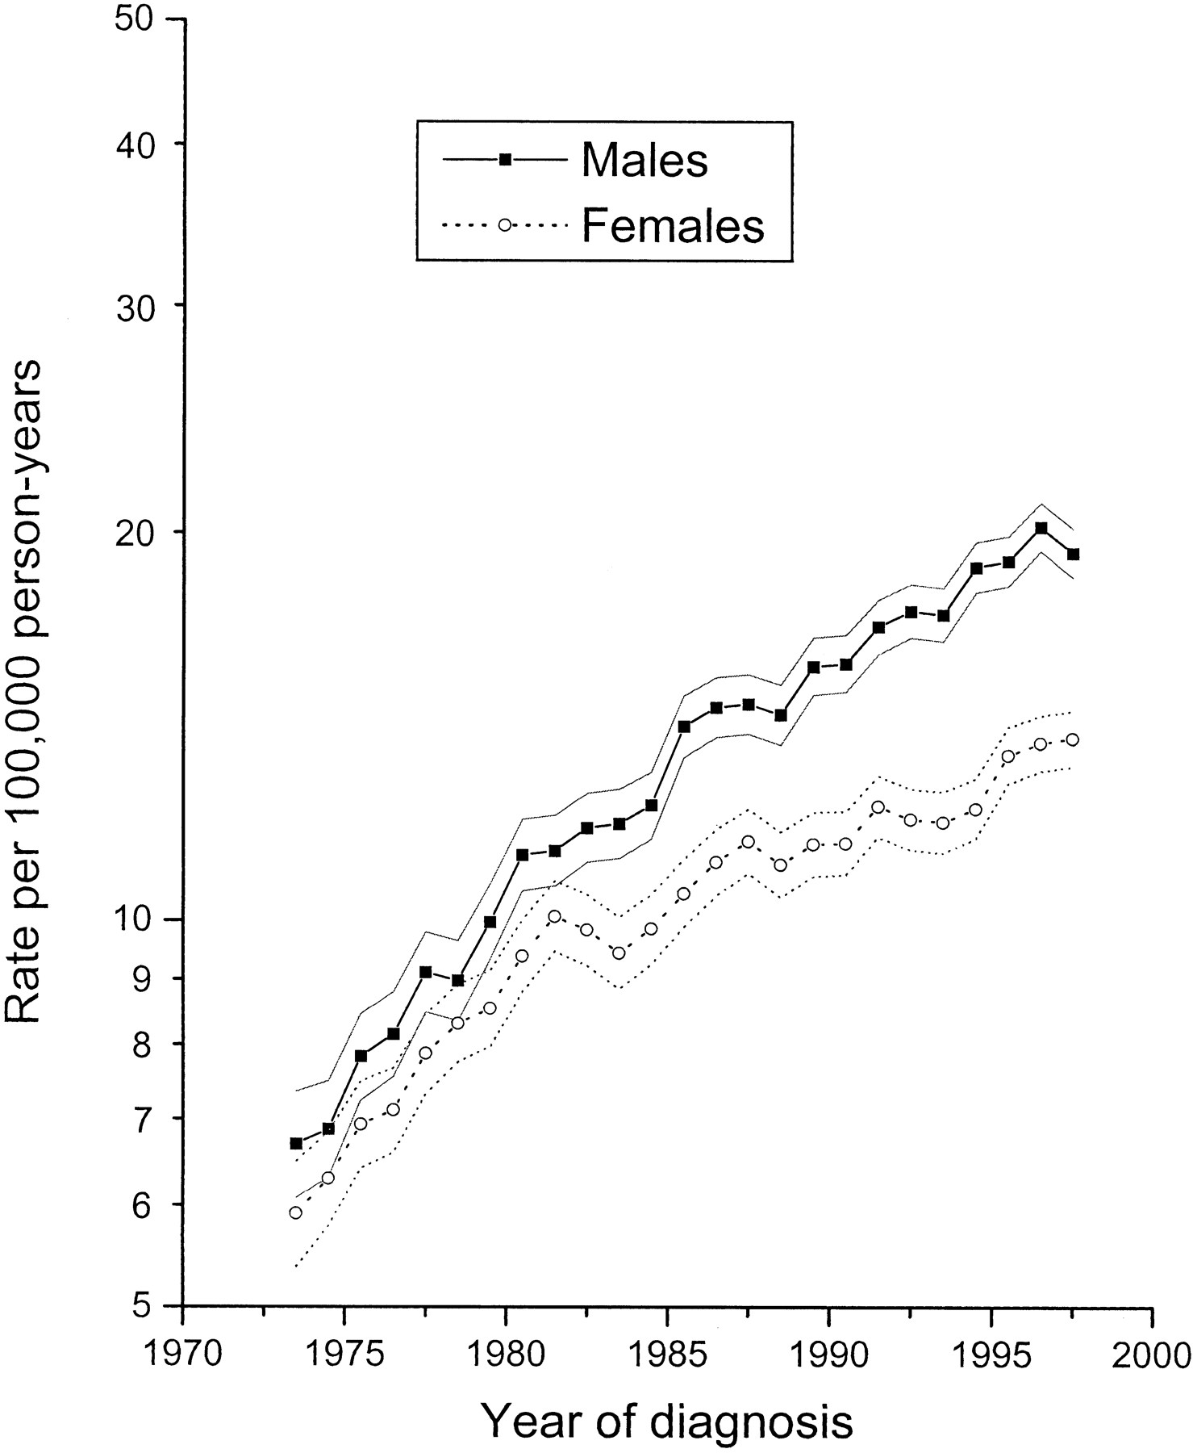
Fig. 1. Age-adjusted (to 1970 U.S. standard population) skin melanoma incidence and 95% confidence intervals (outer ...
Notes:
Fig. 1. Age-adjusted (to 1970 U.S. standard population) skin melanoma incidence and 95% confidence intervals (outer lines) among the white population stratified by sex in the Surveillance, Epidemiology, and End Results Program areas from 1973 through 1997.
Unless provided in the caption above, the following copyright applies to the content of this slide: © Oxford University Press

Slide 2
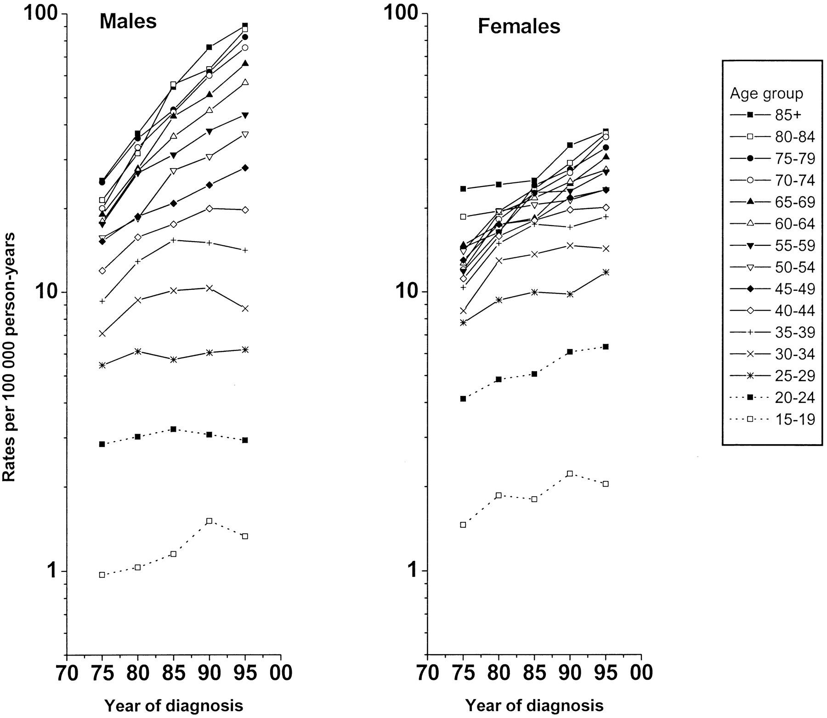
Fig. 2. Age-specific skin melanoma incidence among the white population stratified by sex and calendar year of ...
Notes:
Fig. 2. Age-specific skin melanoma incidence among the white population stratified by sex and calendar year of diagnosis (middle year of the 5-year group plotted on the x-axis) in the Surveillance, Epidemiology, and End Results Program areas from 1973–1977 through 1993–1997.
Unless provided in the caption above, the following copyright applies to the content of this slide: © Oxford University Press

Slide 3
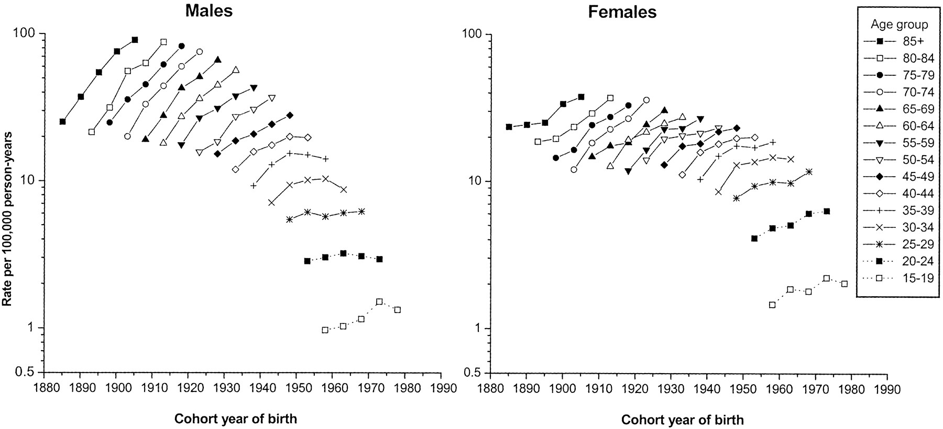
Fig. 3. Age-specific skin melanoma incidence among the white population stratified by sex and birth-cohort year in ...
Notes:
Fig. 3. Age-specific skin melanoma incidence among the white population stratified by sex and birth-cohort year in the Surveillance, Epidemiology, and End Results Program areas from 1973–1977 through 1993–1997. The points vertically above each cohort year portray the cohort's age-specific incidence experience.
Unless provided in the caption above, the following copyright applies to the content of this slide: © Oxford University Press

Slide 4
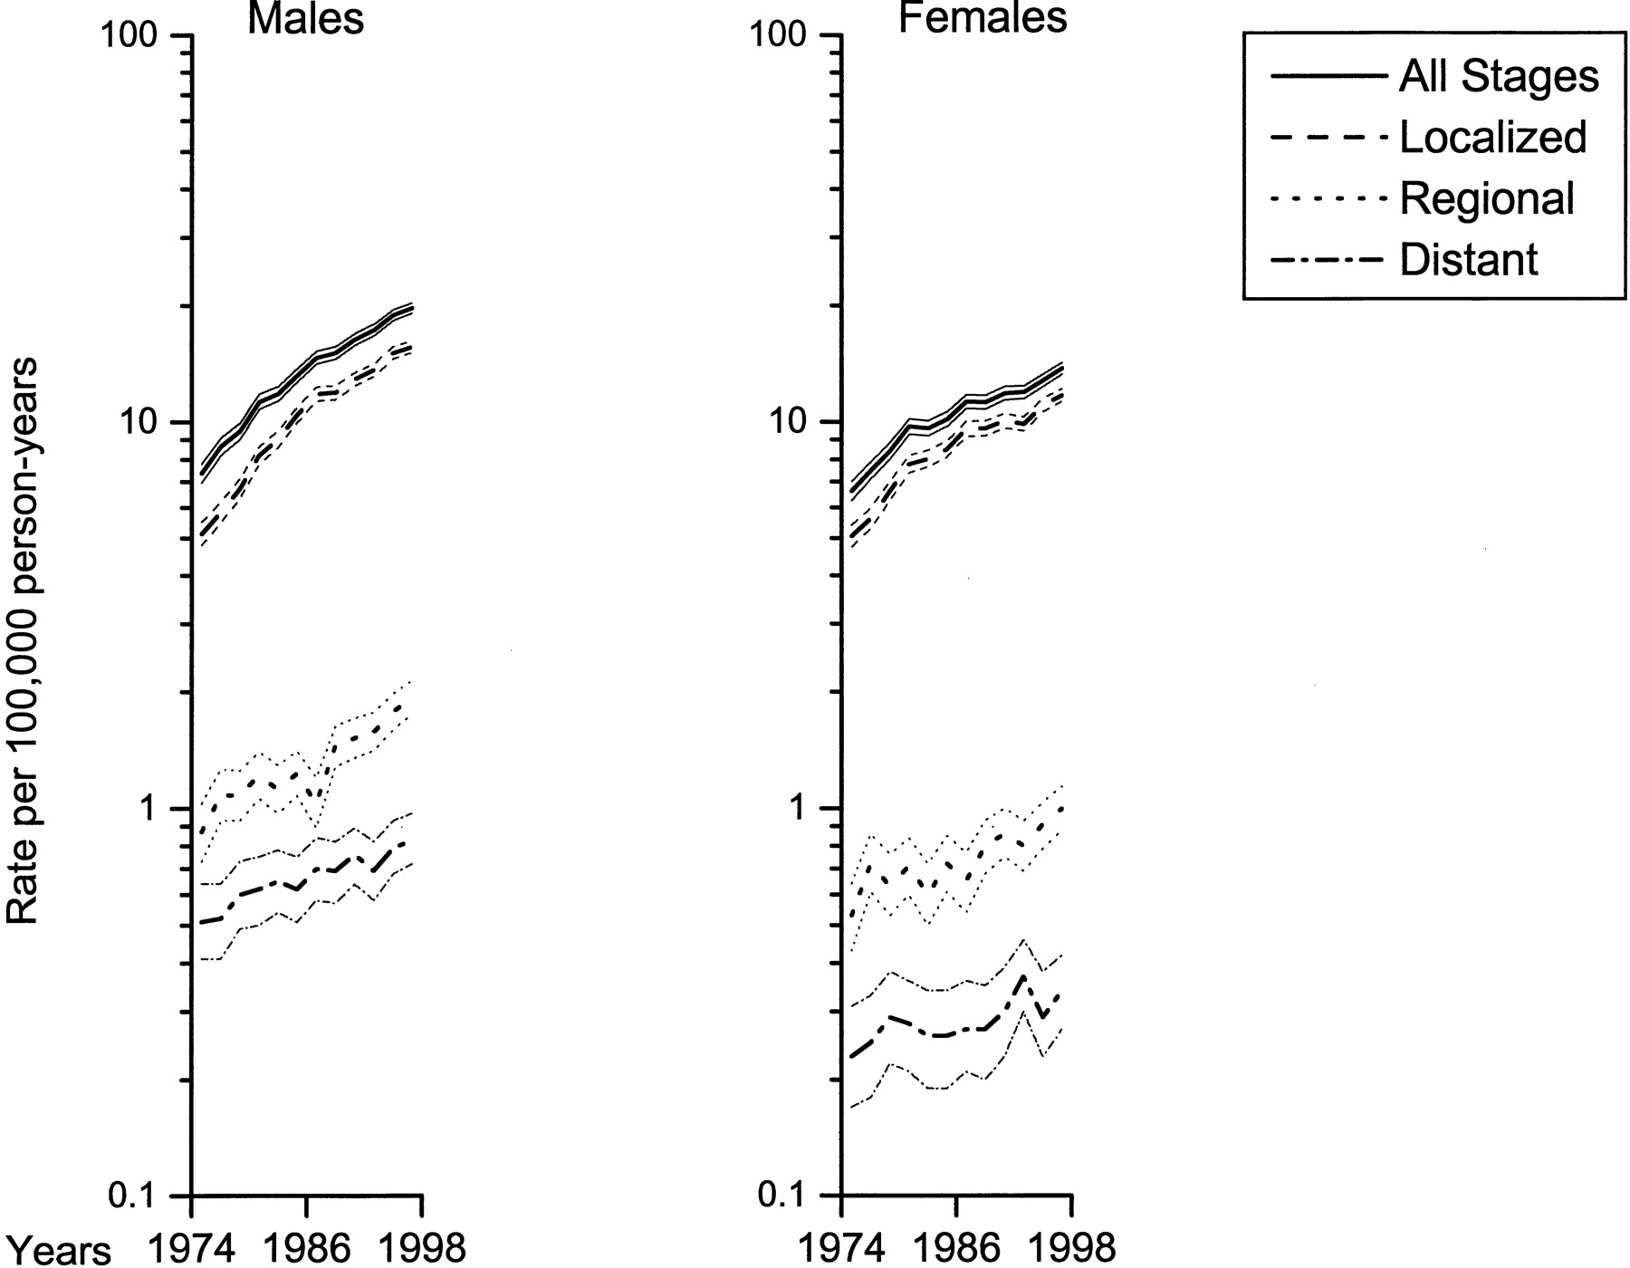
Fig. 4. Age-adjusted (to 1970 U.S. standard population) skin melanoma incidence and 95% confidence intervals (outer ...
Notes:
Fig. 4. Age-adjusted (to 1970 U.S. standard population) skin melanoma incidence and 95% confidence intervals (outer lines) among the white population stratified by sex and tumor stage in the Surveillance, Epidemiology, and End Results Program areas from 1974–1975 to 1996–1997.
Unless provided in the caption above, the following copyright applies to the content of this slide: © Oxford University Press

