Slide 1
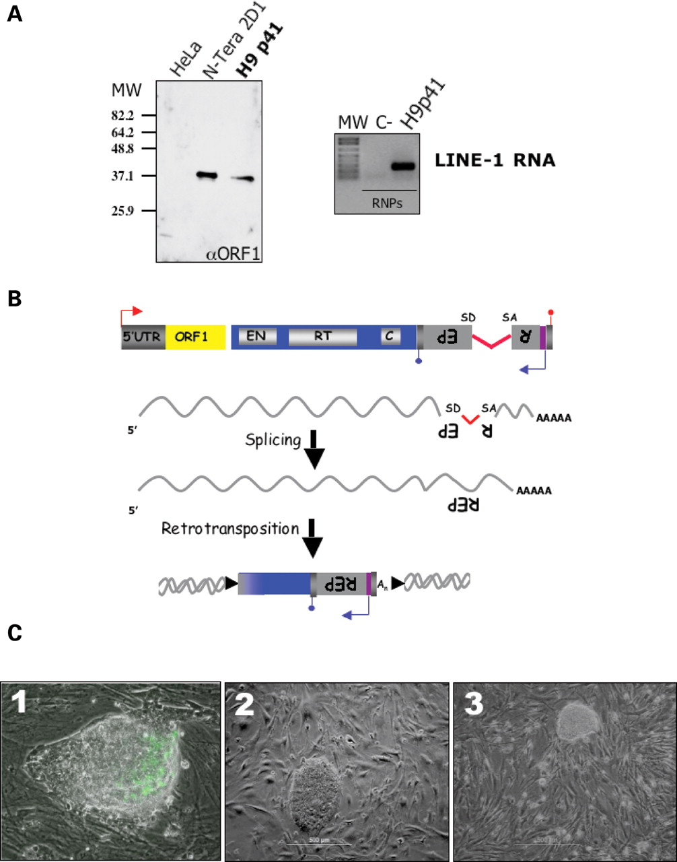
Figure 1. LINE-1 elements can retrotranspose in undifferentiated hES cells. ( A ) Left panel: Western blot analysis ...
Notes:
Figure 1. LINE-1 elements can retrotranspose in undifferentiated hES cells. ( A ) Left panel: Western blot analysis using a polyclonal antibody against ORF1p in ribonucleoprotein particles derived from H9 passage (p) 41 cells. N-tera 2D1 human teratocarcinoma cells are shown as a positive control ( 31 ). HeLa cells are used as a negative control. MW, molecular weight size standards. Right panel: RT–PCR analysis of LINE-1 RNA in H9p41 cell lines. C − denotes an RT–PCR reaction lacking input RNA. MW denotes 1 kb size standard. ( B ) Rationale of the LINE-1 retrotransposition assay ( 19 ). Details are described in the text. ( C ) (1) An undifferentiated Cyth25 colony containing a LINE-1 retrotransposition event from an RC-L1 equipped with the EGFP indicator cassette. (2) An undifferentiated H1p75 hES colony harboring a LINE-1 retrotransposition event from an RC-L1 equipped with the NEO indicator cassette. (3) An undifferentiated H9p60 hES colony harboring a LINE-1 retrotransposition event from an RC-L1 equipped with the NEO indicator cassette. ( D ) (see next page) PCR confirms precise splicing of the intron from the REP indicator cassette ( 19 , 21 ). Cartoons of the unspliced (1243 bp using the EGFP indicator cassette or 1361 bp using the NEO indicator cassette) and spliced (342 bp using the EGFP indicator cassette or 468 bp using the NEO indicator cassette) products are shown beside the gels. Controls for the spliced and unspliced products are indicated by C+ in the top gel and −intron (−I) and +intron (+I) in the bottom gel.
Unless provided in the caption above, the following copyright applies to the content of this slide: © The Author 2007. Published by Oxford University Press. All rights reserved. For Permissions, please email: journals.permissions@oxfordjournals.org

Slide 2
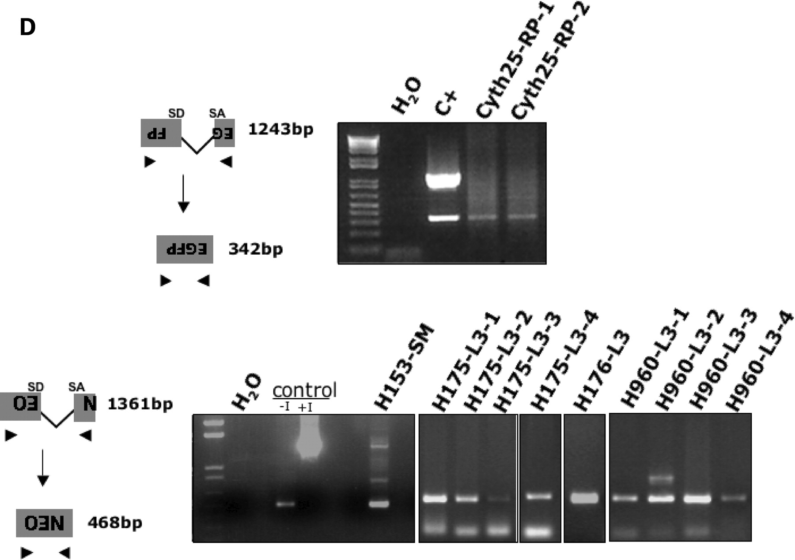
Figure 1. LINE-1 elements can retrotranspose in undifferentiated hES cells. ( A ) Left panel: Western blot analysis ...
Notes:
Figure 1. LINE-1 elements can retrotranspose in undifferentiated hES cells. ( A ) Left panel: Western blot analysis using a polyclonal antibody against ORF1p in ribonucleoprotein particles derived from H9 passage (p) 41 cells. N-tera 2D1 human teratocarcinoma cells are shown as a positive control ( 31 ). HeLa cells are used as a negative control. MW, molecular weight size standards. Right panel: RT–PCR analysis of LINE-1 RNA in H9p41 cell lines. C − denotes an RT–PCR reaction lacking input RNA. MW denotes 1 kb size standard. ( B ) Rationale of the LINE-1 retrotransposition assay ( 19 ). Details are described in the text. ( C ) (1) An undifferentiated Cyth25 colony containing a LINE-1 retrotransposition event from an RC-L1 equipped with the EGFP indicator cassette. (2) An undifferentiated H1p75 hES colony harboring a LINE-1 retrotransposition event from an RC-L1 equipped with the NEO indicator cassette. (3) An undifferentiated H9p60 hES colony harboring a LINE-1 retrotransposition event from an RC-L1 equipped with the NEO indicator cassette. ( D ) (see next page) PCR confirms precise splicing of the intron from the REP indicator cassette ( 19 , 21 ). Cartoons of the unspliced (1243 bp using the EGFP indicator cassette or 1361 bp using the NEO indicator cassette) and spliced (342 bp using the EGFP indicator cassette or 468 bp using the NEO indicator cassette) products are shown beside the gels. Controls for the spliced and unspliced products are indicated by C+ in the top gel and −intron (−I) and +intron (+I) in the bottom gel.
Unless provided in the caption above, the following copyright applies to the content of this slide: © The Author 2007. Published by Oxford University Press. All rights reserved. For Permissions, please email: journals.permissions@oxfordjournals.org

Slide 3
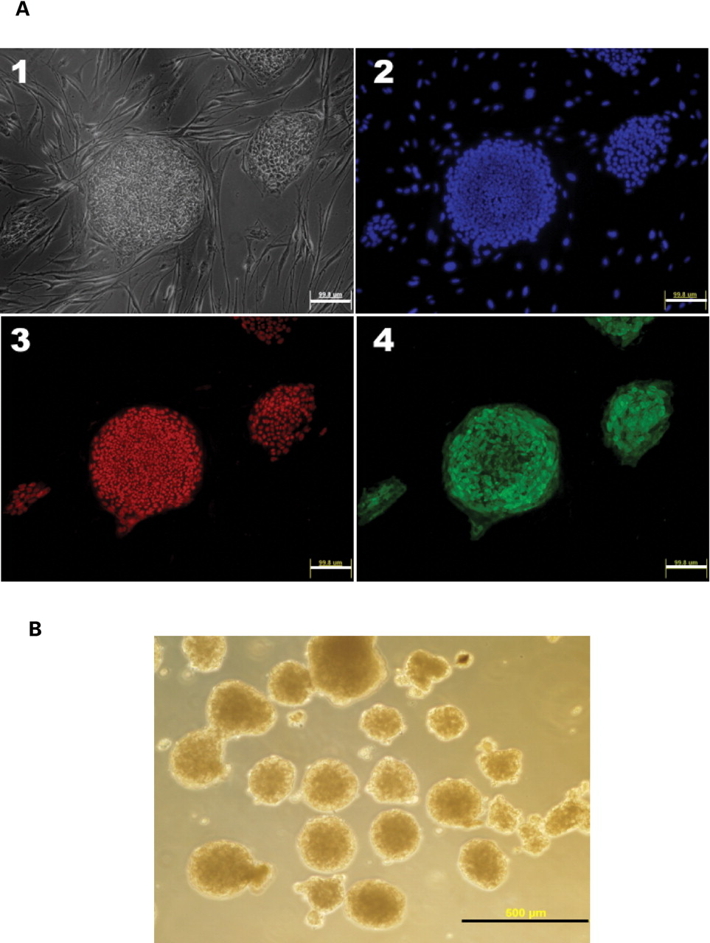
Figure 2. hES cell lines containing a de novo LINE-1 retrotransposition event express multipotent markers and can be ...
Notes:
Figure 2. hES cell lines containing a de novo LINE-1 retrotransposition event express multipotent markers and can be differentiated into embryoid bodies that express mRNAs diagnostic for the three major germ layers. ( A ) (1) Phase contrast micrograph of G418-resistant H9p60 foci. (2) Hoechst staining of the same cells. (3) OCT4 staining. (4) TRA1–60 staining. Bars = 100 µm. ( B ) Embryoid bodies derived from H1p75 hES cells containing a LINE-1 retrotransposition event after 9 days in culture. Bar = 500 µm. ( C ) (see next page) RT–PCR experiments showing expression of endoderm [α-fetoprotein (AFP), and GATA-4], mesoderm [myogenic factor 5 (MYF-5)] and ectoderm [keratin-18 (KRT-18) and Musashi 1] specific genes in embryoid bodies derived from various cell lines containing LINE-1 retrotransposition events (listed at the top of the figure). LINE-1 and β-actin RT–PCR products are shown as controls. MW, molecular weight markers. Water denotes (negative) control reactions lacking input RNA. hES denotes control reactions with total RNA from undifferentiated H1 cells.
Unless provided in the caption above, the following copyright applies to the content of this slide: © The Author 2007. Published by Oxford University Press. All rights reserved. For Permissions, please email: journals.permissions@oxfordjournals.org

Slide 4
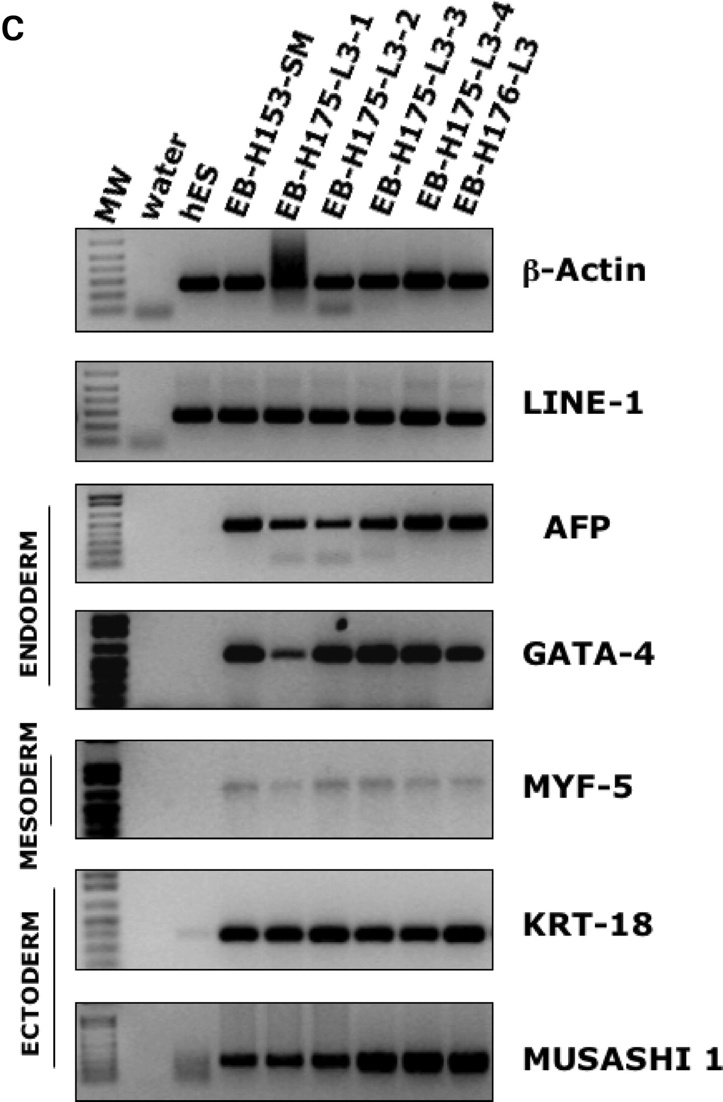
Figure 2. hES cell lines containing a de novo LINE-1 retrotransposition event express multipotent markers and can be ...
Notes:
Figure 2. hES cell lines containing a de novo LINE-1 retrotransposition event express multipotent markers and can be differentiated into embryoid bodies that express mRNAs diagnostic for the three major germ layers. ( A ) (1) Phase contrast micrograph of G418-resistant H9p60 foci. (2) Hoechst staining of the same cells. (3) OCT4 staining. (4) TRA1–60 staining. Bars = 100 µm. ( B ) Embryoid bodies derived from H1p75 hES cells containing a LINE-1 retrotransposition event after 9 days in culture. Bar = 500 µm. ( C ) (see next page) RT–PCR experiments showing expression of endoderm [α-fetoprotein (AFP), and GATA-4], mesoderm [myogenic factor 5 (MYF-5)] and ectoderm [keratin-18 (KRT-18) and Musashi 1] specific genes in embryoid bodies derived from various cell lines containing LINE-1 retrotransposition events (listed at the top of the figure). LINE-1 and β-actin RT–PCR products are shown as controls. MW, molecular weight markers. Water denotes (negative) control reactions lacking input RNA. hES denotes control reactions with total RNA from undifferentiated H1 cells.
Unless provided in the caption above, the following copyright applies to the content of this slide: © The Author 2007. Published by Oxford University Press. All rights reserved. For Permissions, please email: journals.permissions@oxfordjournals.org

Slide 5
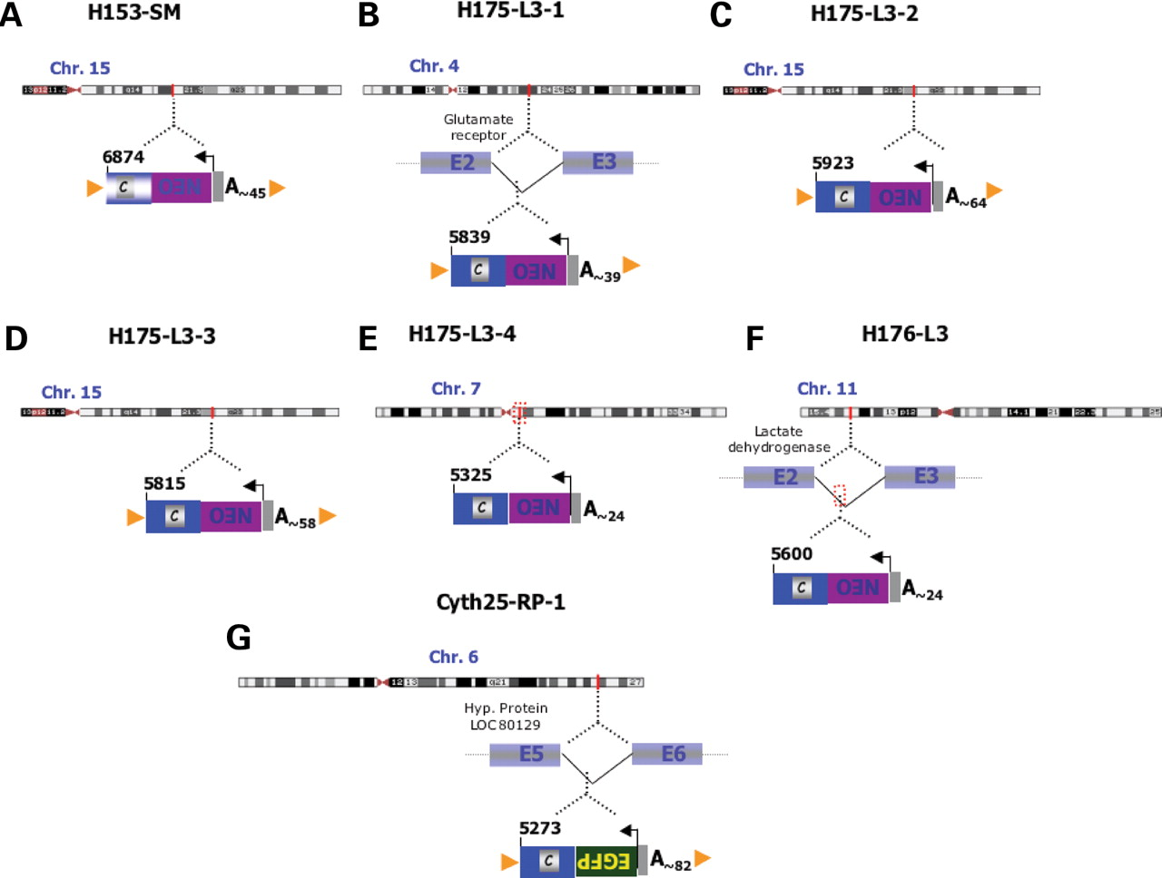
Figure 3. LINE-1 retrotransposition events in hES cells exhibit hallmarks of retrotransposition. Schematics of seven ...
Notes:
Figure 3. LINE-1 retrotransposition events in hES cells exhibit hallmarks of retrotransposition. Schematics of seven LINE-1 retrotransposition events are shown ( A – G ). The names of the cell lines are indicated at the top of each panel. The chromosomal location of each insertion is indicated. Insertions that occurred into known or hypothetical genes are indicated, as are those that resulted in target site deletions (red rectangles; Insertions E & F). Orange arrowheads indicate target site duplications flanking the LINE-1 element. The length of the poly (A) tail is indicated. The numbering indicates the truncation site in the LINE-1 and is based on the L1.2 reference sequence (accession number M80343 ). Additional experimental details are provided in Supplementary Material, Figure S2.
Unless provided in the caption above, the following copyright applies to the content of this slide: © The Author 2007. Published by Oxford University Press. All rights reserved. For Permissions, please email: journals.permissions@oxfordjournals.org

