Slide 1
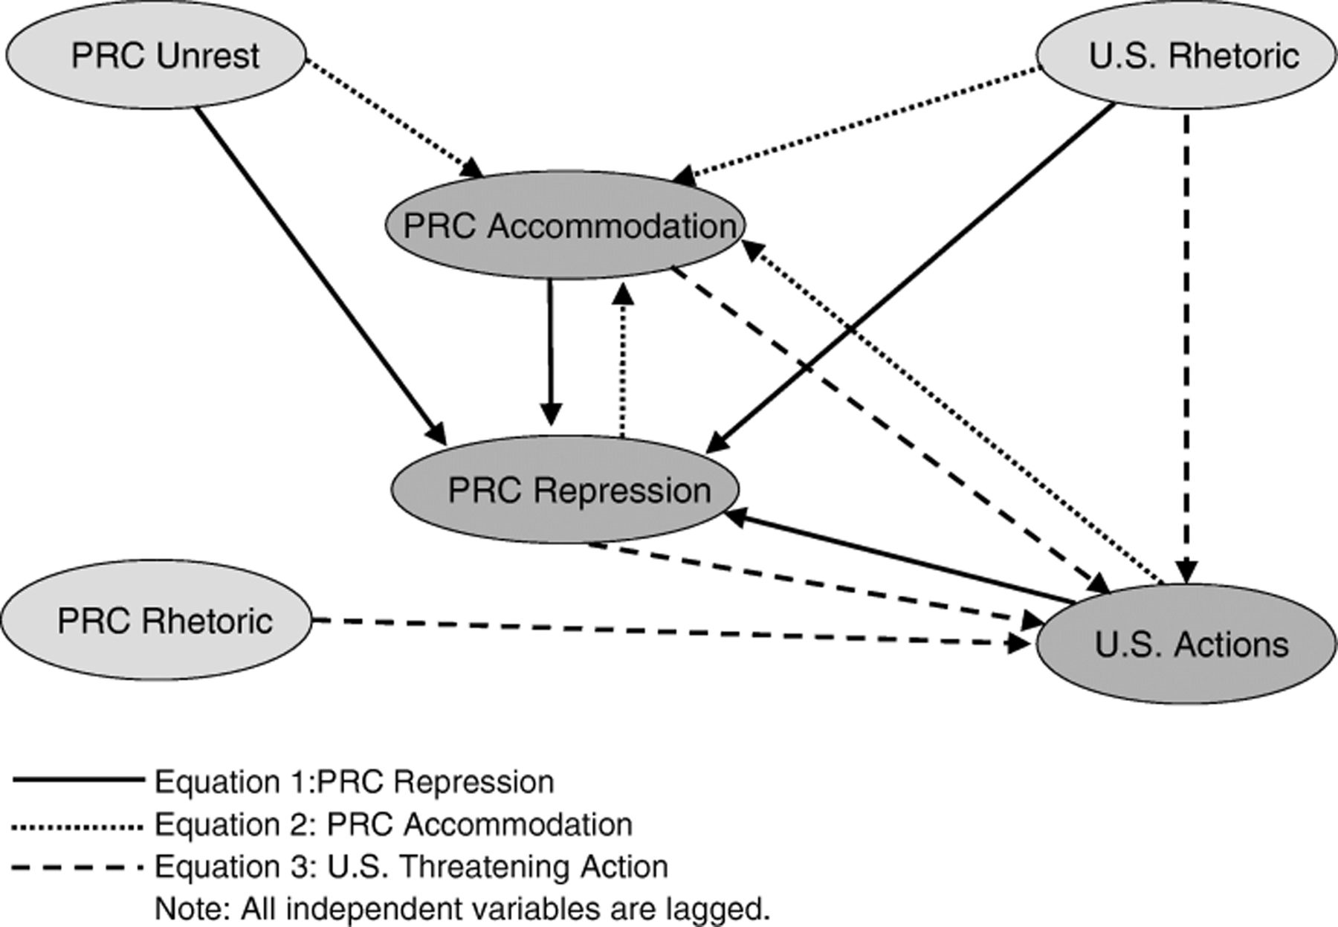
1 U.S. Most Favored Nation Threats
Notes:
1 U.S. Most Favored Nation Threats
Unless provided in the caption above, the following copyright applies to the content of this slide: © 2006 International Studies Association

