Slide 1
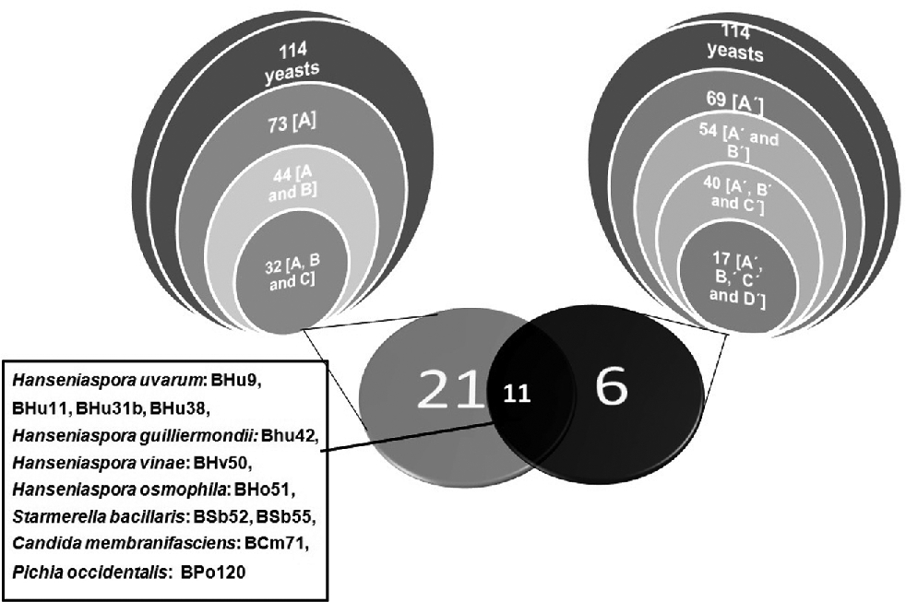
Figure 1 . Stacked Venn diagrams I and II represent the oxidative capacity and fermentative performance, respectively, ...
Notes:
Figure 1 . Stacked Venn diagrams I and II represent the oxidative capacity and fermentative performance, respectively, of the 114 non-Saccharomyces yeast isolates assayed. The classic Venn diagram composed of diagram III and IV represents isolates that presented all characteristics required. References: A: yeast isolates with high levels of cytochrome C oxidase activity; B: catalase-positive yeast isolates; C: yeast isolates tolerant to oxidative stress. A΄: yeast isolates that required ≥19 g of sugar L−1 to produce 1% of ethanol; B΄: yeast isolates able to produce ≥5.2 g of glycerol L−1; C΄: yeast isolates that produced ≤0.7 g of acetic acid L−1; D΄: yeast isolates able to consume ≥50% of initial fructose from grape must.
Unless provided in the caption above, the following copyright applies to the content of this slide: © FEMS 2017. All rights reserved. For permissions, please e-mail: journals.permissions@oup.com

Slide 2
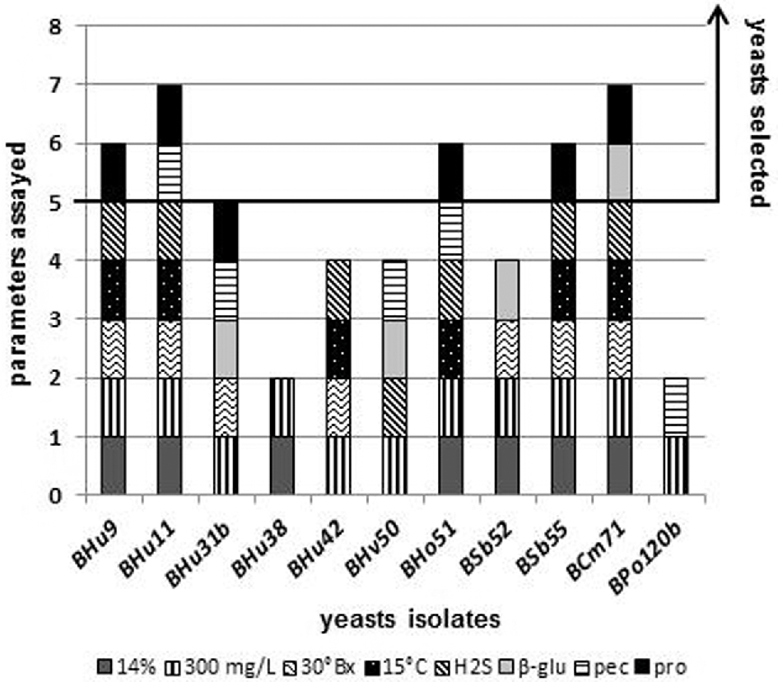
Figure 2 . Physiological characteristics with enological application of the 11 yeast isolates originally selected. ...
Notes:
Figure 2 . Physiological characteristics with enological application of the 11 yeast isolates originally selected. References: yeast isolates: H. uvarum BHu9, BHu11, BHu31b, BHu38, BHu42; H. vineae BHv50; H. osmophila BHo51; S. bacillaris BSb52, BSb55; C. membranaefaciens BCm71; P. occidentalis BPo120b. Parameters assayed: 14%: ability to start fermentation at 14% (v/v) of ethanol. 300 mg L−1: ability to start fermentation at 300 mg of SO2 L−1. 30 °Bx: ability to start fermentation at 30 °Bx. 15°C: ability to start fermentation at 15°C. H2S: ability to produce H2S. β-glu: production of β-glucosidase activity. pec: production of pectinase activity. pro: production of protease activity.
Unless provided in the caption above, the following copyright applies to the content of this slide: © FEMS 2017. All rights reserved. For permissions, please e-mail: journals.permissions@oup.com

