Slide 1
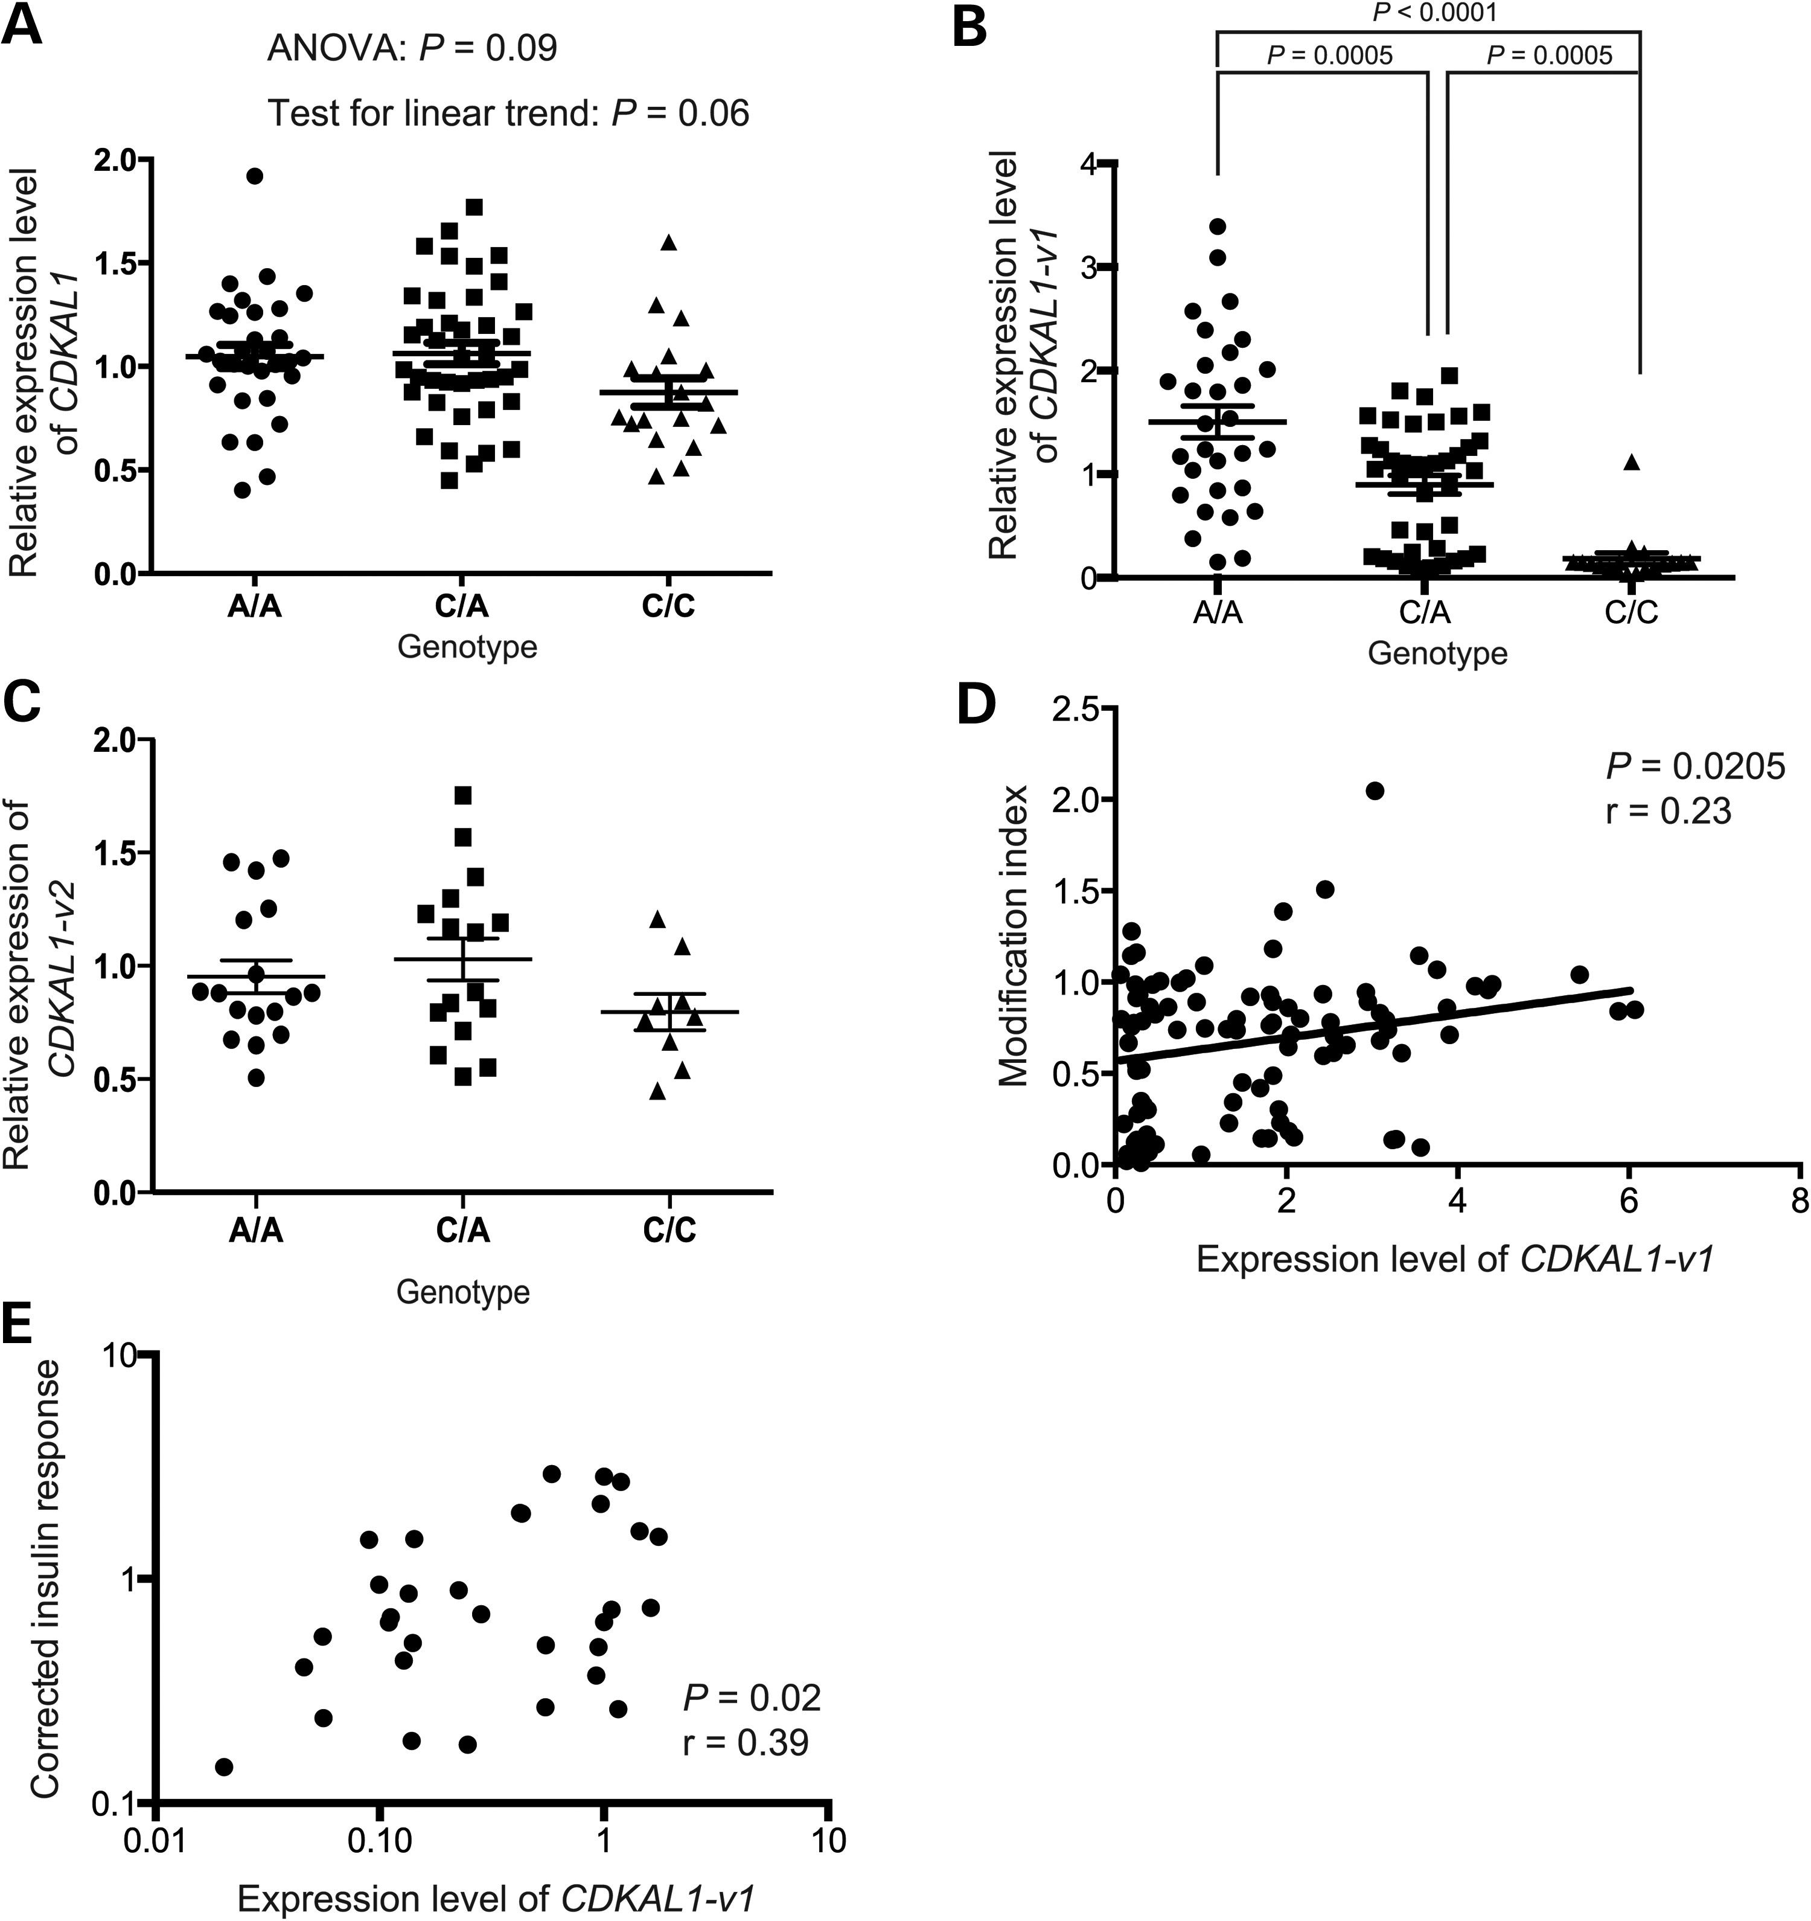
Figure 1. Decreased expression of CDKAL1-v1 in carriers of CDKAL1 risk alleles. (A–C) Comparison of the CDKAL1 (A), ...
Notes:
Figure 1. Decreased expression of CDKAL1-v1 in carriers of CDKAL1 risk alleles. (A–C) Comparison of the CDKAL1 (A), CDKAL1-v1 (B) or CDKAL1-v2 (C) levels in groups of homozygous carriers of non-risk alleles (A/A), heterozygous carriers of a non-risk and a risk allele (C/A) and homozygous carriers of risk alleles (C/C) for rs10946398. n = 30 for A/A, n = 40 for C/A, n = 18 for C/C. (D) Correlation between the ms2-modification level of tRNALys(UUU) and the CDKAL1-v1 level in individuals with mixed genotypes. n = 94. (E) Correlation of the corrected insulin response with the CDKAL1-v1 level in individuals with mixed genotypes. n = 32. Error bars represent mean ± SEM.
Unless provided in the caption above, the following copyright applies to the content of this slide: © The Author 2014. Published by Oxford University Press. All rights reserved. For Permissions, please email: journals.permissions@oup.com

Slide 2
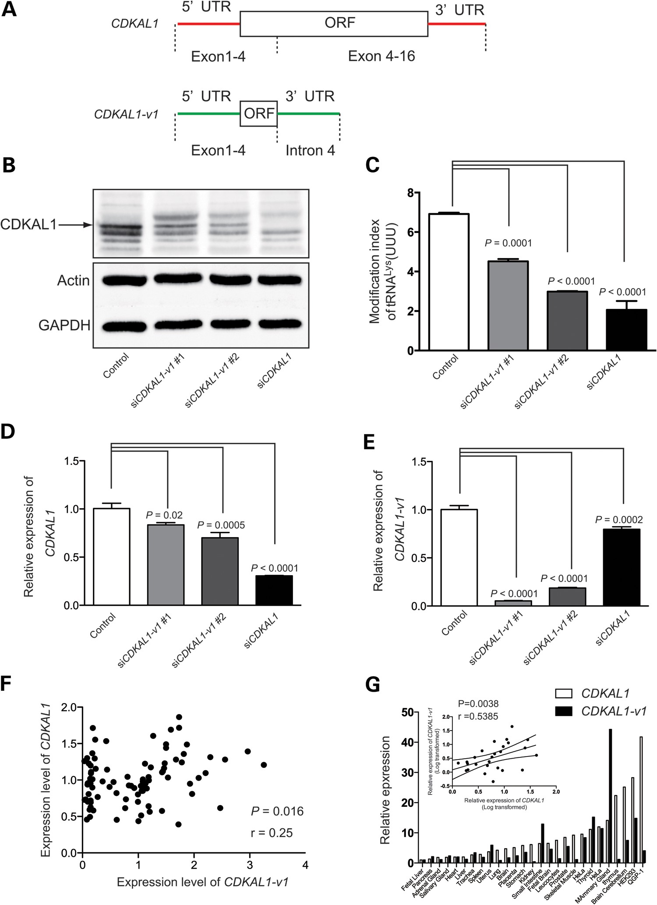
Figure 2. Regulation of CDKAL1 level by CDKAL1-v1. (A) Structures of CDKAL1 and CDKAL1-v1. The 5′UTR and 3′UTR of ...
Notes:
Figure 2. Regulation of CDKAL1 level by CDKAL1-v1. (A) Structures of CDKAL1 and CDKAL1-v1. The 5′UTR and 3′UTR of CDKAL1-v1 are different from those of CDKAL1. The difference is highlighted by a red line in CDKAL1 and a green line in CDKAL1-v1. (B) Decrease in the CDKAL1 level in HEK293 cells transfected with CDKAL1-v1-targeting siRNAs (siCDKAL1-v1 #1 and siCDKAL1-v1 #2). The CDKAL1-targeting siRNA (siCDKAL1) was used as positive control. (C) Decrease in ms2-modification in HEK cells transfected with CDKAL1-v1-targeting siRNAs. n = 4. (D) Downregulation of CDKAL1 by CDKAL1-v1-targeting siRNAs. n = 4. (E) Downregulation of CDKAL1-v1 by CDKAL1-targeting siRNAs. n = 4. (F) Correlation of CDKAL1 and CDKAL1-v1 level in individuals with mixed genotypes. (G) Correlation of CDKAL1 and CDKAL1-v1 level in human tissues and cell lines. Inserted graph in the upper left corner shows linear regression of CDKAL1 versus CDKAL1-v1. Error bars represent mean ± SEM.
Unless provided in the caption above, the following copyright applies to the content of this slide: © The Author 2014. Published by Oxford University Press. All rights reserved. For Permissions, please email: journals.permissions@oup.com

Slide 3
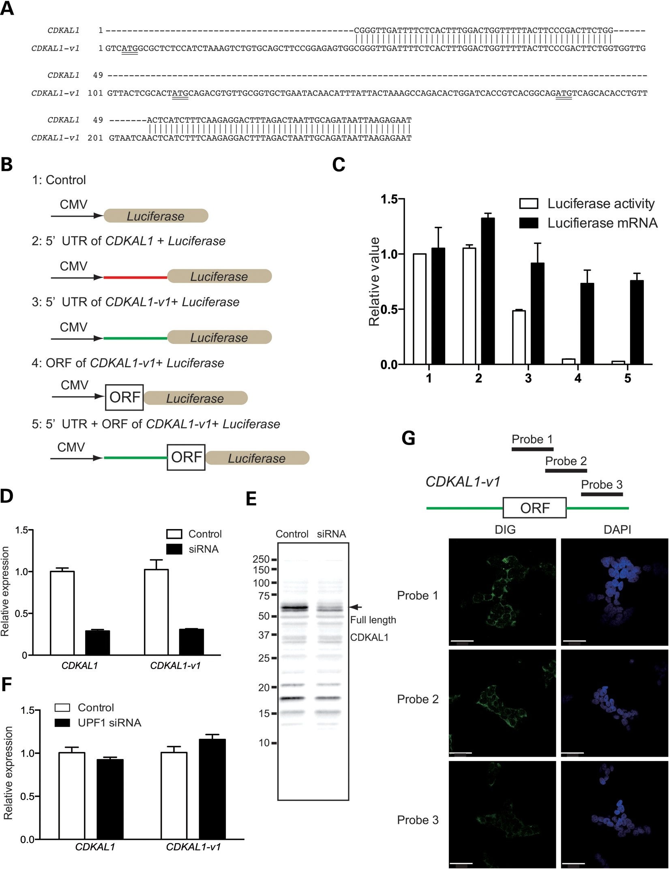
Figure 3. CDKAL1-v1 is a non-coding transcript. (A) Alignment of 5′UTR of CDKAL1 and CDKAL1-v1. ATG codons in upstream ...
Notes:
Figure 3. CDKAL1-v1 is a non-coding transcript. (A) Alignment of 5′UTR of CDKAL1 and CDKAL1-v1. ATG codons in upstream ORF are underlined. (B) Constructs for the luciferase-based reporter assay with which to examine the 5′UTR and ORF of CDKAL1-v1. (C) Suppression of luciferase activity by the 5′UTR and ORF of CDKAL1-v1 is translation-dependent but not transcription-dependent. (D) Knockdown of both CDKAL1 and CDKAL1-v1 in HEK293 cells by a siRNA targeting both transcripts. n = 4. (E) Western blotting to examine the translated product of CDKAL1-v1. The arrow indicates 61 kDa, full length, CDKAL1. (F) Knockdown of UPF1 in fibroblast cells had no effect on CDKAL1 or CDKAL1-v1 level. n = 4. (G) Detection of cellular localization of CDKAL1-v1 by in situ hybridization. The upper illustration shows the regions to which the probes hybridize. The lower images show the cellular localization of probes (Digoxigenin). The nucleus is detected by DAPI staining. Bars = 100 μm. Error bars represent mean ± SEM.
Unless provided in the caption above, the following copyright applies to the content of this slide: © The Author 2014. Published by Oxford University Press. All rights reserved. For Permissions, please email: journals.permissions@oup.com

Slide 4
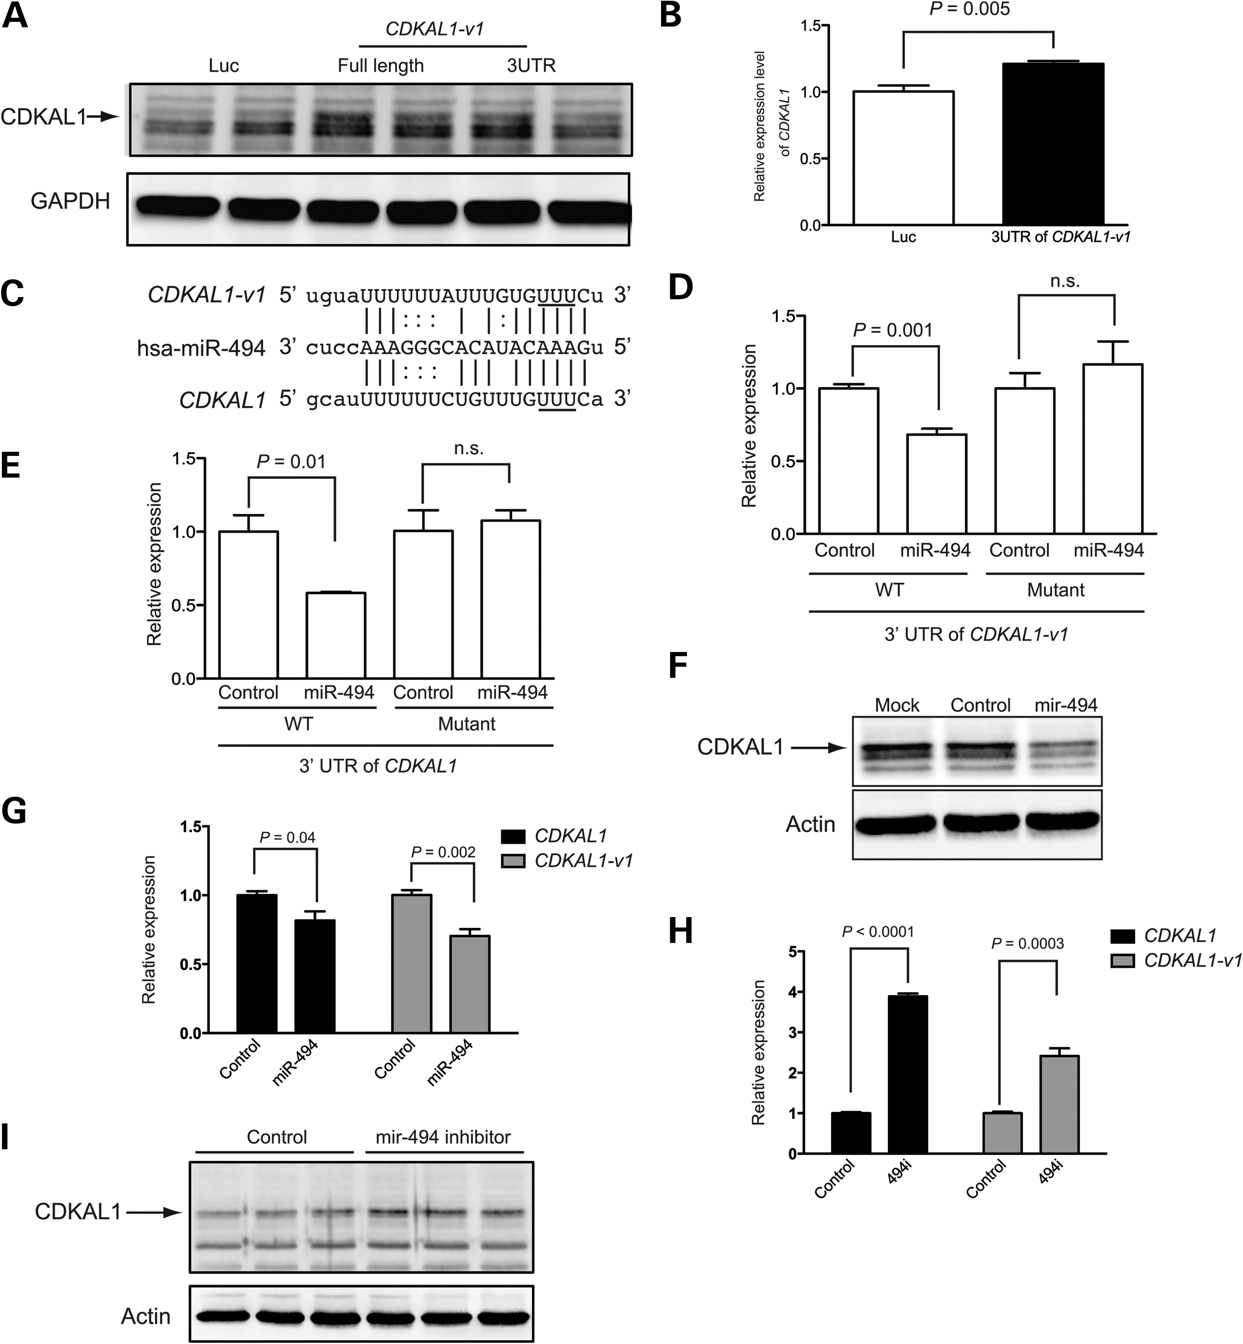
Figure 4. Control of CDKAL1 level by CDKAL1-v1-targeting miRNA. (A) Increase in the CDKAL1 level following ...
Notes:
Figure 4. Control of CDKAL1 level by CDKAL1-v1-targeting miRNA. (A) Increase in the CDKAL1 level following overexpression of full-length CDKAL1-v1 and 3′UTR of CDKAL1-v1. The arrow indicates bands corresponding to CDKAL1. (B) Increase in the CDKAL1 level following overexpression of the 3′UTR of CDKAL1-v1. n = 4. (C) Binding of has-miR-494 to both CDKAL1 and CDKAL1-v1. The solid lines represent canonical pairing. The dotted lines represent non-canonical pairing. The underlined UUU were mutated to AAA to make miR-494-insensitive constructs. (D and E) miR-494 suppressed the luciferase gene-carrying wild-type (WT) 3′UTR of CDKAL1-v1 (D) or CDKAL1 (E) but not the luciferase gene-carrying miR-494-insensitive (Mutant) 3′UTR of CDKAL1-v1 (D) or CDKAL1 (E). n = 4. (F) Reduced Cdkal1 protein level in response to miR-494. (G) Reduced CDKAL1-v1 and CDKAL1 levels in response to miR494. (H) Derepression of CDKAL1-v1 and CDKAL1 by a miR-494 inhibitor (494i). n = 4. (I) Increase in the CDKAL1 protein level in response to a miR-494 inhibitor (494i). The arrow indicates bands corresponding to CDKAL1. Error bars represent mean ± SEM.
Unless provided in the caption above, the following copyright applies to the content of this slide: © The Author 2014. Published by Oxford University Press. All rights reserved. For Permissions, please email: journals.permissions@oup.com

Slide 5
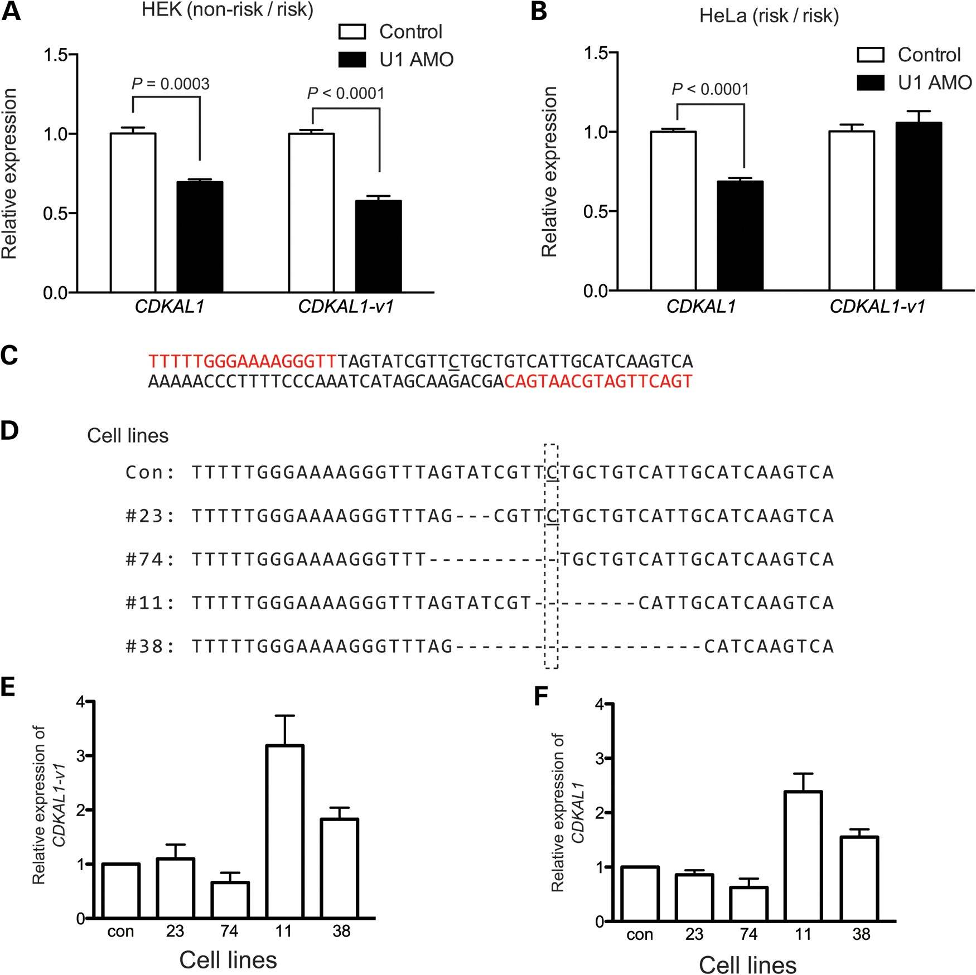
Figure 5. Modulation of splicing by SNPs in CDKAL1. (A) Inhibition of U1 snRNA by U1 AMO suppressed both the CDKAL1 and ...
Notes:
Figure 5. Modulation of splicing by SNPs in CDKAL1. (A) Inhibition of U1 snRNA by U1 AMO suppressed both the CDKAL1 and CDKAL1-v1 level in HEK293 cells carrying A/A alleles (non-risk/risk) for rs10946398. (B) U1 AMO suppressed CDKAL1 levels but not CDKAL1-v1 levels in HeLa cells carrying C/C alleles (risk/risk). (C) Genomic region (nucleotides in red) targeted by TALEN constructs. The underlined C is the SNP site for rs10946398. (D) Genomic sequences surround the SNP site in isolated HeLa cell lines transfected with TALEN. Dashed lines represent deleted nucleotides. Dashed rectangles show the position of the SNP site. (E and F) Expression level of CDKAL1-v1 (E) and CDKAL1 (F) in cell lines with an edited SNP site. n = 4. Error bars represent mean ± SEM.
Unless provided in the caption above, the following copyright applies to the content of this slide: © The Author 2014. Published by Oxford University Press. All rights reserved. For Permissions, please email: journals.permissions@oup.com

