Slide 1
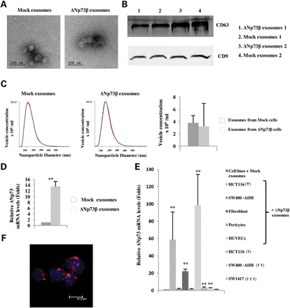
Figure 1. Analysis of exosome identity and transference capacity. (A) Representative electron microscopy image of ...
Notes:
Figure 1. Analysis of exosome identity and transference capacity. (A) Representative electron microscopy image of exosomes and (B) western blot of CD63 and CD9 in exosomes isolated from the HCT116 cell line transfected with ΔNp73β or mock vector (duplicate experiments). (C) Number of exosomes released by ΔNp73 overexpressing HCT116 cells, quantified by NanoSight system. Mock cells were used as control. (D) Quantitative real-time PCR analysis of ΔNp73 mRNA expression in exosomes derived from transfected cell lines. Expression levels were normalized with cDNA concentration (ng/μl). (E) Quantitative real-time PCR analysis of ΔNp73 levels in cell lines incubated with exosomes from HCT116 cells transient (Ψ) and stably (¥) transfected with ΔNp73β, and exosomes from SW480-ADH (¥¥) and SW1417 (¥¥¥) transiently transfected respect their mock control. Representative of four independent experiments (**P < 0.0001). (F) Uptake of PKH67-labeled exosomes by HCT116 cells. In the confocal microscopy image, Topro-3 was used to detect nuclei of cells (blue), E-cadherine was used to label cell membrane (red) and PKH67 was used to label the exosomes (green).
Unless provided in the caption above, the following copyright applies to the content of this slide: © The Author 2013. Published by Oxford University Press. All rights reserved. For Permissions, please email: journals.permissions@oup.com

Slide 2
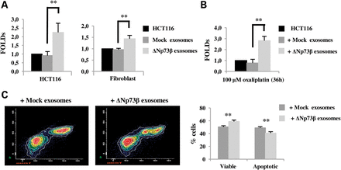
Figure 2. Transfer of exosomal ΔNp73β increases proliferation and drug resistance in recipient cells. (A) Proliferation ...
Notes:
Figure 2. Transfer of exosomal ΔNp73β increases proliferation and drug resistance in recipient cells. (A) Proliferation and (B) viability for drug-resistance analyzed by MTT assay were performed after exosome addition. Treatment with mock exosomes was used as control. (C) Representative of four independent experiments for the drug-resistance experiments by flow cytometry (left) and its quantification (right) (**P < 0.0001).
Unless provided in the caption above, the following copyright applies to the content of this slide: © The Author 2013. Published by Oxford University Press. All rights reserved. For Permissions, please email: journals.permissions@oup.com

Slide 3
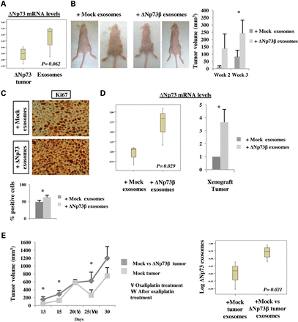
Figure 3. Exosomal ΔNp73β confers oncogenic potential on xenograft tumors. (A) mRNA expression levels of ΔNp73 were ...
Notes:
Figure 3. Exosomal ΔNp73β confers oncogenic potential on xenograft tumors. (A) mRNA expression levels of ΔNp73 were evaluated in the xenograft tumor and in the mice exosomes after exosome treatment. (B) Analysis of xenograft tumor growth treated with ΔNp73β or mock exosomes (left) and size quantification at Weeks 2 and 3 after exosome treatment. (C) Ki67 immunohistochemistry in xenograft tumors after exosome treatment. (D) mRNA expression levels of ΔNp73 in exosomes and xenograft tumor (n = 4 mice per group, Student’s t-test, *P = 0.01). (E) Analysis of xenograft tumor growth with a contralateral ΔNp73 overexpressing tumor. Mice with mock xenograft tumors in only one flank were used as control.
Unless provided in the caption above, the following copyright applies to the content of this slide: © The Author 2013. Published by Oxford University Press. All rights reserved. For Permissions, please email: journals.permissions@oup.com

Slide 4
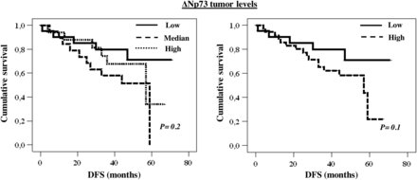
Figure 4. Influence of colon carcinoma levels of ΔNp73 on DFS, Kaplan–Meier curves and P-values. ΔNp73 expression in ...
Notes:
Figure 4. Influence of colon carcinoma levels of ΔNp73 on DFS, Kaplan–Meier curves and P-values. ΔNp73 expression in colon cancer patients distributed by tertiles, low, median and high levels (left) and in two groups of low (new variable combining low and median levels) and high expression (right).
Unless provided in the caption above, the following copyright applies to the content of this slide: © The Author 2013. Published by Oxford University Press. All rights reserved. For Permissions, please email: journals.permissions@oup.com

Slide 5
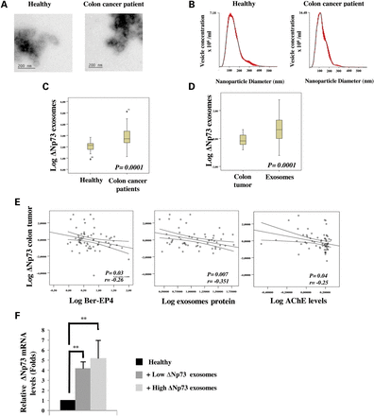
Figure 5. Analysis of ΔNp73 exosomes from colon cancer patients. (A) Identity of exosomes by electron microscopy and ...
Notes:
Figure 5. Analysis of ΔNp73 exosomes from colon cancer patients. (A) Identity of exosomes by electron microscopy and (B) NanoSight system. (C) Statistical analysis of ΔNp73 mRNA levels in circulating exosomes relative to cDNA concentration from plasma of colon cancer patients and healthy controls. (D) mRNA expression levels of ΔNp73 were evaluated in the primary tumor and in exosomes. **P < 0.0001 using Mann–Whitney U-test. (E) Correlations between ΔNp73 mRNA expression levels in primary tumor and exosome quantity measured by Ber-EP4 and total protein levels and acetylcholinesterase activity (P is calculated by analysis of variance; r is the Pearson coefficient). (F) Quantitative real-time PCR analysis of ΔNp73 expression in HCT116 cell line incubated with exosomes from healthy and colon cancer patients bearing low or high levels of ΔNp73 (Student’s t-test, **P < 0.0001).
Unless provided in the caption above, the following copyright applies to the content of this slide: © The Author 2013. Published by Oxford University Press. All rights reserved. For Permissions, please email: journals.permissions@oup.com

Slide 6
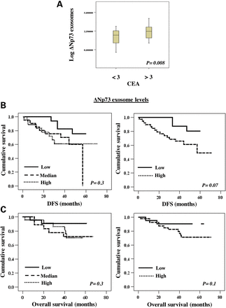
Figure 6. ΔNp73 levels and prognosis in colon cancer patients. (A) Correlation between ΔNp73 mRNA expression levels in ...
Notes:
Figure 6. ΔNp73 levels and prognosis in colon cancer patients. (A) Correlation between ΔNp73 mRNA expression levels in exosomes and CEA (P is calculated by analysis of variance; r is the Pearson coefficient). Influence of exosome levels of ΔNp73 on DFS and (B) OS. (C) Kaplan–Meier curves and P-values. Exosome ΔNp73 expression levels from colon cancer patients were distributed by tertiles (left) and in two groups of low (new variable combining low and median levels) and high expression (right).
Unless provided in the caption above, the following copyright applies to the content of this slide: © The Author 2013. Published by Oxford University Press. All rights reserved. For Permissions, please email: journals.permissions@oup.com

