Slide 1
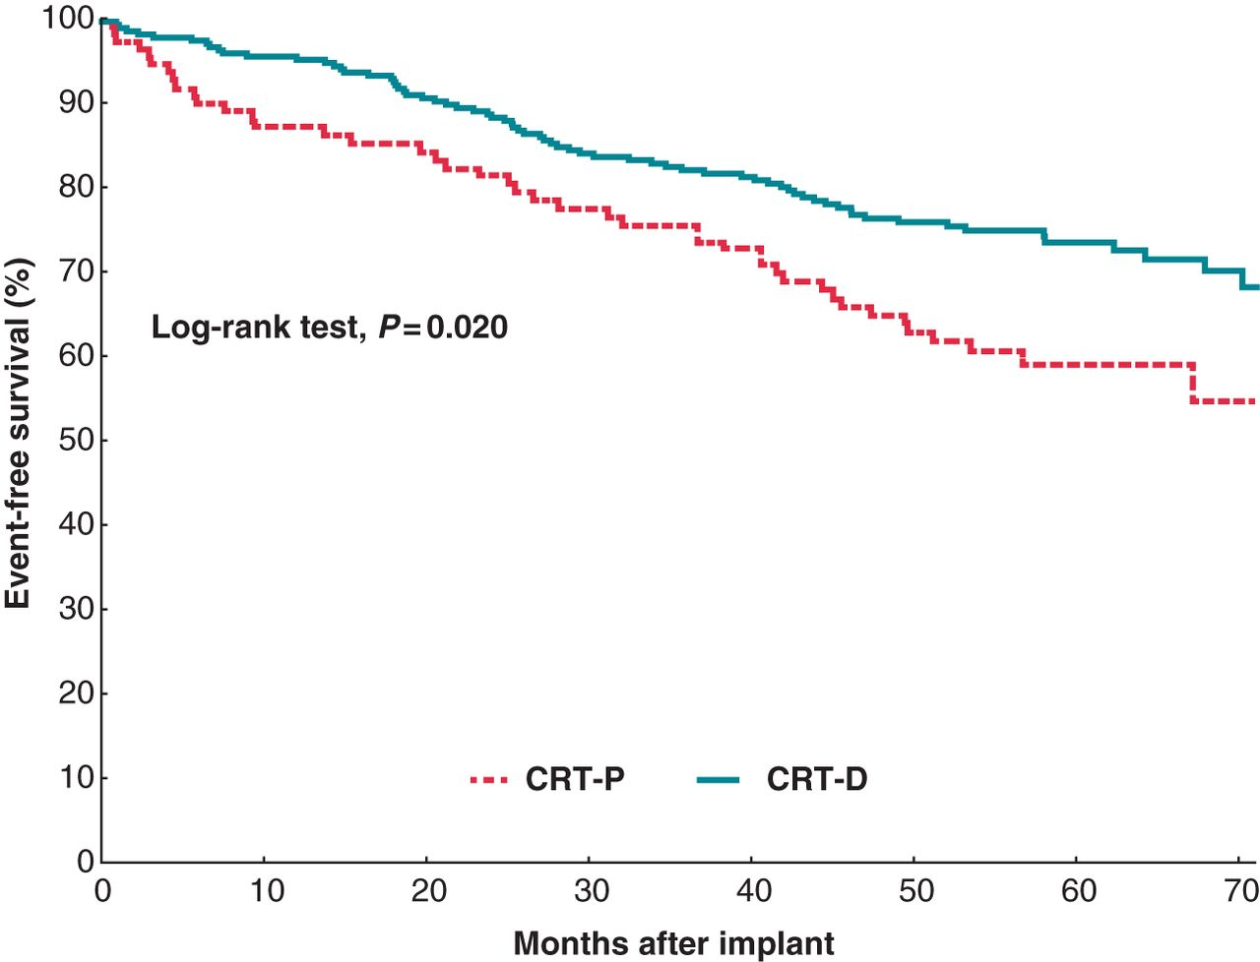
Figure 1 Kaplan–Meier estimates of time to death from any cause, stratified by device type.
Notes:
Figure 1 Kaplan–Meier estimates of time to death from any cause, stratified by device type.
Unless provided in the caption above, the following copyright applies to the content of this slide: Published on behalf of the European Society of Cardiology. All rights reserved. © The Author 2013. For permissions please email: journals.permissions@oup.com.

Slide 2
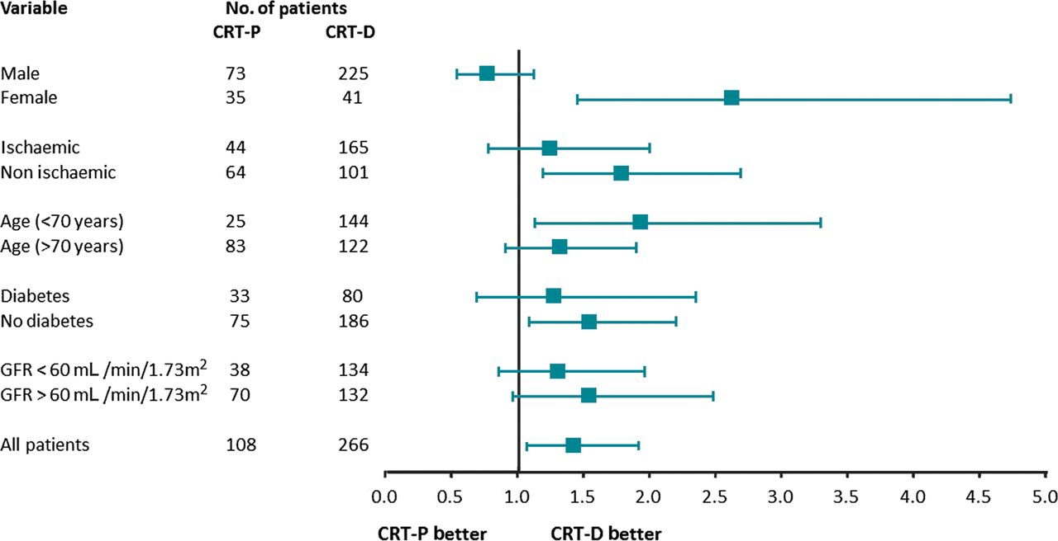
Figure 2 Hazard ratios for survival from all-cause death, according to selected clinical characteristics.
Notes:
Figure 2 Hazard ratios for survival from all-cause death, according to selected clinical characteristics.
Unless provided in the caption above, the following copyright applies to the content of this slide: Published on behalf of the European Society of Cardiology. All rights reserved. © The Author 2013. For permissions please email: journals.permissions@oup.com.

