Slide 1
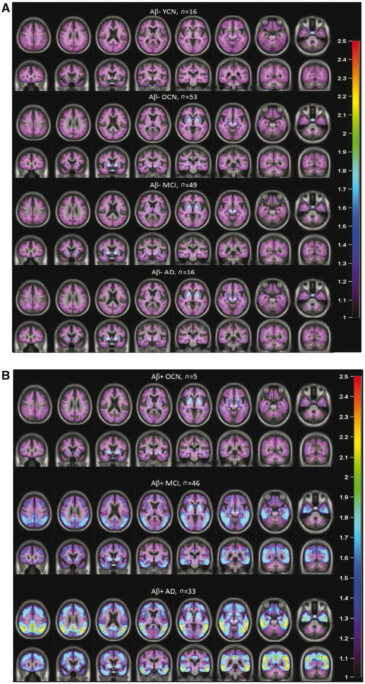
Figure 1 Mean flortaucipir voxel-wise SUVr images for each age/diagnostic cohort by florbetapir PET amyloid status ...
Notes:
Figure 1 Mean flortaucipir voxel-wise SUVr images for each age/diagnostic cohort by florbetapir PET amyloid status (Aβ+ or Aβ−). Images are scaled from 1–2.5 SUVr units and overlaid on an average of MRI from all study patients in radiologic orientation such that the right side of each image represents left hemisphere of the brain. (A) Aβ−; (B) Aβ+. AD = Alzheimer’s disease; ROI = region of interest.
Unless provided in the caption above, the following copyright applies to the content of this slide: © The Author (2017). Published by Oxford University Press on behalf of the Guarantors of Brain.This is an Open Access article distributed under the terms of the Creative Commons Attribution Non-Commercial License (http://creativecommons.org/licenses/by-nc/4.0/), which permits non-commercial re-use, distribution, and reproduction in any medium, provided the original work is properly cited. For commercial re-use, please contact journals.permissions@oup.com

Slide 2
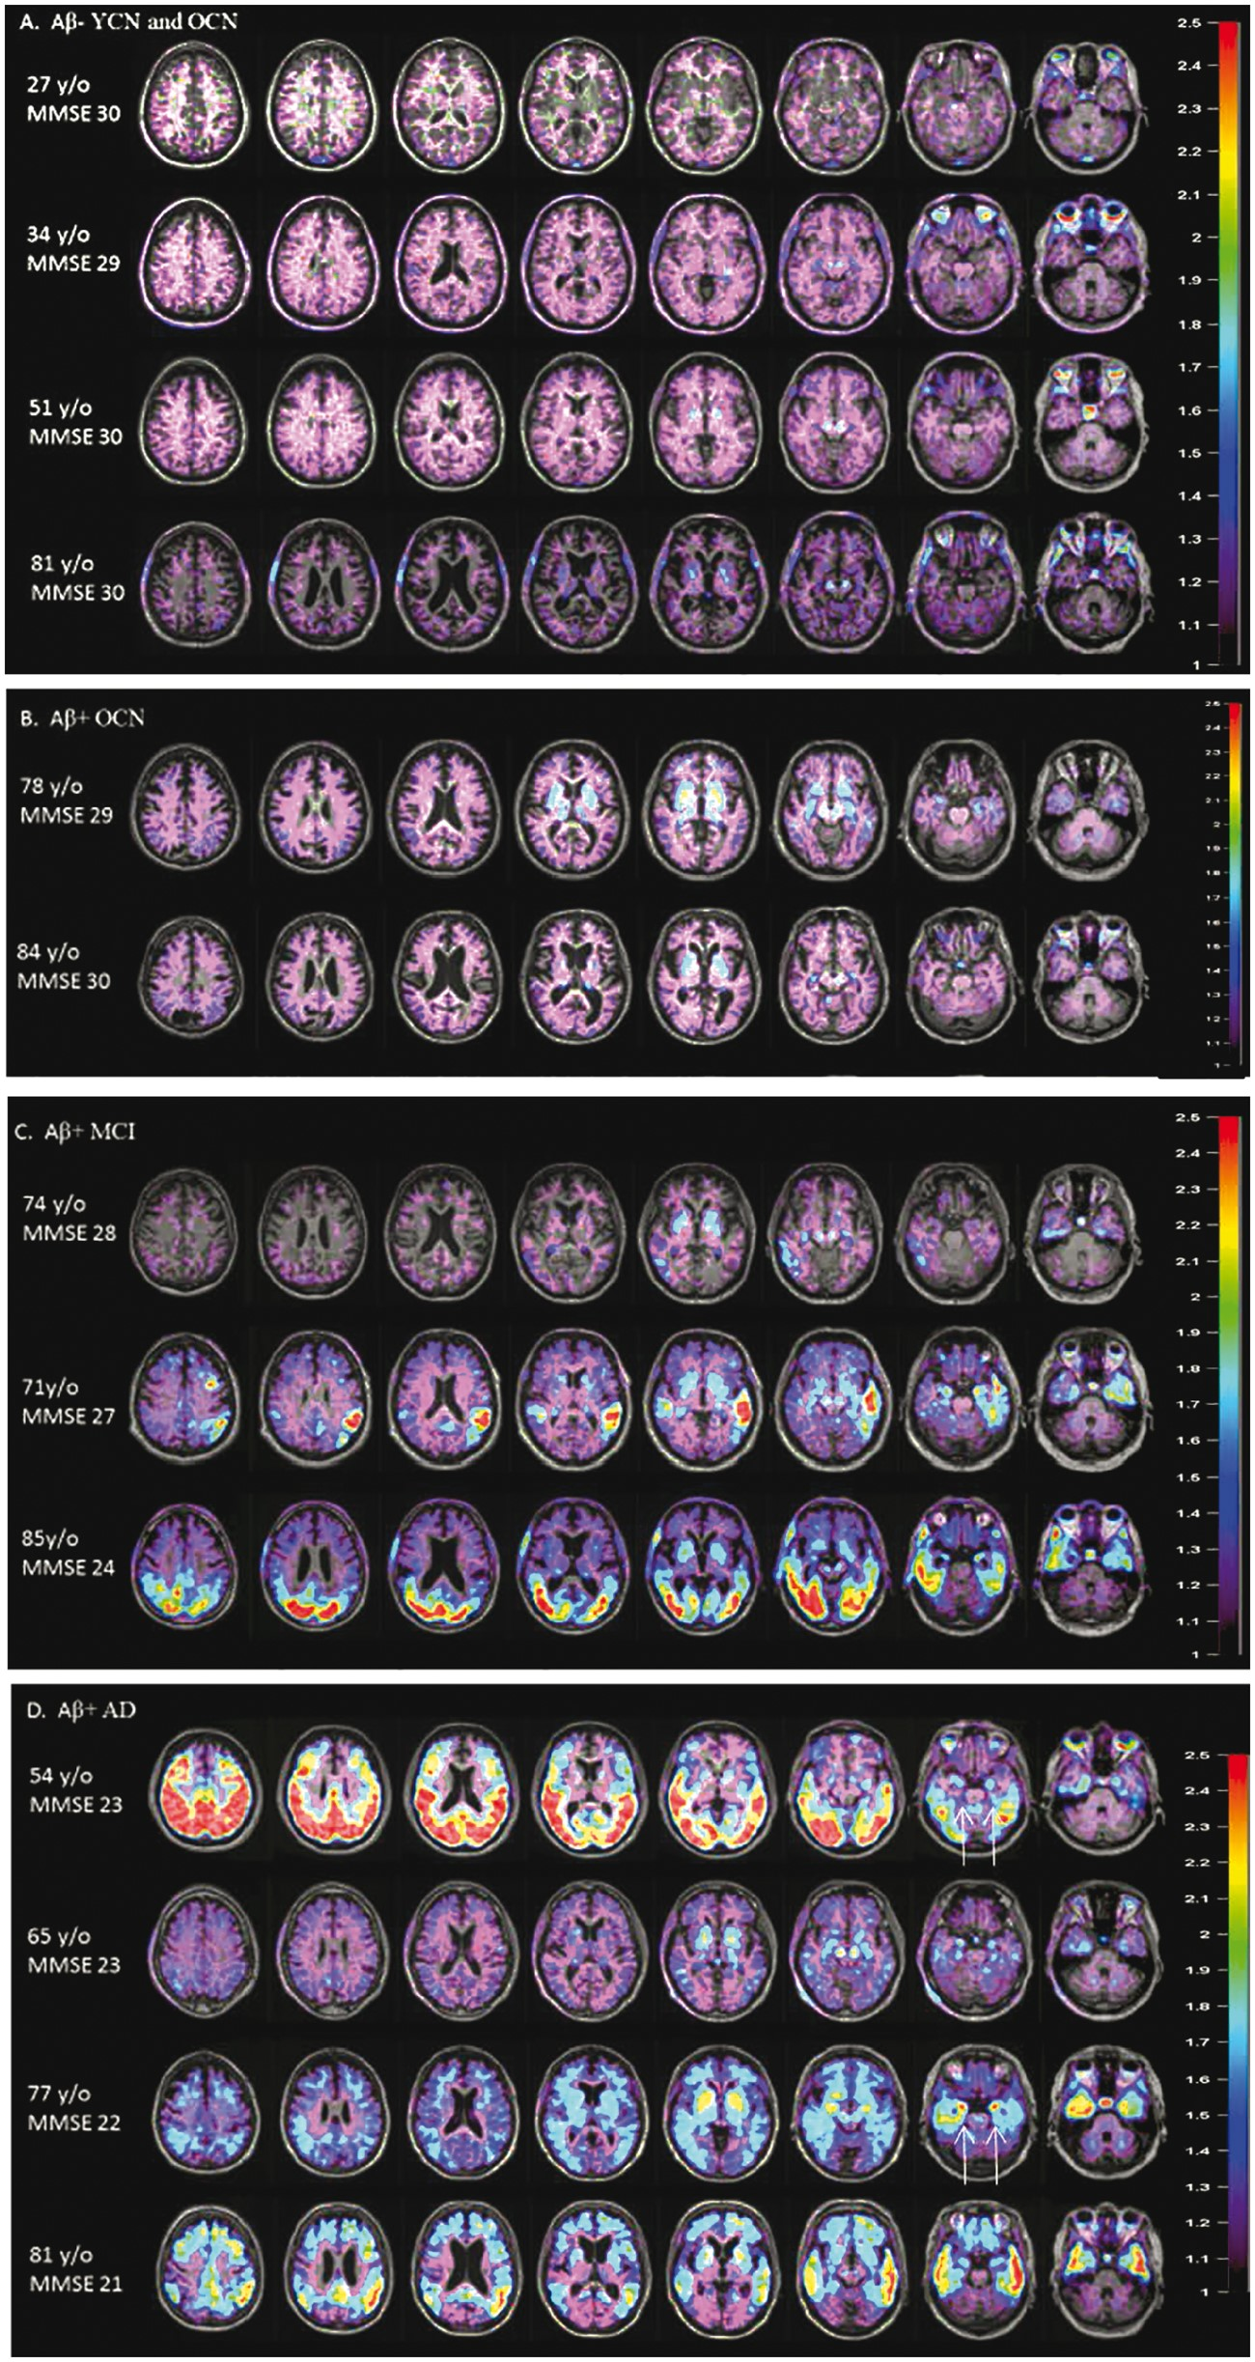
Figure 2 Flortaucipir voxel-wise SUVr images for representative individual Aβ− control (YCN/OCN) and Aβ+ OCN, MCI, and ...
Notes:
Figure 2 Flortaucipir voxel-wise SUVr images for representative individual Aβ− control (YCN/OCN) and Aβ+ OCN, MCI, and Alzheimer’s disease subjects. (A) Aβ− control (YNC/OCN), (B–D) Aβ+ OCN, MCI and Alzheimer’s disease subjects, respectively. PET images are scaled from 1–2.5 SUVr units and overlaid on each subject’s respective MRI. Note in addition to differences in overall extent of retention, there are also subjects with relatively limbic sparing (D, first row) and limbic predominant (D, third row) patterns (arrows) consistent with the pathology literature (Murray et al., 2011). AD = Alzheimer’s disease; y/o = years old.
Unless provided in the caption above, the following copyright applies to the content of this slide: © The Author (2017). Published by Oxford University Press on behalf of the Guarantors of Brain.This is an Open Access article distributed under the terms of the Creative Commons Attribution Non-Commercial License (http://creativecommons.org/licenses/by-nc/4.0/), which permits non-commercial re-use, distribution, and reproduction in any medium, provided the original work is properly cited. For commercial re-use, please contact journals.permissions@oup.com

Slide 3
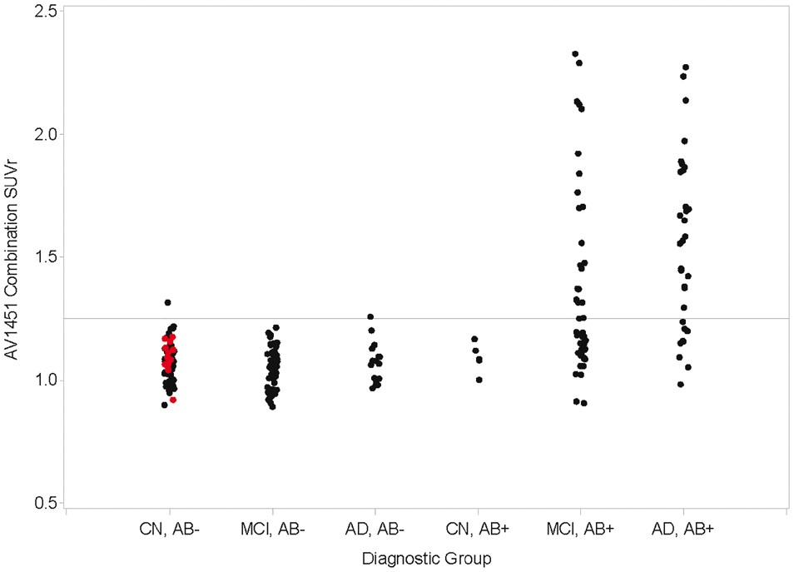
Figure 3 Posterior neocortical composite SUVr for individual subjects by diagnostic category.X-axis: (diagnostic ...
Notes:
Figure 3 Posterior neocortical composite SUVr for individual subjects by diagnostic category.X-axis: (diagnostic group, amyloid status), YCN are shown in red. Y-axis: flortaucipir (AV1451) combination SUVr. Horizontal reference line shows upper 99% confidence limit for YCN. AD = Alzheimer’s disease; CN = cognitively normal.
Unless provided in the caption above, the following copyright applies to the content of this slide: © The Author (2017). Published by Oxford University Press on behalf of the Guarantors of Brain.This is an Open Access article distributed under the terms of the Creative Commons Attribution Non-Commercial License (http://creativecommons.org/licenses/by-nc/4.0/), which permits non-commercial re-use, distribution, and reproduction in any medium, provided the original work is properly cited. For commercial re-use, please contact journals.permissions@oup.com

Slide 4
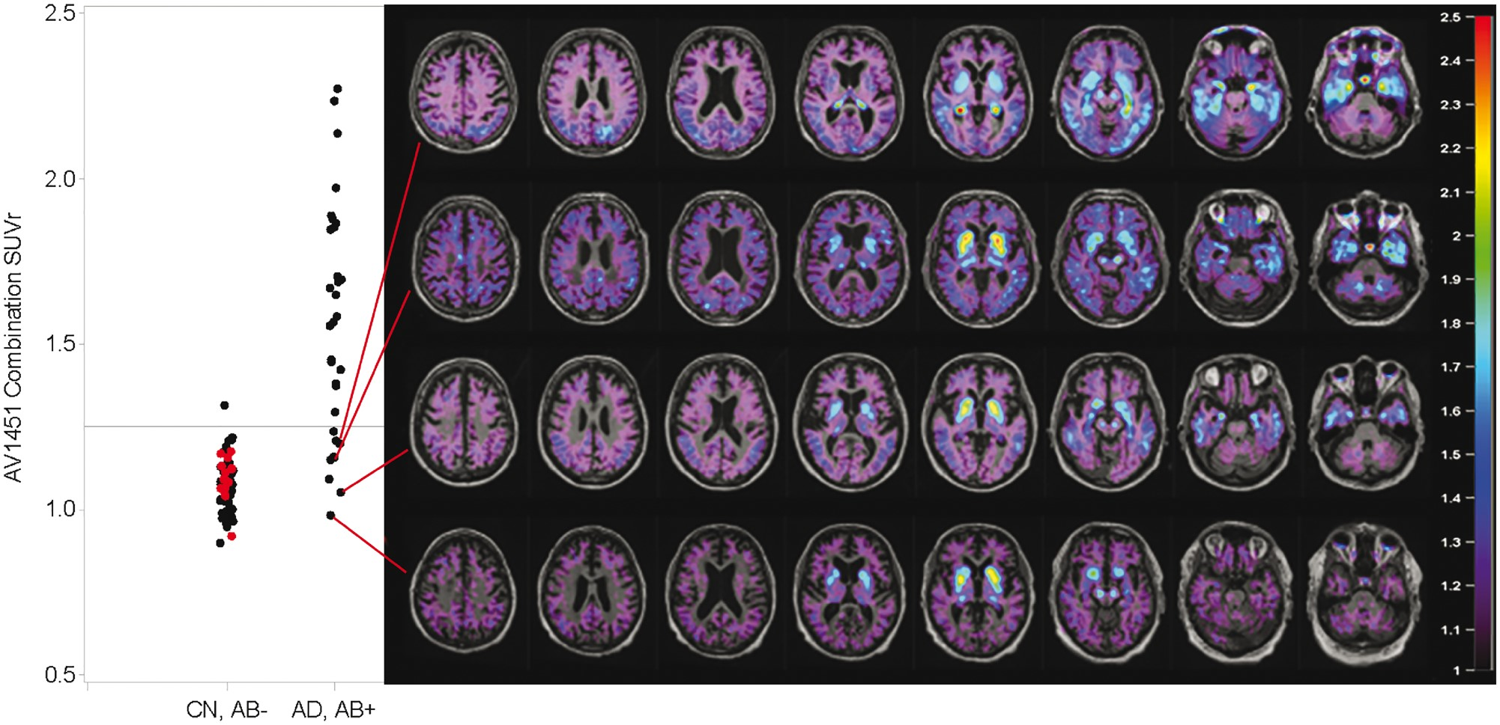
Figure 4 Aβ+ subjects with low cortical average SUVR values. Subjects with low flortaucipir SUVr values may still have ...
Notes:
Figure 4 Aβ+ subjects with low cortical average SUVR values. Subjects with low flortaucipir SUVr values may still have abnormal tracer retention in limited cortical regions. AD = Alzheimer’s disease; CN = cognitively normal; ROI = region of interest.
Unless provided in the caption above, the following copyright applies to the content of this slide: © The Author (2017). Published by Oxford University Press on behalf of the Guarantors of Brain.This is an Open Access article distributed under the terms of the Creative Commons Attribution Non-Commercial License (http://creativecommons.org/licenses/by-nc/4.0/), which permits non-commercial re-use, distribution, and reproduction in any medium, provided the original work is properly cited. For commercial re-use, please contact journals.permissions@oup.com

Slide 5
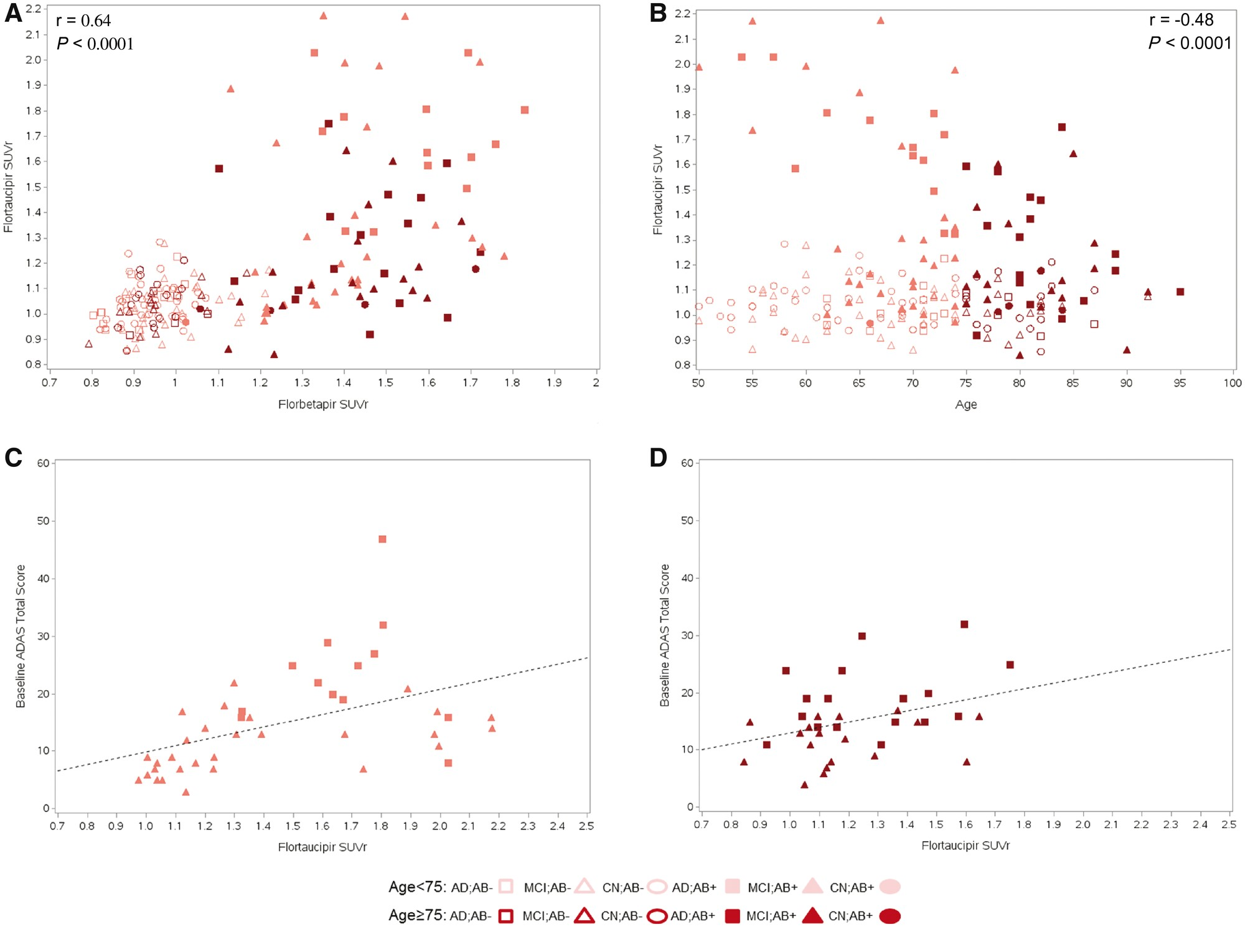
Figure 5 Relationship between florbetapir PET SUVr, flortaucipir SUVr, diagnosis, age and ADAS score. (A) Scatterplot ...
Notes:
Figure 5 Relationship between florbetapir PET SUVr, flortaucipir SUVr, diagnosis, age and ADAS score. (A) Scatterplot of relationship between florbetapir and flortaucipir SUVr for individual subjects by age, diagnosis and amyloid status. (B) Scatterplot of relationship between age and flortaucipir SUVr for individual subjects by age, diagnosis and amyloid status (r and P-values refer to Aβ+ subjects only). (C and D) Scatterplot of relationship between flortaucipir SUVr and cognition for individual subjects by diagnosis and amyloid status and age (75 years D). AD = Alzheimer’s disease; CN = cognitively normal.
Unless provided in the caption above, the following copyright applies to the content of this slide: © The Author (2017). Published by Oxford University Press on behalf of the Guarantors of Brain.This is an Open Access article distributed under the terms of the Creative Commons Attribution Non-Commercial License (http://creativecommons.org/licenses/by-nc/4.0/), which permits non-commercial re-use, distribution, and reproduction in any medium, provided the original work is properly cited. For commercial re-use, please contact journals.permissions@oup.com

Slide 6
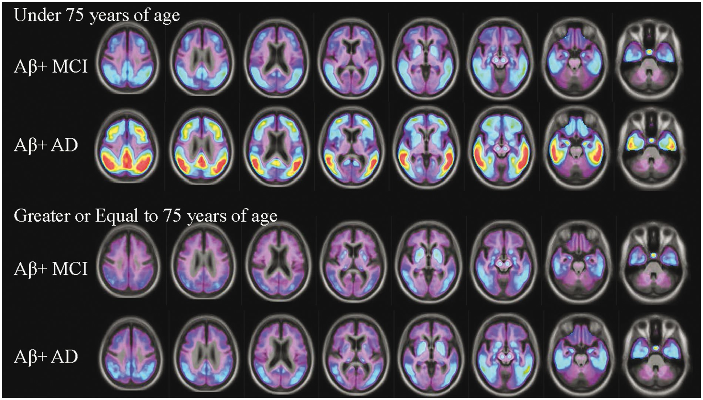
Figure 6 Mean flortaucipir voxel-wise SUVr images for Aβ+ MCI and Alzheimer’s disease subjects <75 years and ≥75 years ...
Notes:
Figure 6 Mean flortaucipir voxel-wise SUVr images for Aβ+ MCI and Alzheimer’s disease subjects <75 years and ≥75 years old. Note the similarity between the pattern of demented (Alzheimer’s disease) subjects ≥75 years to MCI subjects <75 years of age. AD = Alzheimer’s disease.
Unless provided in the caption above, the following copyright applies to the content of this slide: © The Author (2017). Published by Oxford University Press on behalf of the Guarantors of Brain.This is an Open Access article distributed under the terms of the Creative Commons Attribution Non-Commercial License (http://creativecommons.org/licenses/by-nc/4.0/), which permits non-commercial re-use, distribution, and reproduction in any medium, provided the original work is properly cited. For commercial re-use, please contact journals.permissions@oup.com

