Slide 1
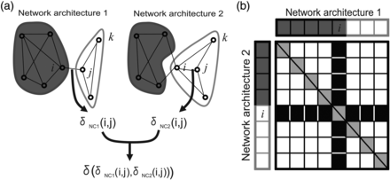
Figure 3. Definition of Similarity index. The main purpose of the Similarity index is to quantify the extent to which 2 ...
Notes:
Figure 3. Definition of Similarity index. The main purpose of the Similarity index is to quantify the extent to which 2 community architectures are similar. (a) An example comparing 2 network architectures, 1 and 2. In this case, δNC1(i,j) = 0 because nodes i and j participate in 2 different communities in network architecture 1, and δNC2(i,j) = 1 because nodes i and j participate in 2 different communities in network architecture 2. Therefore, δ(δNC1(i,j),δNC2(i,j)) is 0. However, between nodes j and k, δ(δNC1(i,j),δNC2(i,j)) is 1 because nodes j and k participate in the same community in both network architectures. By summing all pairs of nodes i and j, we can obtain the final value of the Similarity index. (b) A scheme of how to calculate the Similarity index. The x-axis represents network architecture 1, and the y-axis represents network architecture 2. Colors (dark gray or white) correspond to communities shown in (a). Regions where δNC1(i,j) = δNC2(i,j) are shown as white boxes, and regions where δNC1(i,j)≠δNC2(i,j) are shown as black boxes. The diagonal components would be self-connections, and are not considered in calculating the Similarity index. Graphically, the Similarity index is defined as (total number of white boxes except diagonal components)/(total number of boxes except diagonal components).
Unless provided in the caption above, the following copyright applies to the content of this slide: © The Author 2014. Published by Oxford University PressThis is an Open Access article distributed under the terms of the Creative Commons Attribution Non-Commercial License (http://creativecommons.org/licenses/by-nc/4.0/), which permits non-commercial re-use, distribution, and reproduction in any medium, provided the original work is properly cited. For commercial re-use, please contact journals.permissions@oup.com

Slide 2
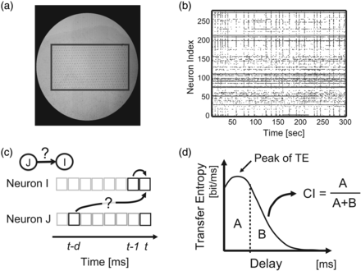
Figure 1. Experimental setup. (a) Micrograph of cortical slice culture on a 512-electrode array. Array is ∼1 × 2 mm, ...
Notes:
Figure 1. Experimental setup. (a) Micrograph of cortical slice culture on a 512-electrode array. Array is ∼1 × 2 mm, outlined for visibility. Small dots are electrodes, arranged hexagonally with 60 μm spacing. (b) Representative raster of activity. Dots represent spikes from 260 sorted neurons, shown for 300 s. (c) Schematic of transfer entropy (TE) showing 2 binned spike trains. TE evaluates how much neuron J's past spiking activity improves the prediction of neuron I's activity beyond the prediction based on neuron I's activity from the previous time bin. Here, delay indicates time lag chosen for the spiking activity of neuron J. (d) Definition of the Coincidence index (CI). When TE was plotted as a function of delay, CI was the ratio of area under the peak (A) to total area under the curve (A + B).
Unless provided in the caption above, the following copyright applies to the content of this slide: © The Author 2014. Published by Oxford University PressThis is an Open Access article distributed under the terms of the Creative Commons Attribution Non-Commercial License (http://creativecommons.org/licenses/by-nc/4.0/), which permits non-commercial re-use, distribution, and reproduction in any medium, provided the original work is properly cited. For commercial re-use, please contact journals.permissions@oup.com

Slide 3
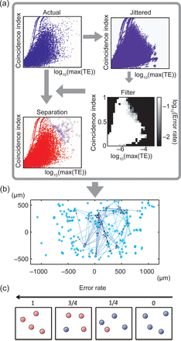
Figure 2. Approach for determining significant connections. (a) First, CI was plotted against log(TE_{max}) for ...
Notes:
Figure 2. Approach for determining significant connections. (a) First, CI was plotted against log(TEmax) for all neuron pairs from actual data (dots represent pairs). Second, CI was plotted against log(TEmax) for jittered data. Third, both plots were combined to construct a filter that indicated the ratio of jittered dots to all dots in each of the 25 × 25 2D bins (white: many jittered; black: few jittered). Fourth, filter was used to indicate actual connections where jittered pairs were few. Several lines in the distributions occur because when coincident firing happens only once or twice, the TE values become disretized. (b) Connectivity map with actual directional connections plotted as arrows. Thickness indicates strength. Circles represent presumed neuron locations on array. (c) The concept of error rate. The red and blue balls, respectively, represent data samples of jittered data (n = 100) and original data included in a bin. Because error rate is defined as ratio of the number of red balls to the number of all balls, the error rate becomes higher toward the left side in this figure.
Unless provided in the caption above, the following copyright applies to the content of this slide: © The Author 2014. Published by Oxford University PressThis is an Open Access article distributed under the terms of the Creative Commons Attribution Non-Commercial License (http://creativecommons.org/licenses/by-nc/4.0/), which permits non-commercial re-use, distribution, and reproduction in any medium, provided the original work is properly cited. For commercial re-use, please contact journals.permissions@oup.com

Slide 4
Figure 4. High numbers of connections occur more than chance in clusters of up to 6 neurons. Each plot shows how often ...
Notes:
Figure 4. High numbers of connections occur more than chance in clusters of up to 6 neurons. Each plot shows how often a given number of connections occurred for clusters of up to 6 neurons. Curves of dotted lines show connections expected by chance. In chance shuffling, the numbers of directed inputs, directed outputs, and bidirectional connections was preserved. Curves of sold lines show connections observed in data. In general, solid lines tended to depart from dotted lines at high numbers of connections, suggesting nonrandomness of connections. Top row (a–d) shows results for networks constructed from effective connectivity (TE); bottom row (e–h) shows results for networks constructed from patch-clamp experiments (synaptic connections; Perin et al. 2011). Small networks inset in (a–d) show schematic example clusters. Number of neurons in each cluster goes from 3 (left) to 6 (right). Note qualitative similarity between effective connections measured by TE and synaptic connections assessed by patch-clamp. Larger groups of neurons tended to have more connections than chance (*P < 0.01, **P < 0.001; z-test).
Unless provided in the caption above, the following copyright applies to the content of this slide: © The Author 2014. Published by Oxford University PressThis is an Open Access article distributed under the terms of the Creative Commons Attribution Non-Commercial License (http://creativecommons.org/licenses/by-nc/4.0/), which permits non-commercial re-use, distribution, and reproduction in any medium, provided the original work is properly cited. For commercial re-use, please contact journals.permissions@oup.com

Slide 5
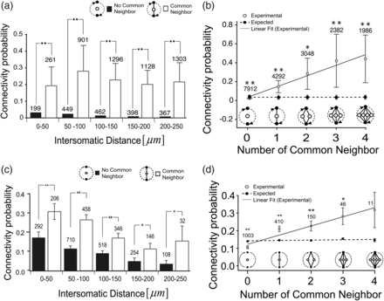
Figure 5. Common neighbors increase probability of further connections. (a) Probability of an effective connection ...
Notes:
Figure 5. Common neighbors increase probability of further connections. (a) Probability of an effective connection (from TE) as a function of distance for pairs that share a common neighbor (filled bars) and those that do not (open bars). Error bars are SEMs of 10 data samples (*P < 0.01, t-test). (b) Probability of an effective connection (from TE) between 2 neurons as a function of different numbers of common neighbors. Solid line is the best fit line from data. Dotted line is best fit line for chance expected values. The expected values were given how many common neighbors will be observed just when given the connectivity probability of the real data. Error bars are SEMs of 9 data samples. For comparison, (c) and (d) show same analyses applied to synaptic connectivity assessed by patch-clamp (Perin et al. 2011).
Unless provided in the caption above, the following copyright applies to the content of this slide: © The Author 2014. Published by Oxford University PressThis is an Open Access article distributed under the terms of the Creative Commons Attribution Non-Commercial License (http://creativecommons.org/licenses/by-nc/4.0/), which permits non-commercial re-use, distribution, and reproduction in any medium, provided the original work is properly cited. For commercial re-use, please contact journals.permissions@oup.com

Slide 6
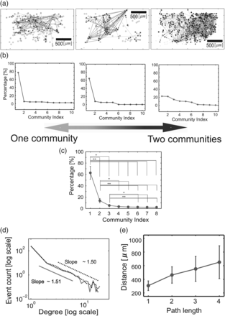
Figure 6. Large-scale structure of networks. (a) Spatial locations of neurons recorded from the rectangular electrode ...
Notes:
Figure 6. Large-scale structure of networks. (a) Spatial locations of neurons recorded from the rectangular electrode array, with effective connections shown. The 3 networks represent the breadth of community structures found. These 3 networks are shown at figure 7(e) and (f) with colored and zoomed. (b) Percentage of neurons included in communities plotted against number of communities, for the 3 networks. (c) Average percentage of neurons included in communities plotted against number of communities. Note that, on average, only 2 communities were needed to encompass over 95% of neurons (*P < 0.01, **P < 0.001). (d) Distribution of neuron degrees, plotted in log–log space. The dotted line is for out-degree, the solid line is for in-degree. Note fat tail of distribution, different from chance expectation. (e) Distance between neurons plotted against path length. Path length tended to increase with distance linearly. The error bars are standard deviation among slices.
Unless provided in the caption above, the following copyright applies to the content of this slide: © The Author 2014. Published by Oxford University PressThis is an Open Access article distributed under the terms of the Creative Commons Attribution Non-Commercial License (http://creativecommons.org/licenses/by-nc/4.0/), which permits non-commercial re-use, distribution, and reproduction in any medium, provided the original work is properly cited. For commercial re-use, please contact journals.permissions@oup.com

Slide 7
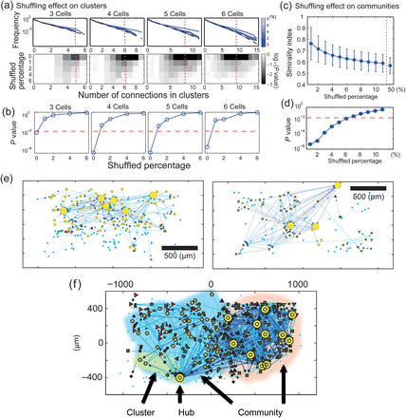
Figure 7. Hubs and their connections can affect connectivity statistics at small and large scales. (a) Upper 4 panels ...
Notes:
Figure 7. Hubs and their connections can affect connectivity statistics at small and large scales. (a) Upper 4 panels show frequency distributions of connections for clusters of 3–6 neurons (as in Fig. 4) after exchanging connections from 1 to 6% of high-degree nodes with connections from 1 to 6% of low-degree nodes. Line color indicates extent of shuffling. Colored lines are above dashed lines, indicating that number of connections in small neuron groups exceeded chance levels. Note that increased amounts of shuffling (lighter colors) caused the curves to fall toward chance levels. The shaded panels below these graphs show the probability of observing each number of connections for a given neuron group size. Percentage shuffled is on the y-axis, number of connections is on the x-axis, and probability is given by shading, with darker representing less probable. Note that least probable connections tend to occur with lowest amounts of shuffling, and that larger numbers of connections are less probable. The red dashed line indicates the number of connections that was found to be least probable for a given neuron group size. (b) A comparison of P-values obtained from shuffling connections of hub neurons. These P-values were given at sections shown by red dotted lines in lower panels in (a). Curves in all cases move upward for larger amounts of shuffling, indicating loss of structure. Note that significant loss of small-scale structure is occurs after shuffling only 1% of hub neurons. (c) Dissolution of community structure by shuffling of hubs. y-Axis is similarity of shuffled community structure to that found in data; x-axis is percentage of hubs used for shuffling. (d) P-values for community structure as a function of shuffling. Again, note that both curves move upward for increased amounts of shuffling, indicating loss of structure at large scale. Note that the percentage at which the large-scale structure was significantly lost (6%) was clearly larger than the percentage at which the small-scale structure was significantly lost (1%). (e) and (f) Spatial locations of hub neurons on the rectangular electrode array are shown as yellow markers, indicating that they could be found both in the center of the array as well as on the edges. (f) The 3 network features (hub, cluster and community) of various scales that we have examined. Translucent red and blue regions cover 2 large communities, which can also be identified by different node symbols (small orange circles or squares). The translucent yellow region covers a representative cluster of 6 neurons.
Unless provided in the caption above, the following copyright applies to the content of this slide: © The Author 2014. Published by Oxford University PressThis is an Open Access article distributed under the terms of the Creative Commons Attribution Non-Commercial License (http://creativecommons.org/licenses/by-nc/4.0/), which permits non-commercial re-use, distribution, and reproduction in any medium, provided the original work is properly cited. For commercial re-use, please contact journals.permissions@oup.com

