Slide 1
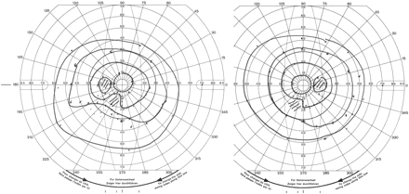
Fig. 1 Visual field defect showing non-congruous left lower quadrantanopia.
Notes:
Fig. 1 Visual field defect showing non-congruous left lower quadrantanopia.
Unless provided in the caption above, the following copyright applies to the content of this slide: © The Author (2006). Published by Oxford University Press on behalf of the Guarantors of Brain. All rights reserved. For Permissions, please email: journals.permissions@oxfordjournals.org

Slide 2
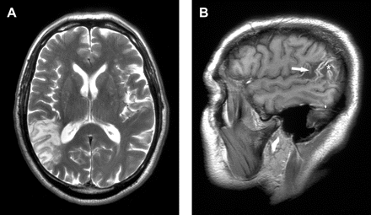
Fig. 2 Cerebral MRI showing an area of infarction involving the right supramarginal and angular gyri with ...
Notes:
Fig. 2 Cerebral MRI showing an area of infarction involving the right supramarginal and angular gyri with surrounding oedema. (A) T2-weighted fast spin echo sequence, axial slice. (B) T1-weighted parasagittal slice. The hyperdensity of the cortex indicating cortical laminar necrosis (arrow) may be noted.
Unless provided in the caption above, the following copyright applies to the content of this slide: © The Author (2006). Published by Oxford University Press on behalf of the Guarantors of Brain. All rights reserved. For Permissions, please email: journals.permissions@oxfordjournals.org

Slide 3
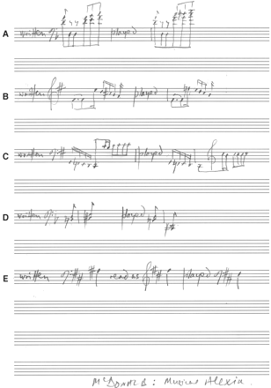
Fig. 3 (A–E) Examples of errors when playing the piano while sight-reading. See text for further explanations.
Notes:
Fig. 3 (A–E) Examples of errors when playing the piano while sight-reading. See text for further explanations.
Unless provided in the caption above, the following copyright applies to the content of this slide: © The Author (2006). Published by Oxford University Press on behalf of the Guarantors of Brain. All rights reserved. For Permissions, please email: journals.permissions@oxfordjournals.org

