Slide 1
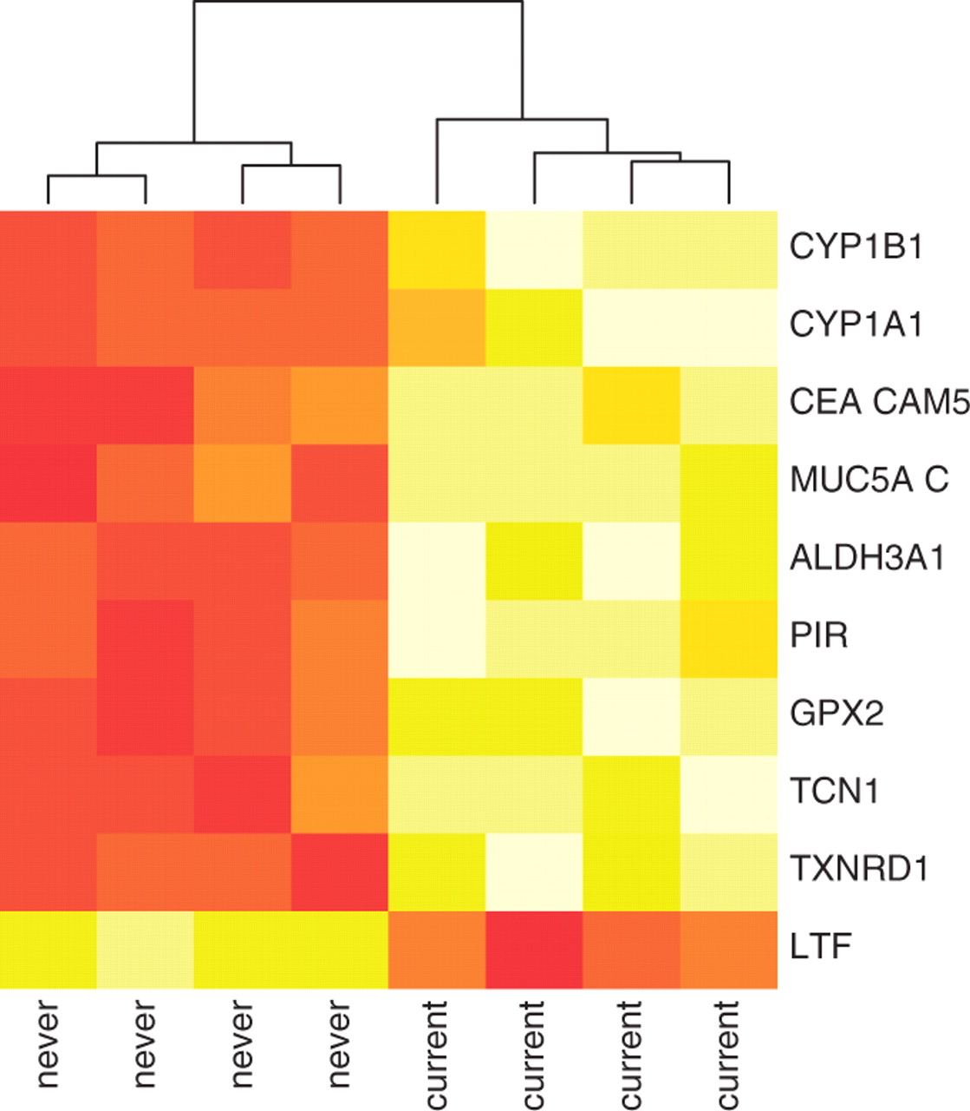
Fig. 1. Heatmap of discriminating genes of dataset GSE4635 at adjusted P<10%. The samples cluster by ‘Smoker’ status ...
Notes:
Fig. 1. Heatmap of discriminating genes of dataset GSE4635 at adjusted P<10%. The samples cluster by ‘Smoker’ status (smokers : current and non-smokers: never).
Unless provided in the caption above, the following copyright applies to the content of this slide: © The Author 2011. Published by Oxford University Press. All rights reserved. For Permissions, please email: journals.permissions@oup.com

