Slide 1
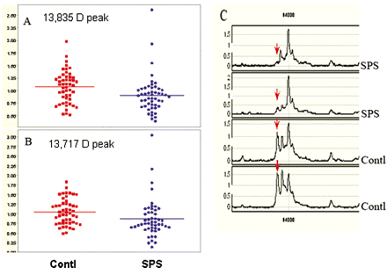
Fig. 1 Proteomic profiling differentiates SPS from control group (A and B). The mean protein peak intensities of two ...
Notes:
Fig. 1 Proteomic profiling differentiates SPS from control group (A and B). The mean protein peak intensities of two different molecular sizes one at 13 835 kDa (A) and the other at 13 717 kDa (B) were found to be significantly lower (p < 0.05) in SPS compared to controls. Each spot represents a single patient, each run in duplicate. The mass spectrometric tracing in C shows the two identified protein peaks, 13 835 kDa and 13 717 kDa from two representative SPS patients compared with two controls. The peak at 13 717 kDa is marked with a red arrow.
Unless provided in the caption above, the following copyright applies to the content of this slide: © The Author (2006). Published by Oxford University Press on behalf of the Guarantors of Brain. All rights reserved. For Permissions, please email: journals.permissions@oxfordjournals.org

Slide 2
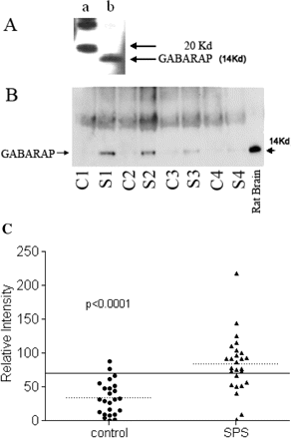
Fig. 2 (A) Polyclonal antibody specificity to GABARAP. The polyclonal antibody to GABARAP developed in rabbit ...
Notes:
Fig. 2 (A) Polyclonal antibody specificity to GABARAP. The polyclonal antibody to GABARAP developed in rabbit recognized the protein of expected 14 kDa size (lane b) in a western blot. Lane a represents molecular size markers. (B) SPS sera immunoprecipitate GABARAP. Sera from SPS and controls were used to immunoprecipitate GABARAP from rat cerebellum total protein extract. Western blots show GABARAP bands detected by the polyclonal antibody E2 from four representative SPS patients (S) and four controls (C). Total cerebellum protein was loaded in the last well (rat brain) and immunobloted with E2 antibody. (C) High prevalence of GABARAP antibodies in SPS sera. A total of 27 SPS sera and 19 controls were used to immunoprecipiate GABARAP from rat cerebellar total protein. The immunoprecipitates were resolved and the bands obtained on immunoblots were quantified using QuantityOne software. The reference sera used to normalize the band intensities of all the sera used was assigned an intensity value of 100. The dotted lines represent respective group means and the solid line indicates two times the mean of the control samples. A total of 19 of the 27 SPS samples and 2 of the 19 control samples had GABARAP antibodies above the cut-off (two times the mean of the controls).
Unless provided in the caption above, the following copyright applies to the content of this slide: © The Author (2006). Published by Oxford University Press on behalf of the Guarantors of Brain. All rights reserved. For Permissions, please email: journals.permissions@oxfordjournals.org

Slide 3
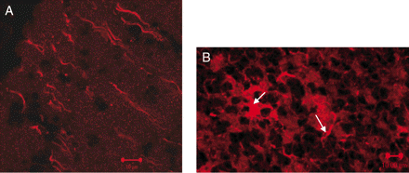
Fig. 3 Confocal microscopy of anti-GABARAP immunoreactivity on cerebellar neurons. Immunostaining of rat cerebellum ...
Notes:
Fig. 3 Confocal microscopy of anti-GABARAP immunoreactivity on cerebellar neurons. Immunostaining of rat cerebellum sections using E2 antibody demonstrates GABARAP immunoreactivity on the axons in the molecular layer (A) as well as neuronal cell bodies and processes (see arrows) in the granular layer (B). Polyclonal rabbit pre-immune serum was used as a negative control.
Unless provided in the caption above, the following copyright applies to the content of this slide: © The Author (2006). Published by Oxford University Press on behalf of the Guarantors of Brain. All rights reserved. For Permissions, please email: journals.permissions@oxfordjournals.org

Slide 4
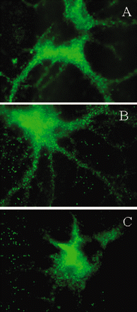
Fig. 4 Inhibition of cell-surface expression of GABA_{A}-receptor by SPS sera. Rat hippocampal neurons were ...
Notes:
Fig. 4 Inhibition of cell-surface expression of GABAA-receptor by SPS sera. Rat hippocampal neurons were treated in vitro with medium alone (A), with control IgG (B) or with an SPS patient IgG (C) for 4 h (magnification ×100). Immunostaining of GABAA-receptor γ2 subunit on representative cell body and neuronal processes demonstrates significant inhibition of the surface expression of GABAA-receptor on neuronal processes (C). Reduction of GABAA-receptor expression was also observed on the cell bodies of some neurons. The IgG purified from an OND subject that did not have detectable GABARAP antibodies, had no effect (B).
Unless provided in the caption above, the following copyright applies to the content of this slide: © The Author (2006). Published by Oxford University Press on behalf of the Guarantors of Brain. All rights reserved. For Permissions, please email: journals.permissions@oxfordjournals.org

Slide 5
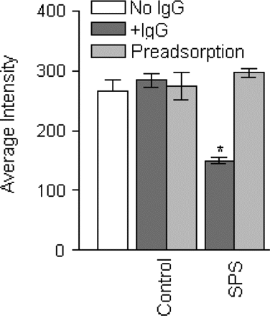
Fig. 5 Pre-adsorption of GABARAP antibodies abolishes the inhibition of GABA_{A}-receptor by SPS sera. A ...
Notes:
Fig. 5 Pre-adsorption of GABARAP antibodies abolishes the inhibition of GABAA-receptor by SPS sera. A total of 15 neurons were analysed in each group by grey-scale analysis for GABAA-receptor surface expression. A significant reduction of GABAA-receptor γ2 subunit surface expression was noted in the neurons treated with the IgGs from the SPS patients (*P < 0.0001; dark grey bar, SPS) compared with those treated with cell culture medium (open bar). The neurons treated with the control IgGs (dark grey bar, control) did not show any effect. When the IgG from a control or the SPS patients was preadsorbed with GABARAP-GST fusion protein, the preadsorbed SPS IgG did not inhibit GABAA-receptor surface expression (light grey bar, SPS).
Unless provided in the caption above, the following copyright applies to the content of this slide: © The Author (2006). Published by Oxford University Press on behalf of the Guarantors of Brain. All rights reserved. For Permissions, please email: journals.permissions@oxfordjournals.org

