Slide 1
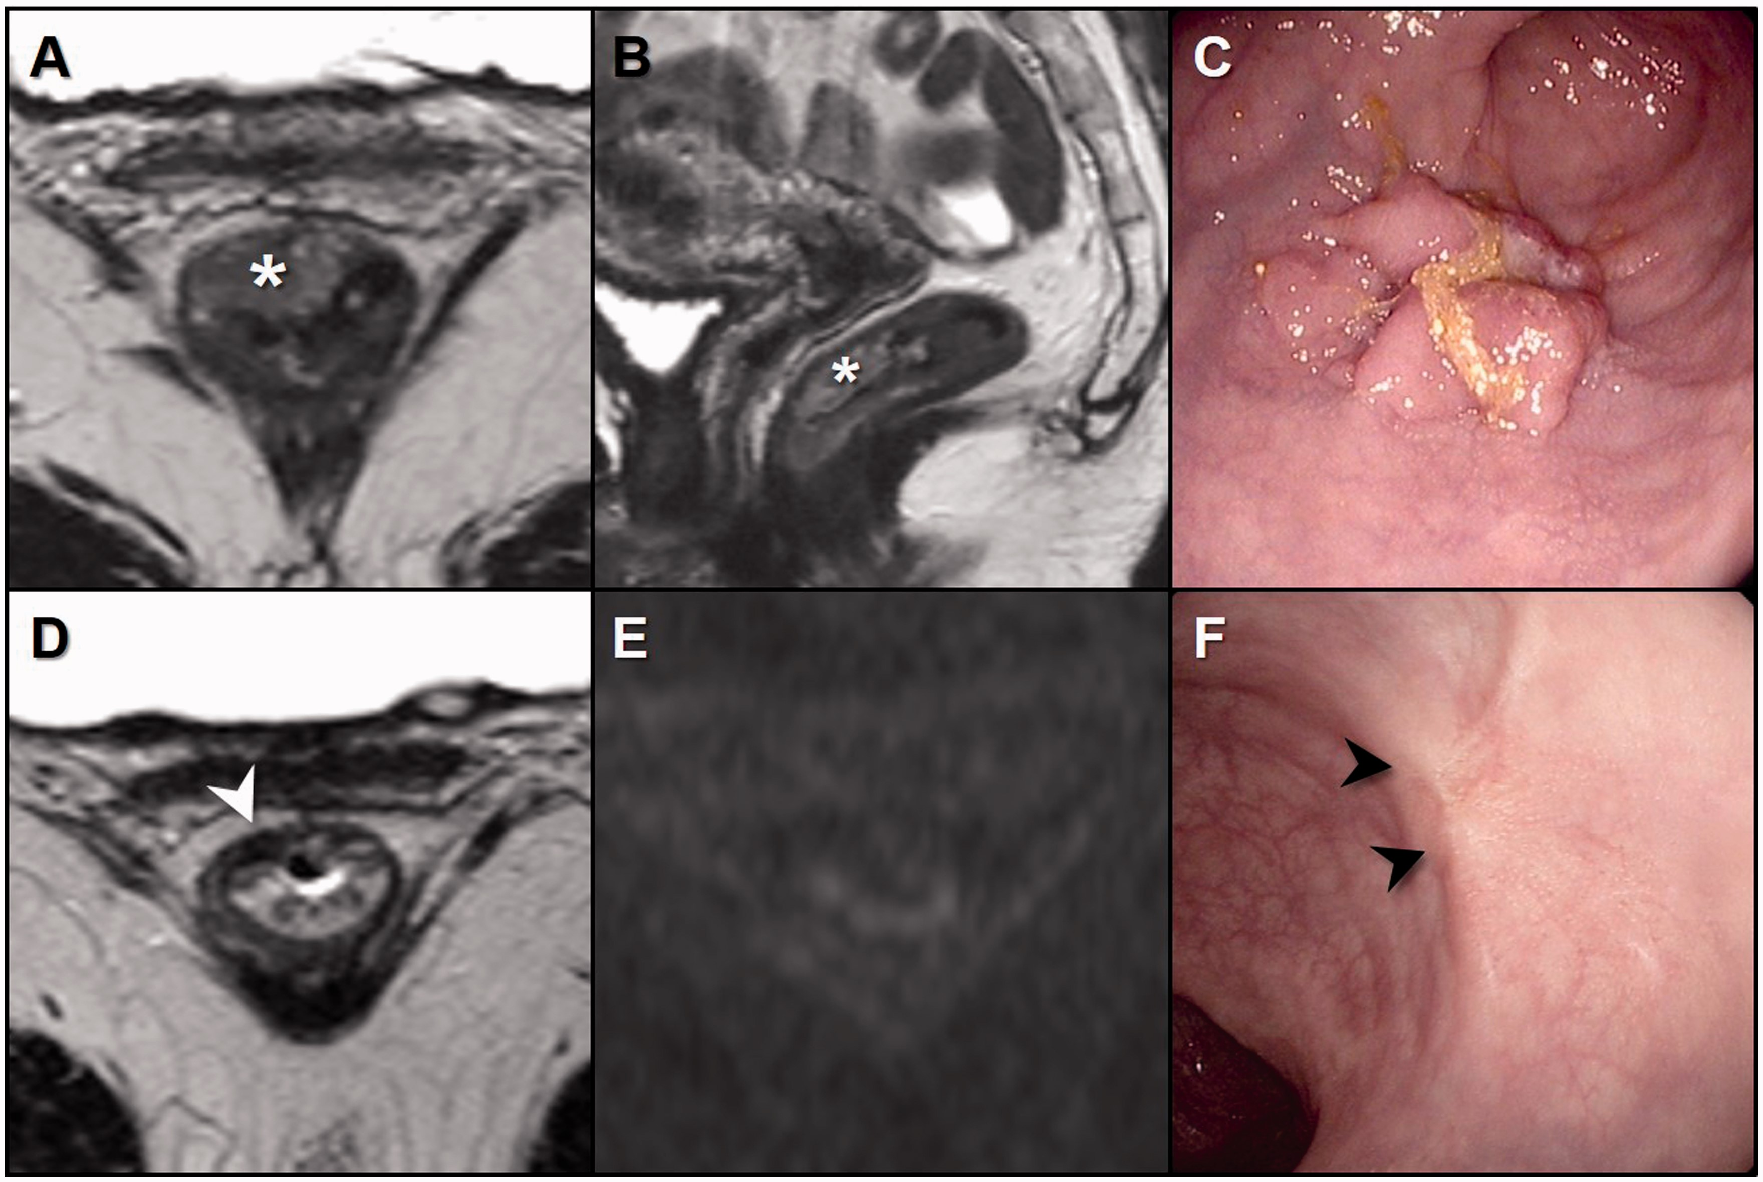
Figure 1. Images of a patient with a clinical complete response at the initial response assessment. Axial (A) and ...
Notes:
Figure 1. Images of a patient with a clinical complete response at the initial response assessment. Axial (A) and saggital (B) T2-weighted MRI of a distal cT2N0 tumor before treatment (indicated with *) and (C) endoscopic image of primary tumor. D) Axial T2-weighted MRI eight weeks postchemoradiation, with the white arrowhead indicating residual fibrosis. E) Diffusion-weighted MRI without any high signal, suggesting a complete response. F) Endoscopy with a typical white scar (black arrowheads) consistent with complete response.
Unless provided in the caption above, the following copyright applies to the content of this slide: © The Author 2016. Published by Oxford University Press. All rights reserved. For Permissions, please e-mail: journals.permissions@oup.com.

Slide 2
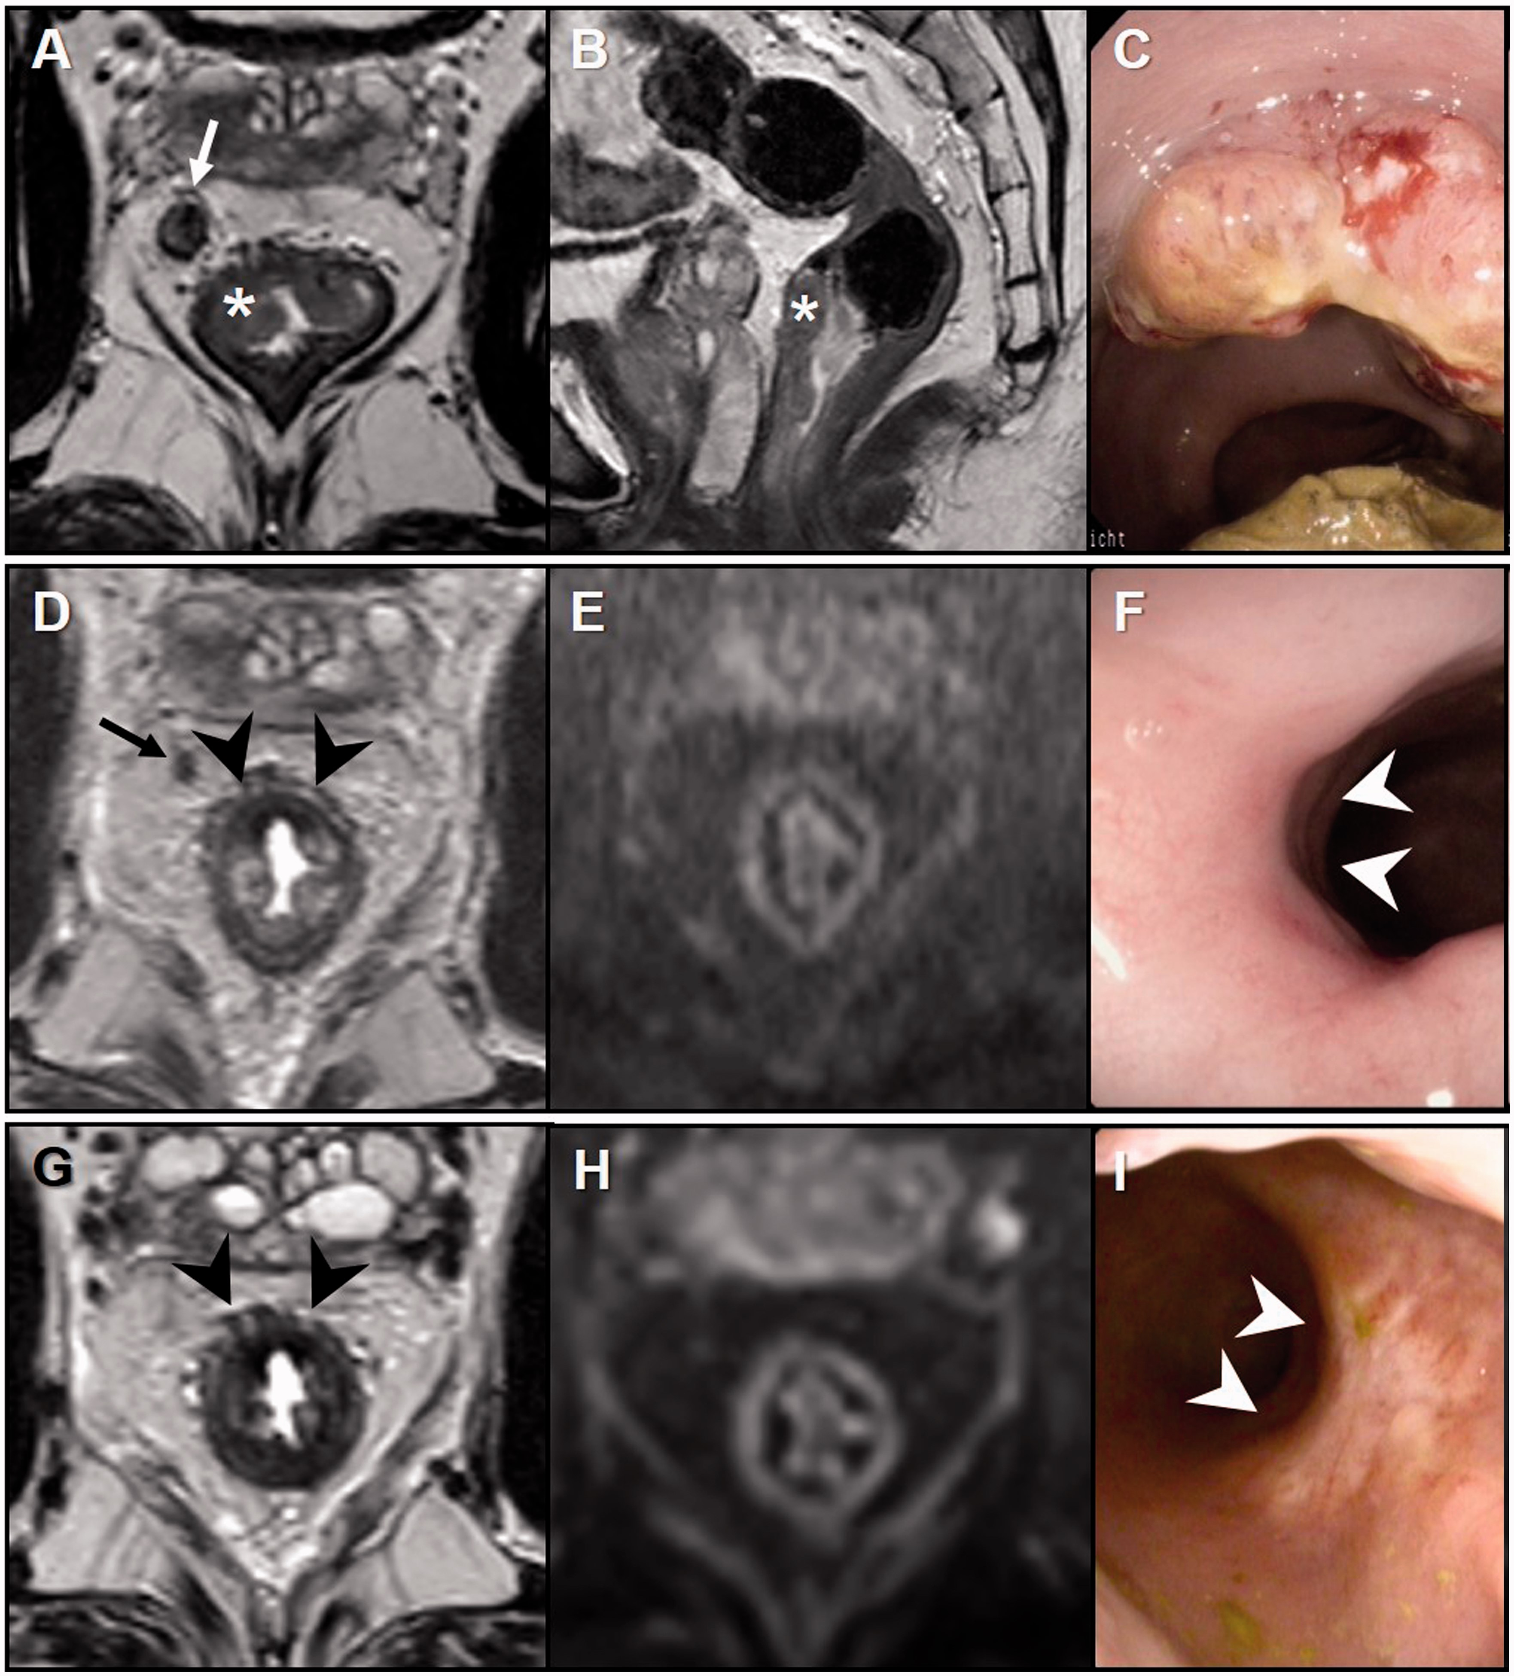
Figure 2. Images of a patient with a near-complete response at initial assessment and clinical complete response after ...
Notes:
Figure 2. Images of a patient with a near-complete response at initial assessment and clinical complete response after a reassessment three months. Axial (A) and saggital (B) T2-weighted MRI of distal cT3 tumor (indicated with *) with evident malignant lymph node (white arrow) before treatment and (C) endoscopic image of primary tumor. D) Axial T2-weighted MRI at initial response assessment 16 weeks postchemoradiation, with the black arrow indicating a residual lymph node, potentially malignant. Black arrowheads indicate residual fibrosis. E) Diffusion-weighted MRI without any high signal, suggesting complete response. F) Endoscopy with a small superficial erythematous ulcer (white arrowheads). G) Axial T2-weighted MRI three months later: the lymph node has disappeared. Black arrowheads indicate residual fibrosis. H) Diffusion-weighted MRI without high signal. I) Typical white scar (white arrowheads) visible on endoscopy.
Unless provided in the caption above, the following copyright applies to the content of this slide: © The Author 2016. Published by Oxford University Press. All rights reserved. For Permissions, please e-mail: journals.permissions@oup.com.

Slide 3
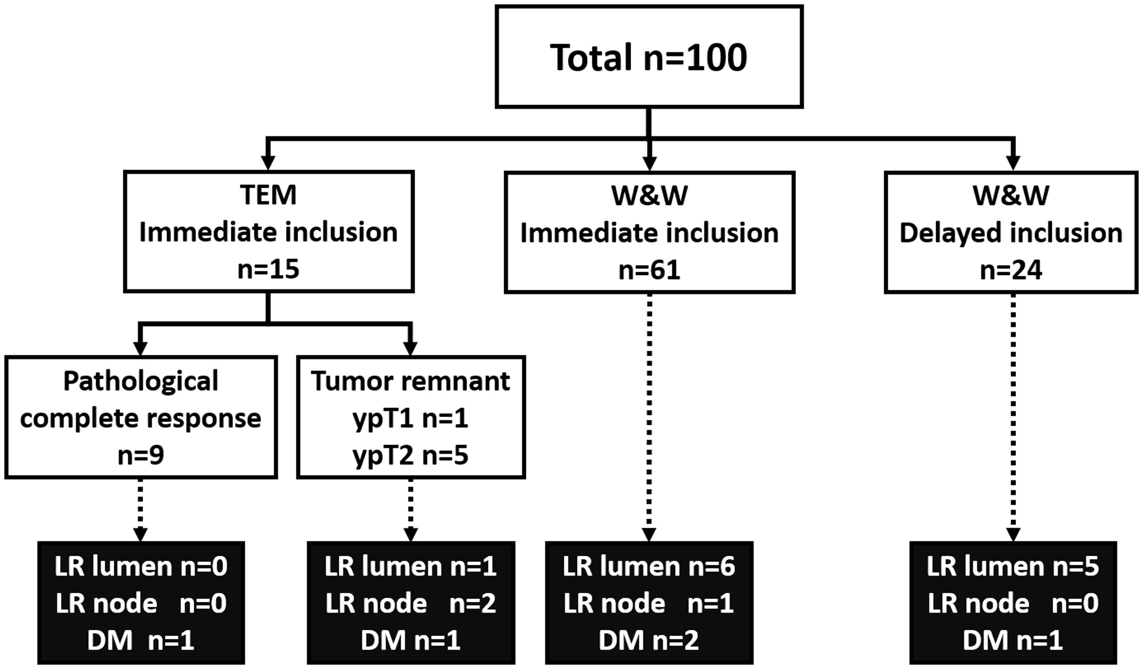
Figure 3. Flowchart of patient selection and inclusion. DM = distant metastasis; LR = local regrowth; TEM = transanal ...
Notes:
Figure 3. Flowchart of patient selection and inclusion. DM = distant metastasis; LR = local regrowth; TEM = transanal endoscopic microsurgery; TME = total mesorectal excision; W&W = watch-and-wait.
Unless provided in the caption above, the following copyright applies to the content of this slide: © The Author 2016. Published by Oxford University Press. All rights reserved. For Permissions, please e-mail: journals.permissions@oup.com.

Slide 4
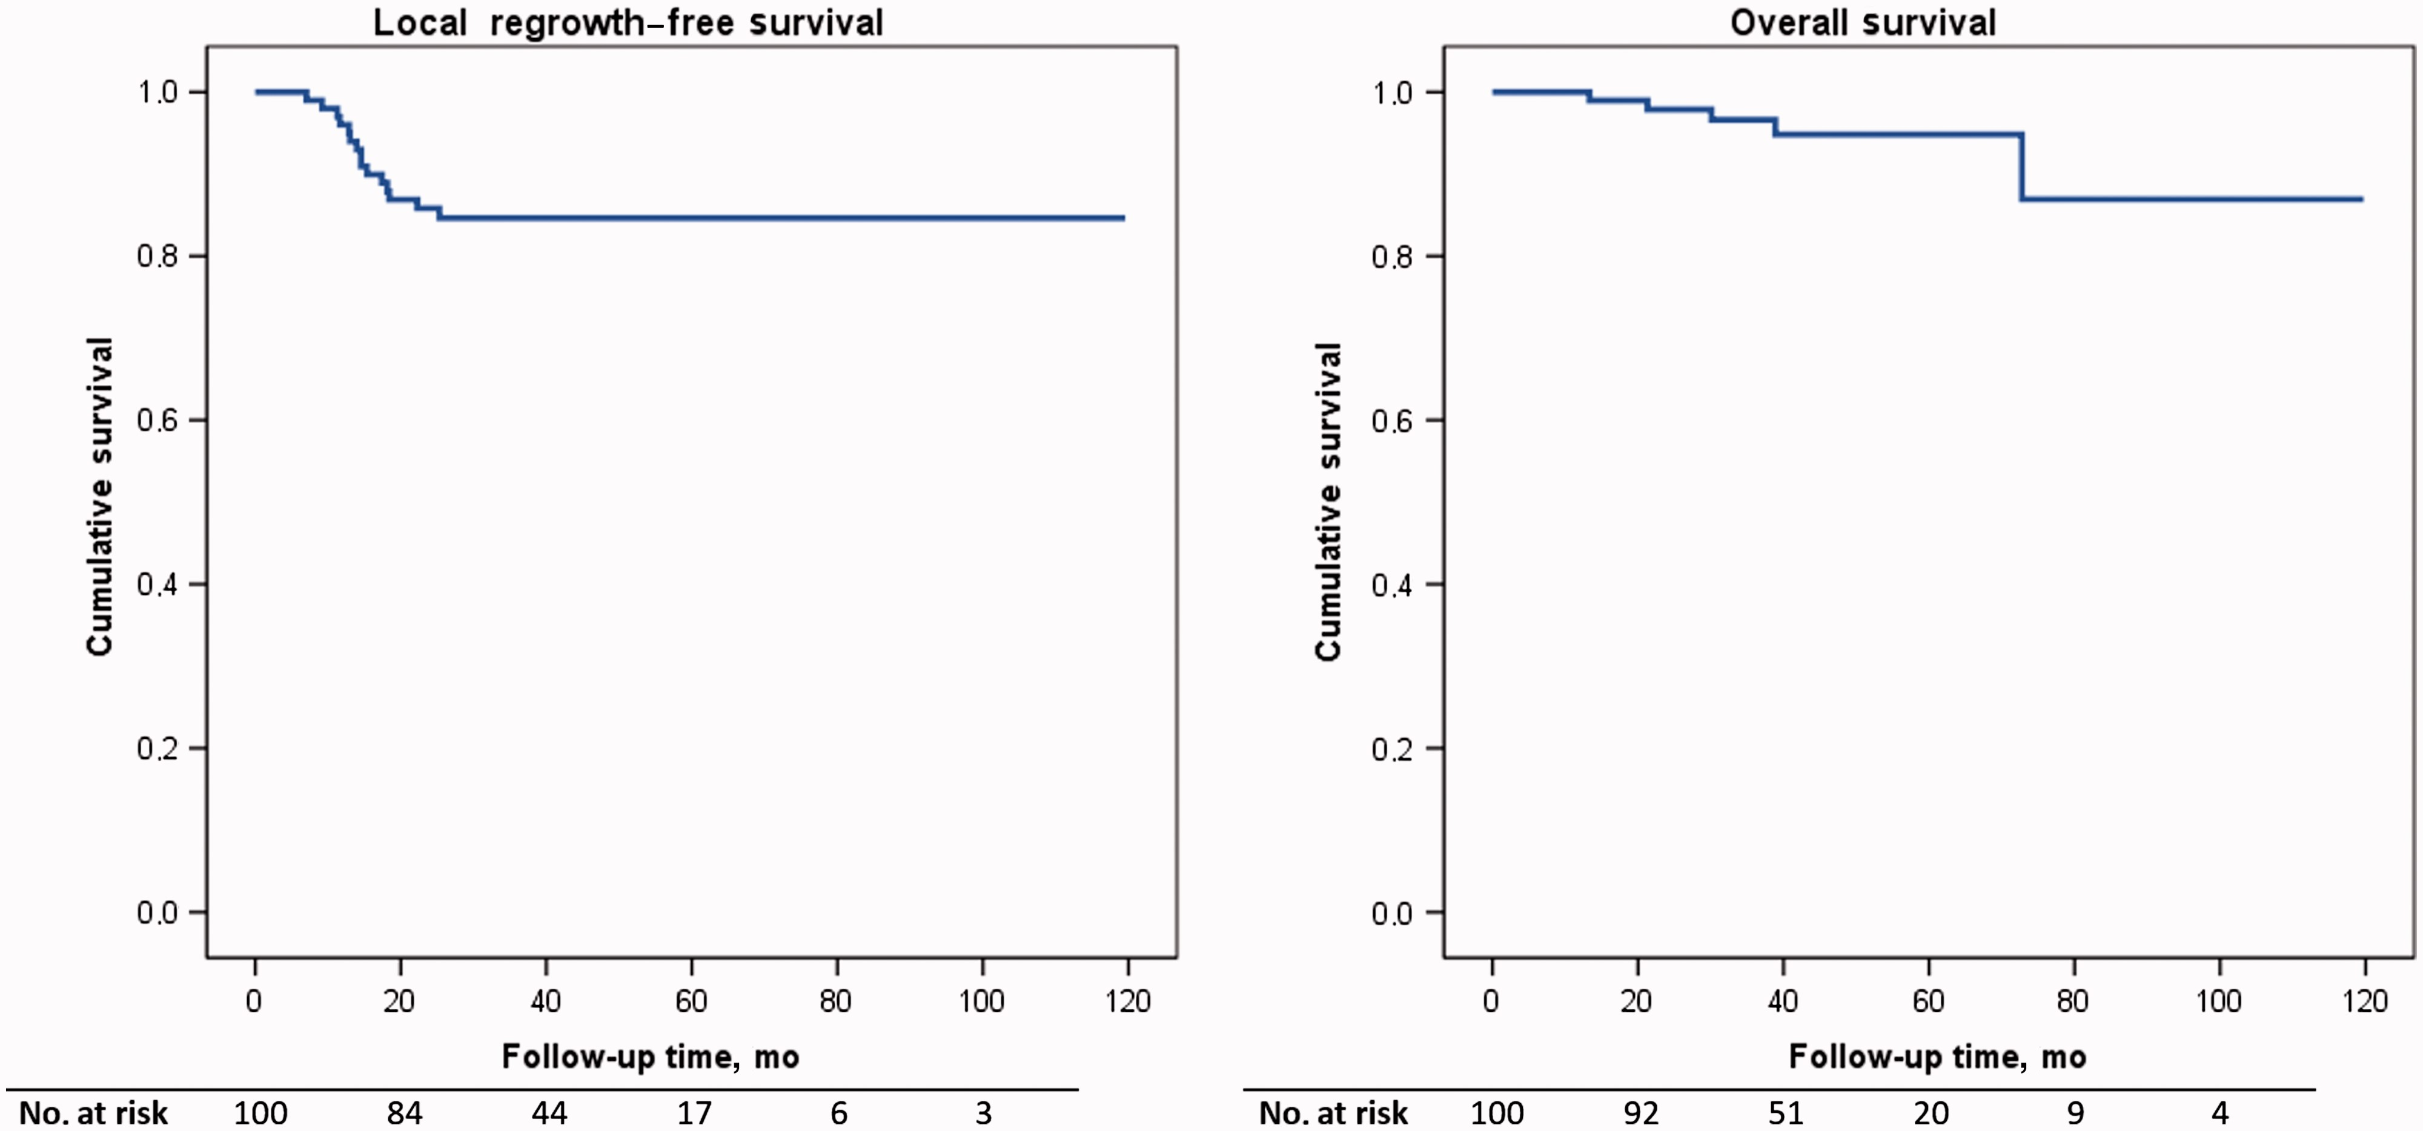
Figure 4. Local regrowth–free survival and overall survival for the total of 100 patients in an organ-preserving ...
Notes:
Figure 4. Local regrowth–free survival and overall survival for the total of 100 patients in an organ-preserving treatment. The numbers of patients at risk at various timepoints are below each curve. Overview of patients with local regrowth, distant metastasis, and/or cause of death* PatientAge, ySexcT stagecN stageDistance from ARJ, cmNeoadjuvant treatmentHistology (TEM)Adjuvant CTxTime to event, moLocal regrowthDistant metastasisTreatmentTotal follow-up, moLocal regrowth without evidence of distant metastasis170Male310.0CRT–1 cycle7Lumen–APR (ypT3N0)54, NED272Male311.0CRT–No9Lumen–APR (ypT2N0)13, NED381Female300.0CRT–No11Lumen–APR (ypT2N0)13, NED455Male200.5CRTTEM: ypT2No13Lumen–CRT + pelvic exenteration (ypT3N0)56, NED569Male315.0CRT–No13Lumen–TEM (ypT2) followed by LAR (ypT0N0)17, NED660Male303.7CRT–No14Lumen–APR (ypT2N0)17, NED776Male214.0CRT–No15Lumen–Endoscopic resection followed by LAR (ypT2N0)35, NED884Male420.0CRT–No15Lumen–APR (ypT3N0)21, DOD (postoperative complications)955Male424.0CRT–Yes15Lymph node–LAR (ypT0N1)50, NED1061Male202.05x5+long intervalTEM: ypT2No15Lymph node–CRT + APR (ypT0N1)54, NED1157Female228.0CRT–Yes22Lumen–LAR (ypT2N0)39, NED1263Female320.0CRT–No18Lumen–APR (ypT2N0)20, NED1363Male305.5CRT–Yes25Lumen–TEM (ypT2), reregrowth LAR (ypT2N0)82, NEDLocal regrowth with synchronous distant metastasis1455Male312.0CRT–No11LumenLungStereotactic radiation lung, brachytherapy rectum30, AWD1555Female321.5CRTTEM: ypT2No12Lymph nodeLungPalliative CAPOX (multiple bilateral lungmetastases)13, AWDDistant metastasis without evidence of local regrowth1657Male300.0CRT–No22–Lung+liverResection liver metastasis and stereotactic radiation lung; second resection repeated liver metastasis37, AWD1778Female326.5CRTTEM: ypT0Yes37–LungStereotactic radiation59, NED1879Female308.0CRT–No38–PeritoneumNo treatment39, DOD (progression of metastases)Death unrelated to disease1974Male310.0CRT–No13–––13, DOC (cerebral infarction)2079Male3115.0CRT–No30–––30, DOC (ruptured abdominal aortic aneurism)2166Male325.5CRT–Yes73–––73, DOC (metastasized melanoma)*APR = abdominoperineal resection; ARJ = anorectal junction; AWD = alive with disease; CAPOX = capecitabine and oxaliplatin; CRT = chemoradiotherapy; CTx = chemotherapy; DOC = death of other cause; DOD = death of disease; FU = follow-up; LAR = low anterior resection; NED = no evidence of disease; TEM = transanal endoscopic microsurgery.
Unless provided in the caption above, the following copyright applies to the content of this slide: © The Author 2016. Published by Oxford University Press. All rights reserved. For Permissions, please e-mail: journals.permissions@oup.com.

Slide 5
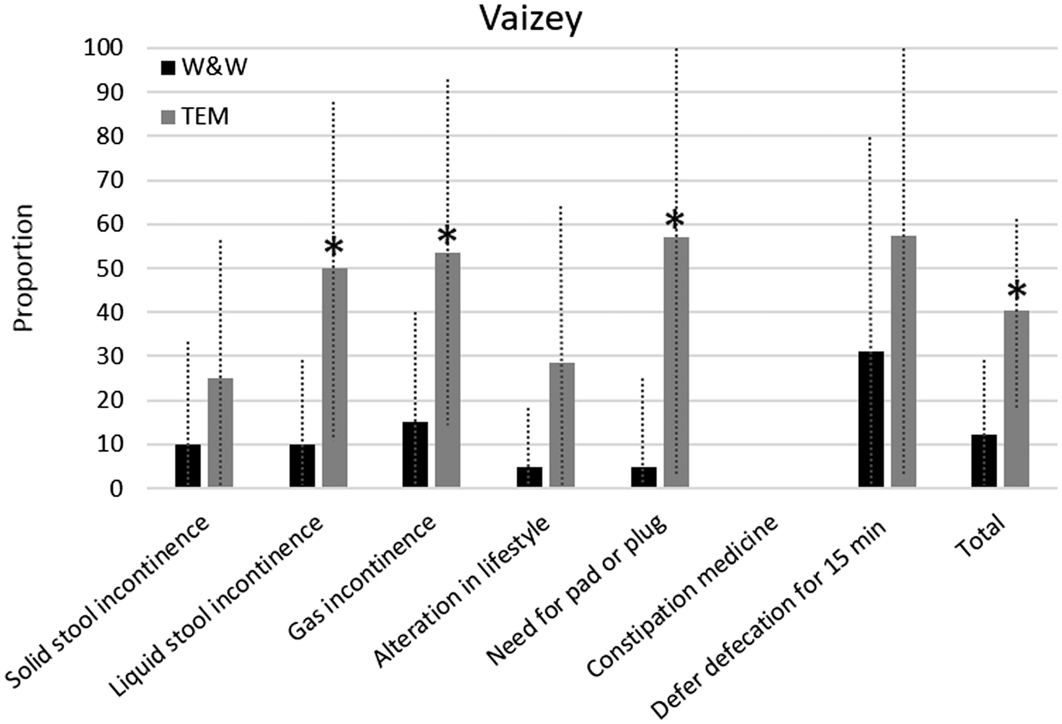
Figure 5. Functional outcome based on Vaizey score. A higher score indicates a poorer result. * indicates that the ...
Notes:
Figure 5. Functional outcome based on Vaizey score. A higher score indicates a poorer result. * indicates that the difference was statistically significant with a two-sided Mann-Whitney U test. TEM = transanal endoscopic microsurgery; W&W = watch-and-wait.
Unless provided in the caption above, the following copyright applies to the content of this slide: © The Author 2016. Published by Oxford University Press. All rights reserved. For Permissions, please e-mail: journals.permissions@oup.com.

