Slide 1
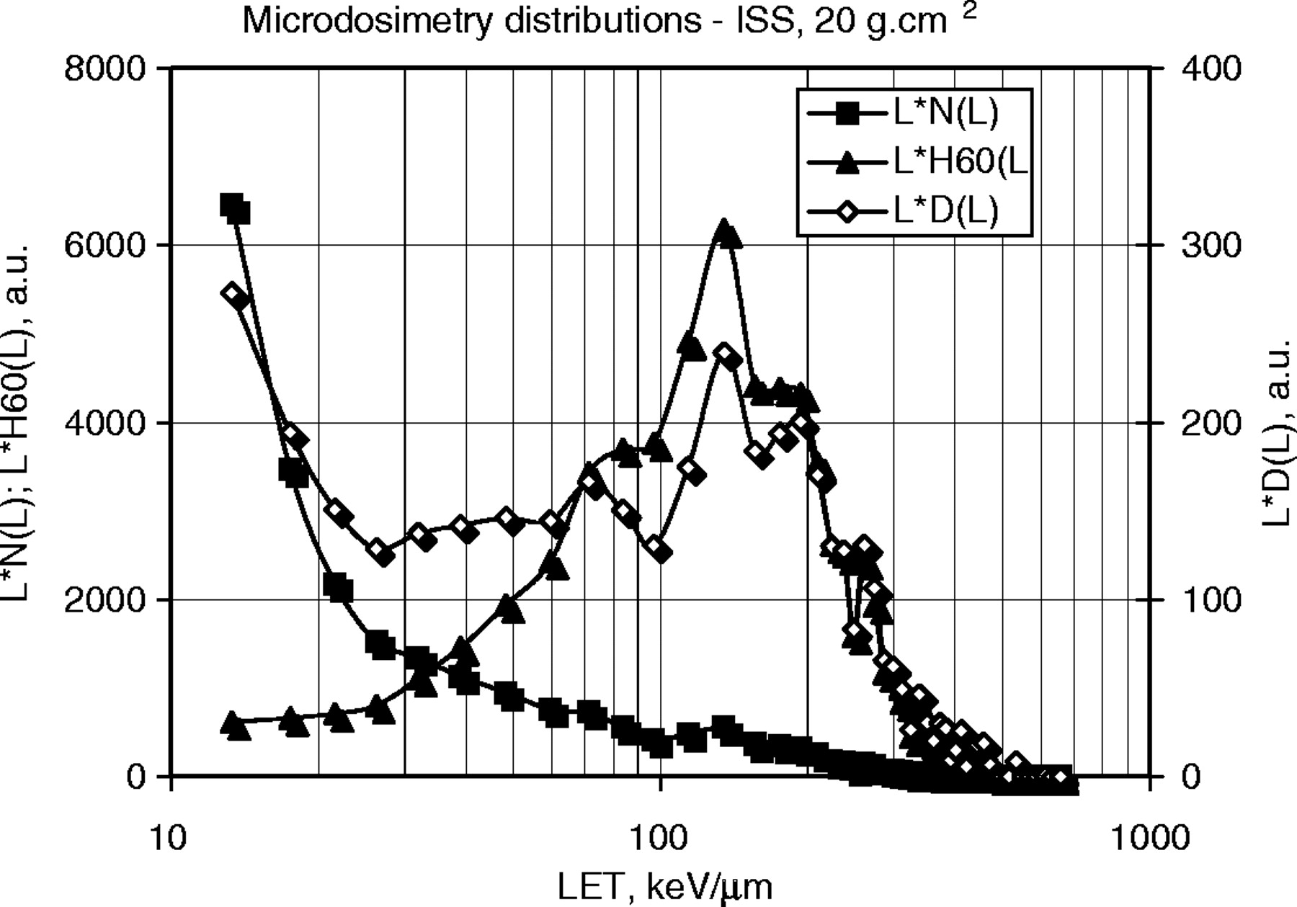
Figure 1. Microdosimetric distributions of particle track numbers and corresponding doses and ambient dose equivalents ...
Notes:
Figure 1. Microdosimetric distributions of particle track numbers and corresponding doses and ambient dose equivalents (ICRP 60); ISS exposure.
Unless provided in the caption above, the following copyright applies to the content of this slide: © The Author 2005. Published by Oxford University Press. All rights reserved. For Permissions, please email: journals.permissions@oxfordjournals.org

