Slide 1
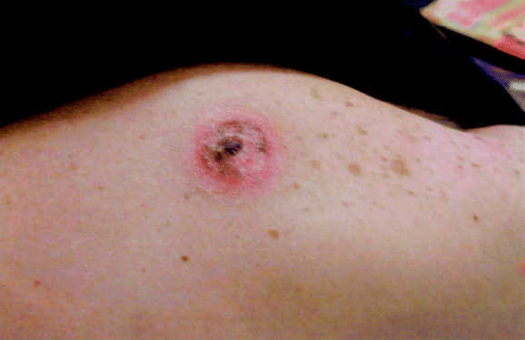
Figure 1 Erythematous plaque on the upper back of a 33-year-old man (patient 1) who returned from a trip to East ...
Notes:
Figure 1 Erythematous plaque on the upper back of a 33-year-old man (patient 1) who returned from a trip to East Africa
Unless provided in the caption above, the following copyright applies to the content of this slide: © 2002 by the Infectious Diseases Society of America

Slide 2
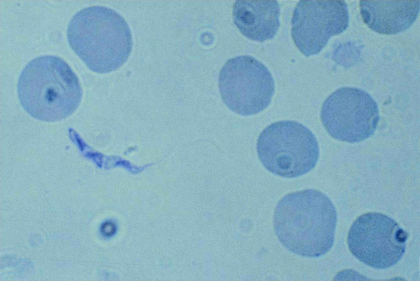
Figure 2 Peripheral blood smear (Giemsa stain; magnification, ×40) showing Trypanosoma brucei rhodesiense (patient 1)
Notes:
Figure 2 Peripheral blood smear (Giemsa stain; magnification, ×40) showing Trypanosoma brucei rhodesiense (patient 1)
Unless provided in the caption above, the following copyright applies to the content of this slide: © 2002 by the Infectious Diseases Society of America

Slide 3
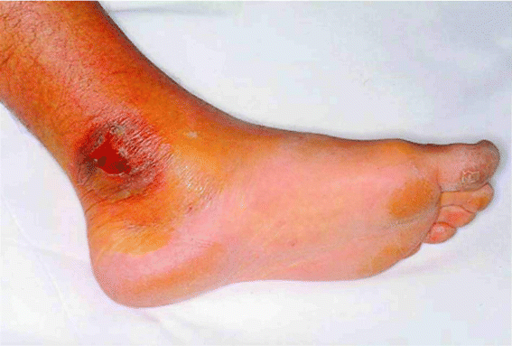
Figure 3 Erythematous and ulcerated plaque on the inner left ankle of a 30-year-old man (patient 2) with African ...
Notes:
Figure 3 Erythematous and ulcerated plaque on the inner left ankle of a 30-year-old man (patient 2) with African trypanosomiasis
Unless provided in the caption above, the following copyright applies to the content of this slide: © 2002 by the Infectious Diseases Society of America

