Slide 1
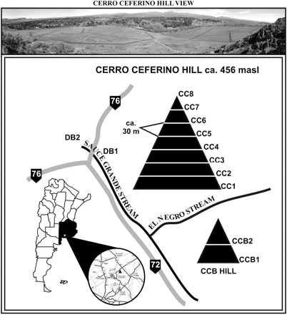
Figure 1 Representation of the study area. The location of Sierra de la Ventana within Buenos Aires Province (black) ...
Notes:
Figure 1 Representation of the study area. The location of Sierra de la Ventana within Buenos Aires Province (black) is indicated by a white dot. The circle in the lower-left part of the figure shows a general view of the sampling site. A detailed representation of the sampling scheme is provided, in which the 2 sampled hills (Cerro Ceferino Hill and CCB Hill) are represented by black triangles. Sampling sites for CC1-8 and CCB1-2 are indicated along the triangles; the distance between each sample (ca. 30 m) is also indicated. The crossroads between route 72 and route 76, where DB1-2 samples were taken, is shown. “Sauce Grande” and “El Negro” are a permanent and a semipermanent stream, respectively.
Unless provided in the caption above, the following copyright applies to the content of this slide: © The American Genetic Association. 2010. All rights reserved. For permissions, please email: journals.permissions@oup.com.

Slide 2
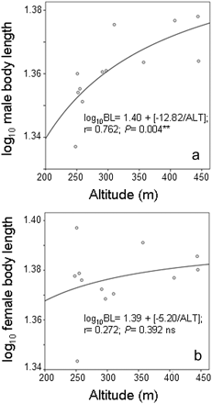
Figure 2 Nonlinear regressions between altitude and log₁₀ body length in 12 samples of the Dichroplus ...
Notes:
Figure 2 Nonlinear regressions between altitude and log10 body length in 12 samples of the Dichroplus pratensis hybrid zone of Sierra de la Ventana. In both cases, the regression equation, correlation coefficient and statistical significance, are included in the figure. (a) log10 male body length versus altitude; (b) log10 female body length versus altitude.**Highly significant; ns, nonsignificant.
Unless provided in the caption above, the following copyright applies to the content of this slide: © The American Genetic Association. 2010. All rights reserved. For permissions, please email: journals.permissions@oup.com.

Slide 3
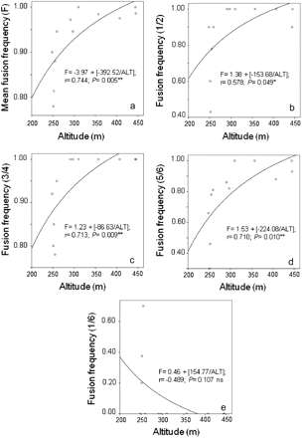
Figure 3 Nonlinear regressions between altitude and frequency of centric fusions in 12 samples of the Dichroplus ...
Notes:
Figure 3 Nonlinear regressions between altitude and frequency of centric fusions in 12 samples of the Dichroplus pratensis hybrid zone of Sierra de la Ventana. In all cases, the regression equation, correlation coefficient, and statistical significance are included in the figure. (a) Mean frequency of different fusions per population (F) versus altitude; (b) Frequency of the 1/2 fusion versus altitude; (c) Frequency of the 3/4 fusion versus altitude; (d) Frequency of the 5/6 fusion versus altitude; (e) Frequency of the 1/6 fusion versus altitude. **Highly significant; *Significant at the 0.05 level; ns, nonsignificant.
Unless provided in the caption above, the following copyright applies to the content of this slide: © The American Genetic Association. 2010. All rights reserved. For permissions, please email: journals.permissions@oup.com.

