Slide 1
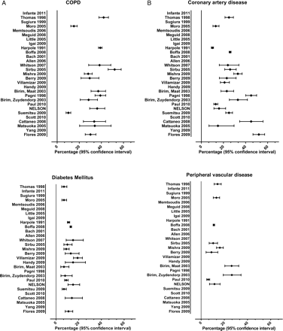
Figure 1: Prevalence of chronic obstructive pulmonary disease, coronary artery disease, diabetes mellitus and ...
Notes:
Figure 1: Prevalence of chronic obstructive pulmonary disease, coronary artery disease, diabetes mellitus and peripheral vascular disease in NELSON lung cancer screening participants who underwent a thoracotomy in comparison with non-screening series from the literature.
Unless provided in the caption above, the following copyright applies to the content of this slide: © The Author 2012. Published by Oxford University Press on behalf of the European Association for Cardio-Thoracic Surgery. All rights reserved.

Slide 2
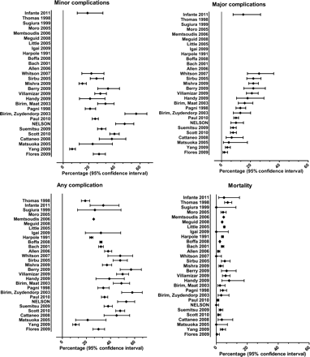
Figure 2: Complication and mortality rates after thoracotomy in the NELSON lung cancer screening trial in comparison ...
Notes:
Figure 2: Complication and mortality rates after thoracotomy in the NELSON lung cancer screening trial in comparison with non-screening series from the literature.
Unless provided in the caption above, the following copyright applies to the content of this slide: © The Author 2012. Published by Oxford University Press on behalf of the European Association for Cardio-Thoracic Surgery. All rights reserved.

Slide 3
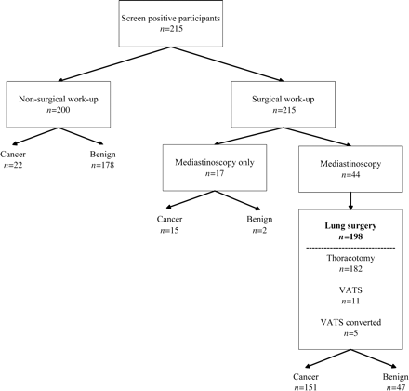
Figure 3: Surgical procedures and outcome in 415 screen positives of the NELSON randomized lung cancer screening ...
Notes:
Figure 3: Surgical procedures and outcome in 415 screen positives of the NELSON randomized lung cancer screening trial.
Unless provided in the caption above, the following copyright applies to the content of this slide: © The Author 2012. Published by Oxford University Press on behalf of the European Association for Cardio-Thoracic Surgery. All rights reserved.

