Slide 1
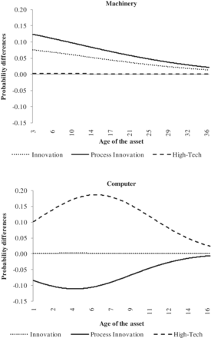
Figure 1 Effect of innovation on predicted discard probabilities. Note: The figure represents the difference in ...
Notes:
Figure 1 Effect of innovation on predicted discard probabilities. Note: The figure represents the difference in discard probabilities between cases where dummy is 1 and cases where dummy is zero, i.e. innovation = innovative (both process and/or product) – non-innovative; process innovation = process innovative – non-innovative; high-tech = high-tech—low-tech.
Unless provided in the caption above, the following copyright applies to the content of this slide: © The Author 2012. Published by Oxford University Press on behalf of Associazione ICC. All rights reserved.

