Slide 1
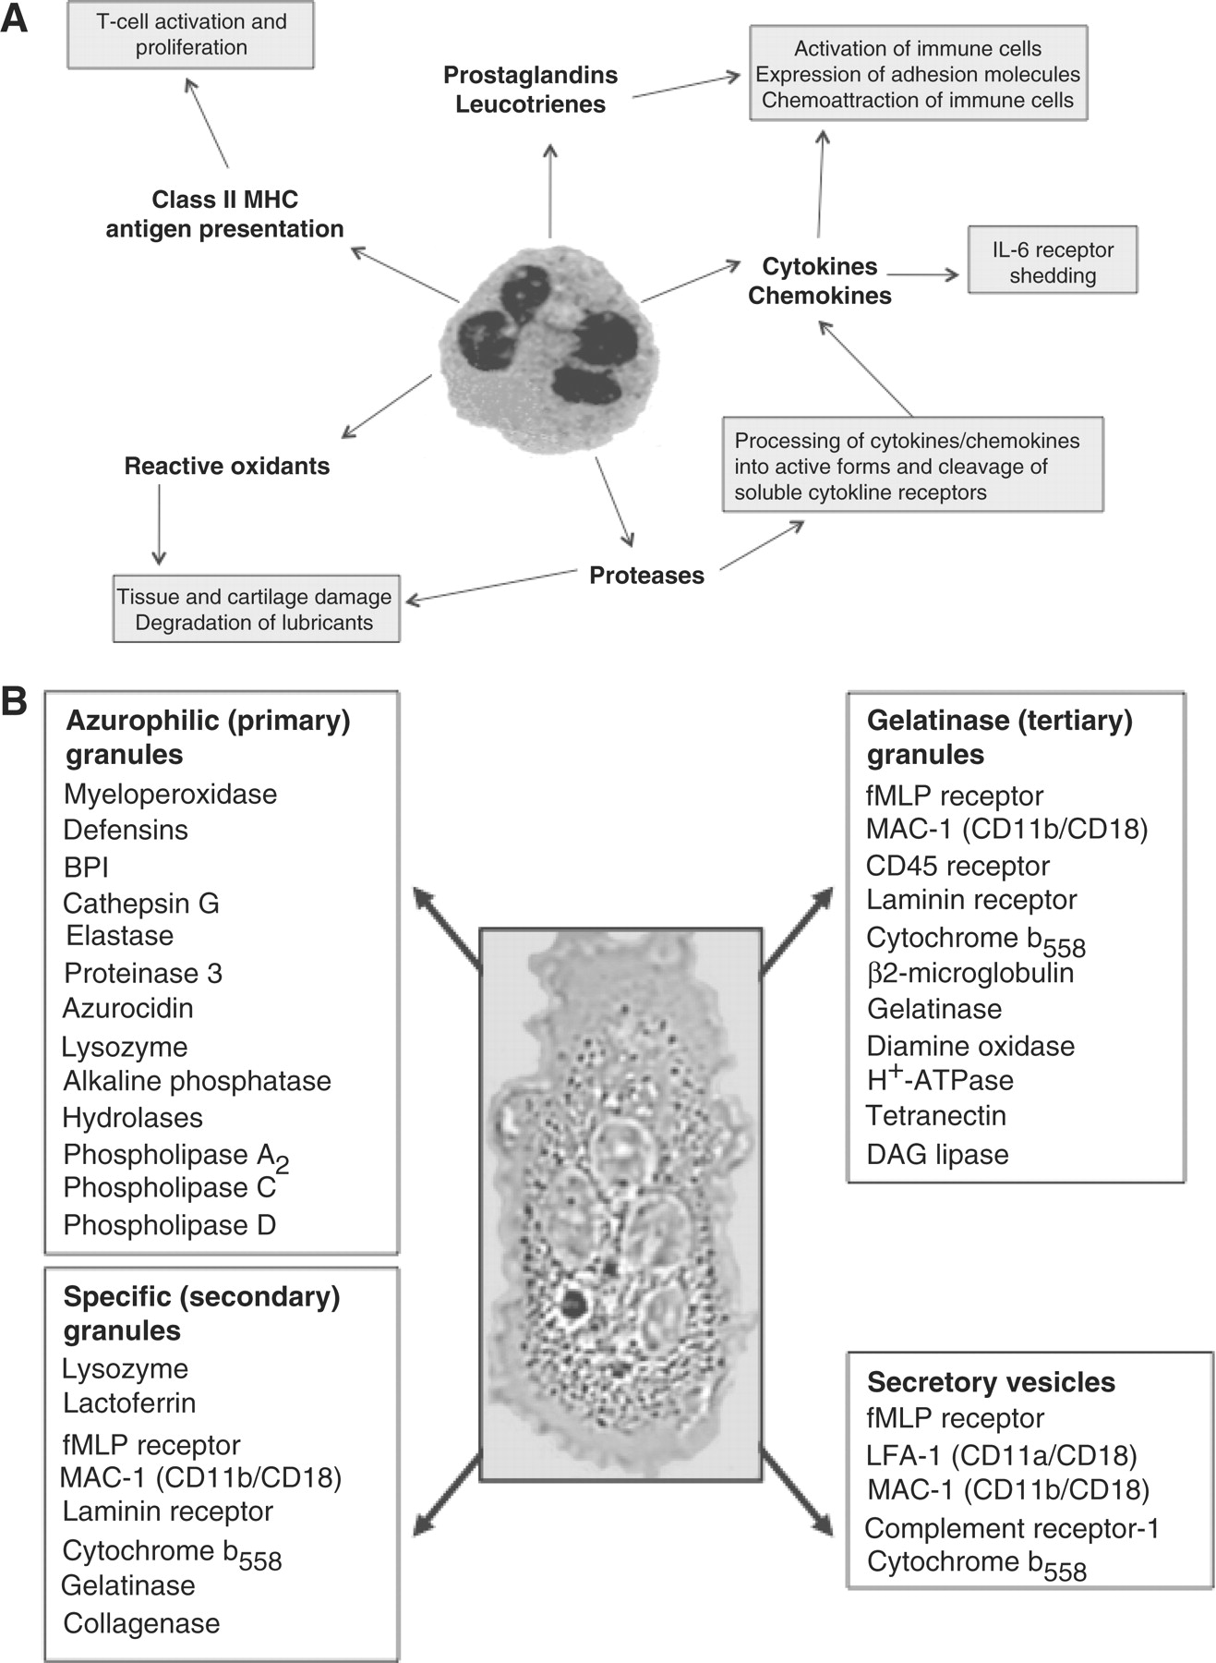
Fig. 1 Properties of neutrophils. (A) Neutrophil functions and products that can actively drive inflammatory ...
Notes:
Fig. 1 Properties of neutrophils. (A) Neutrophil functions and products that can actively drive inflammatory processes. (B) Summary of neutrophil granules and their contents. Neutrophil granules are mobilized upon priming of the cell: secretory vesicles are mobilized first, followed by gelatinase granules, specific granules and finally azurophilic granules.
Unless provided in the caption above, the following copyright applies to the content of this slide: © The Author 2010. Published by Oxford University Press on behalf of the British Society for Rheumatology. All rights reserved. For Permissions, please email: journals.permissions@oxfordjournals.org

Slide 2
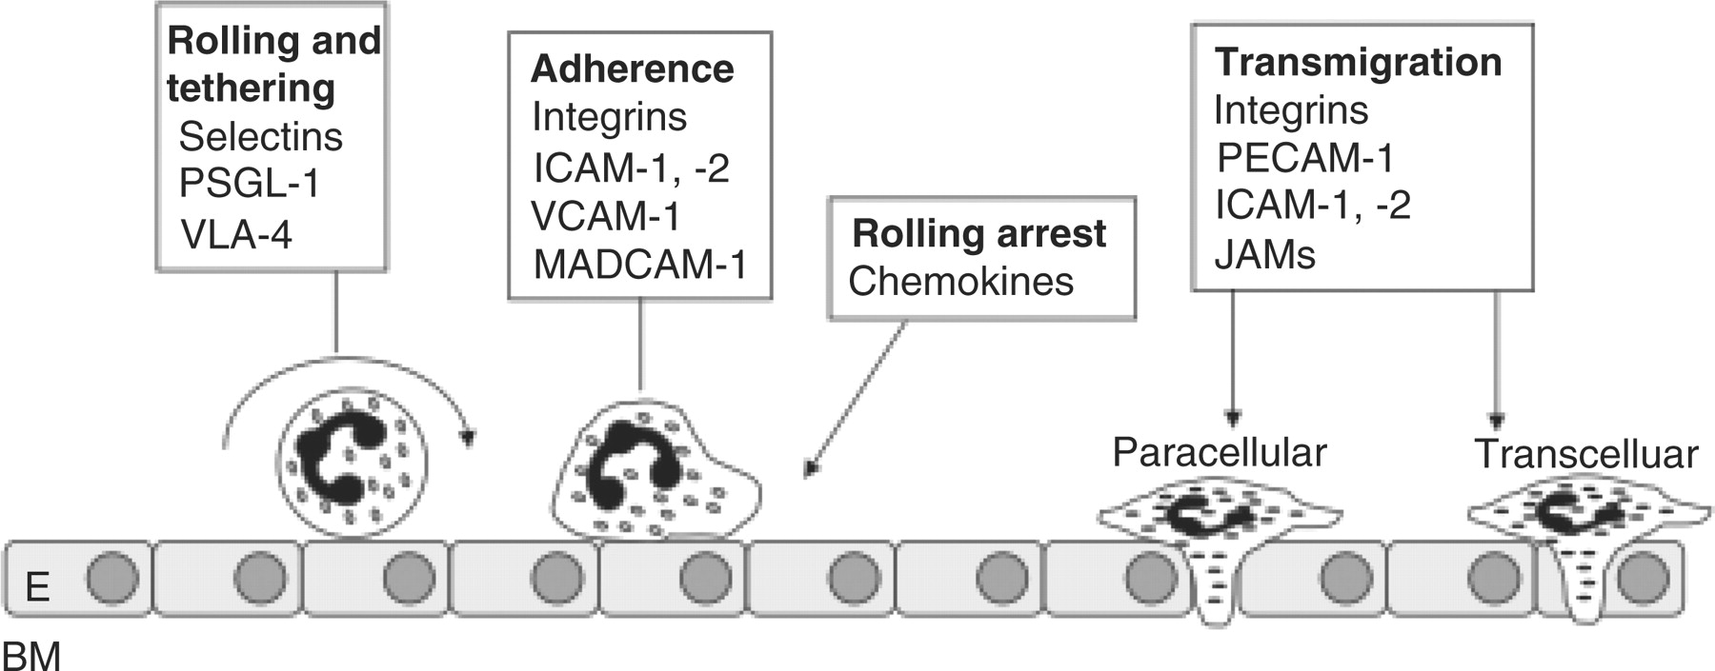
Fig. 2 Neutrophil diapedesis. To pass from the peripheral blood to the site of inflammation, the neutrophil adheres ...
Notes:
Fig. 2 Neutrophil diapedesis. To pass from the peripheral blood to the site of inflammation, the neutrophil adheres to the endothelial wall using selectins, integrins and adhesion molecules. Rolling arrest precedes transmigration through the endothelial lining of the blood vessel, and chemotaxis to sites of inflammation. E: endothelial cell; BM: basement membrane. (Figure adapted from Ley et al. [2].).
Unless provided in the caption above, the following copyright applies to the content of this slide: © The Author 2010. Published by Oxford University Press on behalf of the British Society for Rheumatology. All rights reserved. For Permissions, please email: journals.permissions@oxfordjournals.org

Slide 3
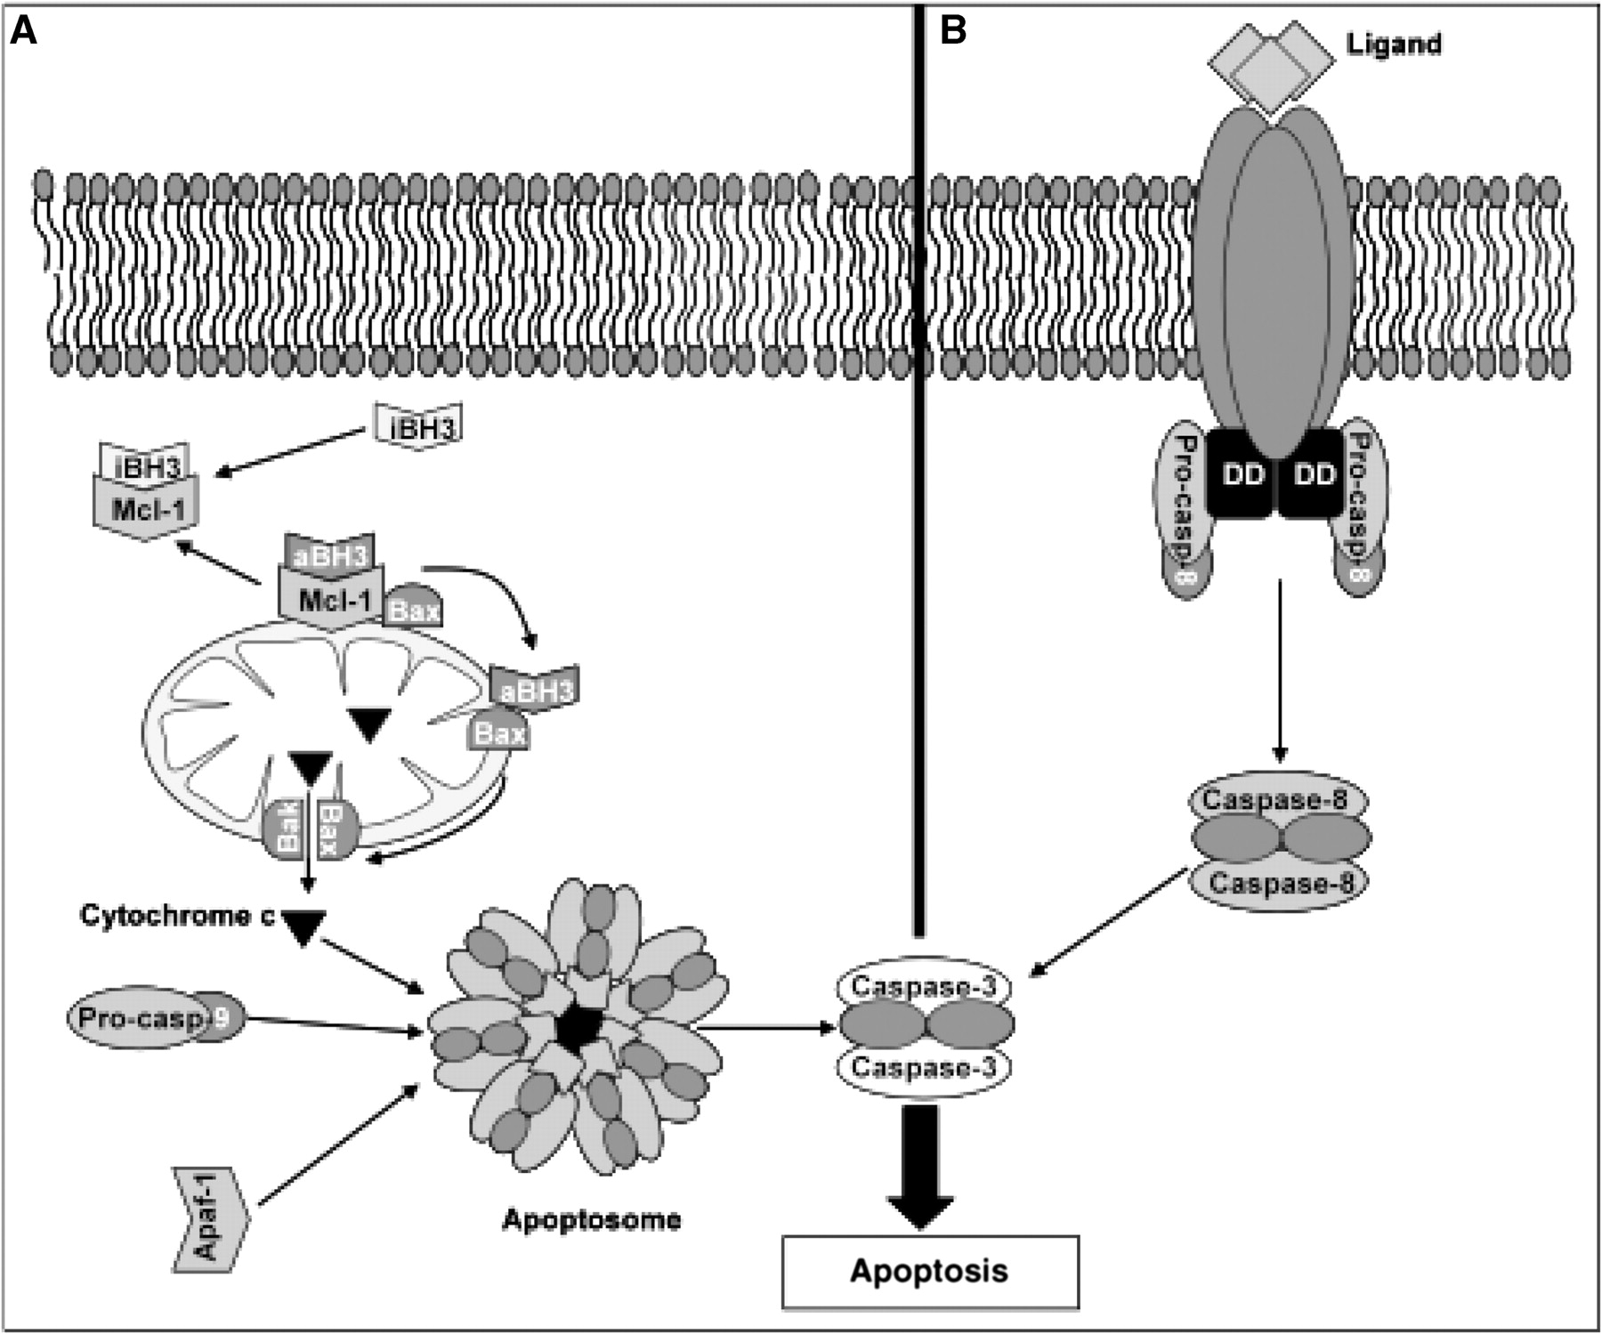
Fig. 3 The intrinsic and extrinsic pathways to apoptosis. (A) The intrinsic pathway is regulated by proteins of the ...
Notes:
Fig. 3 The intrinsic and extrinsic pathways to apoptosis. (A) The intrinsic pathway is regulated by proteins of the Bcl-2 family. Anti-apoptotic proteins such as Bcl-2 and/or Mcl-1 sequester activator BH3 (aBH3) proteins and Bax/Bak. Under conditions of stress, inactivator (iBH3) BH3 proteins antagonize Bcl-2/Mcl-1 releasing the aBH3 proteins leading to oligomerization of Bax/Bak and mitochondrial outer membrane permeabilization. Cytochrome c leakage from the mitochondria combines with caspase-9 and Apaf-1 and initiates formation of the apoptosome, resulting in caspase-3 activation and apoptosis. (B) The extrinsic pathway to apoptosis is triggered by the engagement of a ligand with a death receptor, recruitment of intracellular death and death engagement domains (DD), and activation of caspases-8 and -3. Cross-talk between the extrinsic and intrinsic pathways is mediated by caspase cleavage of Bcl-2 family proteins such as Mcl-1 and Bid.
Unless provided in the caption above, the following copyright applies to the content of this slide: © The Author 2010. Published by Oxford University Press on behalf of the British Society for Rheumatology. All rights reserved. For Permissions, please email: journals.permissions@oxfordjournals.org

Slide 4
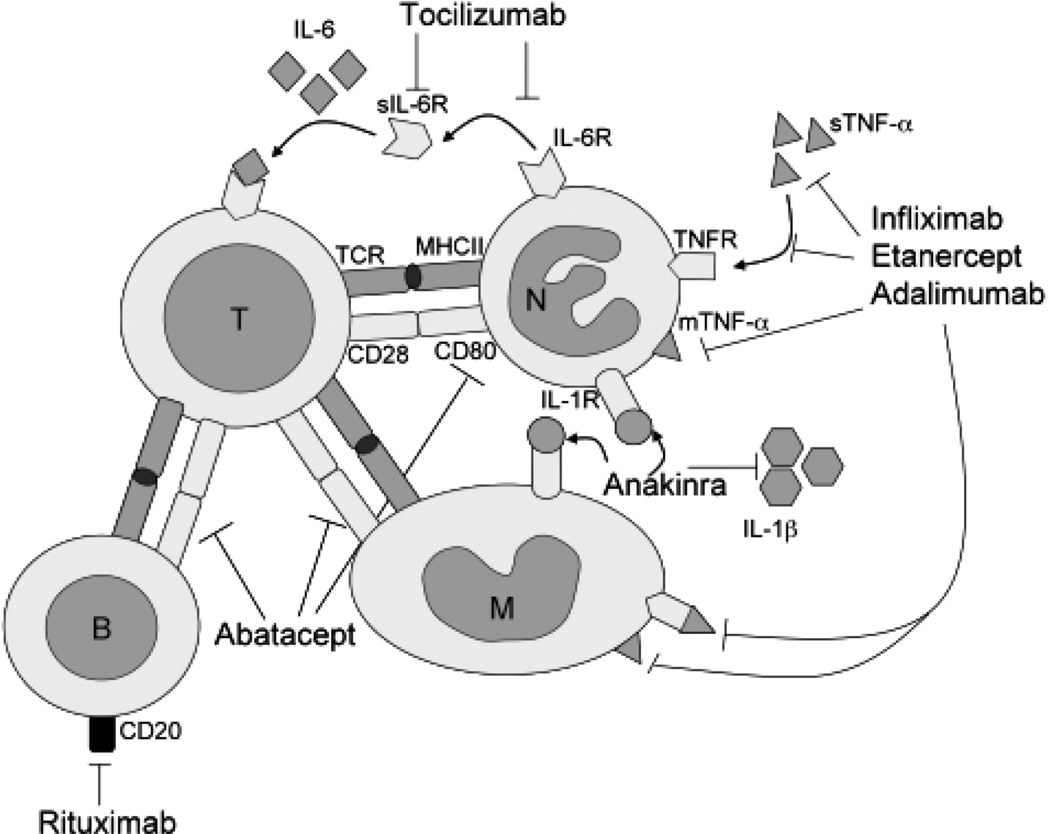
Fig. 4 Summary of the immune targets of biologic therapies. Anti-TNF drugs infliximab, etanercept and adalimumab ...
Notes:
Fig. 4 Summary of the immune targets of biologic therapies. Anti-TNF drugs infliximab, etanercept and adalimumab target soluble (sTNF-α) and membrane-expressed TNF-α (mTNF-α), facilitating blockade of signalling and removal of mTNF-α-expressing cells. Anakinra is an IL-1 receptor (IL-1R) antagonist, which competitively binds the IL-1R and inhibits IL-1 signalling. Abatacept prevents the co-stimulation of T cells by blocking engagement of CD28 with CD80/86, preventing signalling from MHCII on antigen-presenting cells to the TCR. Rituximab targets and removes CD20+ B cells. Tocilizumab inhibits IL-6 signalling by blockade of the soluble (sIL-6R) and transmembrane (IL-6R) IL-6 receptors. M: macrophage; B: B cell; T: T cell; N: neutrophil.
Unless provided in the caption above, the following copyright applies to the content of this slide: © The Author 2010. Published by Oxford University Press on behalf of the British Society for Rheumatology. All rights reserved. For Permissions, please email: journals.permissions@oxfordjournals.org

