Slide 1
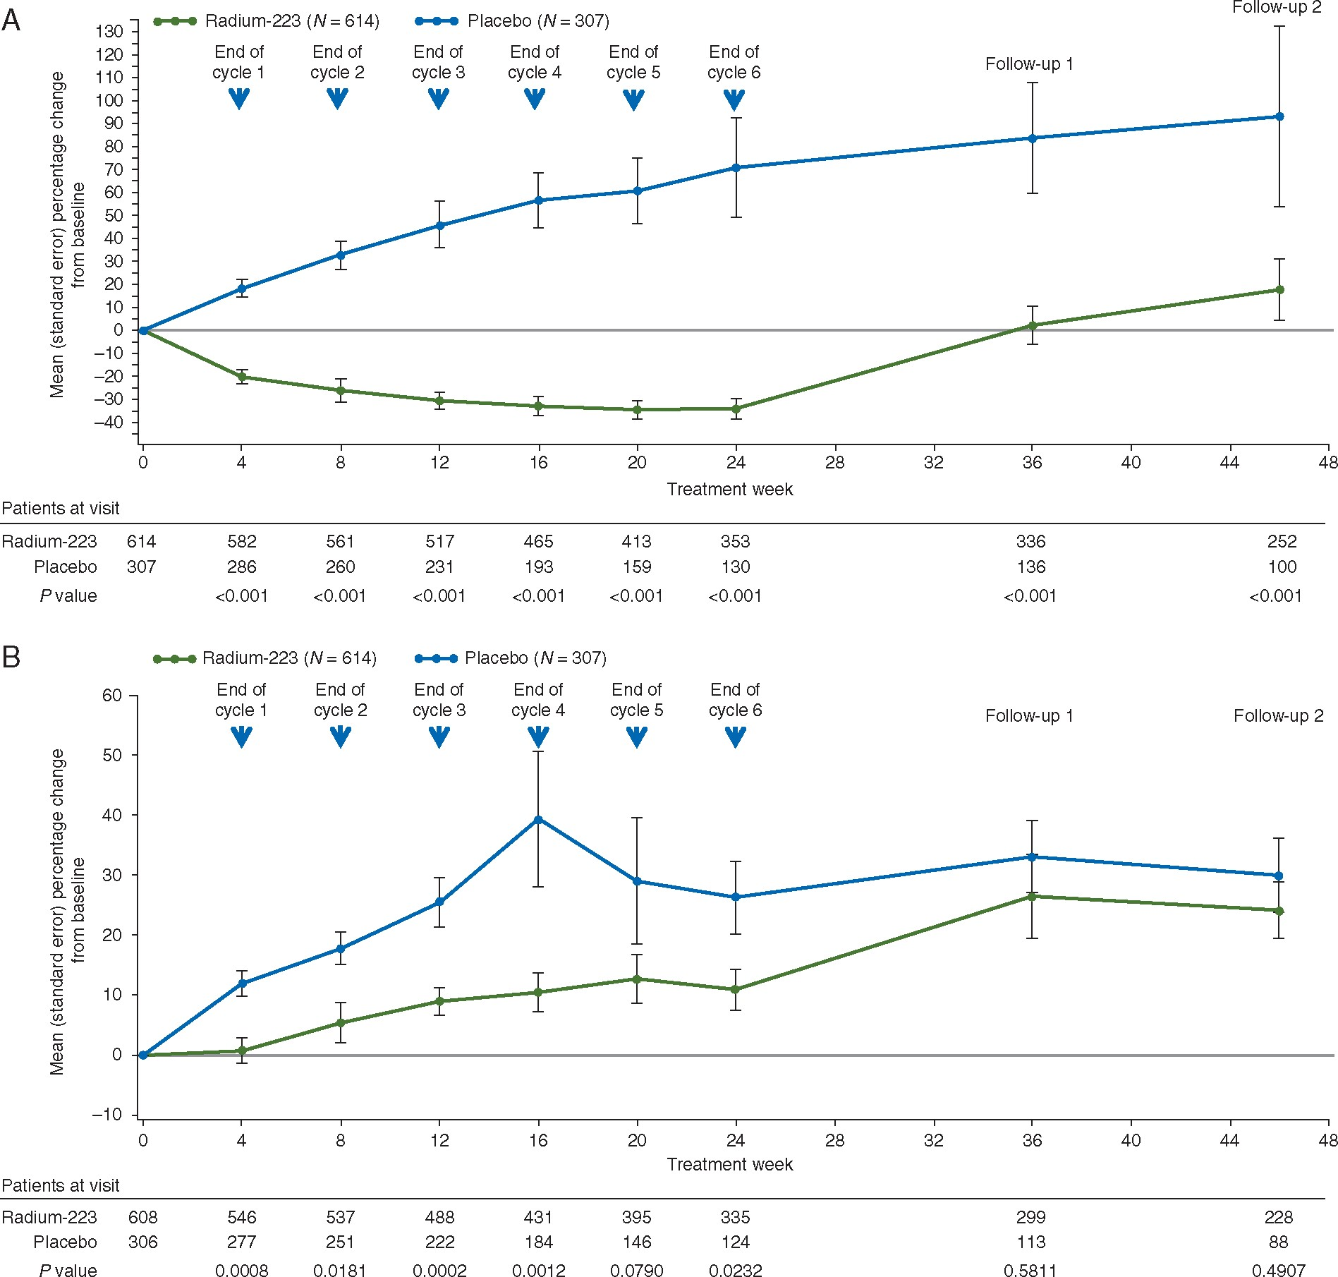
Figure 1. tALP and LDH dynamics in the ITT population. Mean percentage change in (A) baseline tALP and (B) baseline LDH ...
Notes:
Figure 1. tALP and LDH dynamics in the ITT population. Mean percentage change in (A) baseline tALP and (B) baseline LDH at the end of each treatment cycle (6 cycles) and two follow-up visits. Six patients in the radium-223 arm and 1 in the placebo arm did not have baseline LDH determinations and were excluded from this analysis. ITT, intent to treat; LDH, lactate dehydrogenase; tALP, total alkaline phosphatase.
Unless provided in the caption above, the following copyright applies to the content of this slide: © The Author 2017. Published by Oxford University Press on behalf of the European Society for Medical Oncology.This is an Open Access article distributed under the terms of the Creative Commons Attribution Non-Commercial License (http://creativecommons.org/licenses/by-nc/4.0/), which permits non-commercial re-use, distribution, and reproduction in any medium, provided the original work is properly cited. For commercial re-use, please contact journals.permissions@oup.com

Slide 2
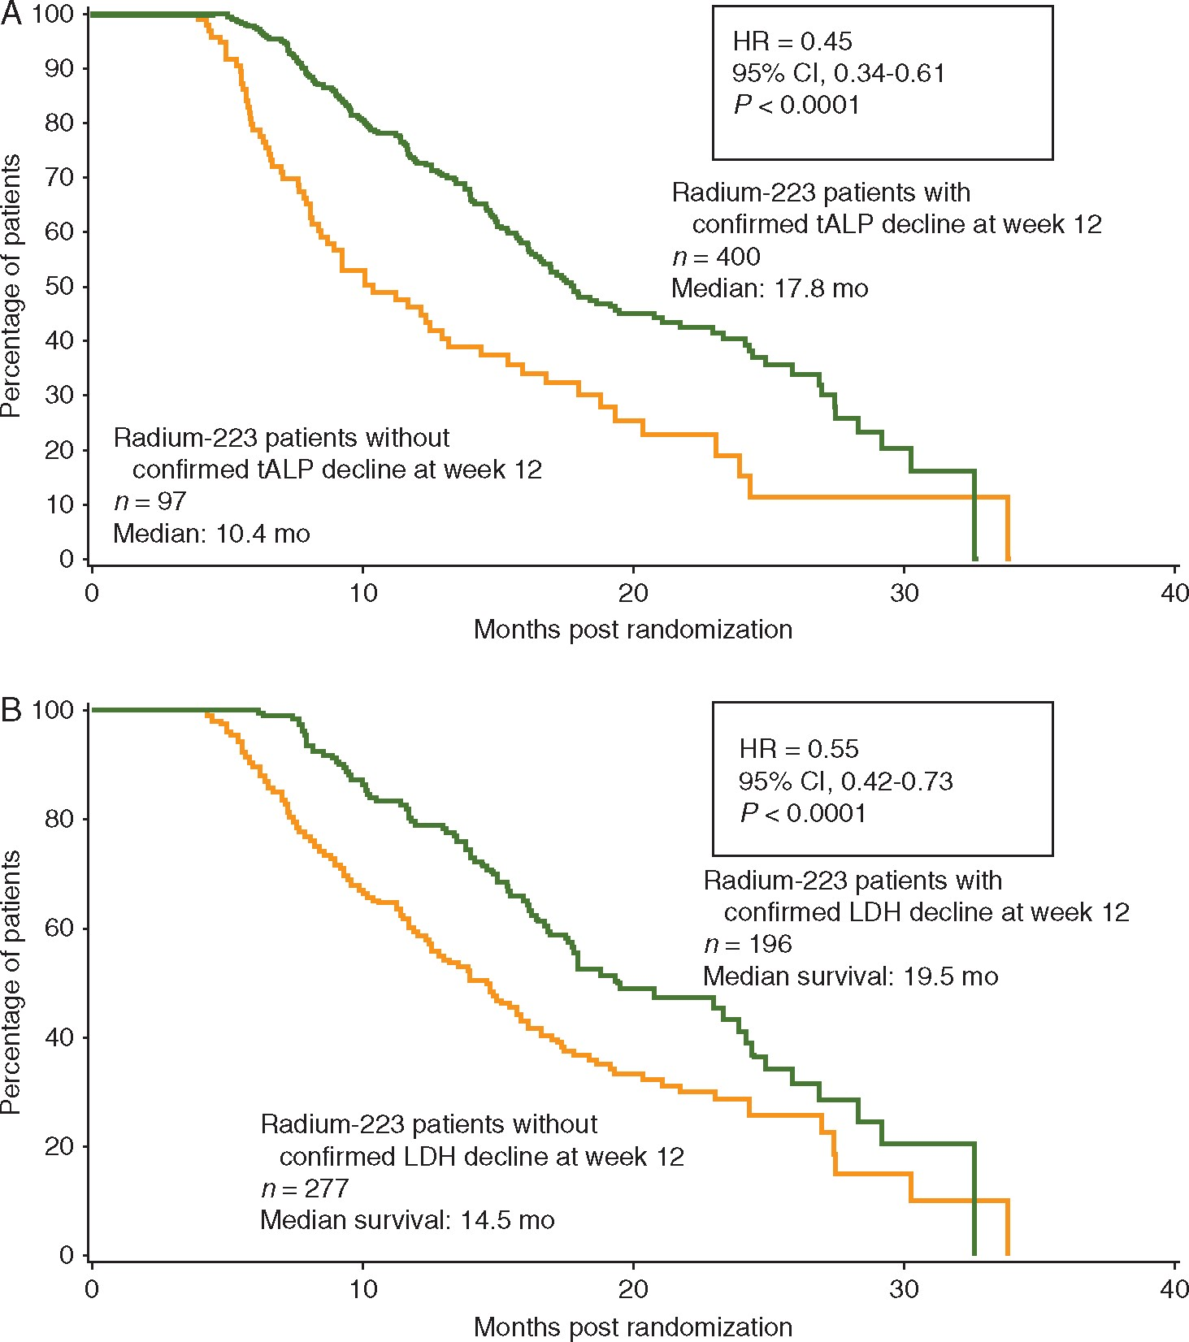
Figure 2. Overall survival in the radium-223 cohort with and without a confirmed decline in (A) baseline tALP and (B) ...
Notes:
Figure 2. Overall survival in the radium-223 cohort with and without a confirmed decline in (A) baseline tALP and (B) baseline LDH at week 12. Confirmed decline was defined as any decrease from baseline at week 12, confirmed ≥3 weeks later. LDH, lactate dehydrogenase; tALP, total alkaline phosphatase.
Unless provided in the caption above, the following copyright applies to the content of this slide: © The Author 2017. Published by Oxford University Press on behalf of the European Society for Medical Oncology.This is an Open Access article distributed under the terms of the Creative Commons Attribution Non-Commercial License (http://creativecommons.org/licenses/by-nc/4.0/), which permits non-commercial re-use, distribution, and reproduction in any medium, provided the original work is properly cited. For commercial re-use, please contact journals.permissions@oup.com

Slide 3
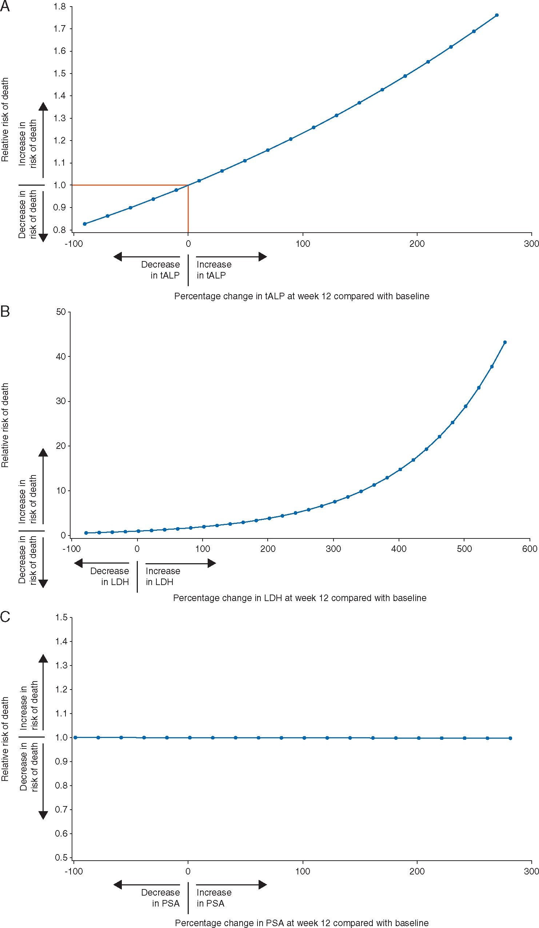
Figure 3. Relationship between percentage change in (A) tALP, (B) LDH, and (C) PSA levels from baseline and risk of ...
Notes:
Figure 3. Relationship between percentage change in (A) tALP, (B) LDH, and (C) PSA levels from baseline and risk of death relative to no change in tALP, LDH, or PSA in the ITT population with baseline marker analyses. The red lines in (A) define the area of decreasing risk of death with decreases in tALP from their baseline level. To make (C) PSA comparable to (A) tALP, its x axis was truncated to include only patients with PSA percentage changes from baseline between -100% and 300%; 46 of 910 (5.1%) patients with percentage changes in PSA >300% were excluded. LDH, lactate dehydrogenase; PSA, prostate-specific antigen; tALP, total alkaline phosphatase.
Unless provided in the caption above, the following copyright applies to the content of this slide: © The Author 2017. Published by Oxford University Press on behalf of the European Society for Medical Oncology.This is an Open Access article distributed under the terms of the Creative Commons Attribution Non-Commercial License (http://creativecommons.org/licenses/by-nc/4.0/), which permits non-commercial re-use, distribution, and reproduction in any medium, provided the original work is properly cited. For commercial re-use, please contact journals.permissions@oup.com

